Slide 1
Modernize Business Processes with Zetadocs Expense and Document Management
Hosted by Sandra Cummins
Notes:
[MAKE INTRODUCTIONS]
Introduction/Thank You
Working with our customers I have learned that each organization is unique in their challenges on how to get the most out of Business Central & NAV,

Slide 2
What is this about?
The challenges and costs with paper based processes and unstructured network folders.
Techniques and solutions that will help your office streamline processes, become paperless and allow your employees to be more productive.
Notes:
I am going to talk about tackling the challenges we hear from customers that relate to expense management, delivery and archival of important information.
During conversations with business owners, we know that each organization has it’s own unique challenges and requirements when it comes to their daily workflows..
Over the years we have developed techniques and solutions that helped organizations modernize common processes like invoice delivery, employee expense approval and allowing employees to be more productive by ensuring they have access to the right information at the right time.

Slide 3
Who is this for?
Any BC or NAV users who currently use paper & network folders for:
Storing essential supporting documents
Sending documents including Invoices and Proof of Delivery notes
Processing expense receipts
And anyone who wants to take advantage of the opportunities that being paperless presents.
Notes:
Audience show of hands – paperless, unstructured folders? Using ZD currently
The people that benefit the most from a document management solution are most often Business Central or NAV users, primarily those who are based in the office and use paper & shared network folders for a variety of reasons.
Does your organization face challenges because employees are not storing documents in the same manner so they become difficult to find?
Does your organization have challenges when it comes to delivering reports out of BC or NAV?
Does your finance team get inundated with expense reports at the end of the month that need to be rekeyed into BC or NAV for processing?
These are some of the things I’m going to be covering in today’s session

Slide 4
Agenda
Zetadocs Expenses
How Zetadocs helps organizations streamline common business process
Business Central
Notes:
[Presenter 1]
[CLICK] Starting with Zetadocs Expenses, I will show you how customers are using Zetadocs Expenses to eliminate the rekeying finance teams often do, while also making it easier for field teams to enter expense reports from the road.
[CLICK] I will then demonstrate the flexibility of Zetadocs and how it can be used to overcome unique challenges when sending out documents and storing files in a consistent way.
CLICK At the end of the presentation I will share with you our plans for Zetadocs support of Business Central.

Slide 5
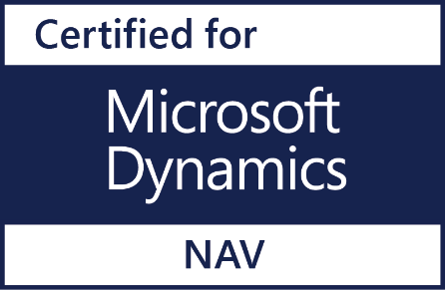
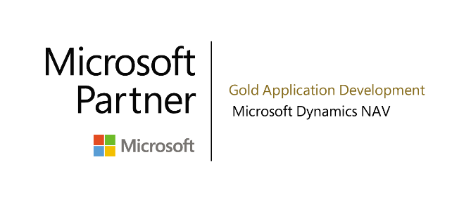
Zetadocs for NAV
Leaders in document management for NAV
Over 5,000 companies use Zetadocs
Available in 17 countries in 7 languages
In partnership with Microsoft
Certified for Microsoft Dynamics NAV
Gold Partner
Notes:
Our history begins with the foundation of Equisys 30 yrs ago, we have offices in London and here in the US in Alpharetta, just north of Atlanta.
[CLICK] In 2007 we introduced Zetadocs for NAV starting with Capture and Delivery, this came from.. Zetadocs is now well established as a widely used document management add-on for NAV, with over 5000 companies using it globally.
[CLICK]. With the development of Zetadocs, we were one of the first NAV add-ons to achieve Certified for Microsoft Dynamics accreditation. As part of our commitment to Microsoft, we strive for and earn that certification every year. Zetadocs is a member of the President’s Club for Microsoft Dynamics and a Microsoft Gold Partner as well.

Slide 6
Why Zetadocs Expenses?
Anytime, anywhere
Fast Reimbursements
Updates itself
Expert support
Take snapshots of receipts, create and quickly submit expenses
Managers can sign off expense reports while on the go for faster processing by finance teams
Fast and accurate reimbursement of payments to staff and credit card companies.
Designed so that both BC, NAV and Non BC & NAV users can use it.
Rapid to implement with no changes to standard BC or NAV objects, no firewall changes
Regular automatic updates without requiring BC or NAV upgrades
Support team in the US
Zetadocs Expenses Support for Business Central and NAV 2009r2 and newer
Notes:
[PRESENTER 1]
Zetadocs Expenses is designed for small to medium sized businesses.
By using Zetadocs Expenses, you have greater control over your expense management process by
[CLICK] offering instant, mobile expense submission and approval. Which is great for companies looking for an easy to use app.
[CLICK] Reimbursements of expenses, including mileage, is fast and accurate, And the solution is designed so that everyone on your staff can use it. BC or NAV users can use it as well as other people on your team who are not BC or NAV users.
[CLICK] When we add new features, the software updates itself because it is a cloud solution. As a result, you are always on the latest version of the software and it updates without you having to do anything.
[CLICK] We offer support from our US office, meaning you can get quick, direct answers to any questions you might have. Keeping in mind that Zetadocs Expenses supports NAV 2009 R2 thru NAV 2018 as well as Dynamics 365 Business Central.

Slide 7
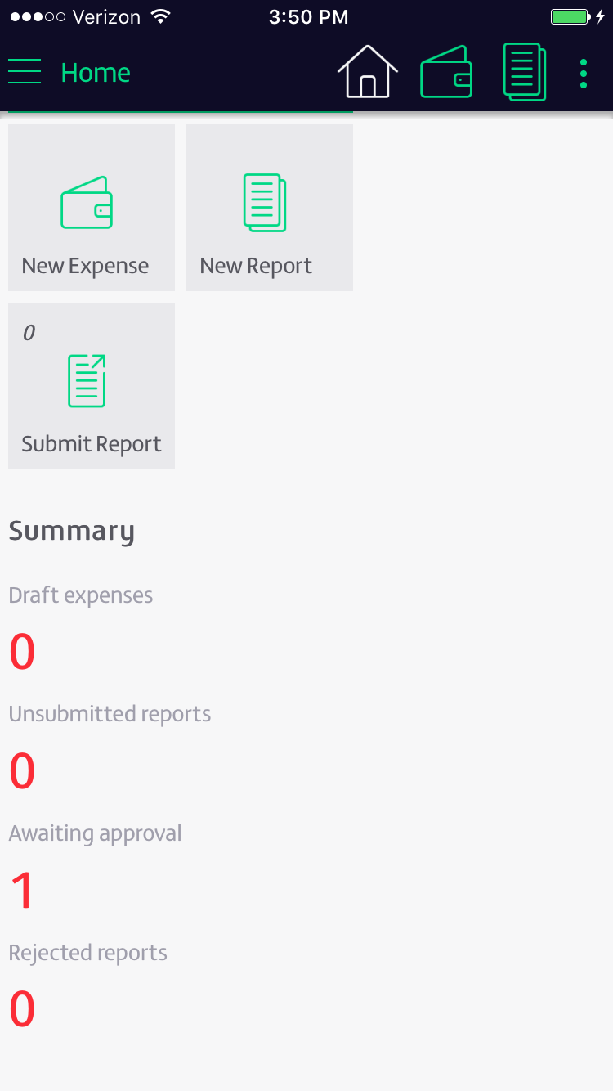
1. Capture
Android and Apple (iOS)

Slide 8
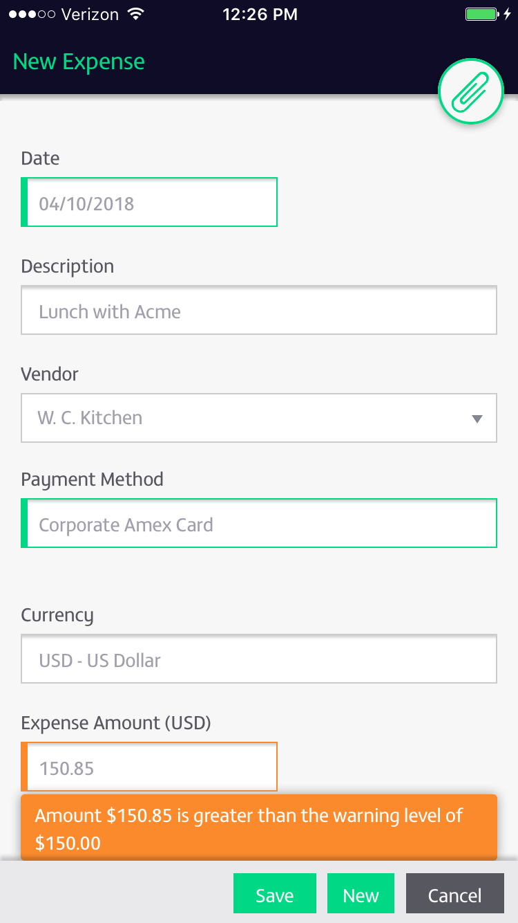
Enforce policies

Slide 9
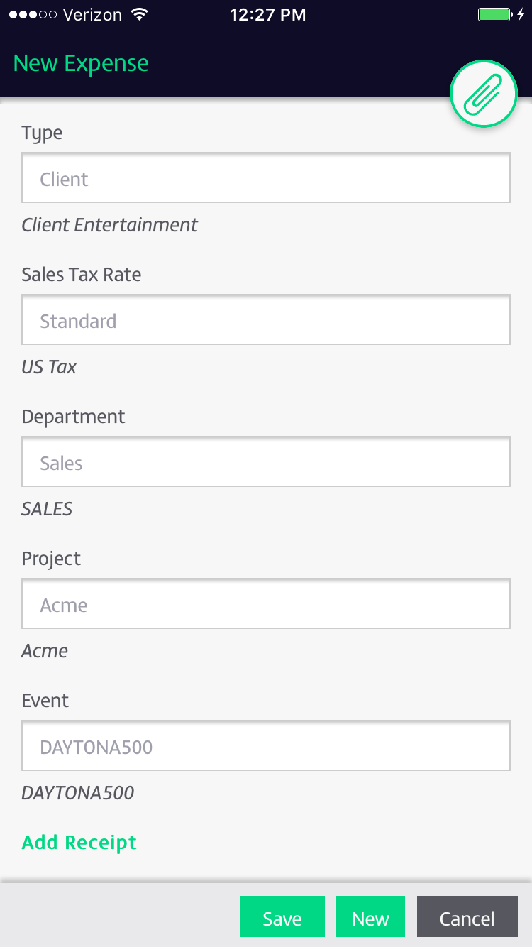
GL Codes Match
Customized Dimension
Fields
Notes:
Email in receipts

Slide 10
1. Capture
Android and Apple (iOS)

Slide 11
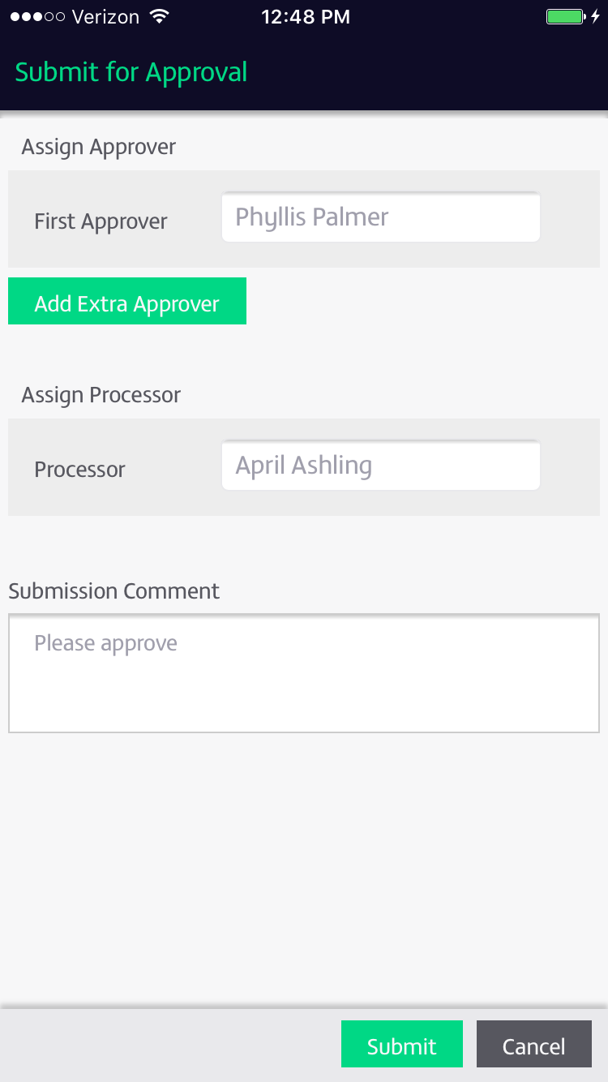

Slide 12
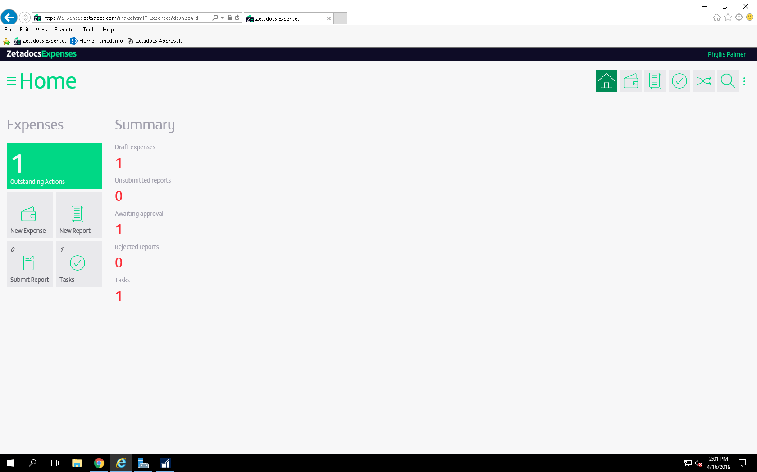

Slide 13
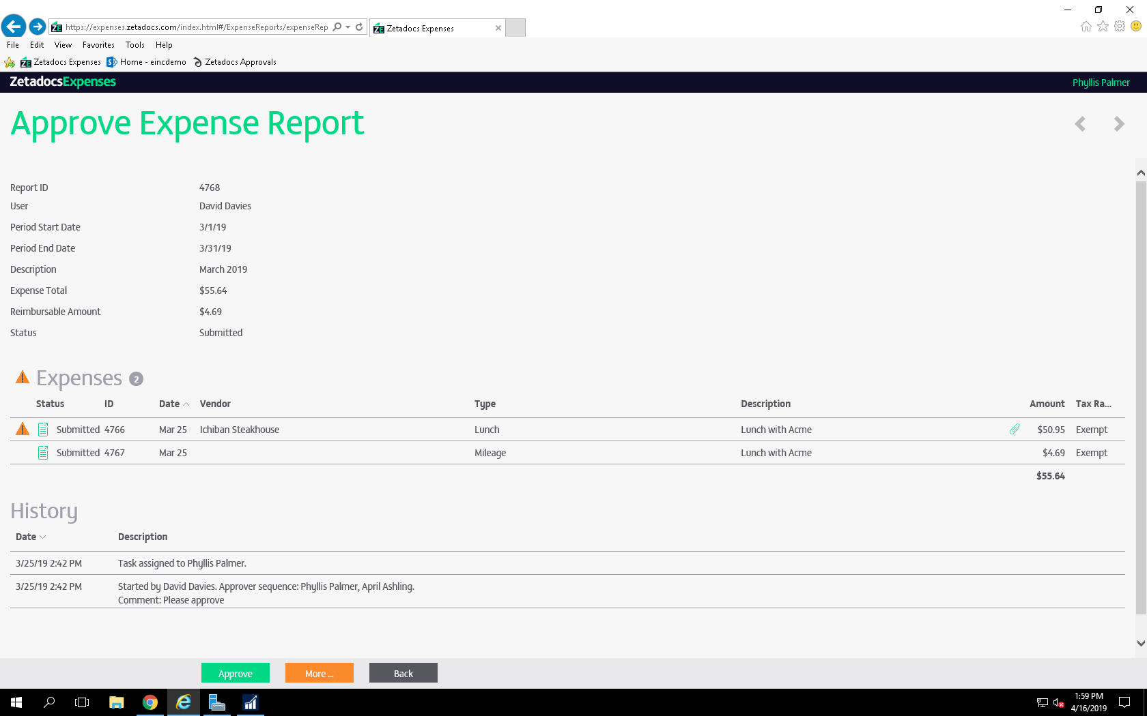

Slide 14
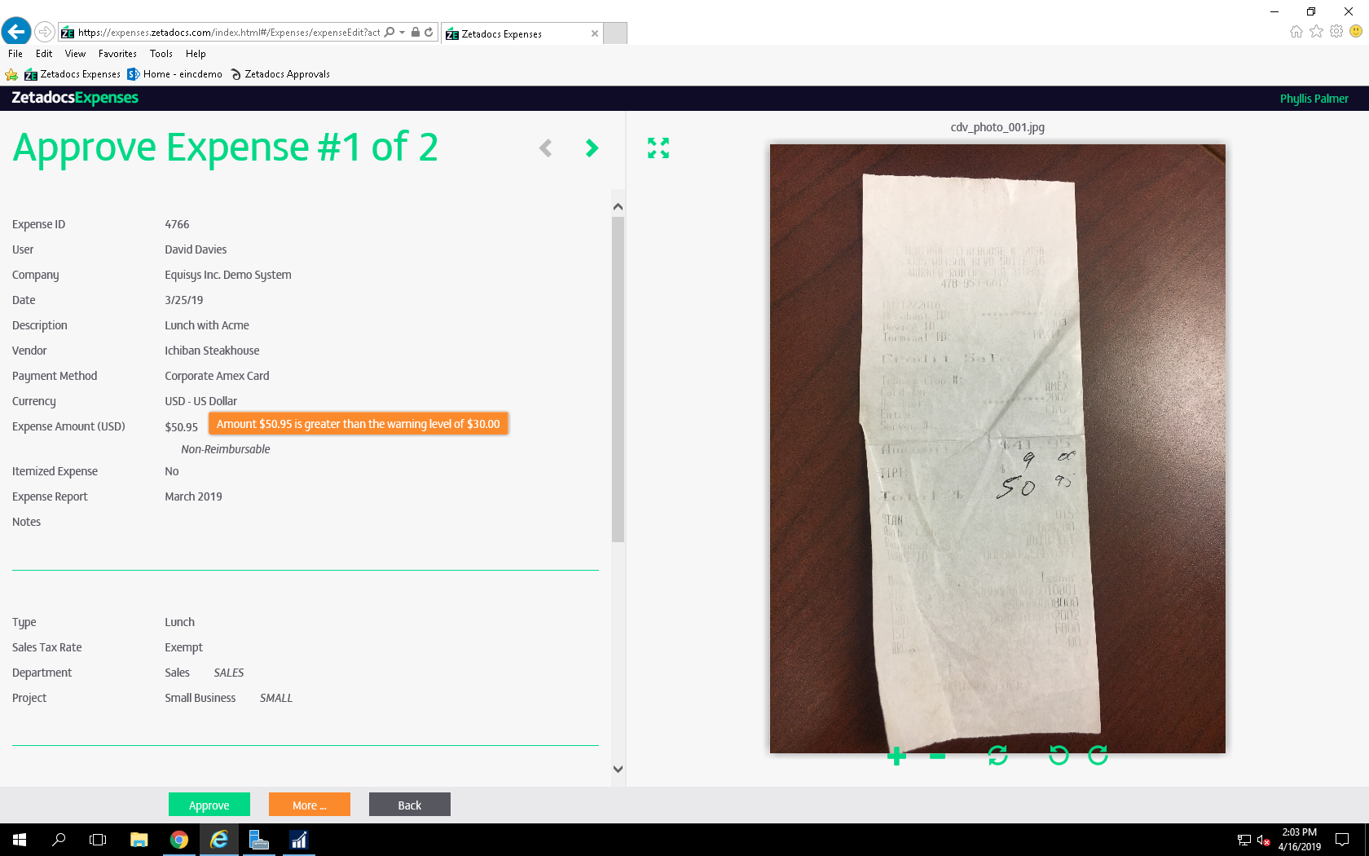

Slide 15
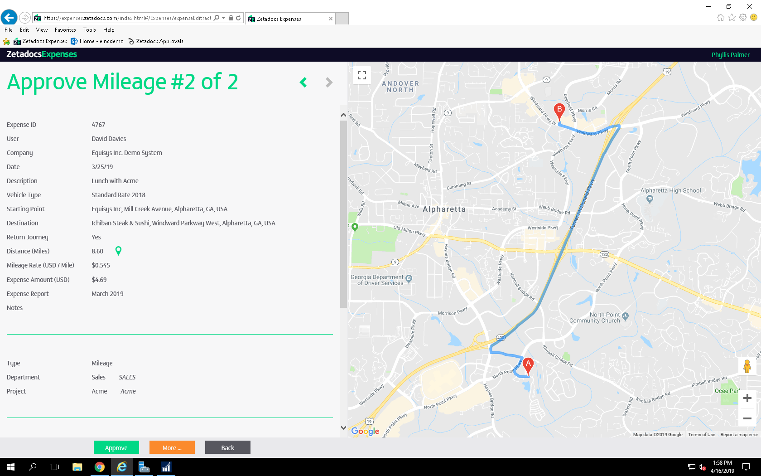

Slide 16
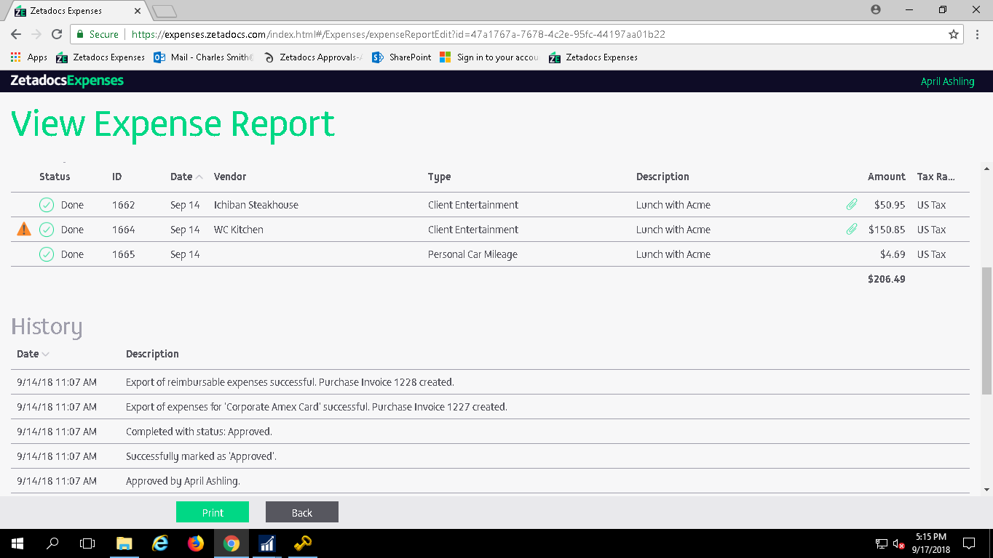
Notes:
This shows you what the expense report looks like on the Zetadocs Expenses website. Phyllis can click on each expense line and drill into the expense to make sure the GL and Dimension coding is correct. When she approves the expense, April will receive an email notification to process the expense. April would click on the link in her email, review the expense report and approve it.
Using web services, the system will export to NAV and create a purchase invoice for the reimbursable expenses and non-reimbursable expenses. You can see under History the notification of the purchase invoices created.
NOTE: We have also added the option to export non-reimbursable expenses from an Expense Report as a NAV Journal instead of a purchase invoice.

Slide 17
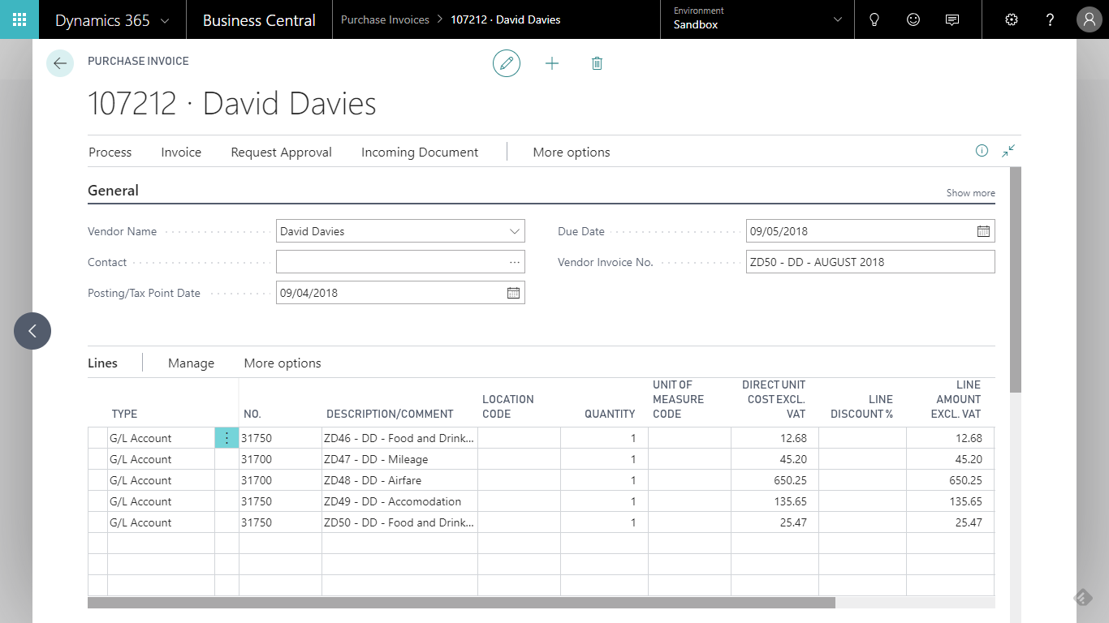
Available Now
Dynamics 365 Business Central Support
Notes:
What you see hear is a screen shot of the purchase invoice that has been created in Business Central.

Slide 18
Storing Documents Electronically
Access supporting information directly from within BC or NAV
Ensure files are stored in a consistent structure
Store documents in a wide variety of BC and NAV records. Remote Access (mobility)
Notes:
[Presenter 1]
Now let’s look at how you can store documents related to the transactions that are crucial to your business.
[CLICK] As we know, it can be really frustrating sometimes to locate a specific document from a directory that stores unstructured data,
[CLICK] The ZD fact box allows you to not only easily store documents in both sales and purchasing records, but also other records. For example, did you know that the Zetadocs fact box can be added to the cash receipts journal, jobs, production orders, and ledger entries?
CLICK Supports Phone, Tablet and web client
[CLICK] What about companies that need to link a large number of inbound documents to the associated BC On Prem or NAV records? You can use Zetadocs Capture to scan hard copies of vendor invoices or shipping documents into BC On Prem or NAV and then link them to the relevant record.

Slide 19
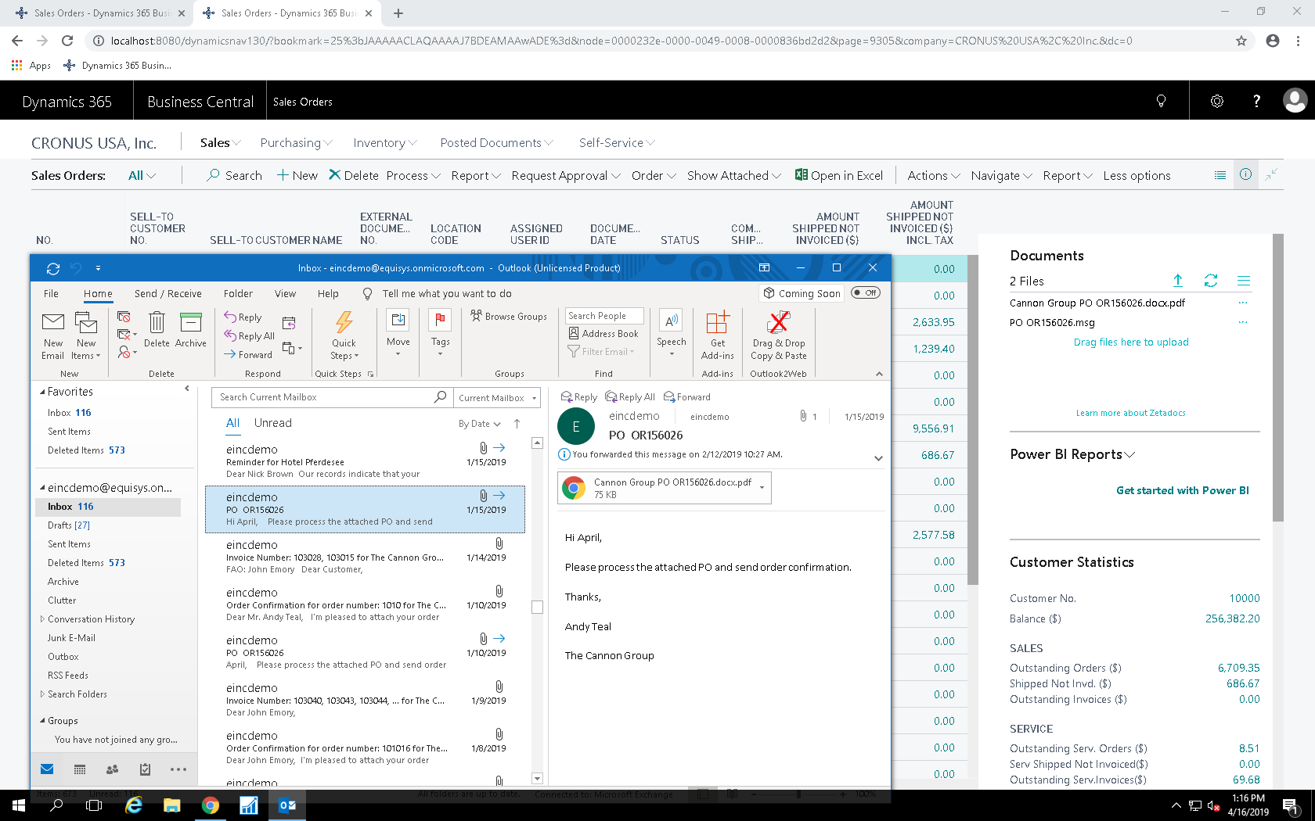

Slide 20
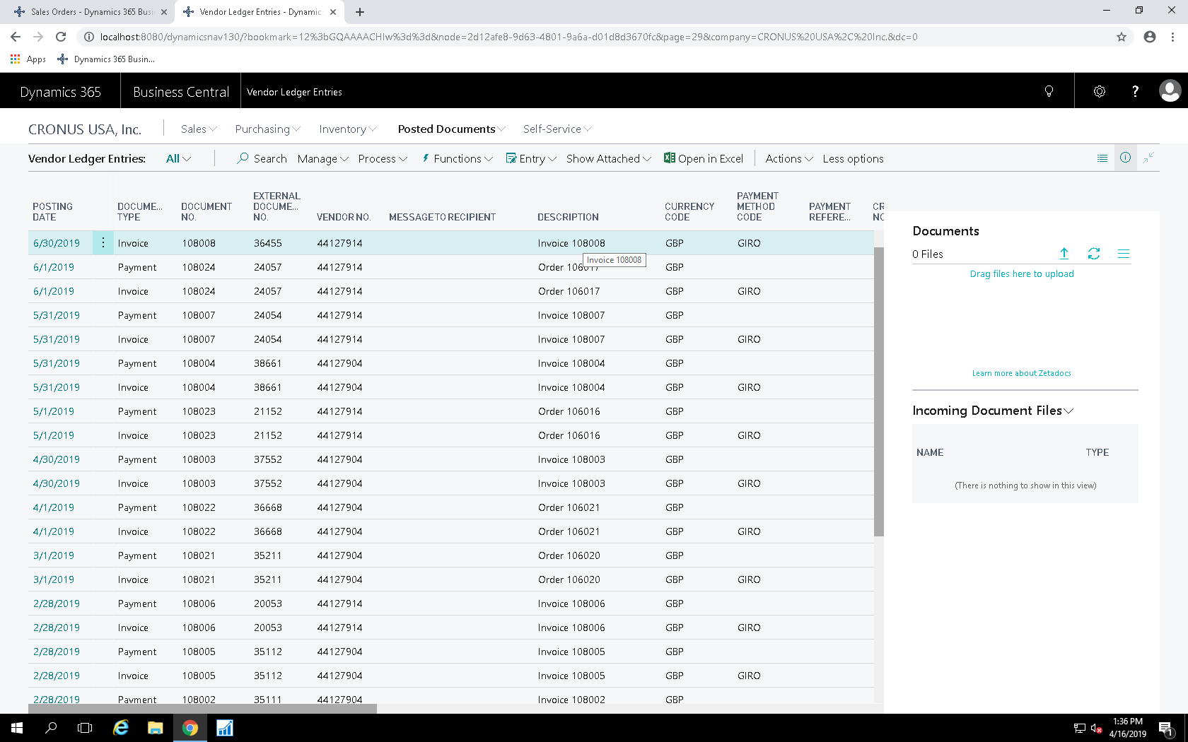

Slide 21
Sending documents from BC & NAV
Ensuring documents are sent to the appropriate contacts
Personalizing emails
Adapting Zetadocs batch delivery to customer needs
Dynamic Attachments/ Automating delivery process
Notes:
[CLICK] We often hear from our customers that sending documents out from BC or NAV is an important part of their business, as this is where they need to send quotes to generate revenue or send out invoices to retrieve payments.
Using Zetadocs Delivery you can send out your quotes, invoices and other documents in a batch as opposed to single send.
[CLICK] When the batch emails go out, the system is designed so that each document is sent to the appropriate contact and allows you to personalize the email message.
CLICK You can personalise the content of batch emails to match the documents you are sending by easily creating your own templates, you can even create messaging in various languages.
[CLICK] Performing batch delivery is great, but sometimes you may want the system to change behaviour based on your customers needs. With Delivery, we can also customize the software to attach supporting documents to what you are sending.
For example, With Delivery Plus, we set up the system for one of our customers where they can Attach drawings from an item card to purchase orders that are sent out in a batch. For business using BC On Prem NAV 2016 and newer, batch delivery can be set up automatically to go out at designated times throughout the day.
{CLICK} Batch delivery can be set up to automatically go out at a specified time of day for users of NAV 2016 and newer as well as BC user.

Slide 22
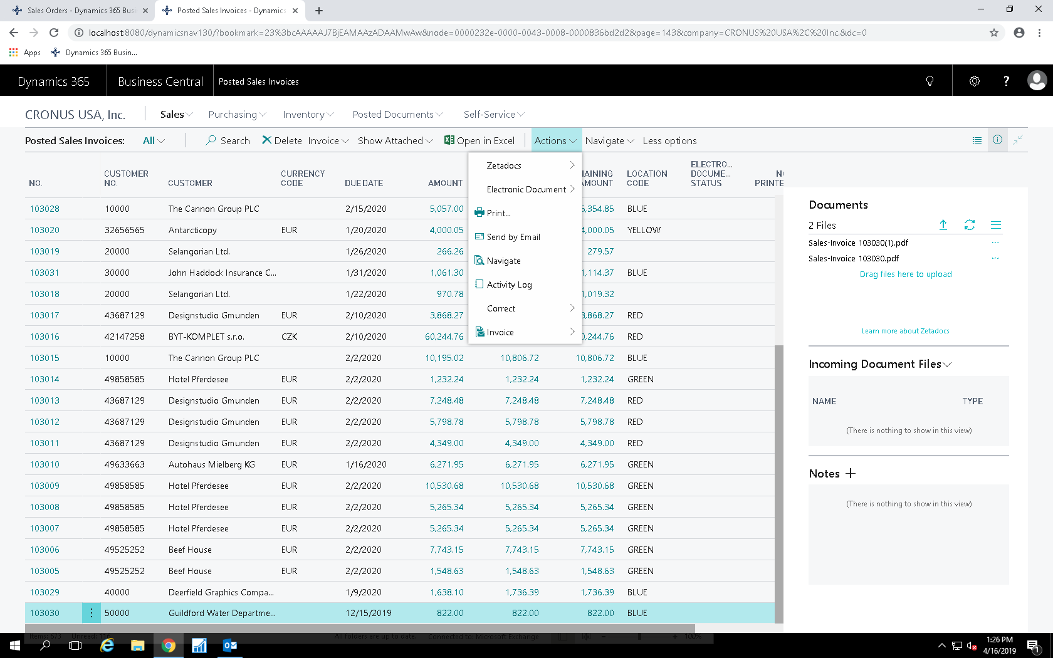

Slide 23
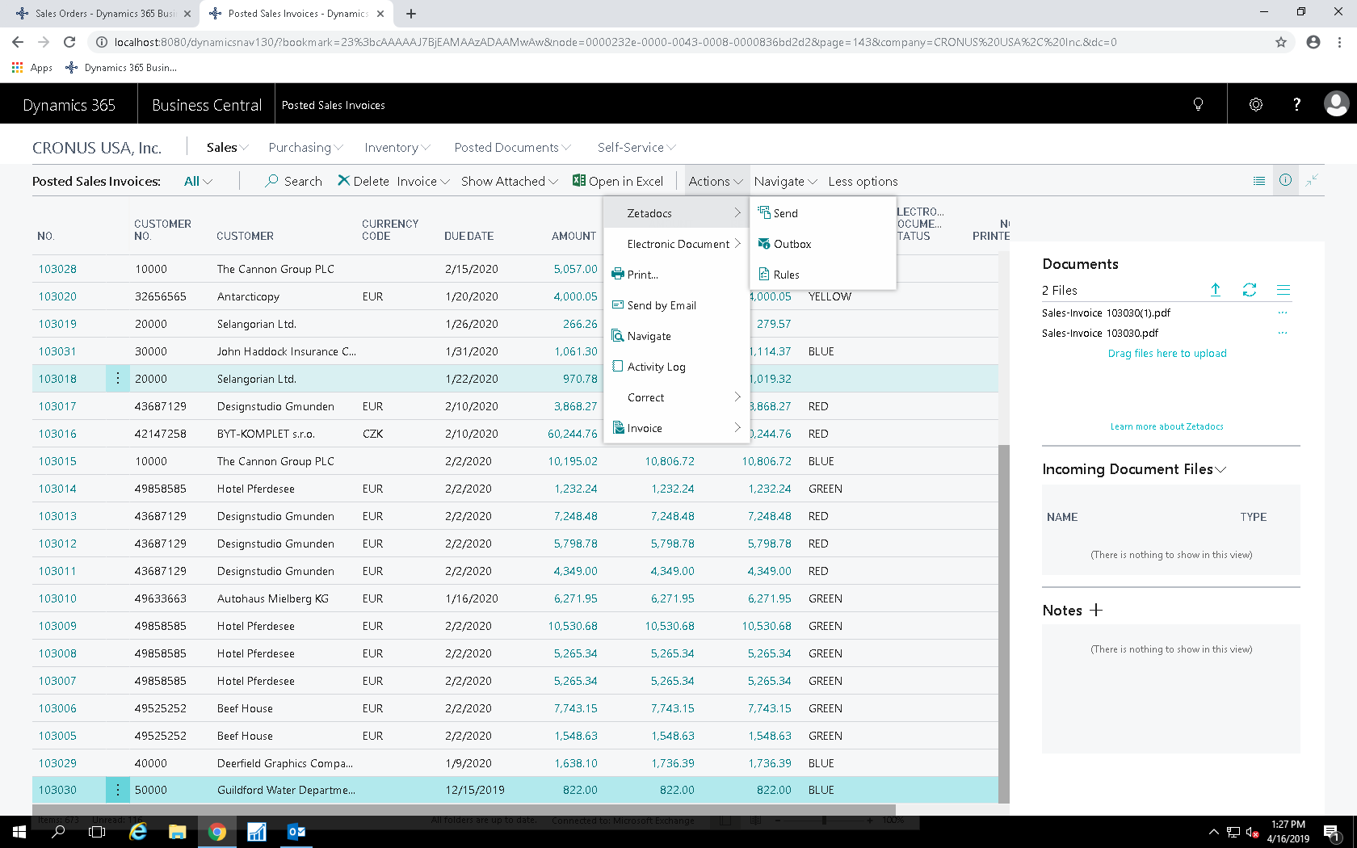

Slide 24
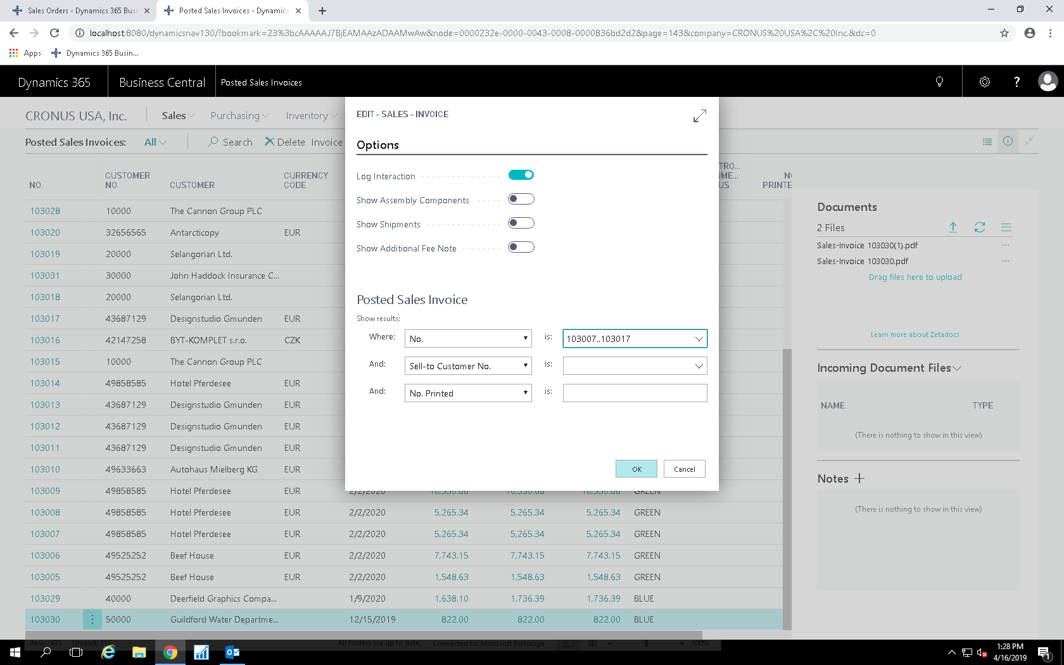

Slide 25
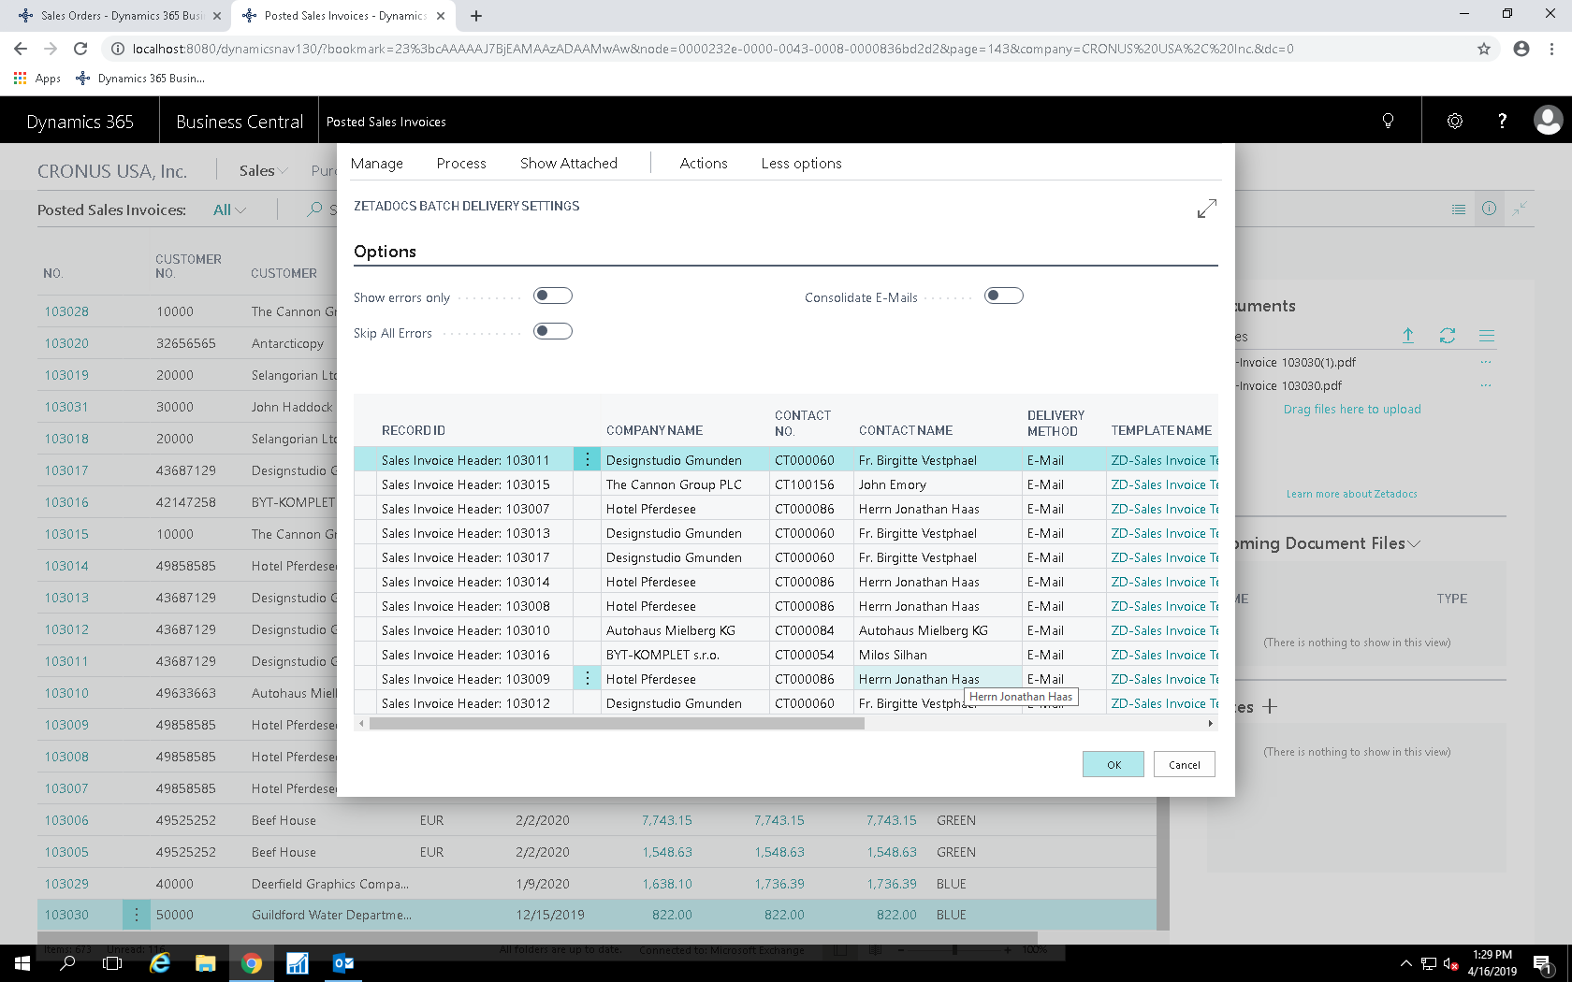

Slide 26
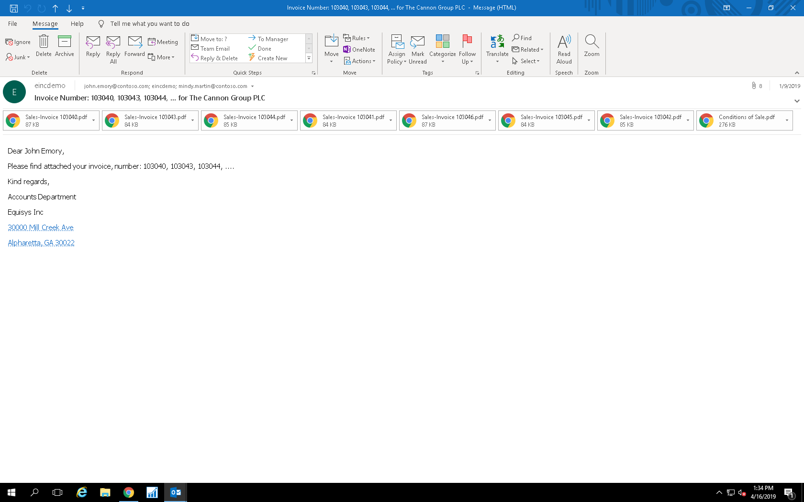

Slide 27
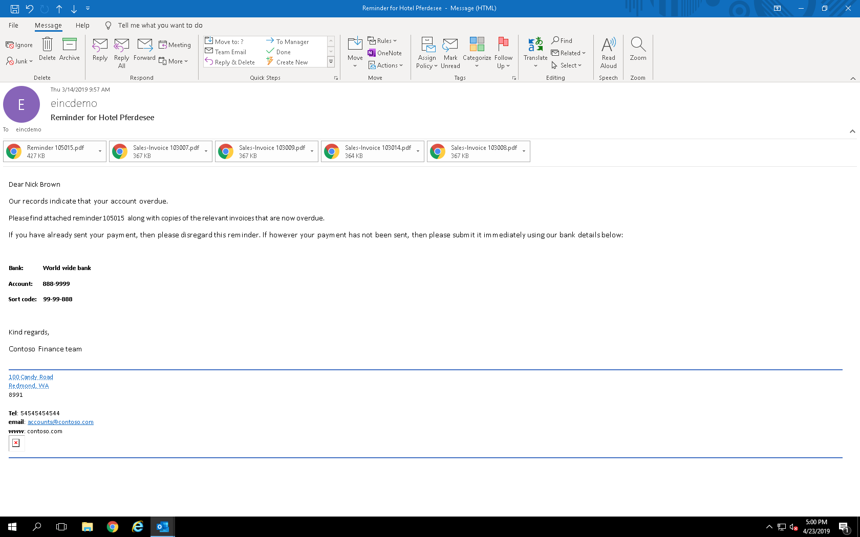

Slide 28
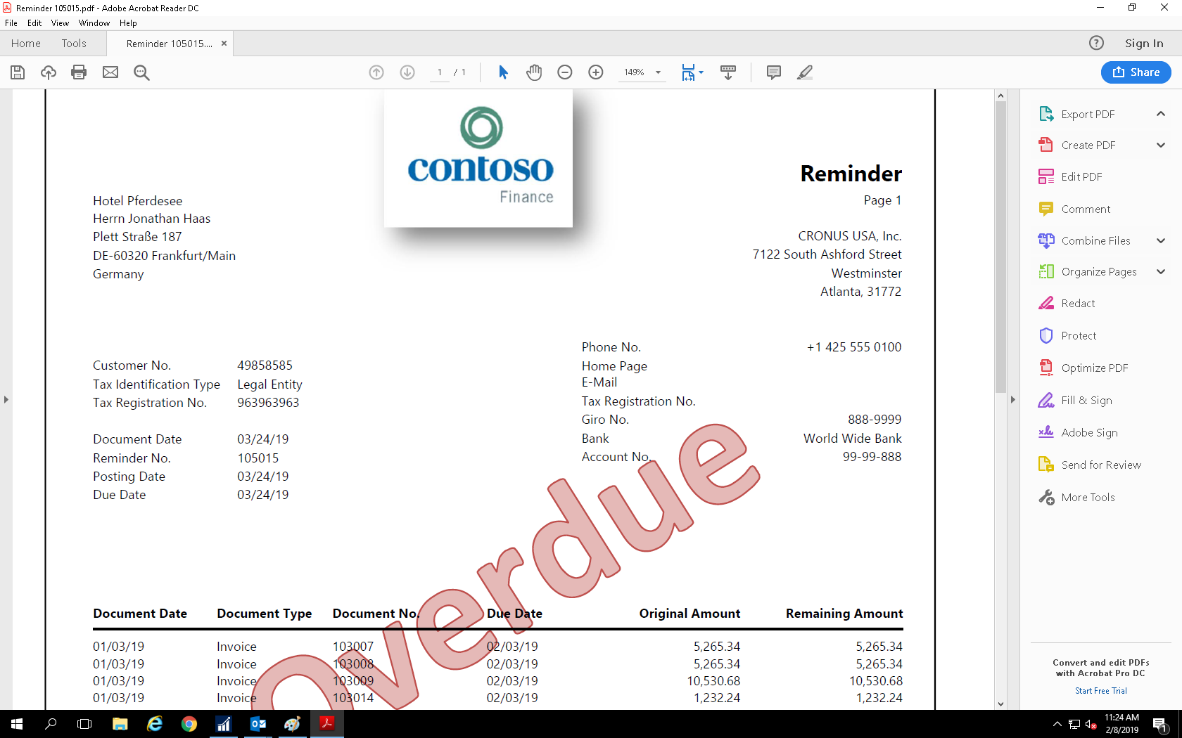

Slide 29
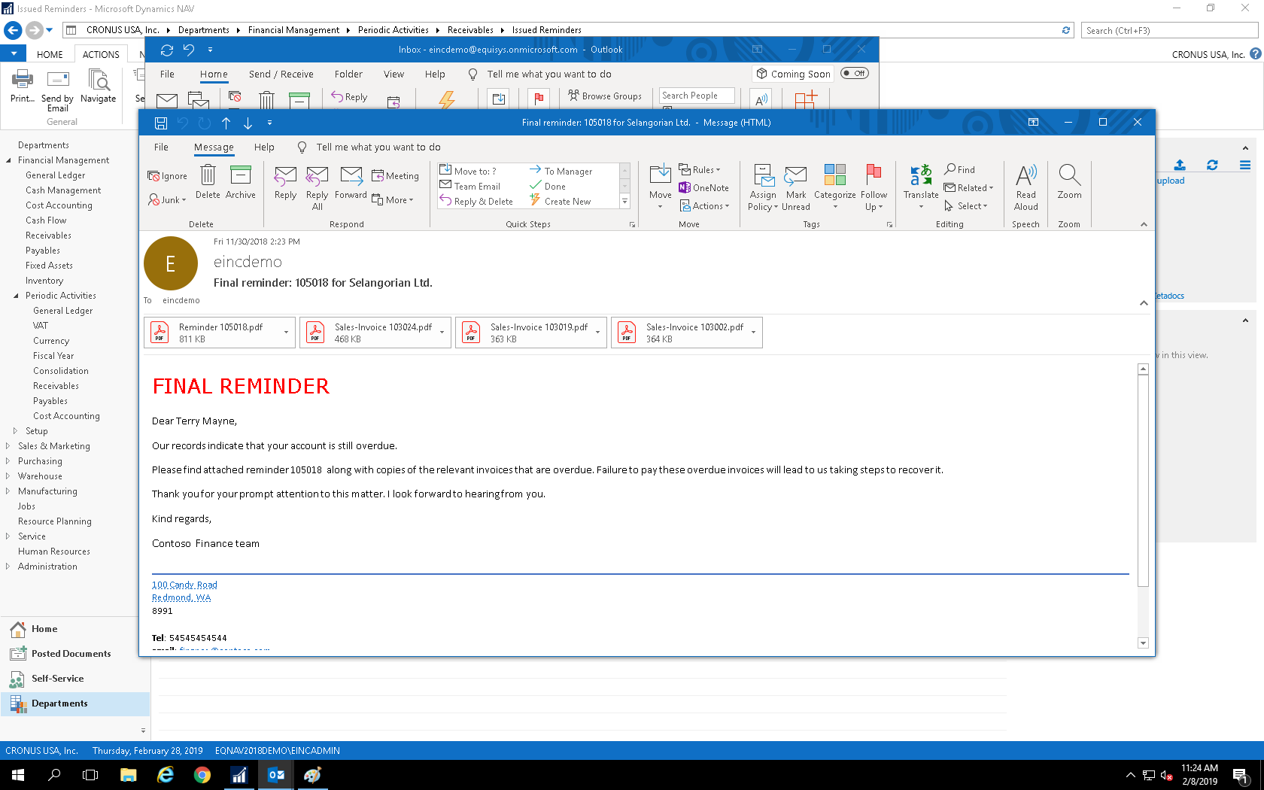

Slide 30
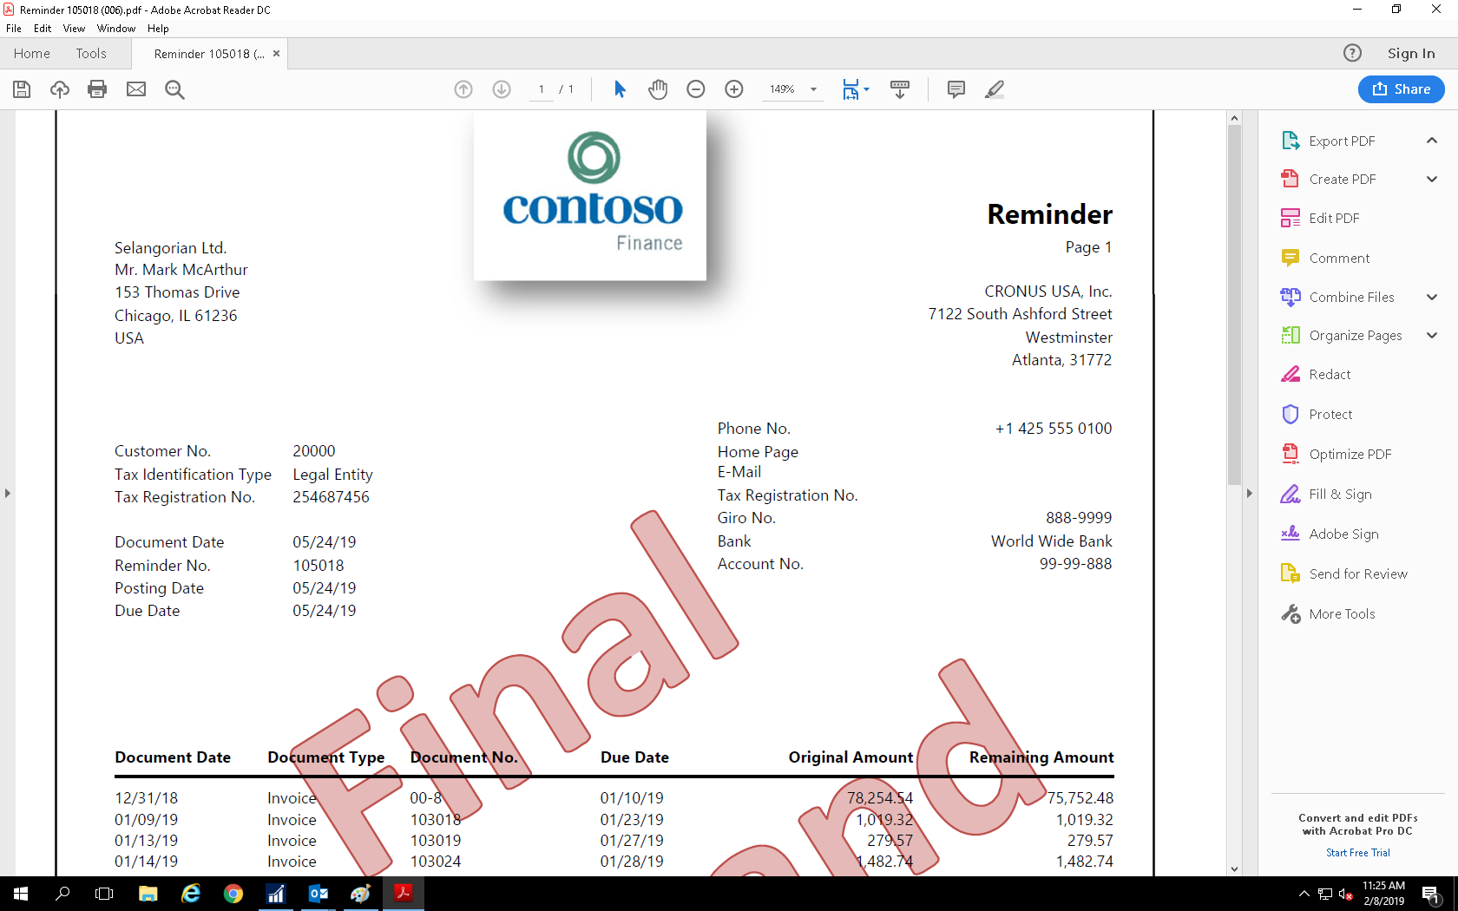

Slide 31
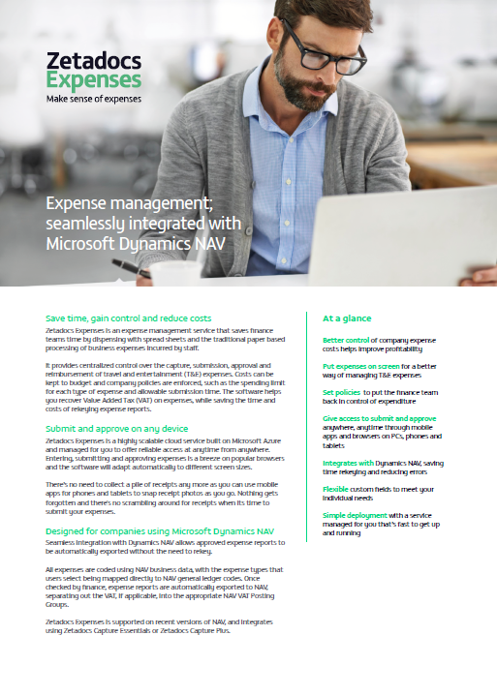
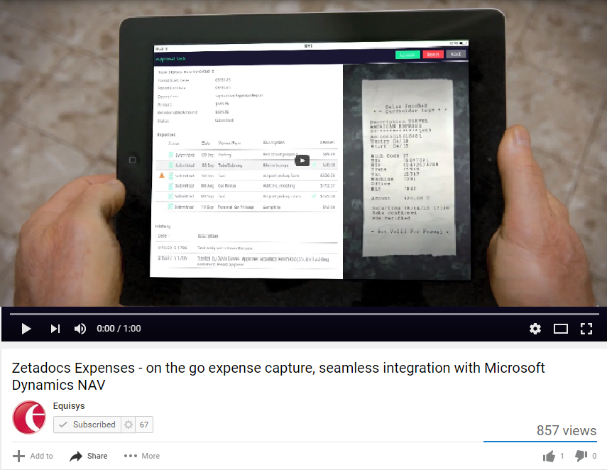
Next steps
Business Central
Speak to your account manager and arrange a one on one demo
Notes:
2 CLICKs Business Central Update – Capture Essentials, Delivery Essentials & Plus available BC On Prem, cloud late Spring/early Summer. Expenses available BC On Prem and Cloud
CLICK We know each company has it’s own challenges. As I have shown with Zetadocs Capture, Delivery and Expenses, each system has the flexibility to meet your requirements. If you would like to explore the functionality of Zetadocs further, I encourage you to arrange a demo. During the demo, you can ask questions specific to your current expense or document management process and evaluate how Zetadocs can help your business.

Slide 32
“As well as making our life easier, we have reduced our delivery costs and fine tuned our order to cash process.”
“Zetadocs does all of the hard work and my team doesn’t need to exit from NAV.”
“We can easily identify the invoices that need to be sent, and keep on top of customer accounts at all times.”
“Zetadocs is saving us over
100 per week on stationery and postage alone, and over 2 hours per week admin time.”
“Zetadocs easily integrates with NAV. The two products really do sit alongside each other seamlessly.”
“I now have more time to chase the debts, sort out any finance issues and support the rest of the finance team.”
“We have reduced our carbon footprint by 850kg per year, and at the same time saved
$25,000 by electronically sending documents.”
“Every day we are saving at least 2 working hours with Zetadocs. This equates to 1 week in every month.”
“Zetadocs appeared to address the issues for the credit control department head on.”
Notes:
Q&A
Up on the screen you can see a few quotes from our customers around the world. As you can see, companies using Zetadocs benefit from direct cost savings and productivity gains when moving to an electronic document management system.
Questions?

Slide 33
Thank you!
Promotional Pricing thru June 30, 2019
10% discount on the purchase of Zetadocs Delivery
15% discount on the purchase of Zetadocs Capture
scummins@usa.equisys.com
678-942-7218
Notes:
Thank you for your time today,

