Slide 1
April 25, 2019
Doing business in every direction with dynamics nav & Business Central
Steve Norris – Director of Pre-Sales, Supply Chain Collaboration

Slide 2

Buying and selling
used to be simple…
Notes:
Map recurring revenue to DC definition

Slide 3

Order anywhere – deliver anywhere
has changed that forever…
Notes:
Map recurring revenue to DC definition

Slide 4

Accurate product information avoids
unexpected surprises…
Notes:
Map recurring revenue to DC definition

Slide 5

Connectivity is the key
Notes:
Map recurring revenue to DC definition

Slide 6
WHO IS TRUECOMMERCE?
UK AND IRELAND
117 employees Offices in
Coventry, Manchester & Dublin
EUROPE
64 employees
Offices in Copenhagen & Brussels
NORTH AMERICA
326 employees Offices in
Cranberry, Reston, Columbus,
Boston, Cincinnati, Colorado
Springs, Wilton & Carlsbad
CHINA
28 employees
Office in Shanghai
$96M
2018 Revenue
12,000
Active Customers
600M
Transactions
535
Employees
globally
130,000
Trade Relationships
92,000
Trading Partner Maps

Slide 7






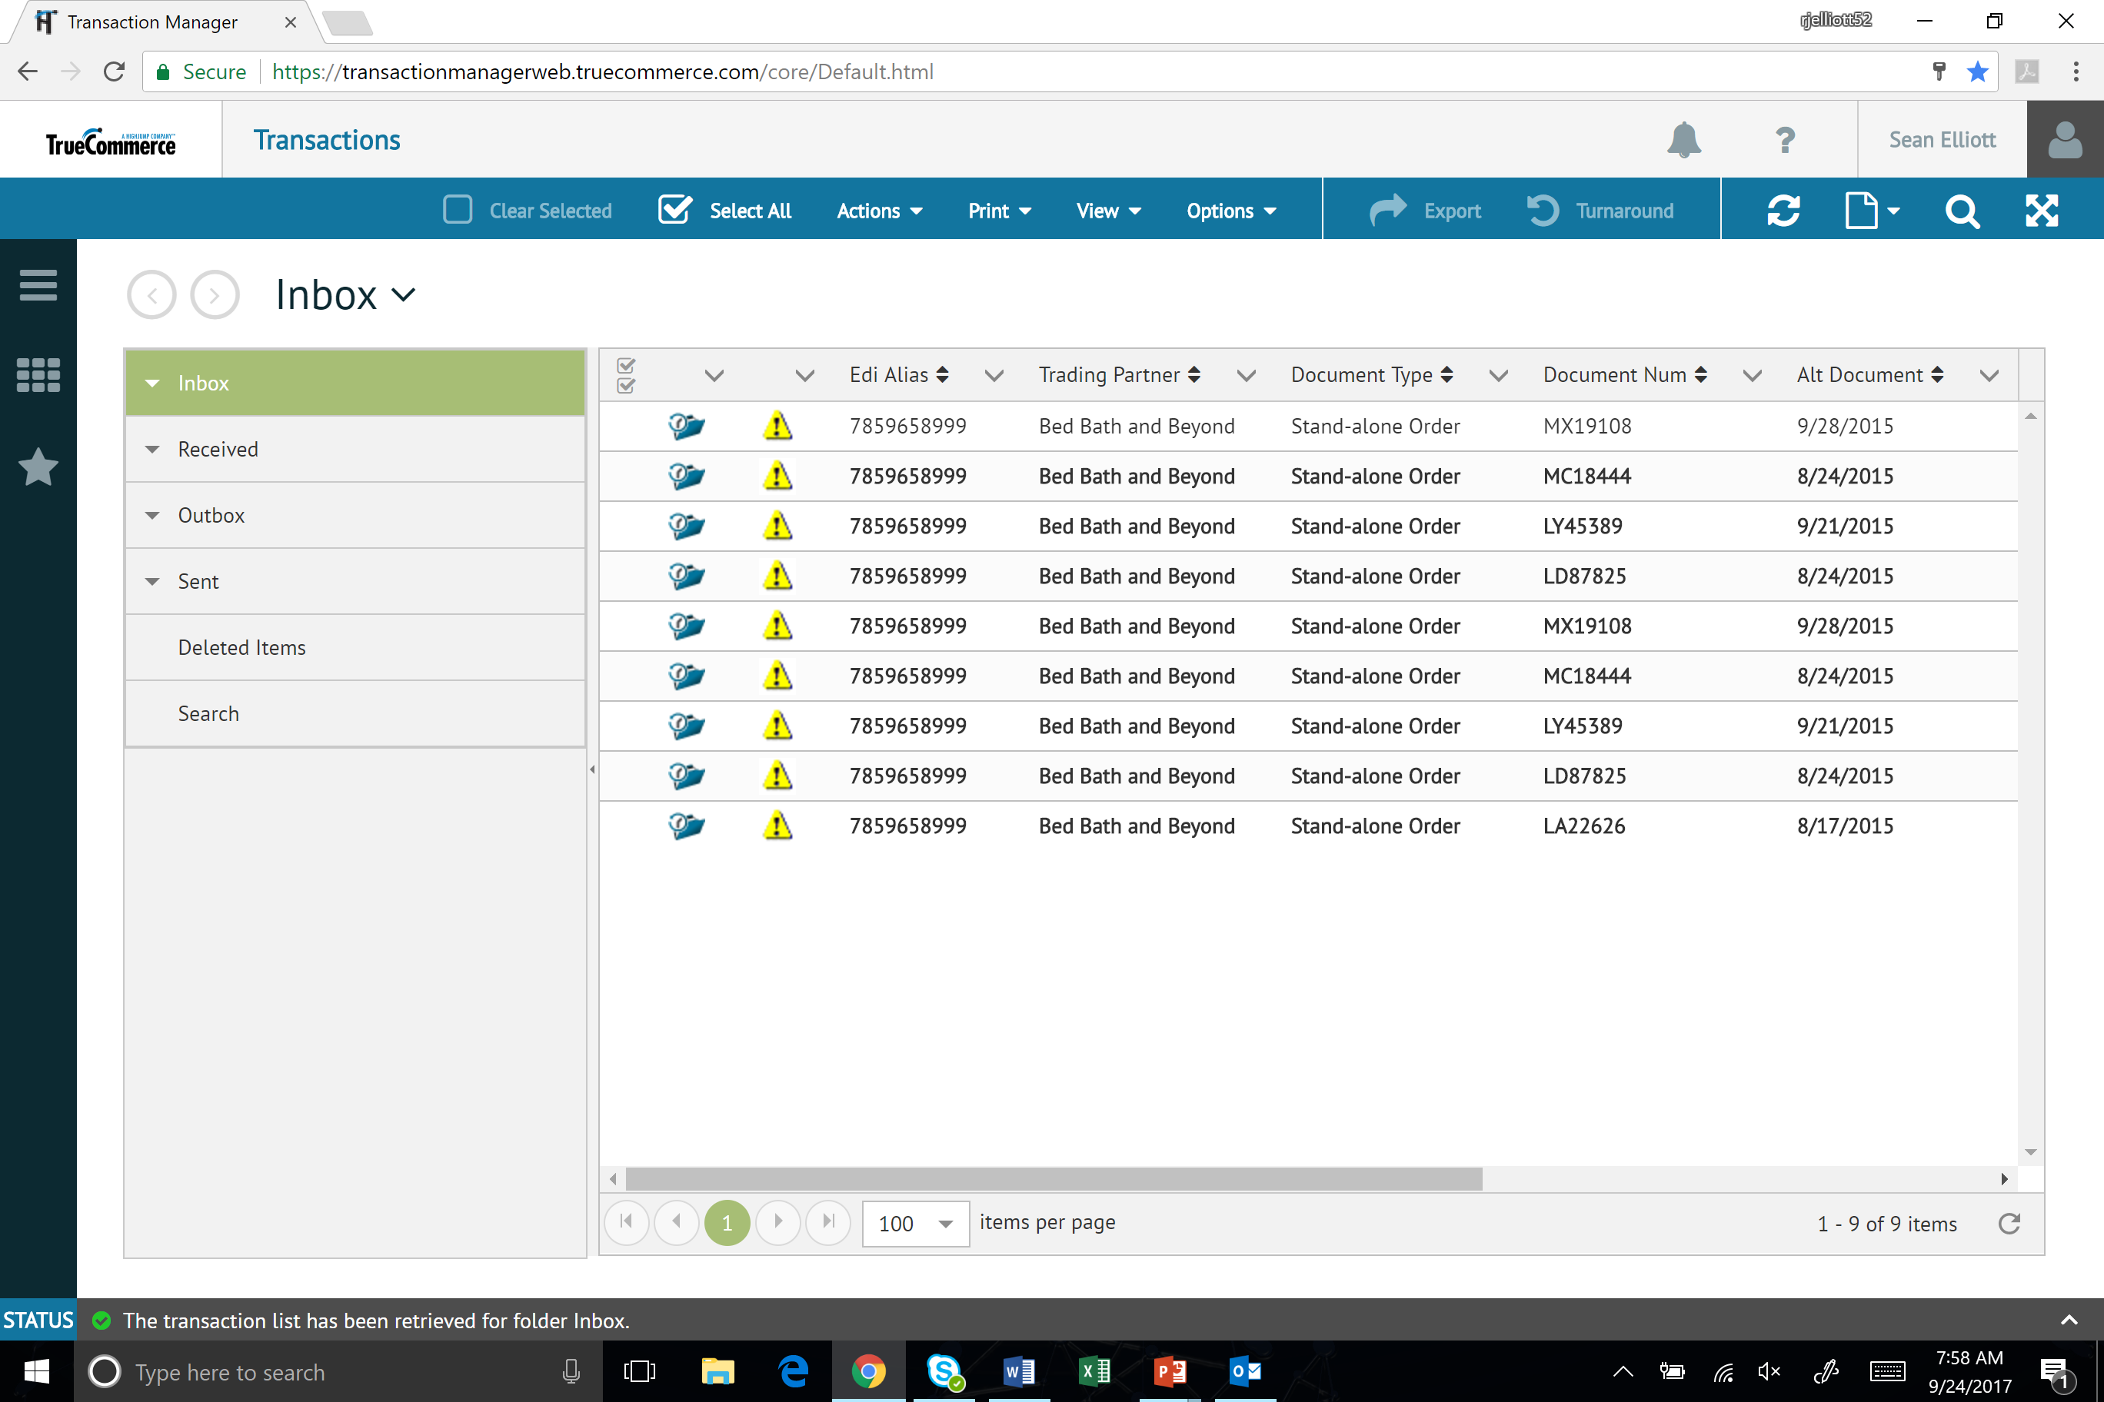
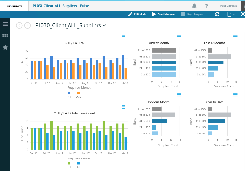
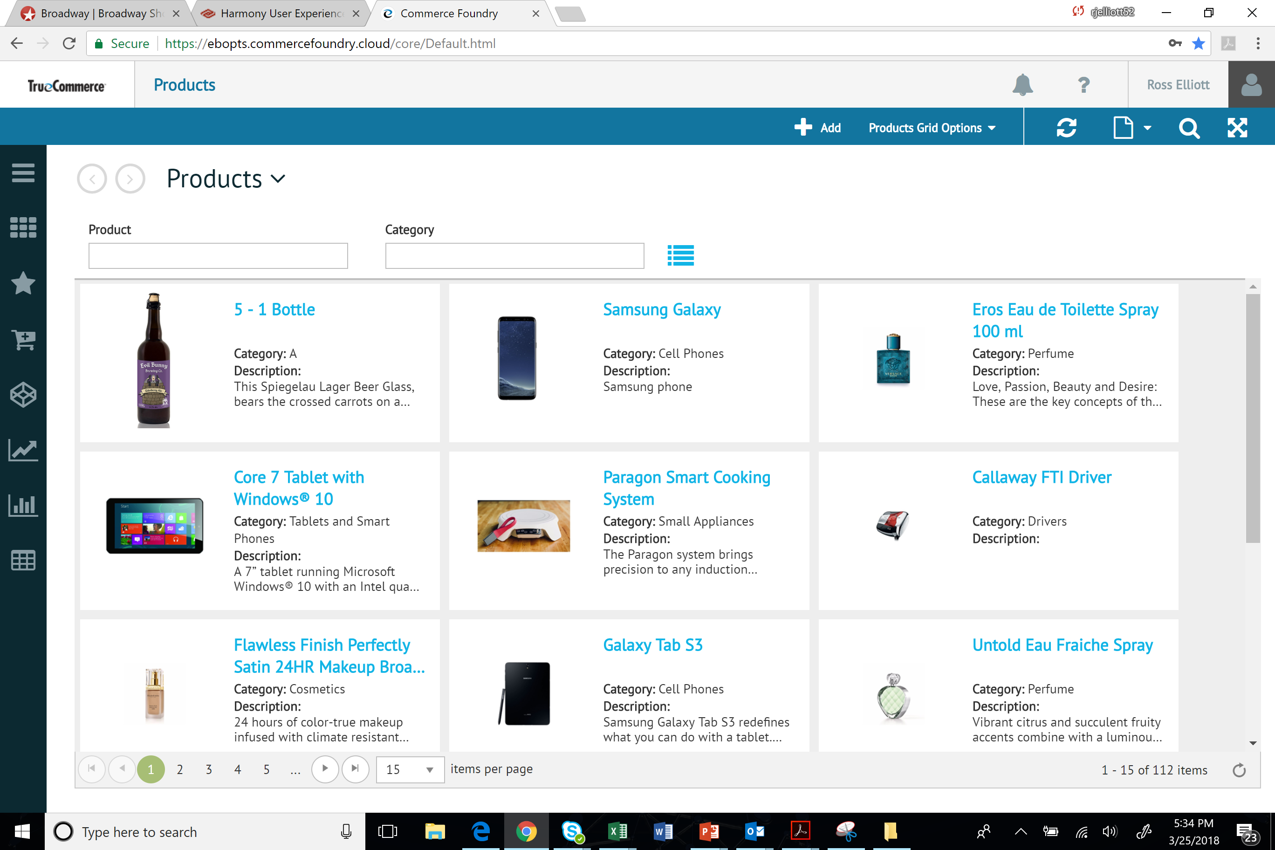
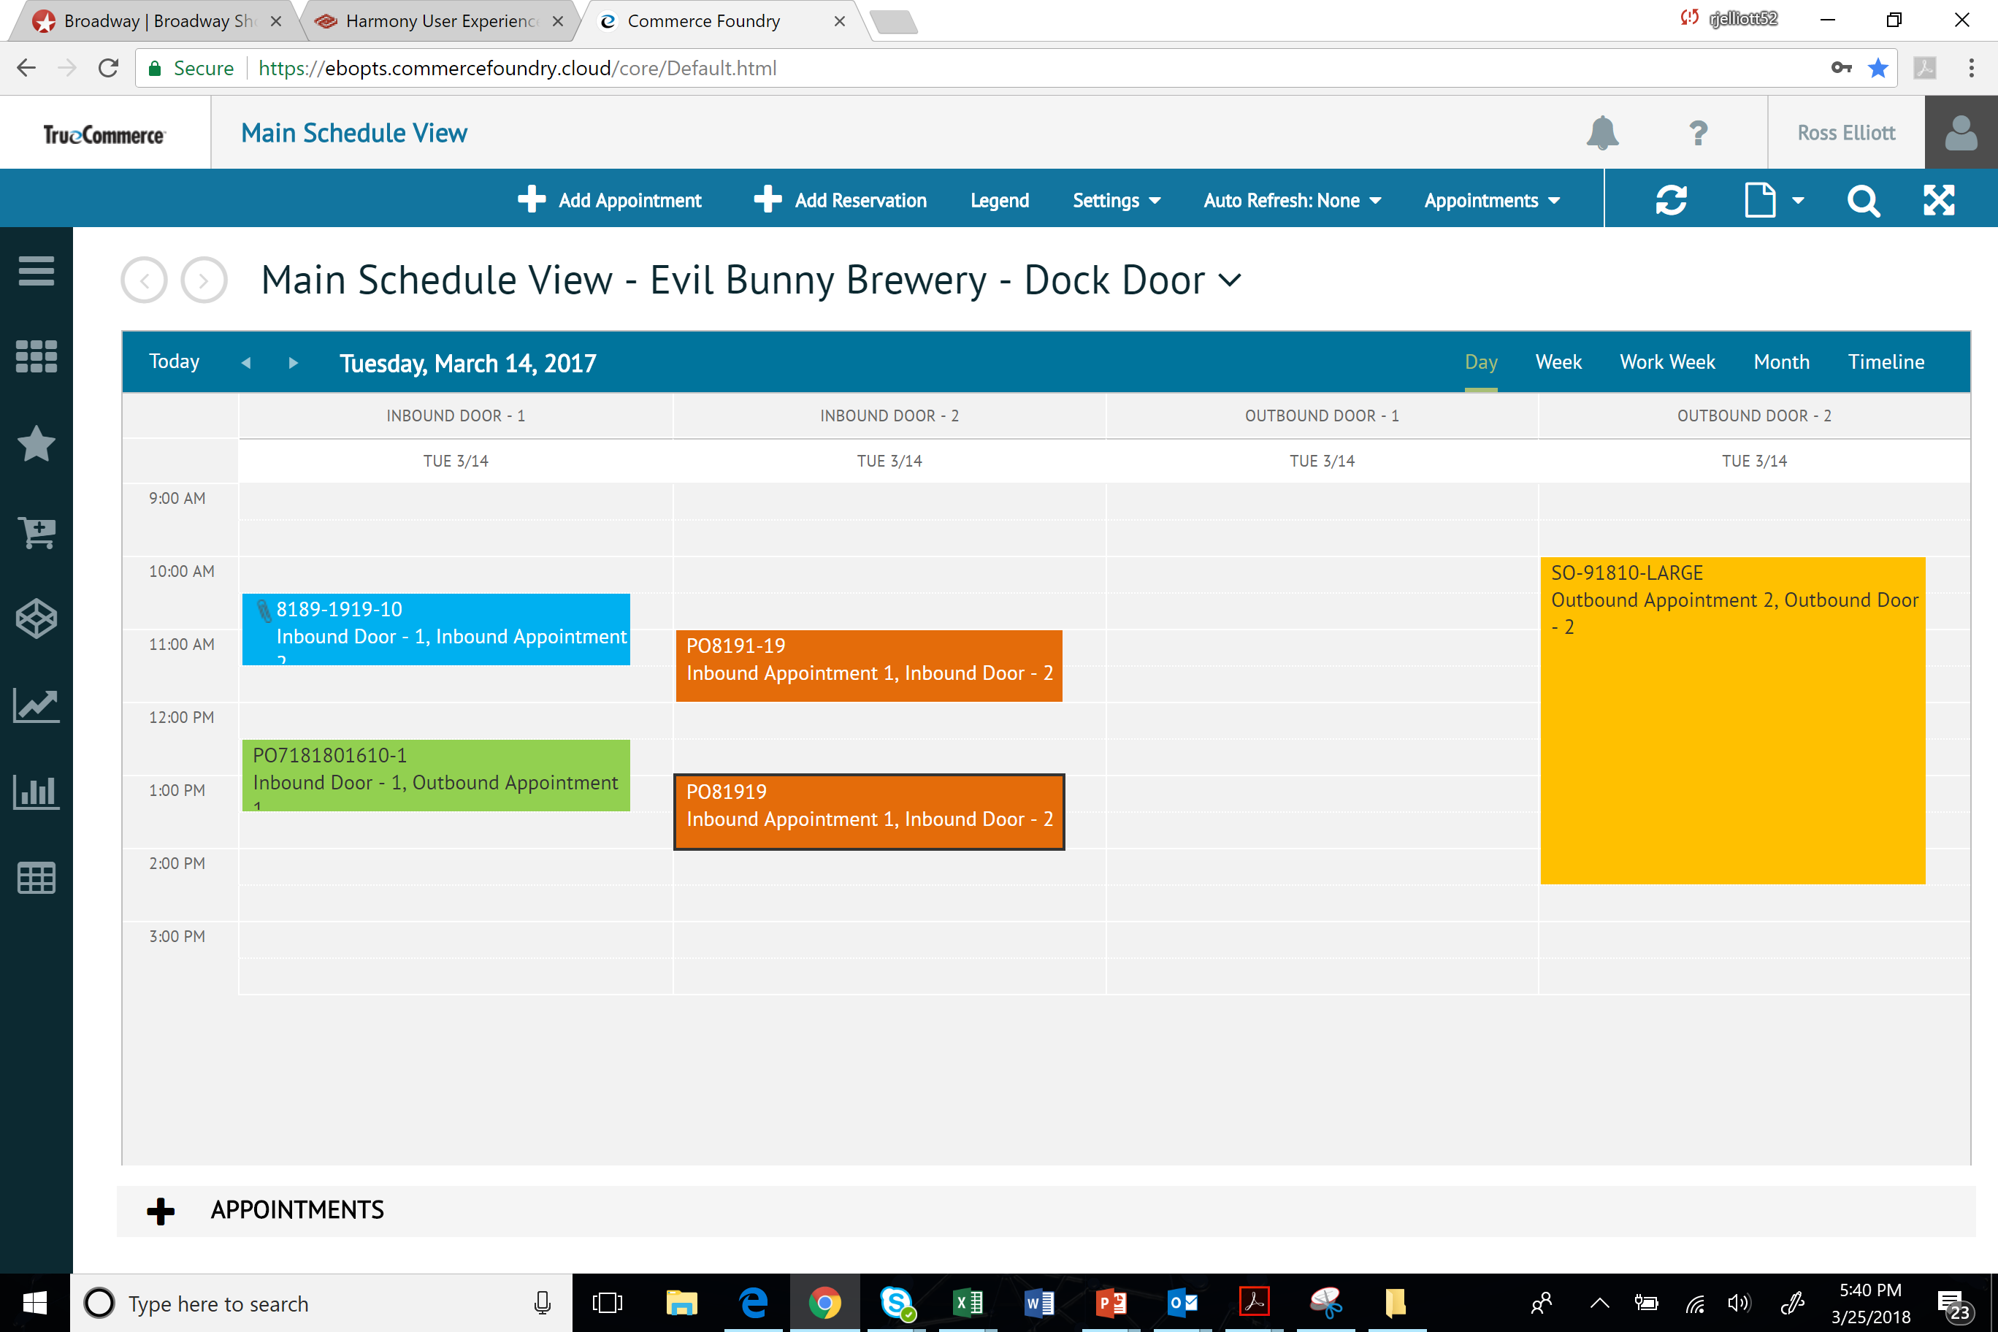
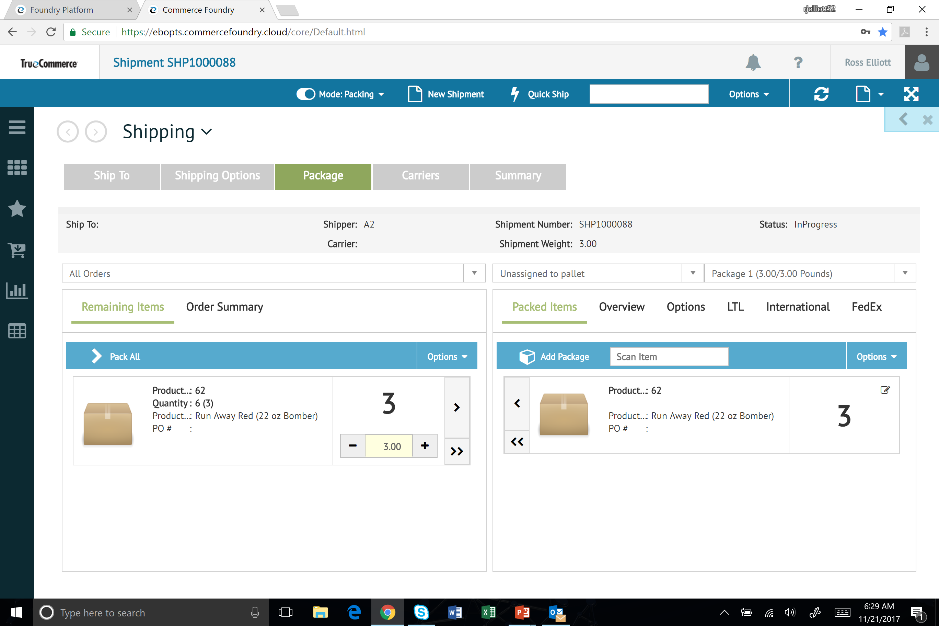
What’s a Commerce network?
Trading
Collaboration
Commerce
inventory
Fulfillment
Trading Community
Translation Service
ERP Integrations
Order Management
Procure to Pay
Supplier Portal
e-Invoicing
DropShip
Storefronts
Mobile POS
Email Order Integration
Marketplace Channels
Cartonization
Packing
Multi-carrier
Product Information Management
VMI
Notes:
*** CHANGE TIERS / SIMPLE.

Slide 8
















Large, Diverse Customer Base
12,000+
Customers
Trading
Diverse
Global Customer Base Across Key Vertical Segments
Collaboration
Planning
Commerce

Slide 9



analysts & customers rating
CHALLENGER
LEADER
LEADER
Magic Quadrant for Multi-Enterprise supply chain business networks
Marketscape for Supply Chain Commerce Networks
Crowd Sourcing Leader for Electronic Data Interchange
Notes:
We are also very proud by the recognition we received from top industry analyst and customer ratings. If you are unfamiliar with these firms, they represent the largest analyst firms that follow software companies. Their job is not just to review companies current state, but as equally important, the investments companies are making to transform their business over the next 5 to 10 years.
Gartner named TrueCommerce as a Challenger in their new Magic Quadrant for Multi-Enterprise Supply Chain Commerce Network.
In addition, IDC, another leading software analyst firm rated TrueCommerce a Leader in their Marketspace for Commerce Networks. Lastly, G2Crowd, a crowd sourcing platform, named TrueCommerce a leader based on customer reviews and surveys.
An interesting fact is that Gartner removed all single channel companies as they were not able to help their customers truly connect in the digital world. Companies you may be evaluating such as SPS, were not included in the magic quadrant for this reason.
*** INTERNAL NOTE ***
Magic Quadrants compare vendors based on Gartner's standard criteria and methodology. Each report comes with a Magic Quadrant graphic that depicts a market using a matrix that evaluates vendors based on their Completeness of Vision and Ability to Execute.

Slide 10

FORGING A DIGITAL FUTURE
Built on a robust technology platform
  Natively multi-tenant
  Highly scalable and resilient
Broad set of unified commerce services
  Addressing connected customers, suppliers and channels
Deep integration capabilities
  Embedded integration in Dynamics NAV & Business Central (NAV 2009 – Current release)
  Powered through configuration and extensions vs. customizing core NAV objects

Slide 11






With tools like truecommerce foundry
Customers
Suppliers
Channels
Systems

Slide 12

CONNECTING CUSTOMERS
Increase agility, timeliness and accuracy by digitally transforming interactions with your customers
  Leverage EDI managed service to quickly achieve compliance with your retail partners
  Extend your business through comprehensive online B2C/B2B eCommerce
  Grow your eCommerce business through connectivity to 100+ online marketplaces
  Save costs by automatically processing e-mailed orders
  Use replenishment planning to ensure that your partners always have the right stock on hand
  Enable your partners with rich drop ship capabilities
  Enhance your fulfillment capacity through a connected 3PL network
  Integrate with your key business systems
  Keep your finger on the pulse of the business with dashboards and alerts

Slide 13

CONNECTING SUPPLIERS
To remain competitive buyers have to rely more upon technology to streamline key processes
  Leverage EDI managed service to connect your supplier ecosystem, both integrated and through a simple to use web portal
  Use eInvoicing to streamline the timeliness and accuracy of supplier invoices
  Use replenishment planning with your supplier partners to ensure that you always have the right stock on hand
  Leverage the “endless aisle” capability of a well constructed drop ship program
  Integrate with your key business systems
  Keep your finger on the pulse of the business with dashboards and alerts

Slide 14

CONNECTING CHANNELS
New tools are needed to keep pace with the expectations of today’s omni-channel savvy customer
  Build commerce ready content with extensive product information management
  Syndicate and promote your products across multiple channels
  Optimize the visibility and fulfillment of orders across channels with directed order management
  Produce compliant, branded labels and commercial paperwork through integrated multi-carrier shipping
  Gain visibility and control of your returns operation
  Build an effective drop ship program

Slide 15

CONNECTING SYSTEMS
The advent of connected systems and connected devices will continue to drive the value of the networked ecosystem
  Building a layer of connective tissue through integrations to:
    Business and ERP systems
    Leading WMS providers
    Marketplaces and Storefronts
    Logistics and CRM systems
    3rd party web services
  Interacting with Personal Digital Assistants (PDA) like Alexa
  Gathering intelligence from sensors and IoT devices

Slide 16

EMPOWERING SOLUTION ASSEMBLY
The mission is to empower customers to assemble vertically specific solutions that facilitate their digital transformation
  Utilizing the digital core to intelligently move business information
  Incorporating rich services for things like digital storefronts, supplier and customer enablement, collaborative replenishment, order management, returns and drop ship
  Augmenting with diverse services for analytics, appointment scheduling, label printing, parcel shipping, document imaging and much more

Slide 17

Let’s Take a Look!

Slide 18

Questions?

