Slide 1
EXPLORING NEXT GENERATION EDI FOR DYNAMICS NAV
April 19, 2018
Steve Norris, Director of Dynamics Solutions Architecture

Slide 2
Agenda
TrueCommerce At A Glance
Technology and Architecture
TrueCommerce Platform for Microsoft Dynamics NAV
TrueCommerce Implementation and Support

Slide 3
Connecting to a Global Ecosystem…
Storefronts and Marketplaces
Major Retailers
Services

Slide 4
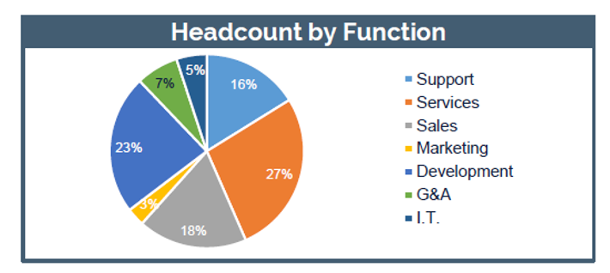
TrueCommerce Overview
Founded | 1995
Offices | Seven Fields, PA (Headquarters) Regional offices: Reston, VA Columbus, OH Westborough, MA Cincinnati, Ohio Carlsbad, CA New Canaan, CT Copenhagen, Denmark Coventry, United Kingdom Shanghai, China
Employees | 520
Michael Cornell
CEO / Chairman
Flint Seaton
CFO
Ross Elliott
President
“Make Electronic exchange painless by providing a comprehensive, end to-end solution that is easy to use, robust and affordable.”

Slide 5
Partnership with Microsoft
Microsoft Gold Certified Partner
Certified for Microsoft Dynamics NAV
Member of NAVUG Community
Supports NAV 2009 through Current Release
Member of the Microsoft Development Council
Notes:
In process of getting CfMD…worked with Microsoft to co-develop

Slide 6
What is EDI?
Electronic Data Interchange (EDI)
EDI provides a common “language” for a company’s computer system
to “talk” to another company’s computer system
Notes:
Anyone doing EDI? Anyone communicating electronically (web portals, XML, etc.)? (Show of hands)
Vendor, Warehouse, Customer
How EDI Helps:
Vendor: Extended product receiving time, ordering accuracy, notification of backorder items, standardizing vendor ordering processes, etc.
Warehouse: Inventory count issues, when did my 3PL actually ship the product, do I have lot/serial requirements with my 3PL, advising trading partner what shipped in which box
Customer: Order entry error, early notification of pricing error or shipping date changes, scorecarding, label compliance

Slide 7
Growing Pains with Multiple Solutions?
Connections
Trading Partner Portal
Trading Partner Portal
Web EDI
VAN
FTP AS2
System
Vendor Central/Supplier Central
Retail
Link
EDI
Translator
XML
Web EDI
Integration
Manual Entry
Manual Entry
Manual Entry
Data
Import
Data
Import

Slide 8
Traditional vs. Next Generation
Traditional
Next Generation
Internal Management of Network Connections
IT Resources Internally
In-House
Translator
In House Trading Partner & Integration Mapping Capabilities
Hosted Application
Managed Facility & Backups
Auto Deployed Mappings
Fully Managed Network & Connections

Slide 9
TrueCommerce EDI Platform for Dynamics NAV
Our strategy has been to deliver depth in integration in NAV using an embedded C/AL based solution
Connects to an expansive global trading network with 92,000 established trading connections
TrueCommerce focuses on flexible configuration options rather than requiring custom coding
TrueCommerce uniquely provides an end-to-end managed service solution for Dynamics NAV from a single provider
Unlimited customer support, free software updates and no annual contracts

Slide 10
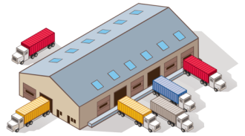
TrueCommerce Solution Overview
Customers
Single
Connection
--------------------------------------------------------------------------------------------------
Suppliers & 3PL’s
Integrated Supplier
Portal Supplier
3PL

Slide 11
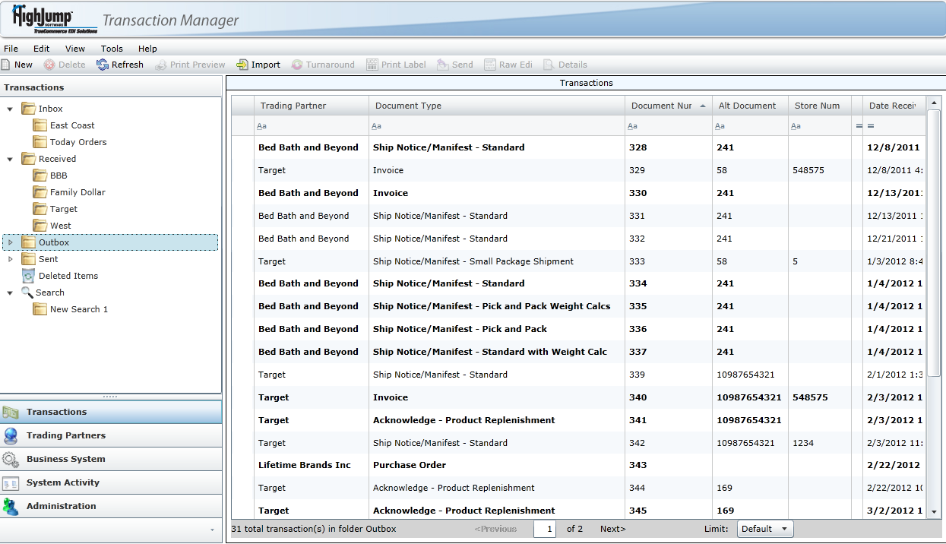
Technology & Architecture
Monitored Managed Network
Hosted application
Tier 3 Data Center
Full Disaster Recovery 2nd Site
Transaction Manager Online
Notes:
The managed service offering not only benefits our clients by proactively monitoring and updating mapping/communications, but as I’m sure you are aware with most cloud services, we eliminate the need to manage expensive hardware. Our footprint has shrank to the point where if you are managing GP, AX, NAV, then you are managing our solution as well. We do have small windows service that needs to run in order to connect the ERP integration to Transaction Manager…

Slide 12
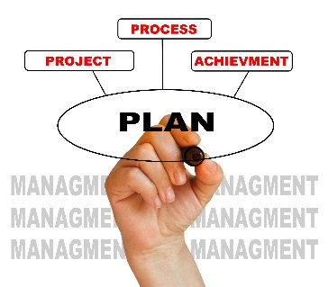
Implementation Approach
Planning
Training
Configuration & Testing
Production
Network Profile Created
Kickoff Call/Project Plan
Business Process Review
One-on-One Training
Online Training Material/ Downloaded Materials
Training Videos
Mapping of New EDI Documents and Partner
Item, Address, Lookup Tables
Business System Testing
Trading Partner Testing
Label & Packing Slip Testing
Move from Test to Production
Handoff to Support

Slide 13
HighJump TrueCommerce Customer Support
24/7 Emergency Support
Support: 8AM to 8PM ET Weekdays
24 - hour access for case submission / status
Phone, email, and online support included
Support Team Goals
Dedicated Integration
Support Team
Responding to customer calls within targeted guidelines
Providing ongoing communication to our customers regarding current status of their issue(s) through problem resolution
Focused on Dynamics NAV
NPS Score: 8.4
Notes:
Add NPS Score and explain

Slide 14
Depth of Integration
Completely Embedded Solution
Multi-Company Support
ASN API for Third Party WMS Solutions
Lot Number and Serial Support
UCC128/GS1 Label Printing

Slide 15
TrueCommerce NAV Customer Community
Notes:
*Add stories – volume and TP’s for companies like Century or Lifetime – What’s the best story(ies) to tell?

Slide 16
Any questions?

Slide 17
THANK YOU!
Steve Norris
Director, Dynamics Solutions Architecture
Steve.Norris@truecommerce.com

