Slide 1
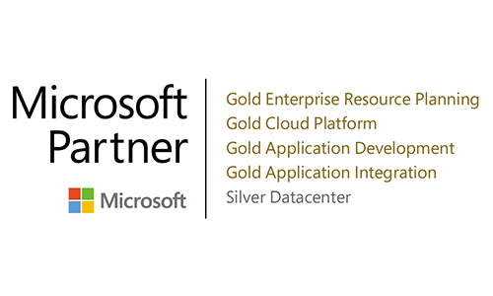
E-Commerce Trends That Microsoft Dynamics Users Can Take Advantage of
/us
Notes:
B2B businesses are all looking to dash ahead in the race to digital transformation. This shouldn't come as a surprise. Every company today, no matter their industry, understands how critical it is to embrace digitization in a seamless and scalable way.
Nonetheless, most are also challenged when it comes to executing the steps that will help them reach this goal. Data challenges, customer experience demands, and systems that are not integrated are major, and sometimes unsurpassable, roadblocks that threaten to keep businesses stagnant.
For Sana, partnering with Microsoft has allowed us to leverage Dynamics 365 Business Central and maximize the potential of our clients business operations and align that with their e-commerce strategies. Business Central lives at the core of Sana's integrated approach to e-commerce, and allows us to power and optimize online operations. We make it easier to build a scalable and efficient e-commerce engine that will drive sales and delight customers (without the back-end complications that come with duplicated or fragmented data).
Sana's tried-and-true approach to e-commerce can help you win more business.

Slide 2
Agenda
The current state of B2B e-commerce
Risks and opportunities for distributors
Risks and opportunities for manufacturers
Partnering together to beat the competition in an increasingly competitive online market
Ryan Steigerwald
Partner Alliances Manager
at Sana Commerce
SPEAKER JOB TITLE

Slide 3
The Current State of B2B E-Commerce

Slide 4
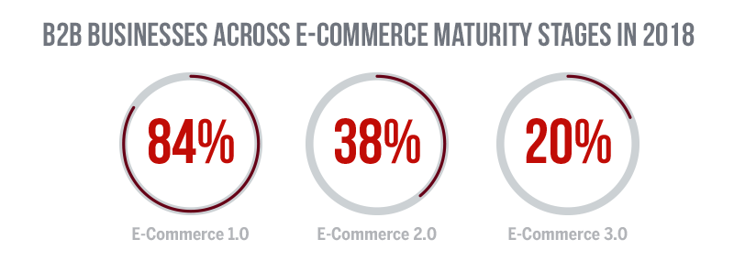
Quick look: B2b e-commerce maturity
(First-generation)
(sales-centric)
(hyper-personalized)
Notes:
The majority of B2B organizations aren't at e-commerce 3.0 yet, and those who are, are simply testing E-Commerce 3.0 features or have goals that align with E-Commerce 3.0 (without fully achieving that level of digital sophistication).
As you can see, the vast majority of B2B businesses have goals that align with E-Commerce 1.0, and are still in a pretty foundational phase of e-commerce. Nearly 40% are embracing sales-focused e-commerce goals by upgrading from their first-generation web store. Looking at the numbers, it’s clear that there is overlap, and that some brands are stuck somewhere between E-Commerce 1.0 and 2.0.

Slide 5
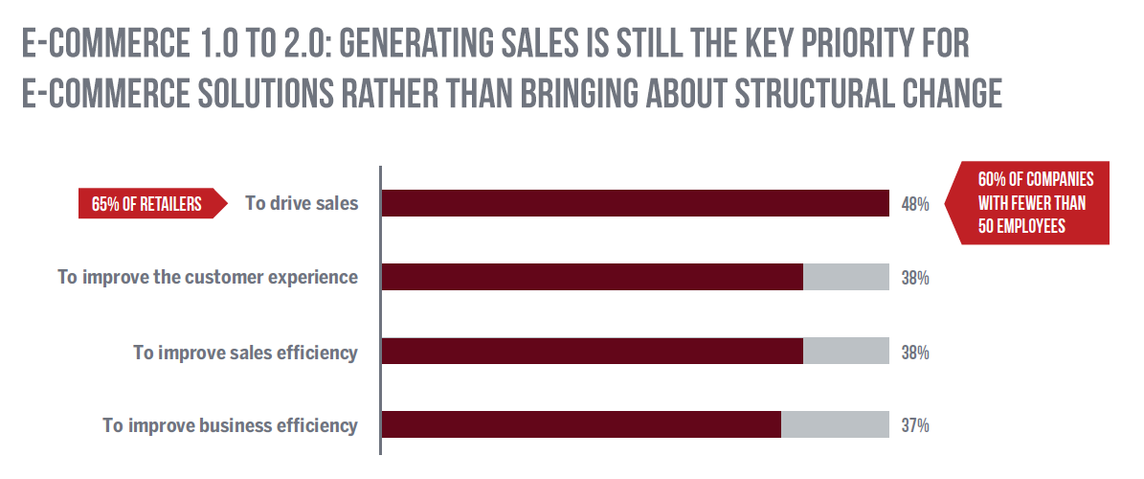
Current state of B2B organizations
Notes:
The B2B companies that are stuck at e-commerce 1.0 and 2.0 are focused less on how they can use e-commerce as a way to structurally transform their business model, and more on achieving short-term targets and results.
While 84% indicated that they’re currently implementing or have operated a web store, most are still focusing on e-commerce 2.0 objectives:
48% indicating that driving sales was the top priority with their B2B e-commerce solution.
Driving sales with an online sales channel turned out to be even more important for retailers in particular, with 65% indicating it was a top priority.
Besides driving sales, e-commerce initiatives also appear to be motivated by the need to improve customer experience and overall business efficiency — goals that, done well, will also lead to increased sales.

Slide 6
Where do distributors fall?
Notes:
The notion of all those buzzwords sounds great, revolutionary…but the B2B world is broad and distributors have particular pains and use cases for e-commerce. Let’s dive into what separates distributors from the B2B industry overall, how they stack up, and what specific challenges they’re facing.

Slide 7
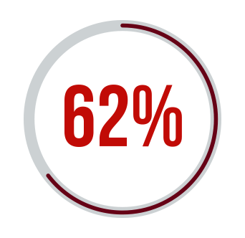
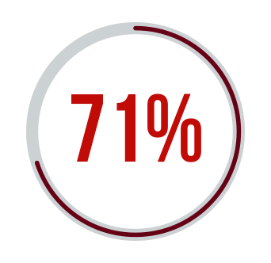
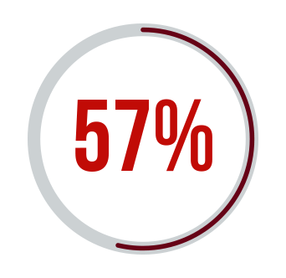
(Mostly) Stuck in, or between, 1.0 and 2.0
of distributors have an e-commerce site today.
of those that don’t have an e-commerce site plan to have one within two years.
of distributors invested in e-commerce in order to drive more sales
of distributors are selling online to reach new customers
Notes:
Consistent with the rest of the B2B space, distributors seem to be largely in the E-Commerce 1.0 and 2.0 phase (or somewhere in between). Compared to the 84% of B2B organizations with web stores, distributors seem to be a bit further behind (with 62%) but quickly catching on (with 80% planning to enter the e-commerce space within two years).
Less than 50% of B2B brands overall are leveraging e-commerce primarily to drive sales. In distribution, this number jumps to 71%, suggesting that (among those who do have a web store) there is a larger percentage of organizations in the e-commerce 2.0 phase. From this data we can draw the conclusion that fewer distributors are understanding the importance of e-commerce (compared to b2b brands), but those two do are moving beyond first-generation approaches and more focused on E-Commerce 2.0 goals.
This is promising, of course, but distributors’ challenges don’t stop with sales.
Source: https://www.digitalcommerce360.com/2018/07/10/infographic-distributors-get-ready-for-b2b-prime-time/

Slide 8
Facing DISTRIBUTION-specific CHALLENGES
Digitization is changing the game
Direct-to-consumer sales
Online B2B marketplaces (think Amazon Business)
HOW CAN distributors ADD VALUE within a digitized SUPPLY CHAIN?
Notes:
Many suppliers are already eliminating the need for distributors by selling directly to retailers or end-consumers, thus forcing distributors to respond by specializing their services and fighting to prove their value.
However, there is a $ 6.6 trillion opportunity for distributors online
So how do they add value?

Slide 9
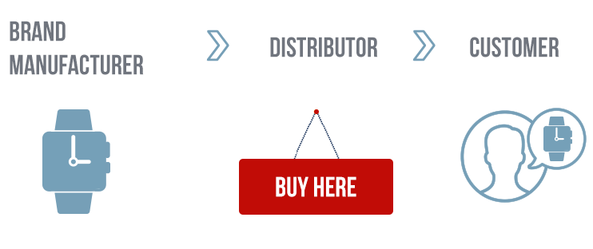
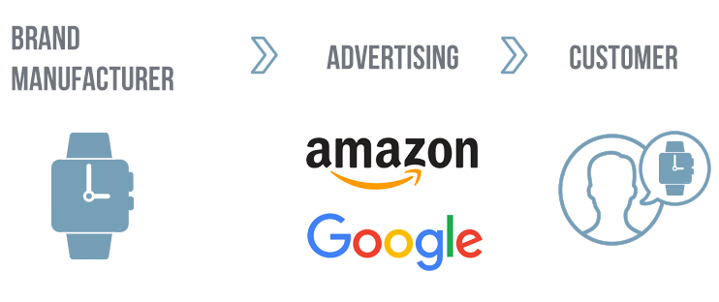
(trying to) Maneuver a digitized Supply chain
Then:
Now:
The shift toward digital is posing a threat to the vitality of distributors’ role within the supply chain.
Notes:
Distributors are fighting to prove their value within a supply chain that is changing; and digital is at the center of this approach. The data tells us that as DTC sales threatens distributors’ staying power, they are largely leveraging e-commerce to position themselves as an integral cog in the supply chain machine.
Today, 68% of North American B2B manufacturers, distributors and/or wholesalers are starting to sell directly to end-customers.
In turn, more than half of distributors are upgrading their infrastructure specifically to improve integration with their supplier’s systems.
We can assume, based on the data, that distributors are using e-commerce to fill more specific needs within their supply chain, rather than just to drive sales or improve sales efficiency. This means that while they have just as much to lose as other B2B organizations, they’re facing more challenges on the road to avoiding e-commerce failure.

Slide 10
Looking ahead: more Obstacles, more competition
Increased Competition
Challenging Marketplaces
Notes:
As e-commerce offers more and more opportunities for revenue growth and overall business success, the competition is naturally steep. Where businesses used to have only local competitors to contend with, with e-commerce, anything goes. Today, increased competition and challenging marketplaces are the primary reason many B2B organizations are failing to meet their e-commerce goals. As we’ve seen, distributors have even more obstacles to contend with.
Distributors are (for the most part) doing their part to embrace e-commerce and remain an invaluable part of the supply chain, but as more businesses adopt and develop e-commerce platforms, it will no longer be enough just to have a web store. Offering an attractive, high-quality, integrated web store with a stellar customer experience is becoming essential for those companies that truly want to differentiate themselves in their markets.

Slide 11
What’s the risk?

Slide 12
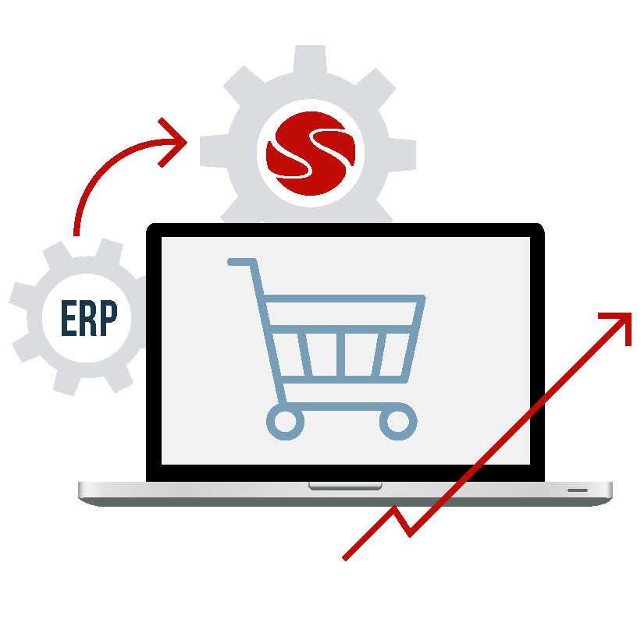
MISSING THE MARK
less than half of B2B ORGANIZATIONS WITH a web store are using data from their e-commerce platform to support or manage key business drivers.
Source: Sapio Research, 2018
Notes:
This means most are not tuned into what customers want or what customers are doing online. You must listen and react in order to achieve a customer-centric B2B strategy, and so far, that largely seems not to be the case.
Customer’s demands (at least the most basic ones) can be achieved pretty easily with the right data – if you know to use it. But if you’re making changes to your web store that aren’t data-driven, or if you’re not making changes at all, the success of your B2B e-commerce solution depends on a shot in the dark.

Slide 13
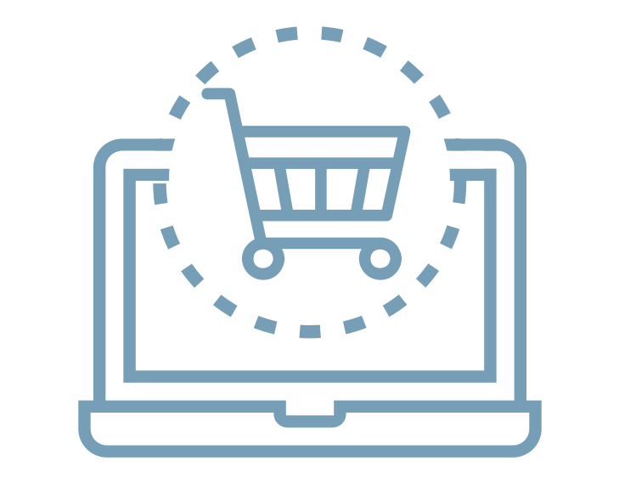
Dropping prices won’t help
83% of b2b buyers would choose to purchase from a business with robust e-Commerce experiences...
...even if they must SPEND MORE TO PURCHASE
Source: Avionos
Notes:
Today, B2B buyers want:
More accurate and reliable product information
Faster and more consistent web performance
easy-to-navigate web stores and product catalogs
Simplified order and payment functionality
And this is just the beginning. As e-commerce technology becomes more sophisticated, customers’ demands will follow. Already, many are frustrated enough with existing experiences that they are willing to forgo a lower-priced option for one that offers a better, more robust experience.

Slide 14
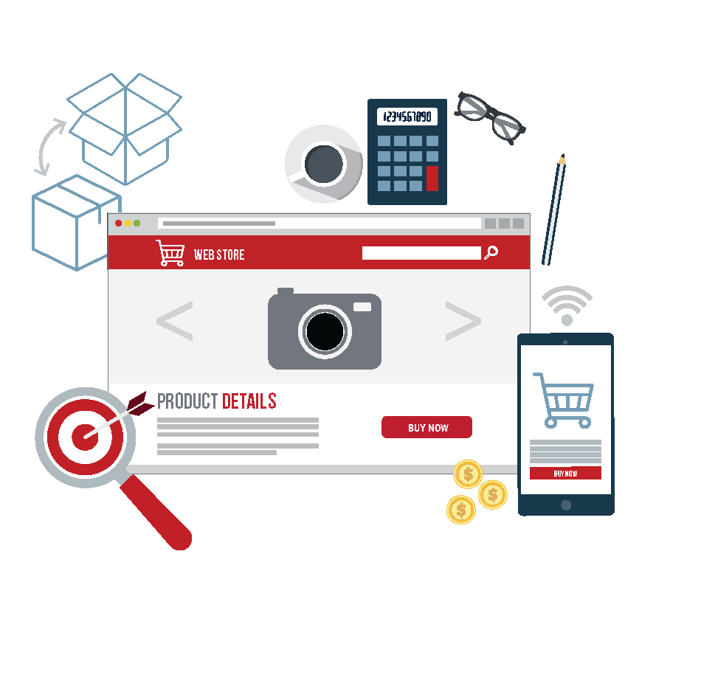
E-commerce Revenue is at stake
distributors not offering a satisfactory e-commerce experience are at risk to lose
2% to 4%
of their online revenue every year.
Source: Real Results Marketing
Notes:
But for distributors, knowing how to step into the e-commerce field without squandering an investment or underwhelming customers is just as important as knowing enough to go digital at all.
In fact, distributors who step into the e-commerce space, but do so unsuccessfully, risk up to 4% of their yearly revenue. This means that if you’re going to do e-commerce wrong, you may as well stick to offline sales (but you will be missing out on the ripe and growing opportunity e-commerce is presenting).

Slide 15
solution: Getting Distribution e-commerce right
Use Online Channels to Make Offline Processes More Efficient
Growth and Scale
Get Pricing and Service Right
Notes:
Distributors are currently at a crossroads: redefine your roles, services, and value proposition, or be replaced by the innovators who will.
Ultimately, thriving in an increasingly digital age is not a question of offline versus online or price versus customer experience. It’s about the making your workforce more efficient and your business more streamlined by treating digitization as a tool rather than viewing it as a roadblock.
Get pricing and service right: accurate, real-time pricing from their ERP, online self-service 24/7 from a web-based portal, optimzied for any device
Use online channels to make offline processes more efficient: sync your sales channels so that your customers can buy where and when they please (and you still have a single view of their behavior).
Room for growth and scale: success that doesn’t move forward eventually fades. Invest in a solution that will allow you to grow and scale without making major sacrifices along the way.
How do you get there? Invest in : ERP Integration, Enriched data, web store design (and performance)

Slide 16
What About manufacturers?

Slide 17
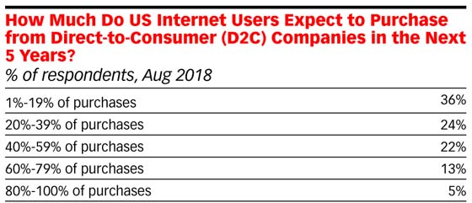
The rise of Direct-to-consumer sales (d2c)
61% of manufacturers, distributors and wholesalers now sell direct to customers.
But customer demand is giving manufacturers a competitive edge.
eMarketer, 2018
Notes:
E-commerce is already changing the market as we know it. Our latest research indicates that nearly half of wholesalers are seeing manufacturers sell directly to end customers. It’s little wonder: e-commerce offers a fantastic opportunity for manufacturers to increase margins by cutting out the middleman.
Forbes predicts that the number of manufacturers selling directly to consumers will grow 71% this year alone. Already, customers as well as manufacturers are benefitting from this shift.
81% of US e-commerce customers expect that they’ll make at least one purchase from a D2C brand within the next five years (eMarketer).
But, for manufacturers this is particularly positive because:
40% of B2B buyers currently prefer buying directly from manufacturers over distributors (most cite accurate and reliable product information on many manufacturers’ web stores).
Among this 40%, buyers are also willing to pay up to 20% more to be able to buy directly from manufacturers
D2C sales are driving more competition between manufacturers, distributors and wholesalers but manufacturers are raking in a larger piece of the pie.
Sources:
https://retail.emarketer.com/article/direct-to-consumer-brands-booming/5bb5098cb979f10740cf32f2?ecid=NL1014/
https://www.digitaldoughnut.com/articles/2018/january/b2b-sales-channels-are-changing-act-now-or-die
17

Slide 18
The adoption of emerging technology
Machine-to-machine ordering is on the rise (and disrupting the way manufacturers do business).
Notes:
For manufacturing businesses, developing technologies like IoT, 3D printing and AI are nothing new.
77% of companies across industries either already use machine to machine (M2M)/IoT as part of their e-commerce platform, and plan to continue to use this technology in the future.
The list of potential disruptors —which will only make competition that much steeper— continues to grow. The adoption of modern, packaged ERPs and e-commerce play a major role, but there is also considerable disruption being caused by advances in mobile technology, VR-enabled improvements like virtual stockrooms, and IOT-driven capabilities like real-time remote inventory sensing. Manufacturers are largely ahead of the game: adopting these technologies early and strategically.
54% of B2B brands think tasks like ordering spare parts completely M2M is a distinct possibility for the future.
As you see here on the slide, another 67% think it will impact their approach to sales strategies and customer service.
18

Slide 19
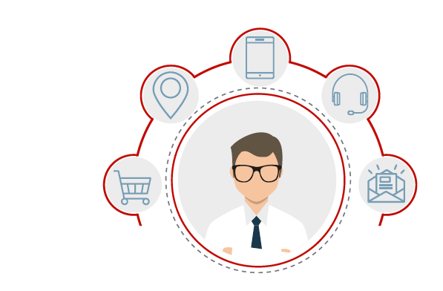
Customer-Focus as a differentiator
The key is to leverage servitization.
Notes:
There is a fundamental shift in the manufacturing industry. The speed of business is picking up, with shorter product cycles and constant iteration making it harder to stand out from the competition and maintain your competitive advantage. All the while, your customers needs are changing too.
This Is all leading to a shift in focus for manufacturers from products to strong services.
What servitization means for manufacturers is a chance to differentiate themselves. You’re no longer competing solely on price and delivery speed: it’s about the quality of services and customer experience.
Your web store is a great platform for these services. This is doubly true if your web store is tightly integrated with your ERP. It means:
One-stop shop. Setting up a single portal for all your products and services provides clarity for your customers.
Increased visibility. Including services in your web store makes them more visible to existing customers and prospective clients doing online research.
Empowered customers. Offering your services online — or at least providing detailed service descriptions — lets customers do business when it suits them.
Speedy self-service. Seamless integration between the web store and the ERP lets you offer certain services, such as RMAs, directly through the web store, with no need for assistance from sales.
19

Slide 20
Lean and agile manufacturing
More efficiency
Faster time-to-market
Better ability to adapt to changing customer needs
Eliminating waste (time, resources)
Notes:
Lean manufacturing (and lean business processes in general) are all about one thing: eliminating things that don’t add value to your customer. It’s about adding more value while using fewer resources. This can include:
Over-production against plan
Waiting time of operators and machines
Unnecessary transportation
Waste in the process itself
Excess of stock material and components
Defects in quality
Agile manufacturing is all about the ability to adapt quickly to customer expectations. Manufacturers are aiming to do both, to be lean and agile to maximize efficiency and customer satisfaction.
A web store is a great tool for your commercial departments to become just as agile and lean as your production silos.
Digital channels like web stores are easier to update with new product iterations or new prices.
A web store lets your customers directly communicate their needs, without having to go through a sales representative or account manager.
Automating this type of communication also frees up a sales representative’s time to add real value instead of doing tedious administration.
20

Slide 21
Obstacles in manufacturers’ e-commerce acceleration

Slide 22
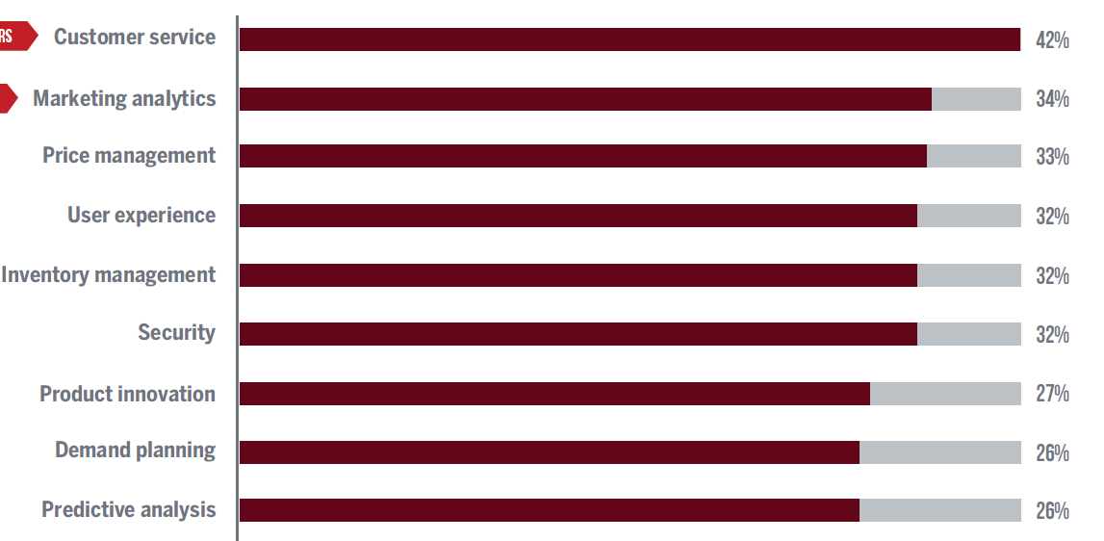
Not Leveraging the data they do have
Only 26-42% use their data to support or manage any of the following:
Notes:
The key challenges all relate to data. But why is data so important?
In our third annual Digital Transformation Report, we asked B2B companies how they use data from their e-commerce platform. This isn’t even all the answers we received, but to keep the data manageable we’ve narrowed the list down to the answers given by more than a quarter of respondents.
As you can see, data from the web store is largely not being used to support or manage processes across the entire business ( or at least not enough).
But this makes sense. What a web store provides isn’t just a convenient way for you and your clients to do business. It’s also a way to build an audit trail of your customers’ needs and interests. The data from your web store is a veritable goldmine for many different silos in your business.
When it comes to e-commerce for manufacturing, the way data is managed is essential. Which is why we’re such huge proponents of ERP-integrated e-commerce. But before we dive into that, let’s take a look at why e-commerce — any kind of e-commerce — makes sense for manufacturers specifically.

Slide 23
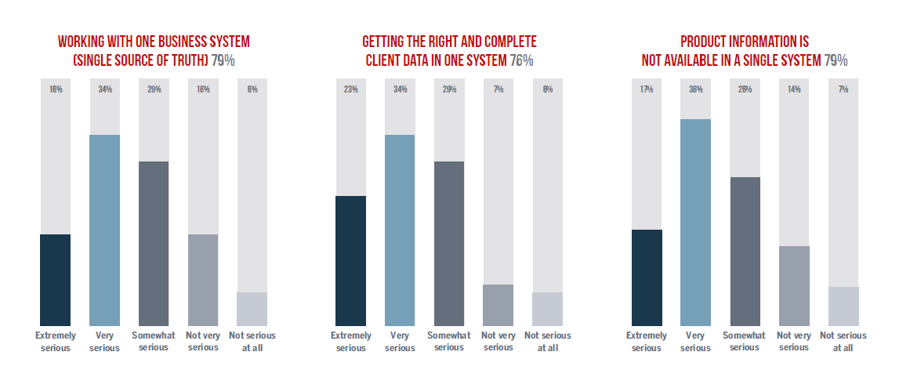
Trouble with data accuracy and integration
Notes:
Almost 80% of B2B businesses have challenges with client or product data.
Obstacles:
Complex systems and processes.
This can keep organization from being innovative
Solution:
Smart integration of systems and processes
ERP as single source of truth
Integration within the digital transformation of production (Industry 4.0) ensures that everything is connected and easier to optimize.
23

Slide 24
big Challenges are Hindering E-commerce success
Data Challenges
Systems That Aren’t Integrated
Notes:
Embracing digital (technologies and e-commerce alike) is the common thread we’re seeing in today’s manufacturing trends. Manufacturers are making a lot of moves in the right direction:
Outpacing competitors in the supply chain with D2C sales / better e-commerce experiences
Focusing on customer-centricity
Improving efficiency and agility of processes
But there are also major roadblocks that hinder manufacturers from achieving their full e-commerce potential and threaten to keep businesses stagnant from this point on. Namely: data and integration.

Slide 25
The Sana Difference

Slide 26
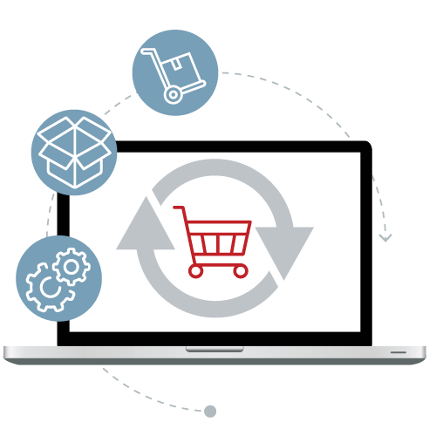
Sana COMMERCE
Worldwide HQ in Rotterdam, Netherlands
US HQ in NYC
300+ employees across 14 global offices
1700 + webstores deployed globally
Forrester Wave – top 8 e-commerce solution
Notes:
Always on the latest version: Upgrades are automated and available on a regular basis, regardless of ERP version.
Security: Up-to-date installation that is protected against vulnerabilities by releasing regular security fixes, performance improvements, and continuous bug fixes.
Extensible, configurable: Offering a customizable SaaS solution that is extensible and configurable based on business needs results in a web store that meets each clients’ unique business needs.
Fixed budget implementation: Monthly rate includes license, hosting, and support

Slide 27
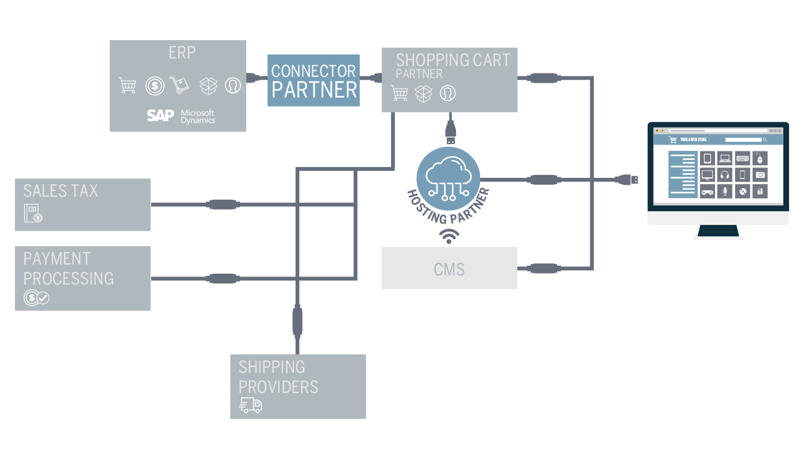

Slide 28
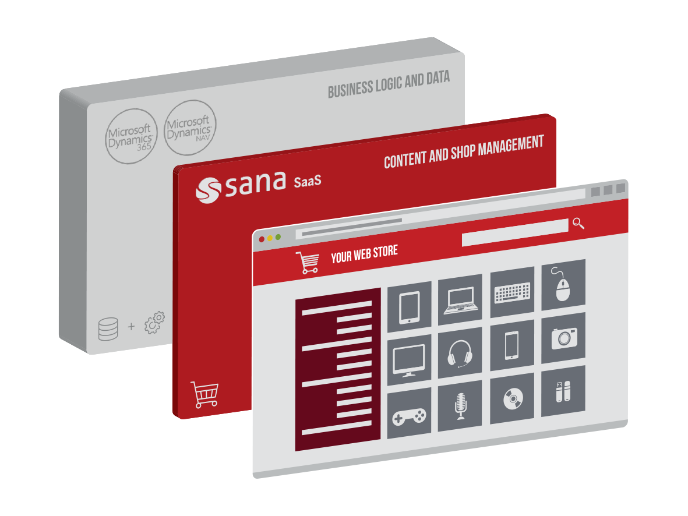
Helping B2B Organizations Perfect E-commerce 2.0
Notes:
Driving efficiency and driving sales. BC & Sana SaaS:
Cloud-based, always on the latest version
Security – always up to date
Extensible, configurable
Fixed budget implementation
Why are we stuck on E-Commerce 2.0?
Businesses are clearly focused on making progress in their e-commerce efforts. They are upgrading their e-commerce platforms, and actively looking for solutions that will help them meet customer demand for improved functionality and a better online shopping experience.
It is noteworthy, however, that these areas of focus are issues that many B2C web stores overcame years ago. Where consumer-focused businesses are moving on to e-commerce 3.0, with native advertising and orchestrated customer journeys, B2B businesses are still laying the foundation for a modern e-commerce platform.

Slide 29
Saas AND Microsoft Dynamics
Custom Add-on
Sana Frontend
Custom Add-on
Frontend API
Extension Points API
Sana Backend
Standard Add-on
Standard Add-on
Custom Integration
Integration API
ERP
Notes:
What does SaaS look like?
Void of heavy customizations, integrations with other 3rd parties are standardized through extension points.
Add-ons can be installed / uninstalled through Sana app store.
Can always run on latest version of Sana, regardless of ERP version; when a feature relies on ERP version, it becomes unlocked on you upgrade to that ERP version

Slide 30
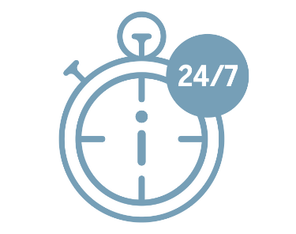
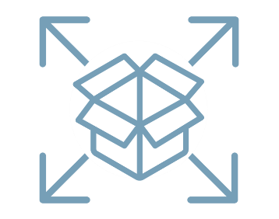
What sana can offer
For your business:
Erp integration (real-time data)
Meet customer Demand
drive revenue, cross- and upsell
More Efficient sales department
Grow and scale
For your web store:
24/7 orders and customer service
Ease of use / navigation
Availability of product and stock information
Use E-Commerce to drive Offline Efficiency
Easily Manage Complex Orders
Notes:
Sana’s integrated approach to e-commerce can strengthen both your business proposition and your online customer experience.
With our solution, we ensure that digital channels use product and pricing information taken direction from one single source of truth — Your ERP. We use your ERP to drive the features, functionality, and product information that appear in your web store, so the data is always accurate and updated in-real time.
And what’s the result?

Slide 31
Sana Commerce
Notes:
Zumex

Slide 32
Sana customer success stories
Notes:
Zumex

Slide 33
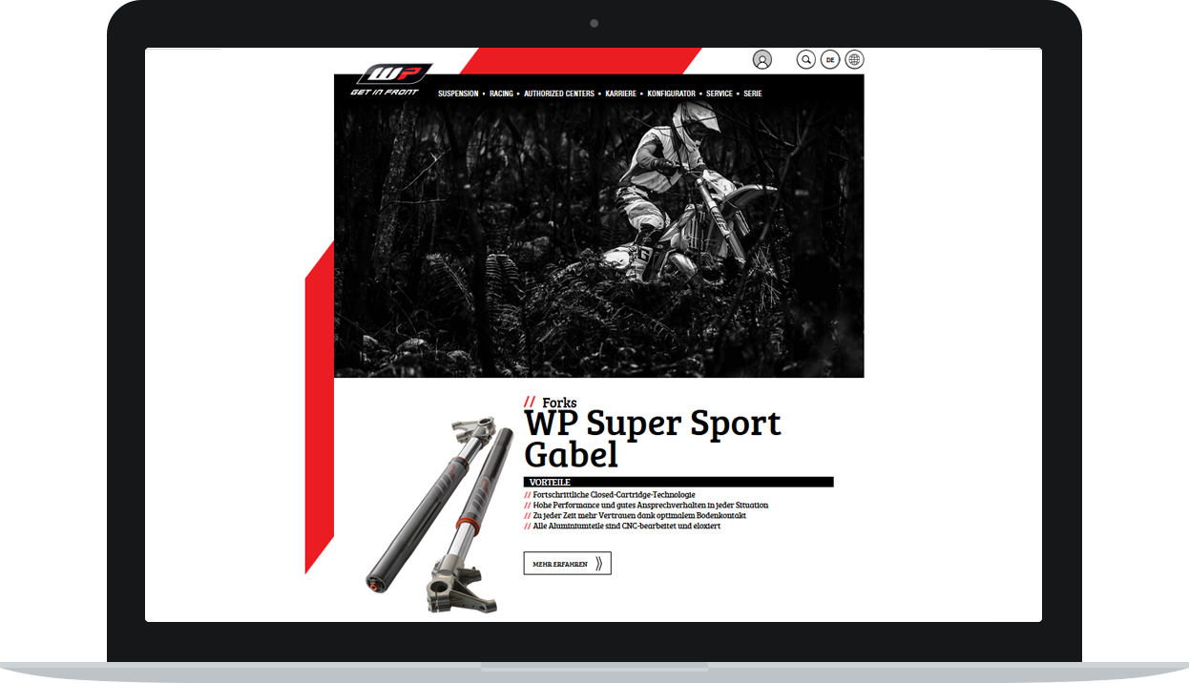
“With Magento, we were having to build our business logic twice, once in the ERP and again in the web store. Whereas with Sana’s ERP integration, there was no need to replicate our data. That was a huge time saver.”
– Sean Hefferin | Supply Chain Manager at Moto Direct
Notes:
Moto Direct is one of the leading motorcycle clothing and accessory manufacturers and distributors based in the UK. Its portfolio includes some of the market’s biggest brands. Initially a simple buy-and-sell distributor, Moto Direct grew to become a much more complex business involved in manufacturing and brand development.
Challenge: As Moto Direct was experiencing rapid growth, its existing B2B e-commerce website – which was both outdated and lagging behind its competitors – was holding the business back. The company needed a new B2B web store to integrate with its Microsoft Dynamics NAV ERP system, which was due to launch at the same time.

Slide 34
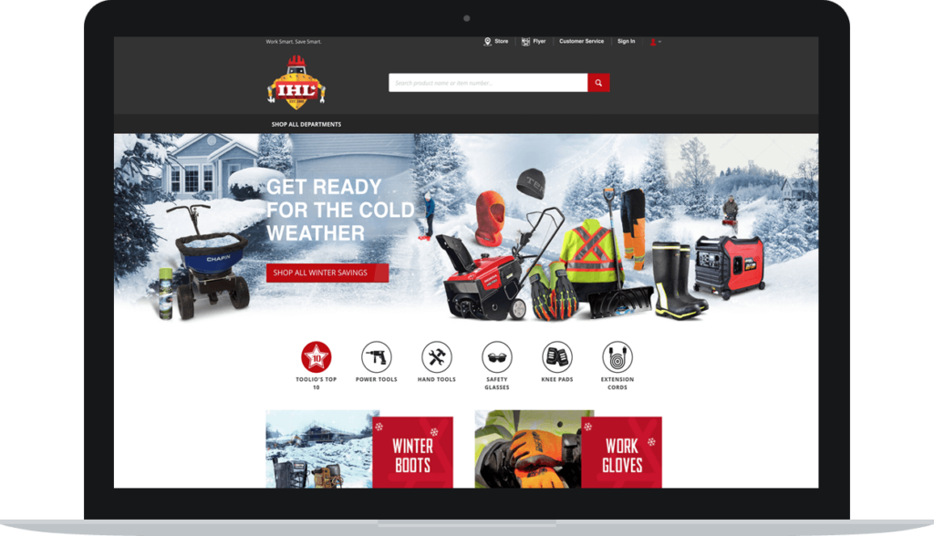
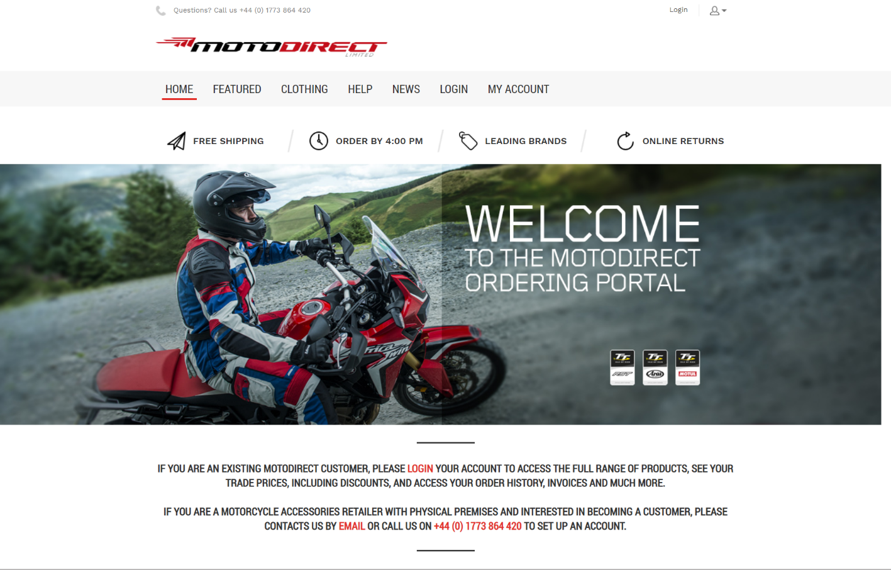
Moto Direct
Goals:
Improve performance, design and usability
Simplify large, complex ordering for B2B customers
Account and order information accessible online 24/7
Obstacles:
Cost of customizations required for B2B
Complexity of integrating B2B logic
Notes:
The company’s goal was to:
Improve the web store’s performance, design and usability
Make it easy for its B2B customers to place large, complex orders
Allow its customers to access their account and order information online
This was one of the biggest projects undertaken by the company. Initially, it chose Magento as its e-commerce solution partner.
Obstacles:
When implementing Magento, the main issues faced by Moto Direct included:
Cost of B2B customization: As Magento isn’t a pure B2B platform, there were many missing features. This meant additional development was needed, which added time, cost and complexity, and held the project back.
Complexity of integrating B2B logic: When integrating Magento with Microsoft Dynamics NAV, the business logic and processes already stored in the ERP have to be replicated in Magento. From complex pricing to real-time, accurate inventory information, a lot of additional development and manual work was needed to synchronize the data between the NAV ERP and Magento. This would not only prove to be an issue during implementation, but would also require constant maintenance after the web store launch.
Despite having already invested a lot of time and money, Moto Direct made the difficult decision to find a new provider, and switched to Sana Commerce. Here’s what made that decision easier.

Slide 35
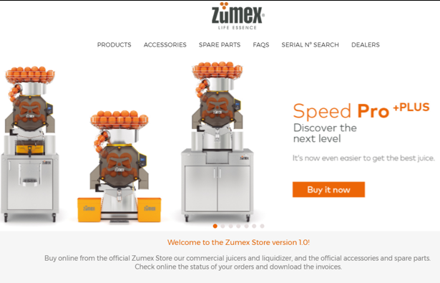
zumex, a leading food service equipment manufacturer, improved their existing
e-commerce experience by making their erp system the driver of their online experience.
Notes:
One of these clients is Zumex, who is now live with a Sana web store serving both B2B and B2C clients in Spain.
Zumex invests heavily in businesses processes, starting with their ERP. They find immense value in improving and automating internal processes.
For them, Sana was a sustainable solution that would grow alongside their business and leveraged the investment they had already made in their ERP.

Slide 36
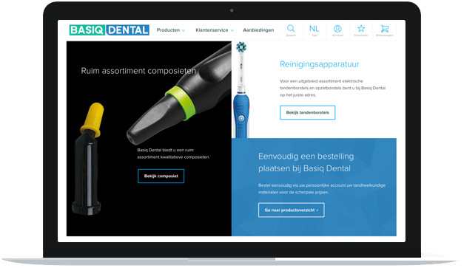
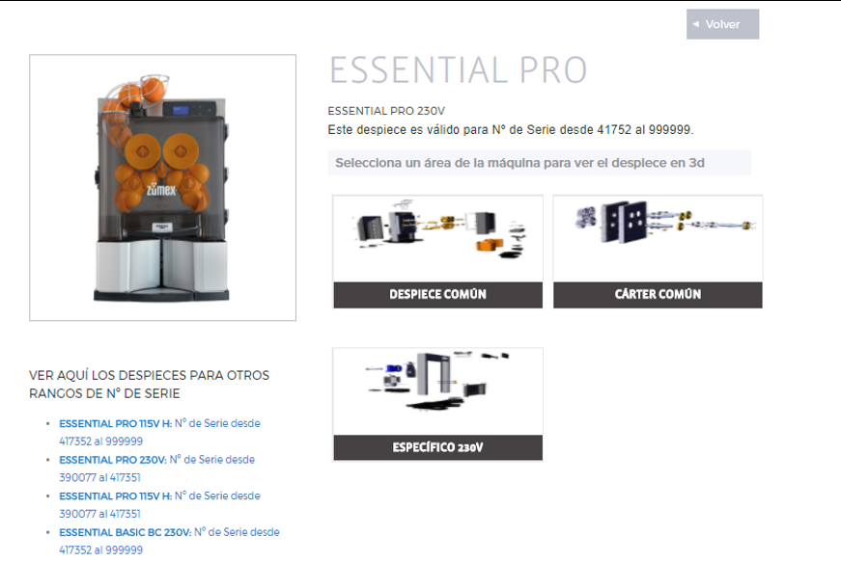
Investing in next-generation e-commerce
Zumex CHOSE SANA for:
Direct reuse of all business logic from their ERP to support complex selling
Single source of truth for data (inventory, delivery dates, prices)
Global support (multilanguage, multicurrency) / easy international roll out
Proof of concept to seal the deal
Notes:
***Additional talking points beyond the reasons they chose Sana: here are some details about what internal mechanics and customers can both do on the Zumex site. (Optional)
They also have a team of mechanics that service Zumex machines across the country. These mechanics also use the web store when on site with clients. In conjunction with SOLIDWORKS, 3D CAD software, Zumex mechanics are able to locate the machine they are servicing online, find any part within a 3D drawing and place an order for the spare part the client needs to ensure any issues with their juicers can be remedied quickly.
On the customer side, they can:
Place an order.
Use the web platform to access the historic order data to find the list of products the customer ordered in the past and zoom in on the bill of materials.

Slide 37
Summary

Slide 38
E-commerce for manufacturers: Key Takeaways
74%
The pace of digitization is fast and gaining speed. Embracing technology and customer-centricity is the answer to keeping up. Trends will continue to reflect this.
Data and systems integration are necessary, and without them your e-commerce efforts will fall short of expectations.
A Sana Commerce (SAP or Microsoft dynamics) integrated
e-commerce approach enables manufacturers to be lean, agile, and future-ready.
74%

Slide 39
Download our Latest Research Report
Notes:
Want to read our latest research report on the current state of e-commerce? Visit our booth.

Slide 40
r.steigerwald@sana-commerce.com | 248-918-3625
https://www.linkedin.com/in/ryansteigerwald/
Ryan Steigerwald
Partner Alliances Manager
At Sana Commerce
SPEAKER JOB TITLE

