Slide 1
Building a Modern Finance Function

Slide 2
AGENDA
Who we are
What is CPM, exactly?
What you need to do
Reporting
Budgeting
Collaboration
How you do them (demo)
Dashboards
Workflow
Scenarios
Report Distribution
The near future
Exciting upcoming features

Slide 3
About Prophix
Established in 1987
Privately owned
Canada HQ, global partner network
3200+ customers
100+ countries
Used in any industry
Recognized by leading Industry Analysts

Slide 4
FIVE TRENDS FOR TOMORROW
AGILITY: Accelerated change
DIVERSITY: Choice & competition
PERFORMANCE: Fast flow of information
UBIQUITY: Universal technology
SCALE: Falling barriers

Slide 5
Fundamentally change how people work in Finance

Slide 6
What’s the difference?
ERP?
CPM?
BI?

Slide 7
What you need to do
Budgeting & Planning
Budgeting & Planning
Reporting & Analytics
Reporting & Analytics
ENABLES YOU TO AUTOMATE THE MANAGEMENT CYCLE OF PLANNING, REPORTING, ANALYSIS, REFORECASTING, AND SCENARIO MODELLING
Workflow & Automation
Workflow & Automation
Consolidation
Consolidation
Notes:
Most software that focuses on helping these process focuses on streamlining your FINANCE processes. At Prophix, we want to move away from simply making things easier to FULL AUTOMATION. Making manual tasks as automated as possible. Making the impossible with spreadsheets and other competing solutions possible.

Slide 8
Not good enough…
AMAZING USER EXPERIENCE
QUALITY & PERFORMANCE
INNOVATION

Slide 9
Software Demonstration
Notes:
Prophix Full Demo

Slide 10
Prophix benefits
Central hub with data integrity and security - reduce errors and reconciliation
Enhance Finance function – more analytics, business expansion planning
Easy to use and maintain (product usage and intuitiveness)
Easy to implement (with ongoing Prophix Support)

Slide 12
Artificial Intelligence
Natural Language Processing
Machine Learning
Notes:
How the Office of Finance will leverage AI

Slide 13
Natural Language Processing
Hey Prophix, how much did income increase this month?
Income increased by 37.9% this month
Command & Control
Please get me the monthly income dashboard
Voice
Okay, retrieving monthly income dashboard
Inquiry
Please send a copy to Jasmine Chan and Tony Park
Sending to Jasmine and Tony
The Prophix Virtual Analyst

Slide 14
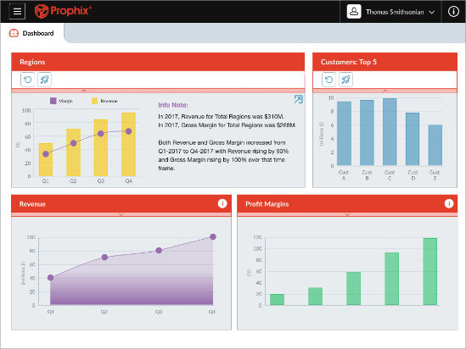
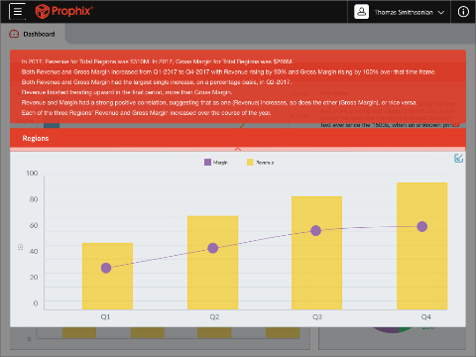
Dashboard Narrative Insights
Explaining what has happened
Insights delivered in Natural Language on Dashboard
Understand trends, exceptions and impacts to the business
Enhances experience for the casual data consumer

Slide 15
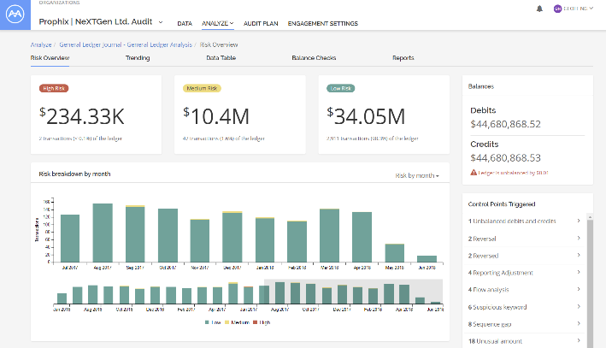
Anomaly Detection
Anomaly Detection
Automated analysis and classification
Quickly identify hidden risks
Reduce time for reconciling account during month end
Utilize machine learning rather than normal spot sampling

Slide 16
Dream with Us.

