Slide 1



Customer Payment Portal – Automate Your Receivables
Fauwaz Hussain
Director of Sales & Marketing
fauwaz@nodus.com
Nodus Technologies Inc.

Slide 2

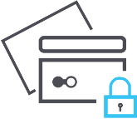

What You Will Learn Today
Inefficiencies in A/R and how to fix them
What is PCI compliance and why it is important
How Nodus can help (Demo)

Slide 3

Accounts Receivables
Heartline of the business
Managing incoming revenue
Collecting payments from customers
Applying payments to sales documents
Manage the accounting system
Achieve it all while spending as little money as possible

Slide 4








How to improve A/R Process
An inefficient A/R Process
Achieving accuracy with convenience
Automation
Customer
Convenience
Integration
Security
Manual Labor
Customer Inconvenience
Double Entry
Risk of Fraud

Slide 5

Automation
Automate the tasks your employees do manually so they have time to focus on more pressing responsibilities

Slide 6

Manual A/R Process
Individually mail or email invoices
Send reminders to customers
Collect payment information by mail or over the phone
Process credit cards through terminal or take checks to the bank
Send confirmation receipts
Enter payments into accounting system
Resend invoices because they were lost in transit
Make multiple phone calls to reach the customer
On average, 80%
of A/R collection expenses accrue from labor costs.
Request new payment method after credit card gets declined

Slide 7
Cost of Paper Billing*
Based on 600 invoices/month
Cost | Calculation | Total
Printing | $0.70 X 600 | $420.00
Mailing | $0.49 X 600 | $294.00
Preparing and Sending | $3.33 X 600 | $1998.00
Second Notice | $4.52 X 200 | $904.00
Third Notice | $4.52 X 100 | $452.00
Receive & Apply Payment | $3.33 X 600 | $1998.00
Monthly Cost of Paper Billing
$6,066.00
Annual Cost of Paper Billing
$72,792.00
*For further explanation, see Nodus’ White Paper on Paper Billing

Slide 8

Customer Convenience
Today’s customer is looking for more control over their payments. Easy and convenient processes make for more satisfied customers.

Slide 9
Online Bill Pay Users Are:
12.5%
35%
20%
More likely to pay their bills on time
Less likely to leave
Known for
purchasing 20%
more products
than paper bill
users.
*For further explanation and data source, see Nodus’ white paper on paper billing

Slide 10

THE INTEGRATION
GA ______________P
P
Delayed reporting
Double entry
Manual reconciliation
Disconnected departments
No real-time data

Slide 11

Security
Did you know?
When it comes to payments, the merchant is 100%
responsible for protecting their card holders data.

Slide 12

Cost of a Data Breach
The average cost of a breach to a small business is $36,000.
Medium & Large businesses run into the millions.
Even worse, 31% of customers terminated their relationship with the company after receiving notification of a breach.
http://files.firstdata.com/downloads/thought-leadership/Small_Businesses_Cost_of_a_Data_Breach_Article.pdf

Slide 13

What is PCI Compliance?
    Information Security standard for organizations handling
    cardholder information
    Created by Visa and
    MasterCard to reduce fraud
    Now maintained by the PCI
    SSC but enforced by Card
    Brands
PCI DSS (Payment Card Industry Data
Security Standard)
PCI SSC (Payment Card Industry
Security Standard Council)

Slide 14
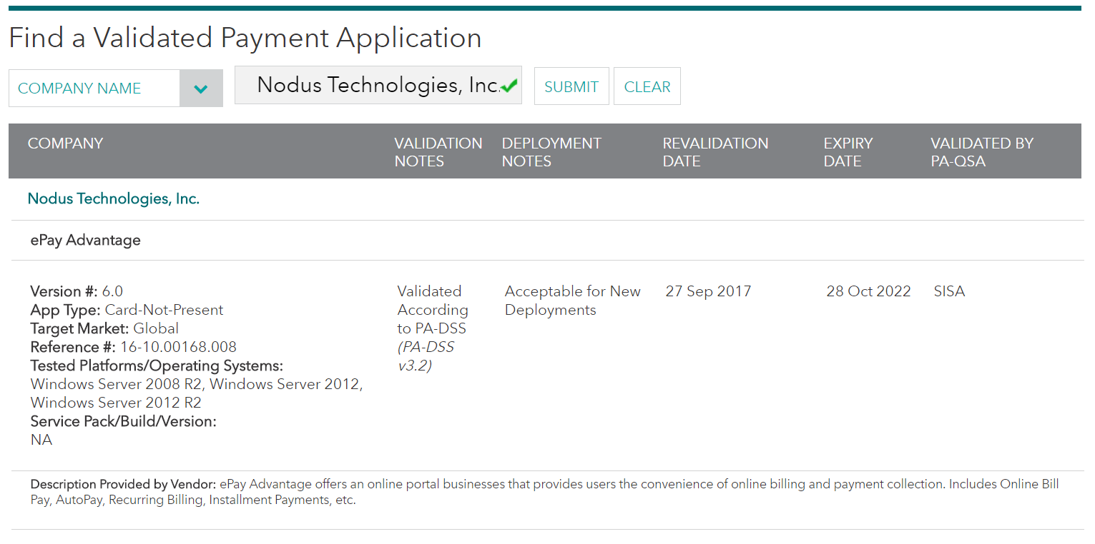
Secure Software
www.pcisecuritystandards.org

Slide 15
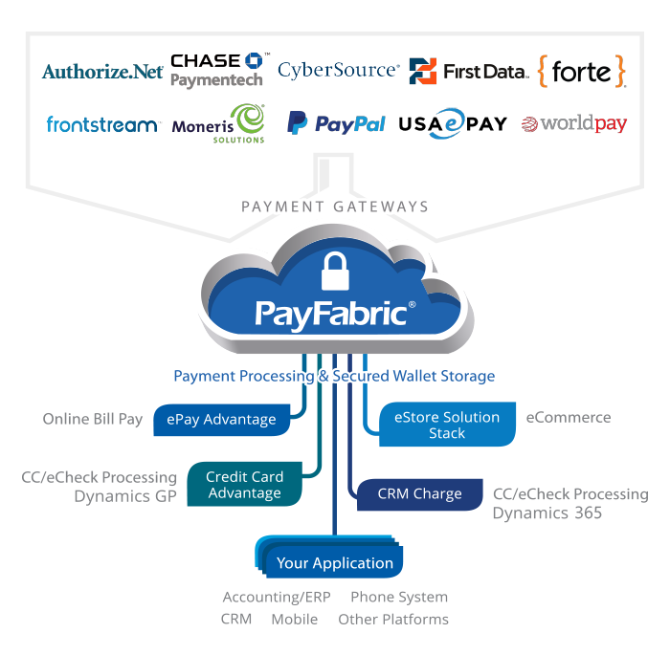
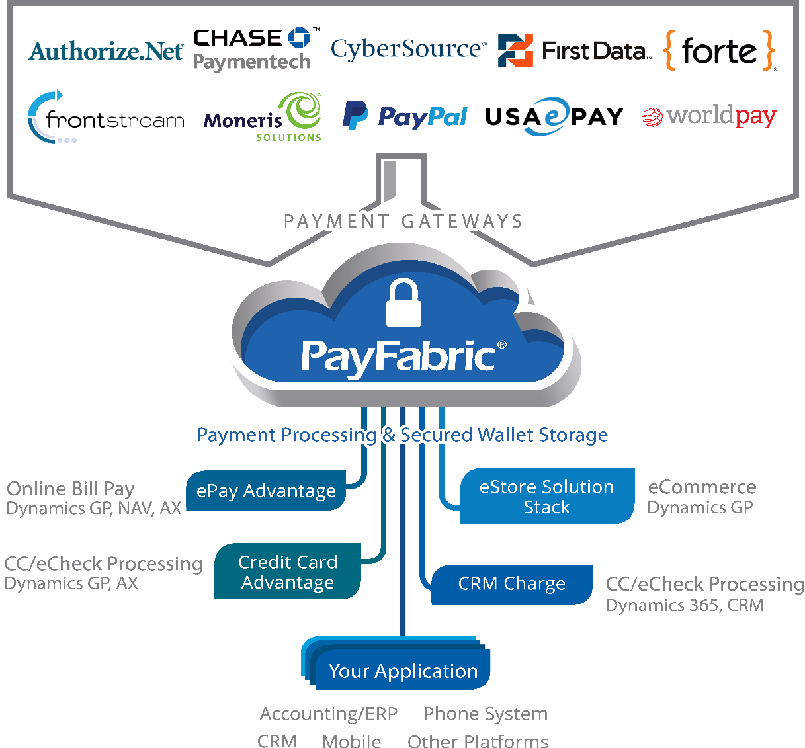

Cloud-Based Storage
PayFabric: Nodus’ proprietary cloud-based payment processing and storage system
Features and Benefits
Validated with PCI Data Security Standards
Connections to multiple payment gateways and processors
Hosted Payment Entry and Wallet Screens
  Eliminates:
  Point of Entry
  Transmission
  Storage

Slide 16



ePay Advantage
Customer Payment Portal
Payments are processed and applied back in Dynamics
Flexible reporting
Email templates
Confirmation receipts
Past due reminders
Automatic invoice delivery and payment reminders
Credit card/eCheck transactions
Real-time or scheduled payments
Level 2/3 processing
Customers enter in their own payment information and submit for processing
Bi-directionally integrated with Dynamics

Slide 17


Product Demo

Slide 18






About Nodus
Experienced in Electronic Payments Industry
1+ Billion Dollars Processed
200+ Partners in Microsoft Dynamics Channel
1,500 + Enterprises served
5+ Million Transactions Processed
PA-DSS Certified Integrated Payment Solutions
17 years of experience in ePayments and ERP/CRM integration (Founded in 2002)

Slide 19




Nodus Payment Solutions
Remove the burden of PCI compliance challenges through secured encryption & innovative tokenization technology
Save processing fees with Smart Field Level Handling for Level 2/3 Qualifications
Protection against fraud and data breach
Supporting both US and international payment gateways & processors

Slide 20
Thank You!
Nodus Technologies, Inc.
Fauwaz Hussain
fauwaz@nodus.com
909-482-4701 x8239

