Slide 1
NAV Payroll
The Last Piece of the Cost Structure Puzzle

Slide 2
Employee Setup Wizard

Slide 3
Deduction Setup Wizard

Slide 4
Employee Salary Templates

Slide 5
Reverse Transactions

Slide 6
Organize Payroll Ledger Entries by Dimension

Slide 7
PTO Requests with Employee Web Portal

Slide 8
Batch Payroll Processing

Slide 9
Adjust Payroll Documents from Batch Payroll Screen

Slide 10
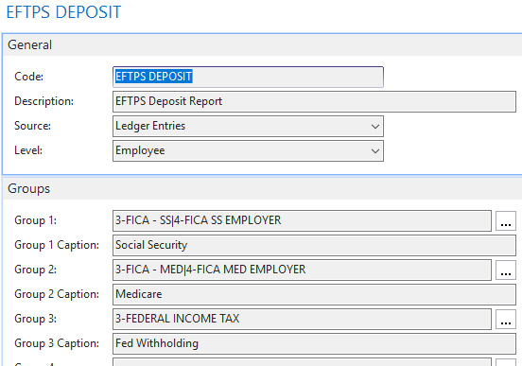
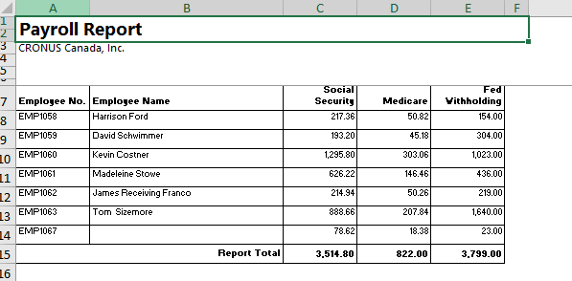
Custom Report Layouts: Select the Fields you want to include

Slide 11
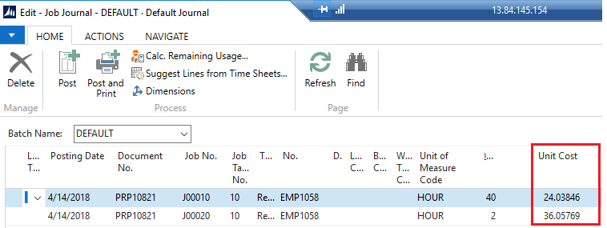
Transfer Payroll to Jobs Journal

Slide 12
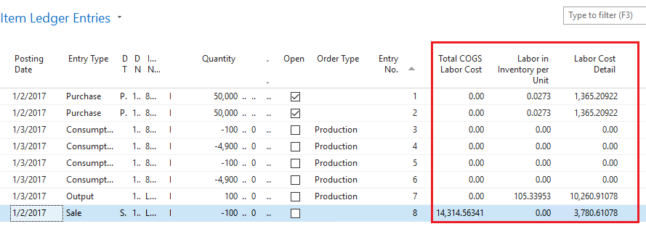
Labor Cost Detail in Item Ledger

Slide 13
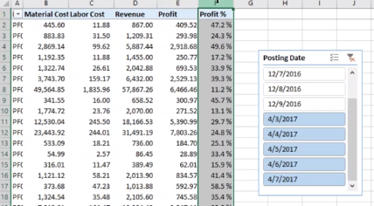
Leverage Power BI Reports

Slide 14
Post 1000 payroll documents every 2 minutes: it took us only 50 seconds to process 400 employees

Slide 15
Thank You

