Slide 2
Agenda
Primo Payday / NAV Payroll Value Proposition
Feature Overview
Resources
HR Functions
Painless Payday Premium
Live Demo

Slide 3
Primo Payday / NAV Payroll Value Proposition
Built in C/AL code
Fully integrated with D365 BC
Payroll posts directly to GL and Vendor Ledger
Primo Payday Pricing Similar to Quickbooks
Utilize Dimensions
Automated Setup Process via Wizards
Automated Tax Table Updates for US and Canada
Online Manuals with ‘Key Word Search’
Can Outsource Federal / State tax and doc filing
Painless Payday Premium

Slide 4
Payroll Posts Directly to Ledger

Slide 5
Payroll Ledger Entries – GL / Vendor Ledger

Slide 6
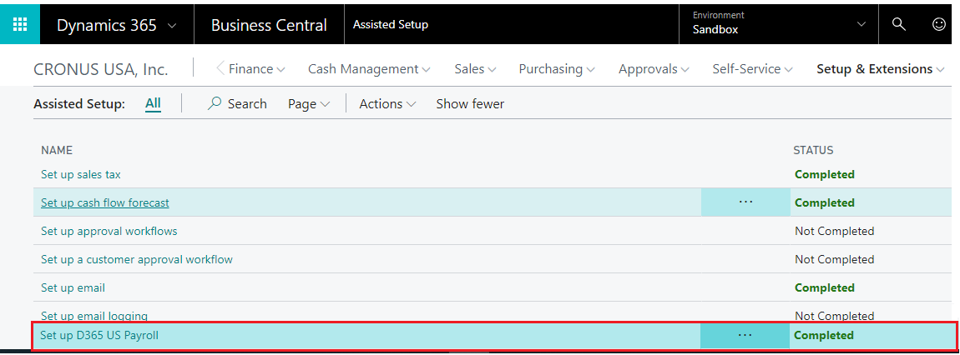
Assisted Setup Wizard

Slide 7
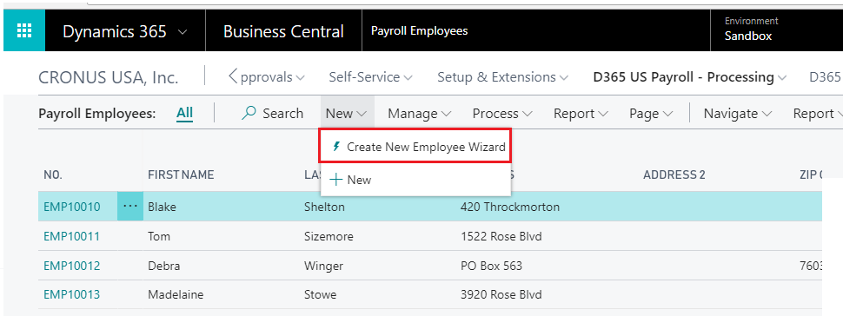
Employee Setup Wizard

Slide 8
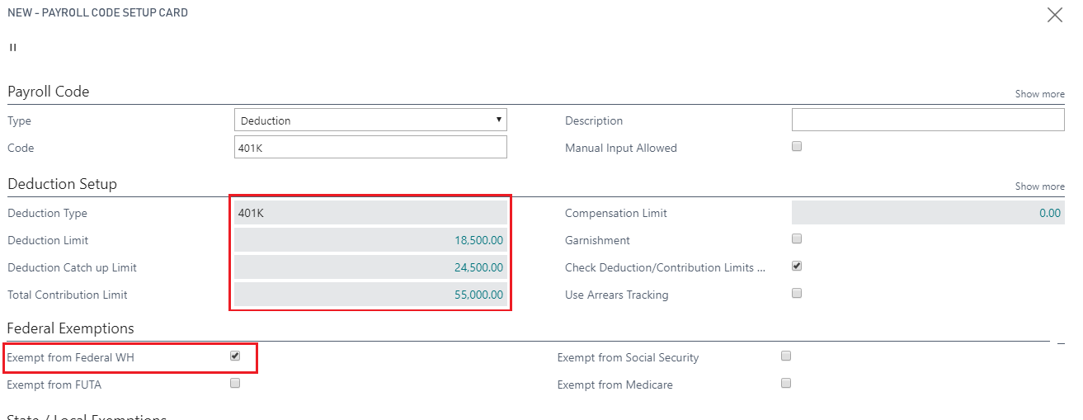
Deduction Setup Wizards

Slide 9
Training Resources
www.navpayroll.com
-online manuals
www.primopayday.com
-training videos

Slide 10
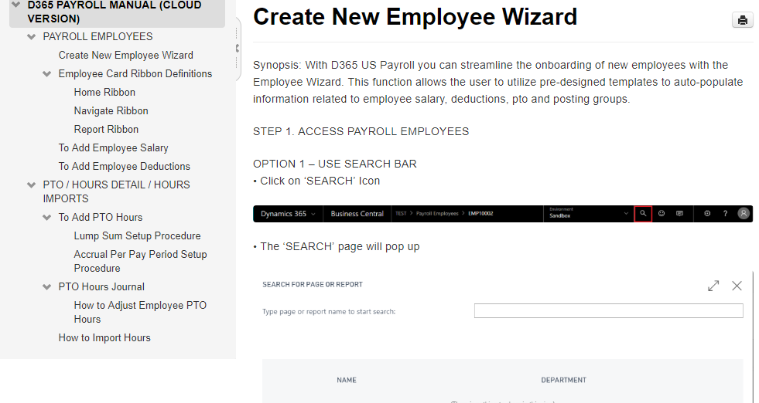
Online & Print Manuals

Slide 11
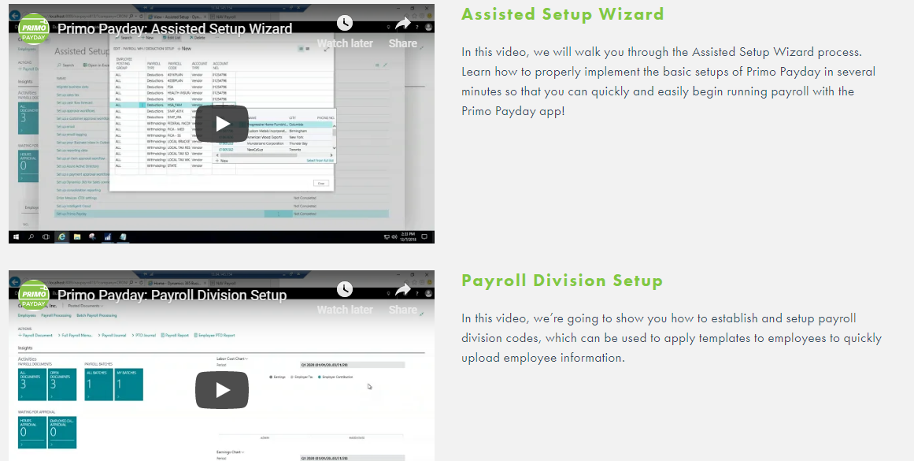
Training Videos

Slide 12
HR Features
Applicant Tracking

Slide 13
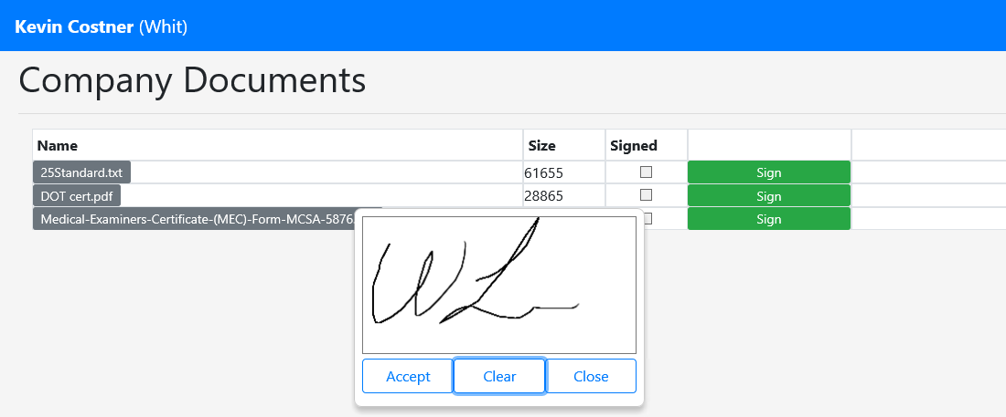
HR Features
Updated Employee Portal
Open Enrollment
E-Signing of Documents

Slide 14
Painless Payday Premium
The customer runs payroll and we handle everything else:
Federal, State & Local Tax Remittance
Federal, State & Local document E-Filing
W-2, W-3, 940 and 941
Cost:
$2,000 per year per state
$1,000 per year per locality
$50 per year per employee

