Slide 1
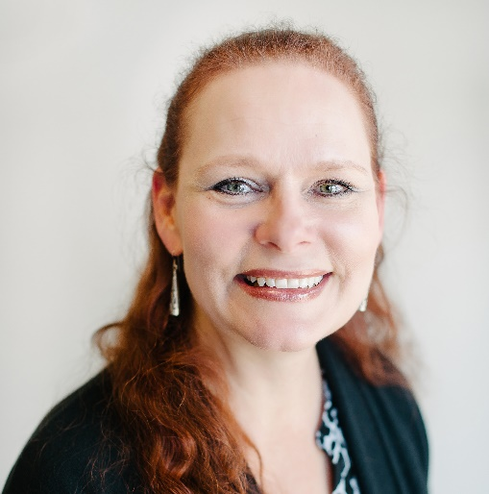
Reserved for Intro Picture
Please contact Tim for Assistance
Marlene Mankin
Application Consultant
mmankin@innovia.com
Picture
Notes:
Welcome to ‘Using ClickLearn to create customized NAV training videos & documentation. My name is Marlene Mankin, I have been with Innovia for almost 4 years. I will be your guide today as we move through what ClickLearn is and how it can help your Business.

Slide 2
What is ClickLearn?
ClickLearn is a Knowledge capturing tool that helps you turn any task in your business into a full set of learning materials.
Notes:
We can define ClickLearn as a capturing tool that helps turn any task in your business into a full set of learning materials.
Today we will go through
ClickLearn features,
some best practices
and a short demo with a peak into a what an E-Learning portal could look like through clicklearn.
Has anyone heard of ClickLearn before?

Slide 3
What can ClickLearn do for you?
Written Material
Training Documentation
PDF Documentation
PowerPoint slides
E-Learning Portal
On-Screen Assistant
Easy to maintain
Video Guides
Notes:
ClickLearn will create Training Documentation, PDFs and PowerPoint slides
There is an On-Screen Assistant
the assistant comes out onto the screen to walks you through a task or process
It is easily maintained
Once you create the documentation - if you change a process in NAV you record the change and replace or merge into the existing recording
After producing your recording it creates Video Guides
ShowMe, TryMe & TestMe –
We’ll go through these in more detail later when we look at the E-Learning portal

Slide 4
ClickLearn (cont.)
Update to newer versions of Dynamics NAV
Record/document in multiple languages
On-Screen Assistant can be merged into NAV’s help
Publish to SharePoint, a Web Site, etc.
Notes:
Material easily updated with new versions of Dyn NAV and into multiple languages
ClickLearn allows you to ‘Convert’ an old version of documentation into a newer version through a NAV Converter. It updates screen shots, etc.
Option to record in multiple languages and will allow you to take an existing recording and translate to another language. Does anyone what to guess how many languages?
ClickLearn has 45 languages set up and has a total of 60 built into their templates.
http://www.clicklearn.dk/voicecloud
And in the future - they are plan on utilizing a new feature from Amazon that pauses and emphasizes the words in a sentence call Polly.
On-Screen Assistant can be merged into NAV’s help
Your users would be able to go to the ?help on NAV
You can Publish to SharePoint, a Web Site, etc. and make available via iPad, iPhone, etc.

Slide 5
Best Practices
Identify Key processes with each department
Outline the recordings needed to be performed
What questions to ask to help to decide what to record?
What would a new employee require in terms of training?
Are there infrequently performed operations (monthly, yearly, etc.)?
Processes within/across departments that need training?
Should you break up the processes into sub-processes to give the best result for the user?
Notes:
1. Identify Key processes with each department
Outline the recordings needed to be performed
* Maybe how to add a new customer, or how to enter a vendor – you can even add notes that can inform the employee on when to make ‘tax exempt’ etc.
What questions to ask to help to decide what to record?
What would a new employee require in terms of training?
* Is there training all new users need to go through? how to login, processes like Vendors and Customers (maybe customers are only added from a Contact and then created) Can anyone think of any others?
Are there infrequently performed operations (monthly, yearly, etc.)?
* Month-end process or year-end process? Any others? Maybe physical inventory
Processes within or across departments that need training?
A returned item, Sales order (Sales, Accounting, Warehouse & Shipping)
Should you break some processes into sub-processes to give the best result for the user?
* For instance, you do not want the recording or document to be so long that no one wants to use it. If you break them up into smaller chunks, it makes it easier for the user can look up specific tasks rather than a large book or video like, how to enter the vendor, how to set up discounts, how to enter a purchase invoice, how to pay the vendor, etc. Does this make sense?

Slide 6
Best Practices (cont.)
Decide on e-Learning Portal structure
Examples:
By Roles
By Departments
Decide on Structure Standards
Create standard layouts for documents and recordings
Shelf, Book & Recordings
Notes:
Decide on e-Learning Portal structure
Examples:
By Roles
Sales Rep, Accounts Payable Clerk, Purchaser, etc.
By Departments
Sales, Accounting, Purchasing, etc.
Note: recordings can be in multiple books
Decide on Structure Standards
Create standard layouts for documents and recordings – for Consistency
Shelf, Book & Recordings – Next slides chart will explain visually

Slide 7
Let’s look at ClickLearn
Notes:
Let’s look at ClickLearn.
Escape – to reviel Clicklearn.
We will go through a simple recording so that you can get an idea of how it’s created. Then later we will look at an E-Learning Portal I have built so that you can visualize how an E-Learning Portal would work for your company.
Open NAV – Role Center Home - Cronus
Open ClickLearn Studio
Make sure NAV is open and at the Role Center page
Open Click Learn
Record
Select NAV Platform – double click
English
Warning to tell you to wait for the Green and to do Ctrl +Ctrl to end the recording
Show error if you do not wait for the Green Box – up one screen
Click to next screen

Slide 8
Notes:
Show error you get when you do not wait for the Green box.

Slide 9
ClickLearn Recording
Notes:
New recording
Edit
Delete & other options with Right click on line
Group lines together
Double clck on line – turn instruction off
Can add notes etc
Tell them next would be the Replay. The Replay will stop with errors – when you have no errors you can then Produce
Show Error – Next Screen.

Slide 10
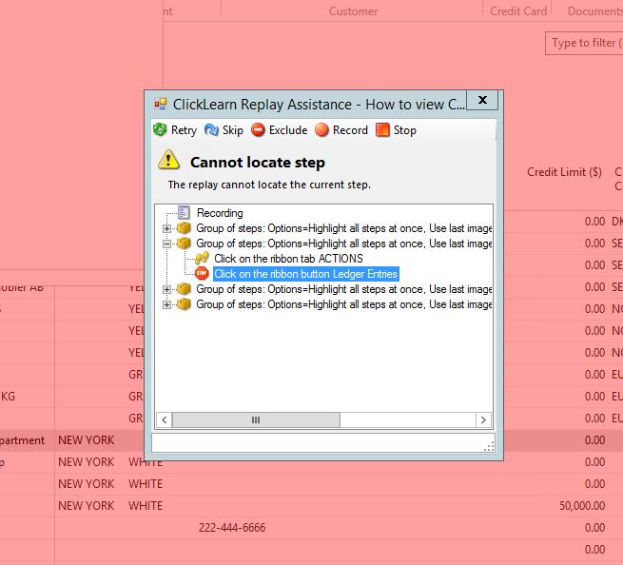
Notes:
Replay (to look for errors) then Produce
Explain the error

Slide 11
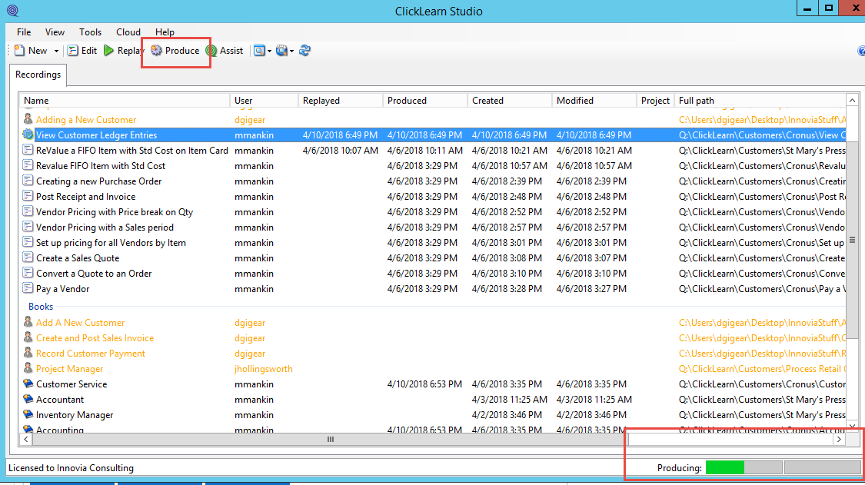
Notes:
Make sure NAV Is back to the main Role Center
Once you have Produced the recording – you will see it has created some documents
Show the premade one View
Show Assist
Customer > Cronus
View Customer Ledger Entries. in the folder

Slide 12
E-Learning Portal Structure
Shelf
(E-Learning Portal)
Book
(Role or Department)
Recording 1
Recording 2
Book
(Role or Department)
Recording 3
Notes:
The E-Learning Portal Is structured with Recordings, Books and Shelf.
An easy way to remember the structure is - You have your RECORDINGS and they get inserted into your BOOKS and the books are placed on the SHELF
Show Books and Shelf – how recordings are added.
Show Structure in CLICKLEARN

Slide 13
E-Learning Portal Example
Notes:
Stored on the Q:drive
Show the premade one View
Show Assist
Customer > Cronus
.View Customer Ledger Entries. in the folder
Let’s look at one I have been working on as an example.
Show Me
The program makes the entries and shows you how to do something
Try Me
Interactive with the program – Show this one – click learn walks you through as you are clicking
Test Me
Interactive without boxes – it tells you but does not show were to clicl
PDF- Show this one
Word doc (opened at the bottom of the page)
Power Point

Slide 14
Any Questions?

Slide 15
Thank You for Attending!
Notes:
I want to thank you for joining us today!

