Slide 1
Jet Reports & Power BI
Presented by Jet Reports
Tristan Threlkeld, NAV Channel Manager | Jet Reports
tristant@jetreports.com

Slide 2
ABOUT JET REPORTS
Jet Reports delivers unparalleled access to data through fast and flexible reporting and business analytics solutions that are cost effective, provide rapid time-to-value, and are built specifically for the needs of Microsoft ERP users.
11,000 Companies in 94 countries use Jet Reports
everyday for their financial reporting.
Founded in 2002

Slide 3
LOCATIONS
Headquartered in Portland, OR
With distribution offices in 14 countries around the globe

Slide 4
OVER 10,000 COMPANIES IN 94 COUNTRIES
“Since implementing Jet Reports, our company has seen revenue growth of over 32 percent.”
– Mat Ealy, Kinsey Archery

Slide 5
WHAT IS JET PROFESSIONAL?
A fast, flexible financial and business
reporting solution inside of Excel.
Allows Microsoft Dynamics ERP users to get all the operational data
they need.
Eliminate errors by accessing and pulling all your data directly in Excel.
Cut the cost of hard-coding and programming reports to zero.
No more copying, pasting or manually exporting.

Slide 6
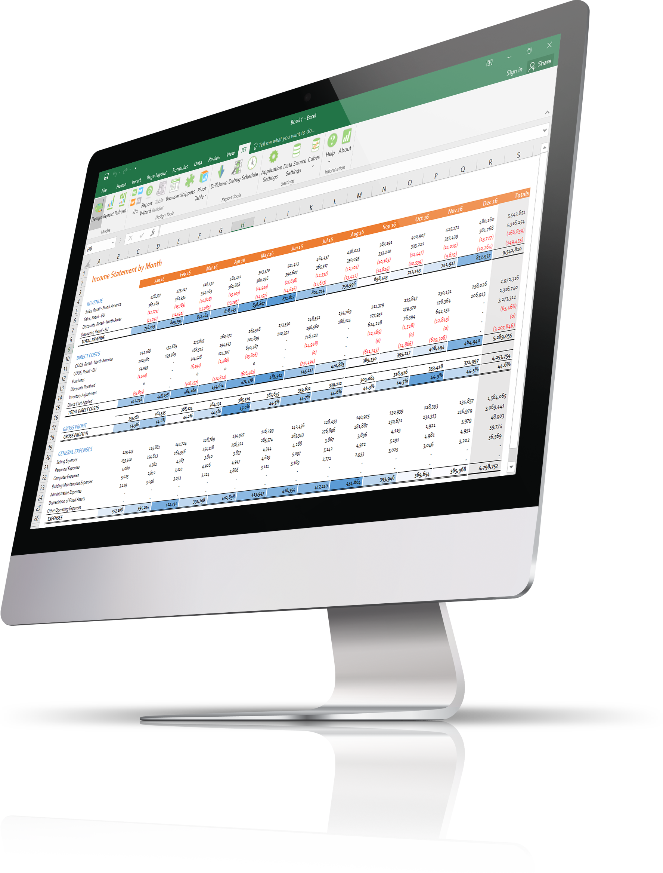
Drill down on the numbers directly from Excel.
Access reports from anywhere on the web.
Complete report management, collaboration, and publishing platform.
Never second guess if you are looking at the right
data or workbook.

Slide 7
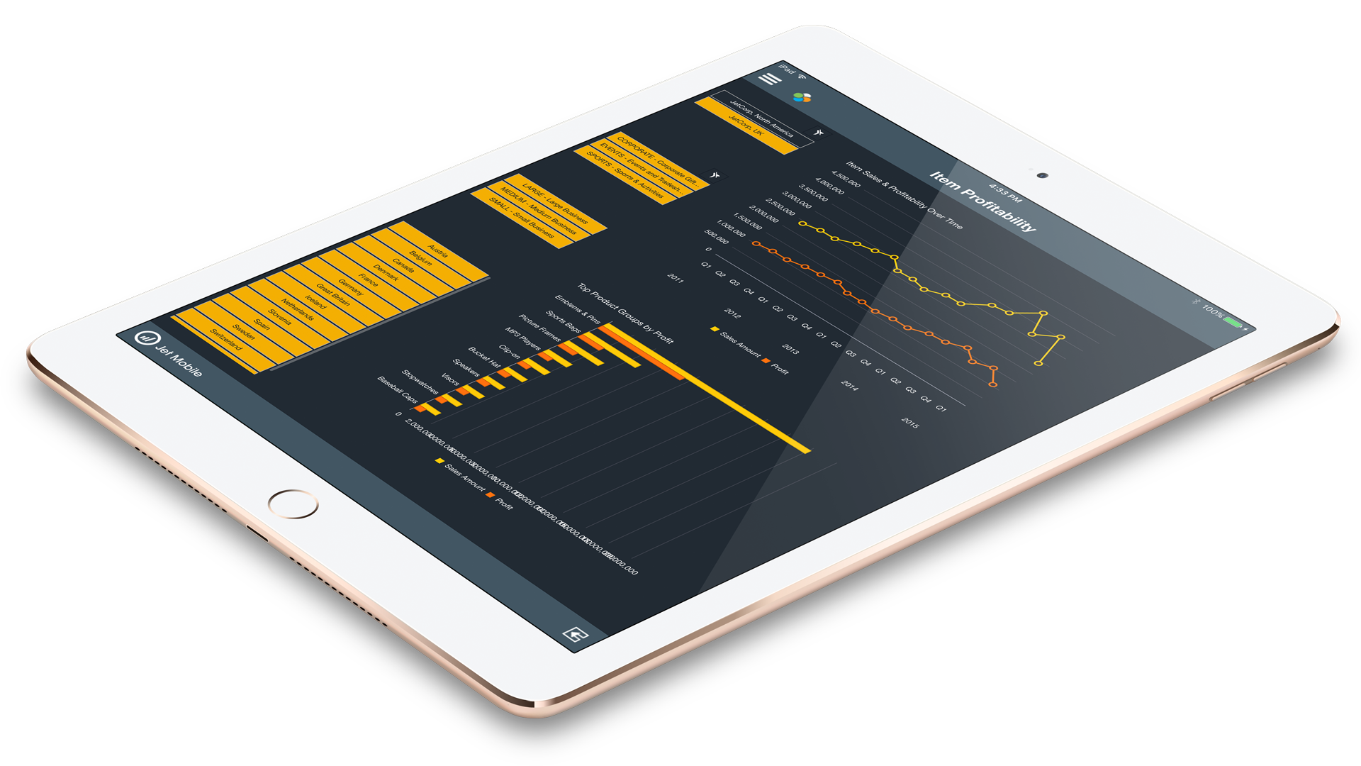
WHAT IS JET ENTERPRISE?
A corporate analytics and reporting platform delivering fast,
flexible dashboards and financial reports in Excel and on the web.
Eliminates any need to understand the underlying data structure when viewing data inside Excel or Microsoft Power BI.
Provides accurate, governed data for one version of the truth.
Rapid time-to-value through turnkey installation in hours, not weeks or months.
Pre-built cubes, data warehouse, and dashboards.
Low cost of ownership – includes unlimited users and a drag-and-drop customization platform.

Slide 8
WHAT IS BUSINESS INTELLIGENCE?
DATA
SOURCES
ETL
PROCESS
DATA
WAREHOUSE
BUSINESS INTELLIGENCE
ERP
DATA WAREHOUSE
CUBE
Data optimized for entry
Data optimized for reporting
Data organized for top level analysis by role
Jet Enterprise

Slide 9
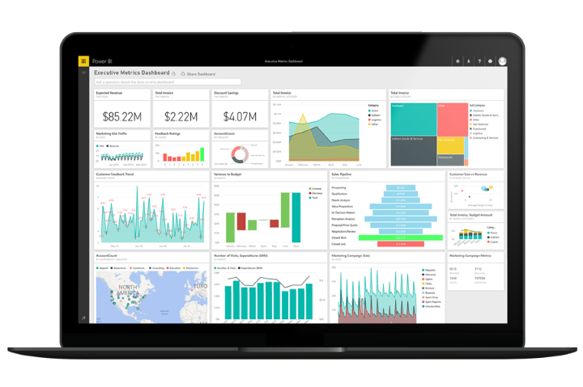
WHAT POWER BI IS
Power BI is a suite of business analytics tools to analyze data and share insights on the web.
Excellent data visualization tool with the ability for users to access dashboards from the web or their mobile device
Embedded visualizations inside of corporate applications
Gateways to access on premise data directly from the cloud
Low cost of ownership – licensing is $10 per user per month

Slide 10
WHAT POWER BI IS NOT
Power BI is not an end-to-end solution when left solely in the hands of the average business user
A data modeling background is necessary unless you already have all of your data in ONE streamlined data source such as a data warehouse or Analysis Services database
Delegation of security, user access, and setting up the gateways requires ongoing IT involvement
Many people think that Power BI is free (there is a limited free version) but the paid version is typically needed for all users in a corporate environment

Slide 11
THE BEST OF BOTH WORLDS
Power BI front-end combined with a prebuilt back-end maximizes usability and value of Power BI
Little to no knowledge of ERP tables/fields required by Power BI users when using the data warehouse and cubes
Security and access to underlying data can be controlled centrally through many BI Tools
Connecting to a data warehouse and cubes enables publishing of corporate dashboards with Power BI from Day 1
Allows users to create both board-level financial statements as well as dashboards, not one or the other.

Slide 12
THANK YOU
Tristan Threlkeld, NAV Channel Manager | Jet Reports
tristant@jetreports.com

