Slide 1
Take Your Business to a Higher Altitude with Reporting, Analytics and Budgeting from Jet Global
With Channel Manager Aaron Straughan

Slide 2
Agenda
Who is Jet Global?
Rebranding from Jet Reports
Product Suite Overview
Jet Analytics – ‘Fast Analysis without Technical Expertise’
Jet Budgets – ‘Transform your Budgeting Experience’
New Feature Preview

Slide 3
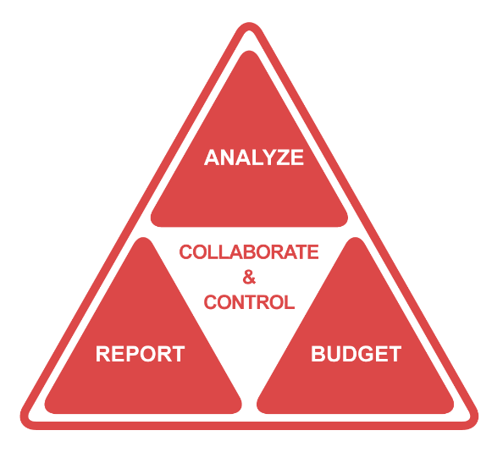
Welcome To…
A Data Revolution for Microsoft Dynamics Customers and Partners all Over the World
Delivering total data access and control through a complete suite of integrated products so you can make decisions at the speed of business, without the need for bottlenecked technical resources, or data expertise.

Slide 4
OVER 10,000 COMPANIES IN 94 COUNTRIES
Since implementing Jet Reports, our company has seen revenue growth of over 32 percent.
– Mat Ealy, Kinsey Archery

Slide 5
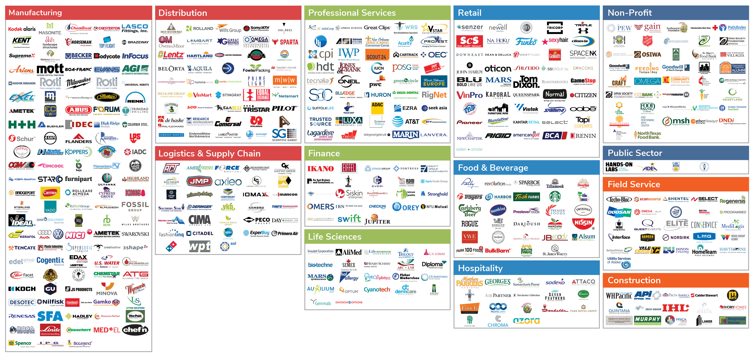
Our Top 500 Customers

Slide 6
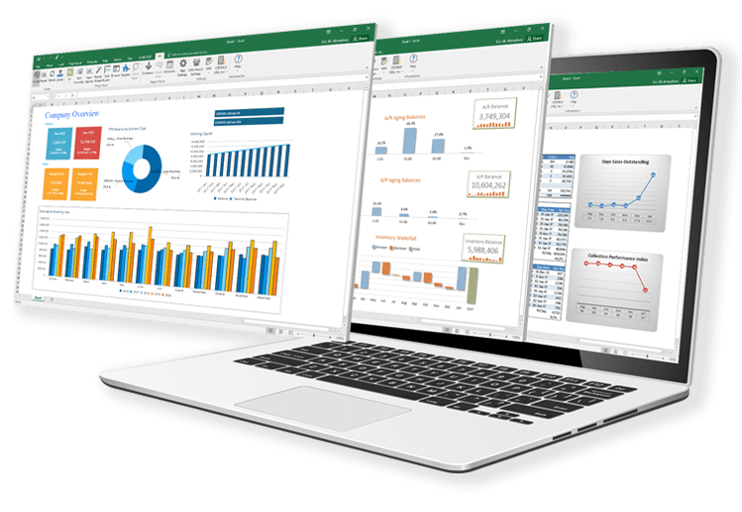
What is Jet Reports?
Advanced operational and financial reporting inside of Excel.
Get all the operational data you need from Microsoft Dynamics, in the format you want.
Report portability forever – automatically move from one version of Dynamics to the next.
Eliminate errors by accessing and pulling all your data directly in Excel.
No more copying and pasting, or manually exporting.
Cut the cost of hard-coding and programming reports to zero.

Slide 7
What is Jet Analytics?
A corporate analytics and reporting platform delivering fast, flexible dashboards and financial reports in Excel and on the web.
Eliminates any need to understand the underlying data structure when viewing data inside Excel or Microsoft Power BI.
Provides accurate, governed data for one version of the truth.
Rapid time-to-value through turnkey installation in hours, not weeks or months.
Pre-built cubes, data warehouse, and dashboards.
Low cost of ownership – includes unlimited users and a drag-and-drop customization platform.

Slide 8
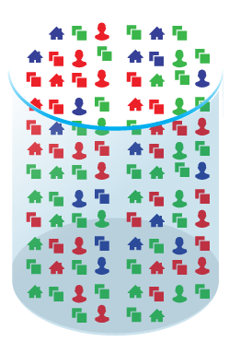
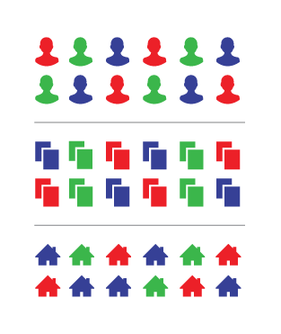
Raw Data
Optimized Data
DATABASE (S)
DATA WAREHOUSE
BI CUBES
1,300+ tables
22,500+ fields
Complex data model
Relevant data only
Organized by subject
Multiple sources
Dimensionality
Calculation
Speed
Reporting
Business Intelligence

Slide 9
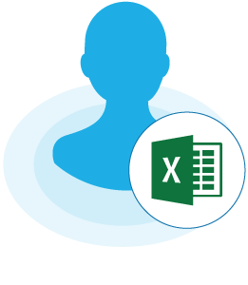
Legacy Database
CRM Database
Jet Analysis Services
Dynamics Database
Jet Data Manager
Jet Data Warehouse
Database
Jet Excel Add-In
Jet Staging Database
Power BI
User
Office 365
Excel Online

Slide 10
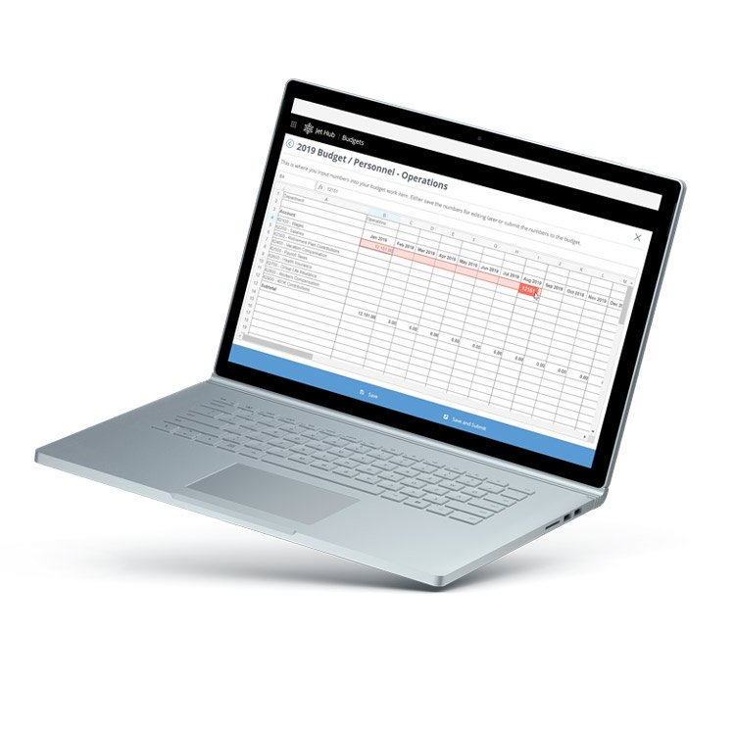
What is Budgets?
A simple, adaptable, and easy-to-use fiscal planning solution to control the budgeting process.
Eliminate manually created, inconsistent spreadsheets that are impossible to reconcile.
Never cut and paste, or fear you have the wrong version.
Keep the budget process on track with scheduled, automated assignments and status visibility.
Web-based, centralized workflow.
Instant integration to Dynamics to import approved numbers.

Slide 11
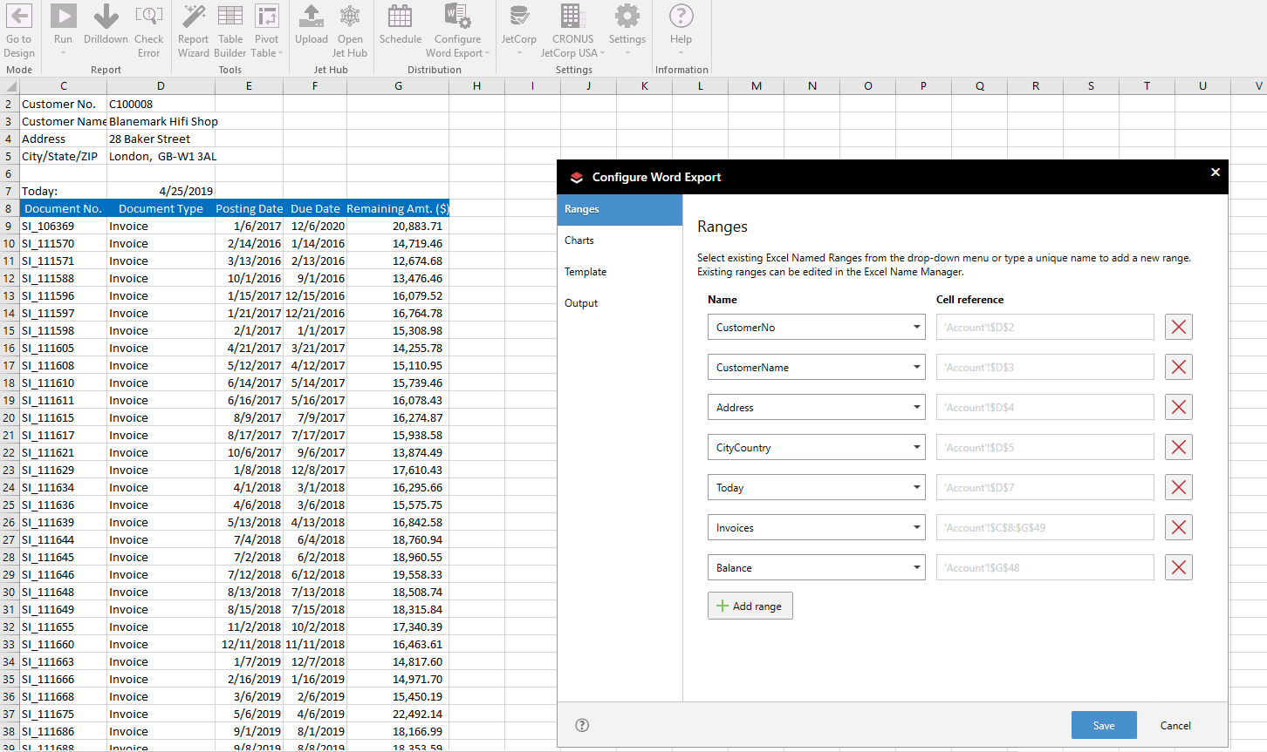
New Product Feature Preview
Export to Word Functionality

Slide 12
Thank You
WWW.JETGLOBAL.COM
2175 NW Raleigh St. Portland, Oregon 97210 USA
+1 503 608 3602
sales.us@jetglobal.com

