Slide 1
Reserved for Intro Picture
What’s NEW in NAV 2018
Please contact Tim for Assistance
Tom Doran
Customer Engagement Director
tdoran@Innovia.com
Jeff Pergolski
Customer Engagement
jpergolski@Innovia.com
Picture
Picture

Slide 2
Announcing Microsoft Dynamics NAV 2018
As we continue to execute on our Dynamics 365 product strategy, we realize smaller businesses sometimes prefer an end-to-end business management solution, instead of an application for each individual line of business within their organization.
We’re executing on that commitment by expanding Dynamics 365 for Finance and Operations, Business Edition to include the full breadth of Dynamics NAV. This next generation solution will be available to the market in the first half of 2018.
1. A Microsoft Dynamics 365 cloud application, which enables partners participating in the Cloud Solution Provider (CSP) Program to deliver an end-to-end cloud business management solution to their small and mid-sized customers – across key business functions, including sales, financial management, project management, and operations
2. A business application platform for ISVs, which enables Microsoft ISV Cloud Embed program partners to build and offer vertical cloud solutions directly to customers.

Slide 3
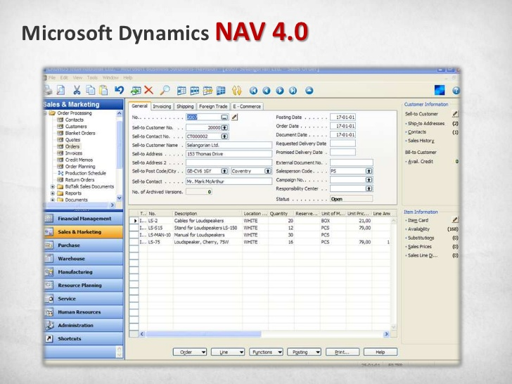

Slide 4
Dynamics 365 Business Management Cloud Solution Roadmap
TODAY
Fall 2017
Spring 2018
Ongoing
Dynamics 365 for Financials, Business edition
Dynamics 365 for
Financial and Operations, Business edition
Dynamics 365 for
Finance and Operations, Business edition
Dynamics 365 for x (Cloud)
Dynamics 365 for x (Cloud)
Dynamics 365 for x
(Project
”Tenerife”)
Dynamics NAV 2016
Dynamics NAV 2017
Dynamics NAV 2018
Dynamics NAV 2018 R2
Dynamics 365 for x
(On prem)
Notes:
<no speaker notes needed>

Slide 5
Setup & Extensions

Slide 6
Customer Benefits
A single place for settings
The new Setup & Extensions page provides a single place for accessing various setup and settings
Assisted setup
Commonly required configuration tasks have assisted setup (wizards), which aid in the process. All of these can now be accessed in one place
Manual setup
All detailed settings pages are available in the manual setup list
Sub lists allow for filtering to settings within an area, such as Finance or Inventory
The list entries have descriptions, an area and keywords, and all are searchable
Service connections and add-ons
Service connections, such as OCR, SMTP, currency exchange services, CRM connection etc can also be managed from the Setup & Extensions page
Finally, extensions are listed as well, to allow adding and configuring extensions.

Slide 7
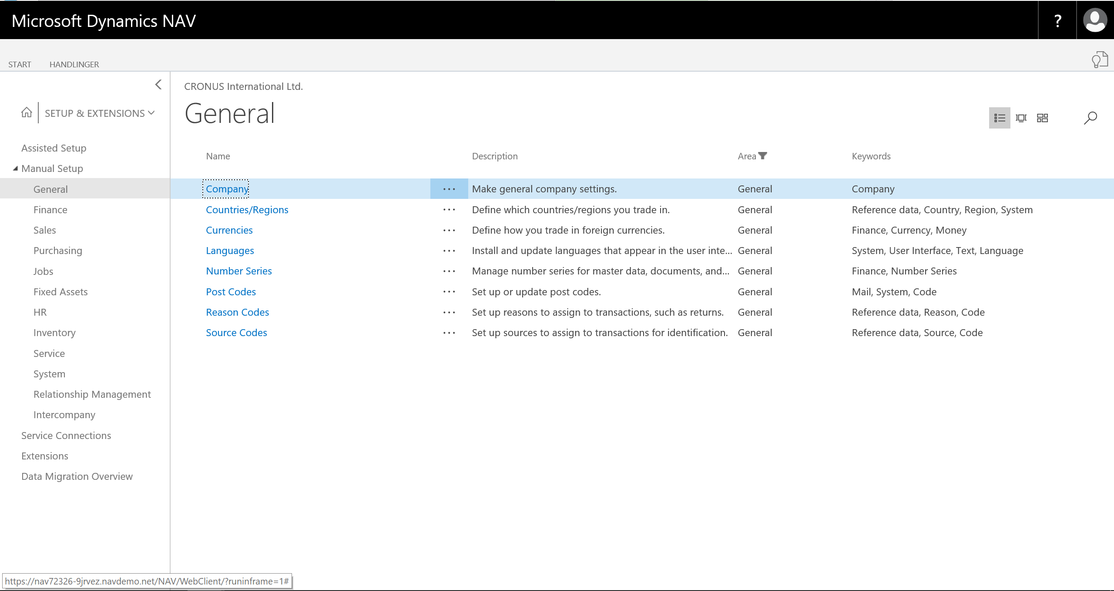
Setup & Extensions

Slide 8
User Tasks

Slide 9
Customer Benefits
User Task Setup
System wide tasks
Assign to any user
Track due date
Recurrence available
User Task Lists
Role Center
Pending User Task cue added to all roles
Utility
Bulk-delete completed user tasks

Slide 10
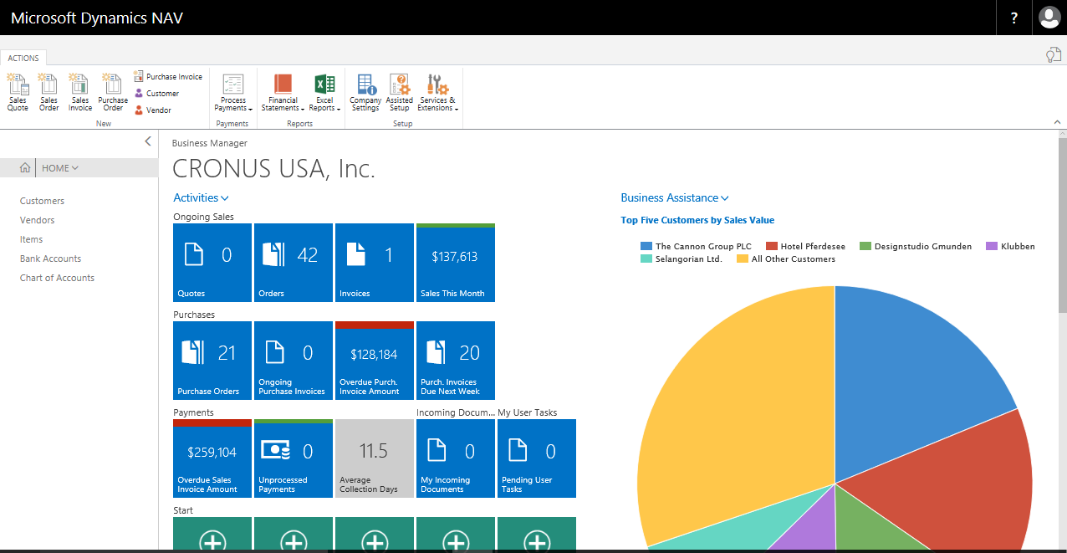
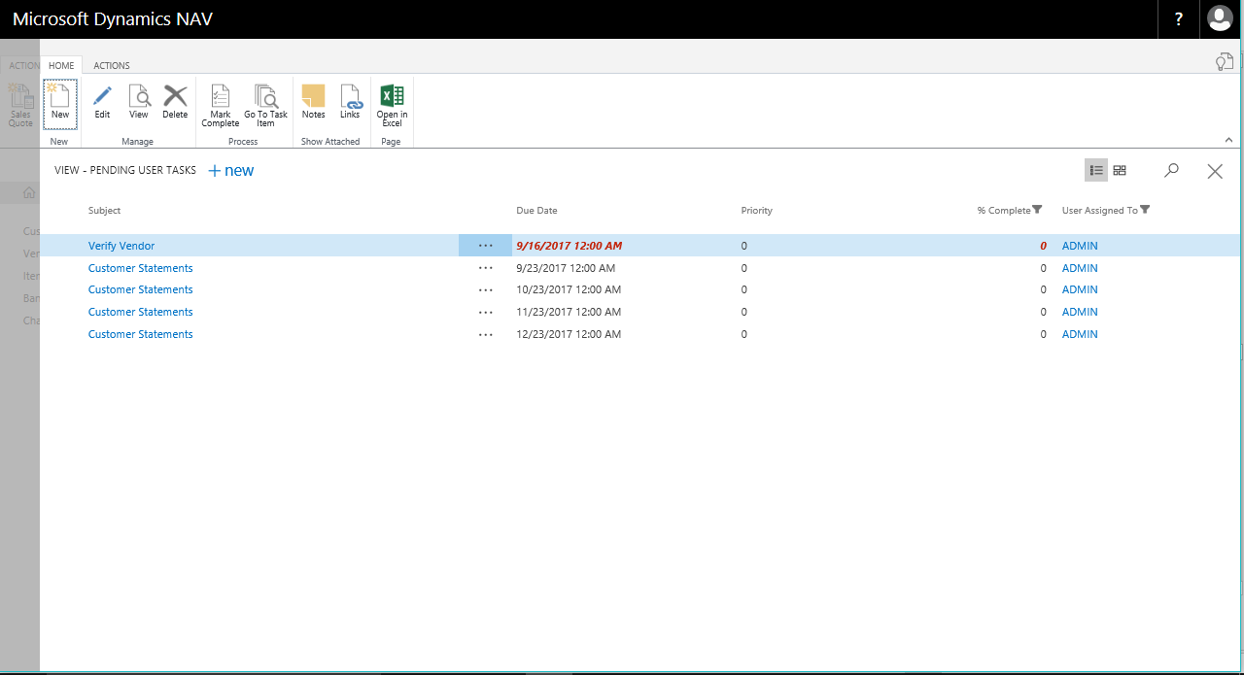
User Tasks

Slide 11
Employee ledger entries

Slide 12
Customer Benefits
Journal support
Create journal entries directly for employees. There is no longer a need to create vendors for employees.
You can decide whether to use balancing accounts or a separate total line in the journal
Only LCY supported
Employee posting group
Define the default posting group (account) used for an employee on the employee card
Payments
Make payments to the employee in Payments Journal
You can apply payments to open employee entries in one go, linking the payment to the employee journal entry and closing both
Correct mistakes with unapply payments
Payment suggestion
Like with vendors, get a list of all outstanding employee payments

Slide 13
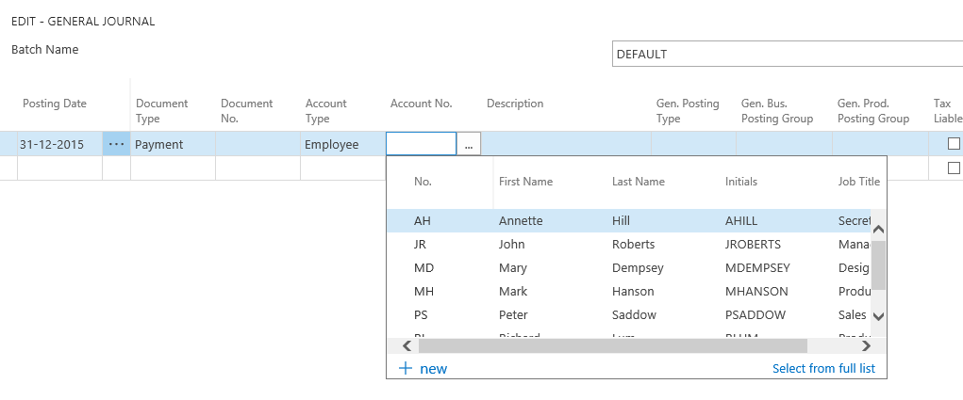
Employee ledger entries

Slide 14
Image Analyzer

Slide 15
Customer Benefits
Contact Persons
While attaching images to the contact card, automatically detect a person’s age and gender
Items
Identify attributes of an item from a picture including: type and color
Suggests attributes based tags

Slide 16
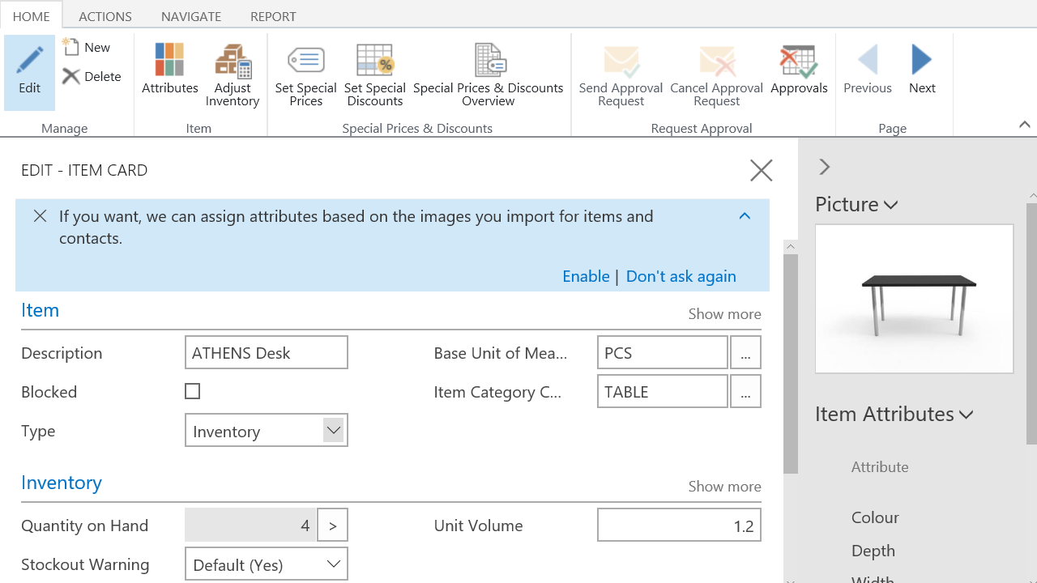
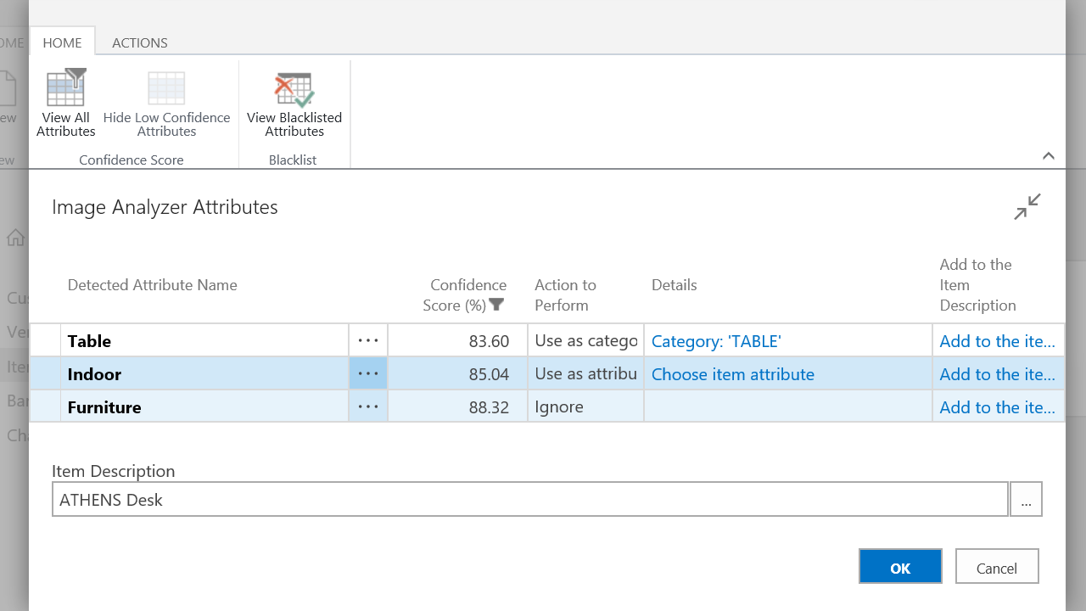
Image Analyzer

Slide 17
Dynamics 365 for Sales Integration

Slide 18
Customer Benefits
Assisted Setup
Synchronize your data across the two apps, including sales orders, item availability, units of measure, and currencies
Connection setup guide now includes coupling of salespersons to users of Dynamics 365 for Sales
Synchronization
run full synchronization when the connection has been set up. The synchronization runs in the background so that the user can continue working
Productivity
When creating sales or purchase documents, the default salesperson/purchaser code is specified for your user account.
set default chances of success in sales cycle stages in opportunity management
send a sales quote to a contact without having to create them as customers first.
Efficiency
Sales orders from Dynamics 365 for Sales with write-in products transferred to Dynamics NAV
Sales orders from Dynamics 365 Sales can be automatically converted to sales orders in NAV without manual intervention

Slide 19
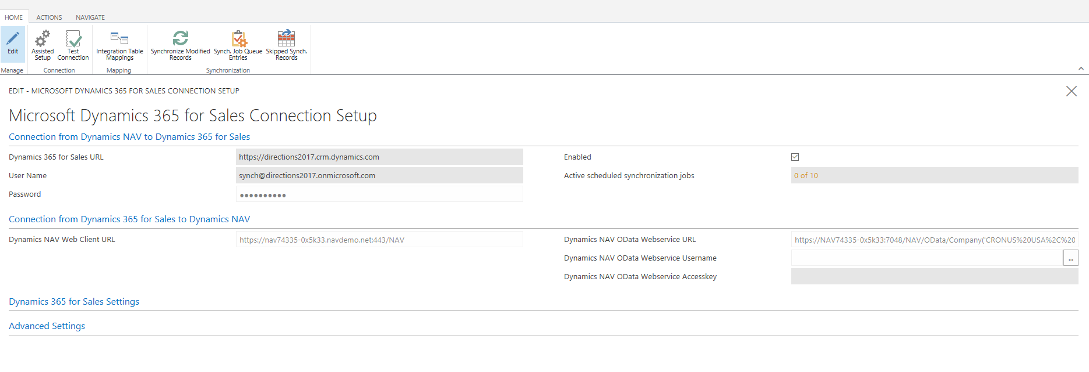
Dynamics 365 for Sales Integration

Slide 20
Sync vendors to OCR

Slide 21
Customer Benefits
Sync vendors
Get access to detailed vendor data in Lexmark ICS.
Whenever a new invoice is trained in Lexmark ICS, the proper vendor name can be assigned, ensuring naming consistency between the systems.
Improved OCR quality
Lexmark ICS can use the vendor names to better detect an invoice from a vendor the first time
Triggered on changes
Whenever a vendor is changed, it will update Lexmark ICS if sync is enabled
Control data share
Out of the box, sync is not enabled, so that nothing is sent without consent.
It must be enabled in the OCR Service Setup

Slide 22
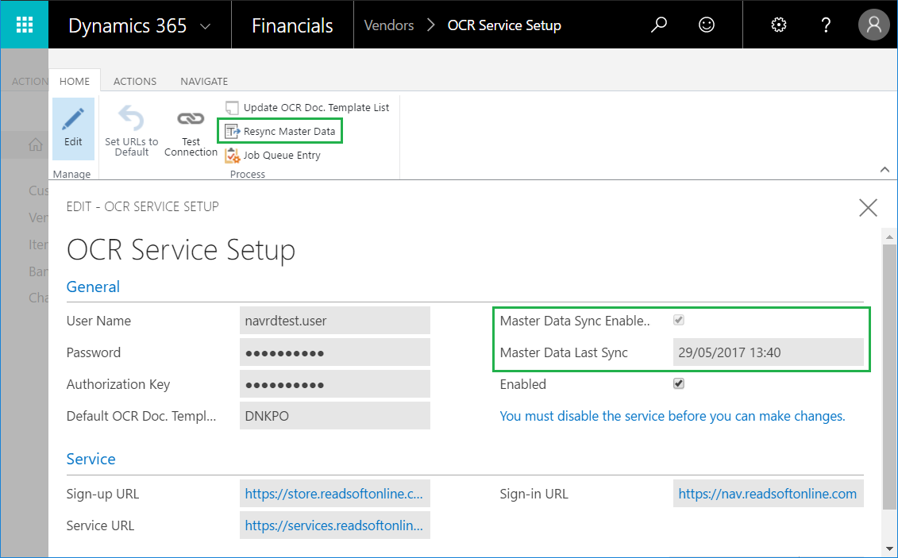
OCR setup

Slide 23
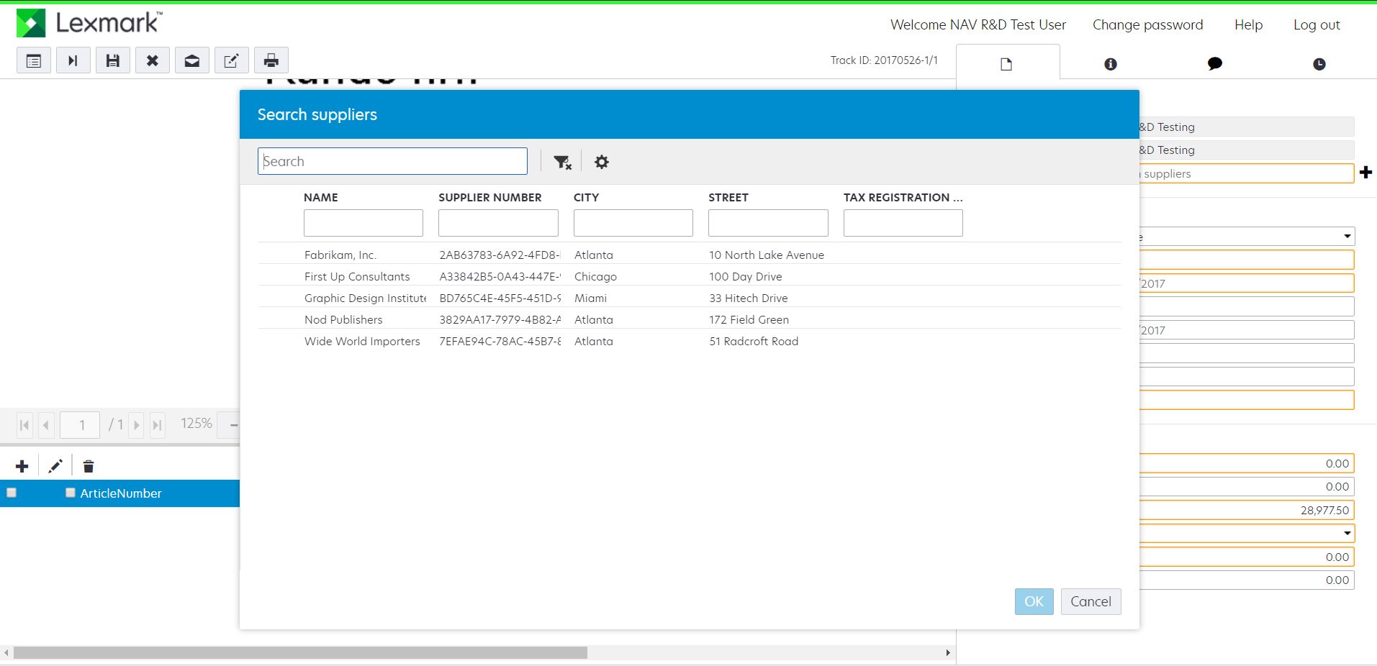
Kofax ICS vendor data

Slide 24
And there is more much more

Slide 25
Additional improvements
Item Charges – distribute by volume and weight
Direct Transfer orders. You no longer need to use an in-transit location.
Master data addresses for customers and vendors can be updated from sales and purchase documents
Show help search results along with in-product search
Intercompany: Automation of IC Outbox and IC Inbox
Bulk Invoicing – Select more
Posting Groups – Suggestion of accounts
Print G/L Register report with “Show details” options which will print descriptions form related posted document lines.
New reports: Received, Not Invoiced Purchase Orders and Shipped, not Invoiced Sales Orders
Check printing – 3 checks per page
Payroll import - QuickBooks

Slide 26
Microsoft Flow Embed Experience

Slide 27
Customer Benefits
Embedded
Offers pure embed experience – create, edit and manage your Flows from within Dynamics NAV
Connect
Connect using the Microsoft Dynamics NAV connector
Connect and monitor Dynamics NAV or ‘non’ Dynamics NAV data
Manage & Monitor
Easy to manage approvals
Monitor, notify and update data automatically
Environment
Select the Flow environment you want to work with

Slide 28
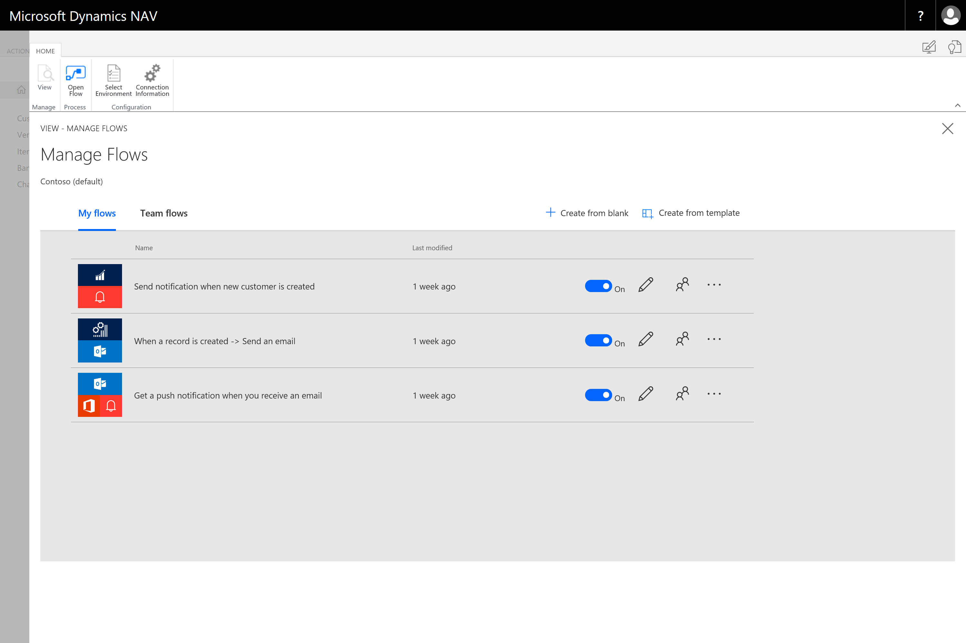
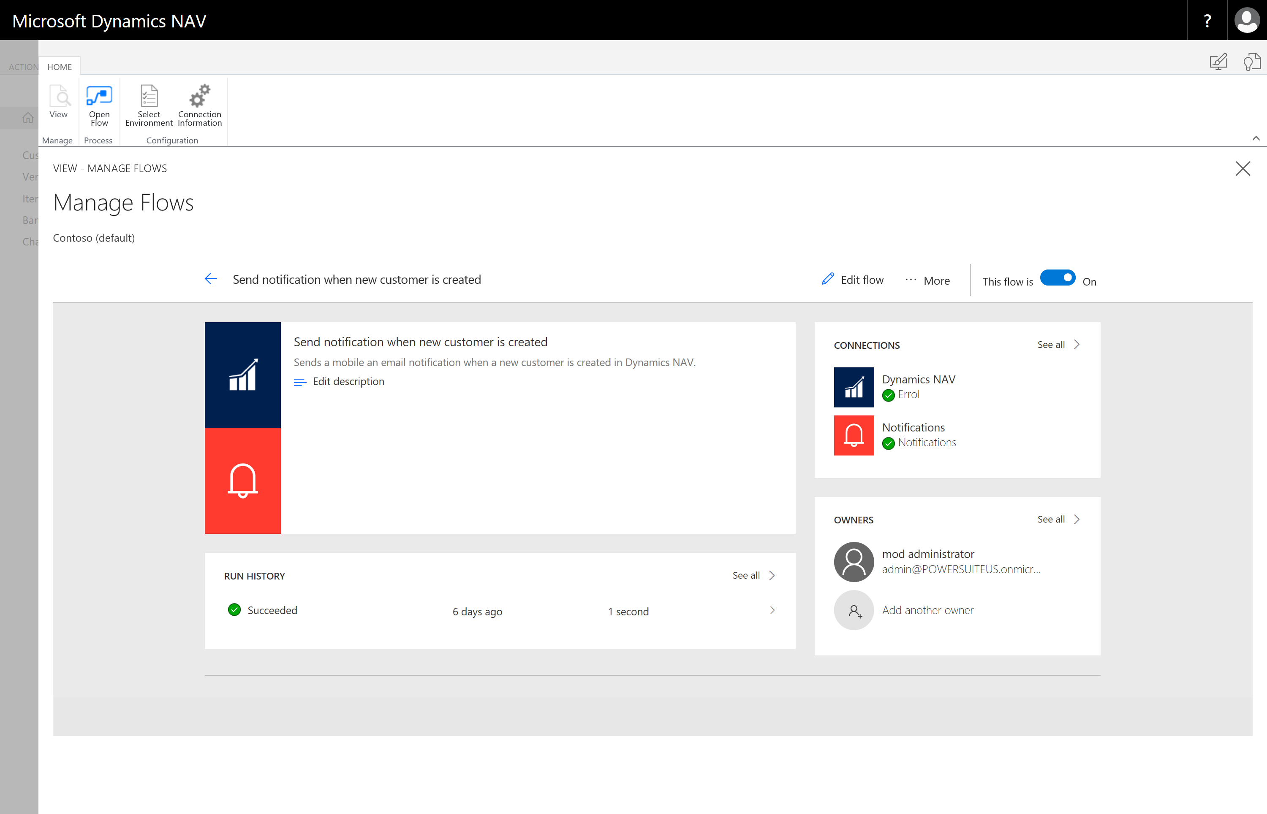
Microsoft Flow Embed Experience

Slide 29
Power BI Reporting

Slide 30
Customer Benefits
Discoverability
With the new Power BI reporting control, you can gain awareness of your Power BI reports by making them visible from within the most highly-used lists in reports by simply selecting Dynamics NAV
interact and filter the records from the associated list page
Contact Packs
Updated content packs for NAV 2018 to support latest Power BI functionality
Direct navigation to Power BI content packs available within your organization
Direct navigation to Power BI content packs available to the general public
Easy Setup
All necessary connection information available in a single page
Updated Connector
New Microsoft Dynamics NAV Power BI connector

Slide 31
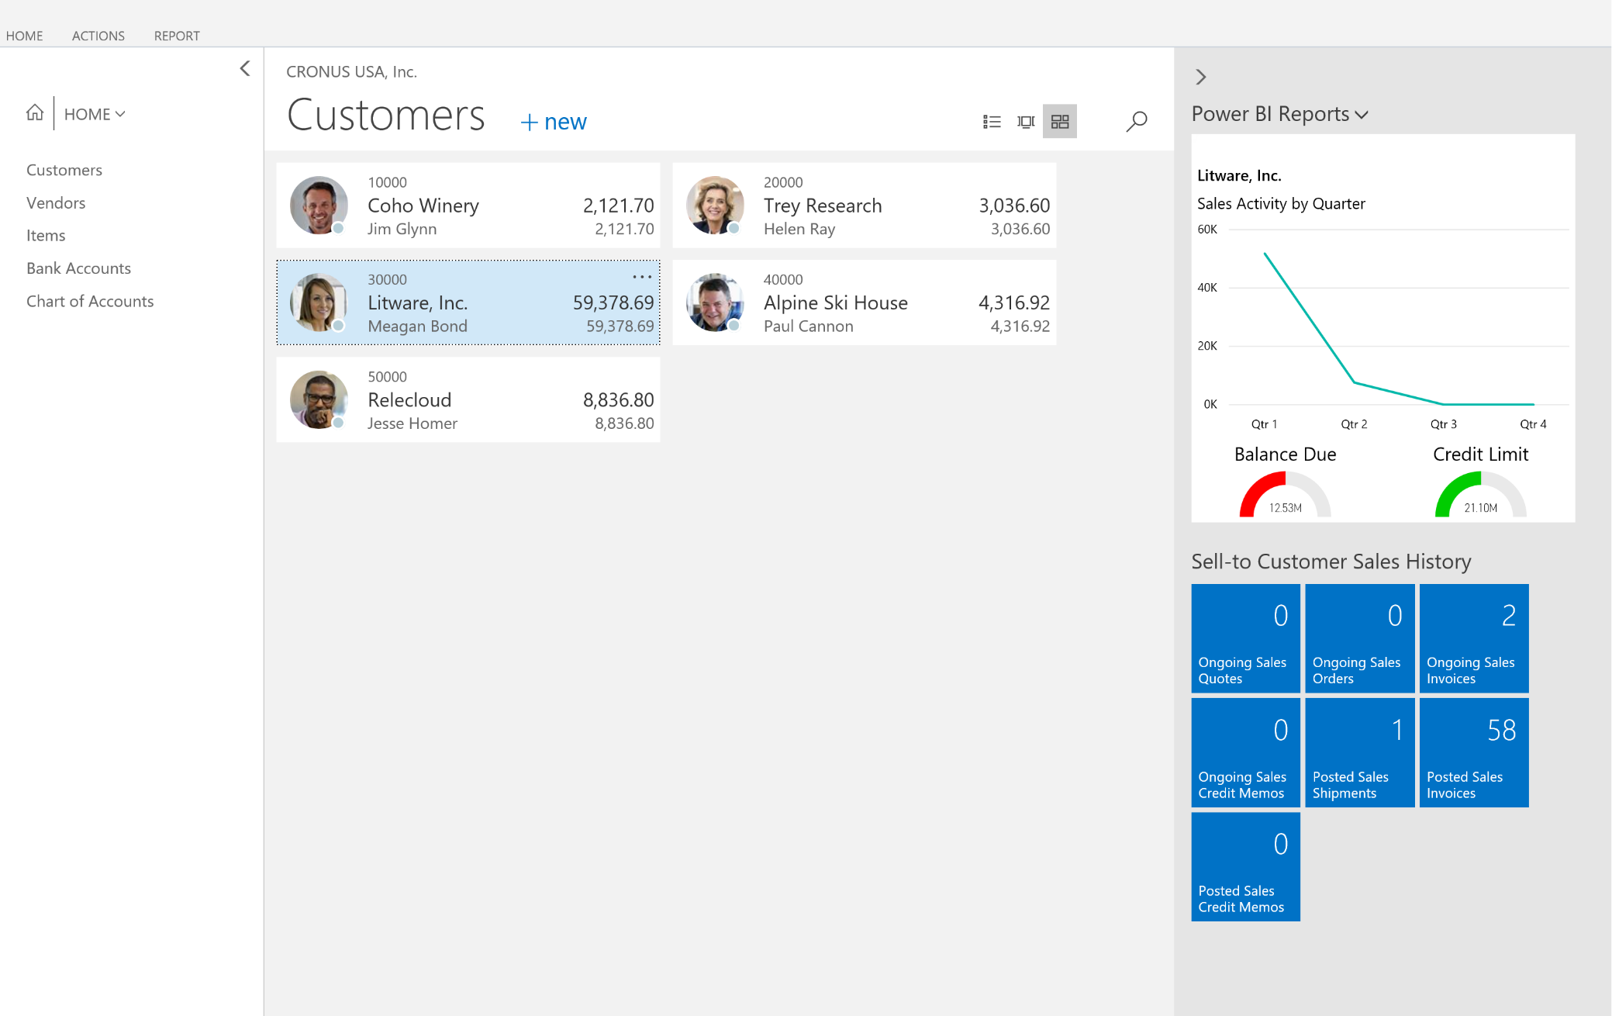
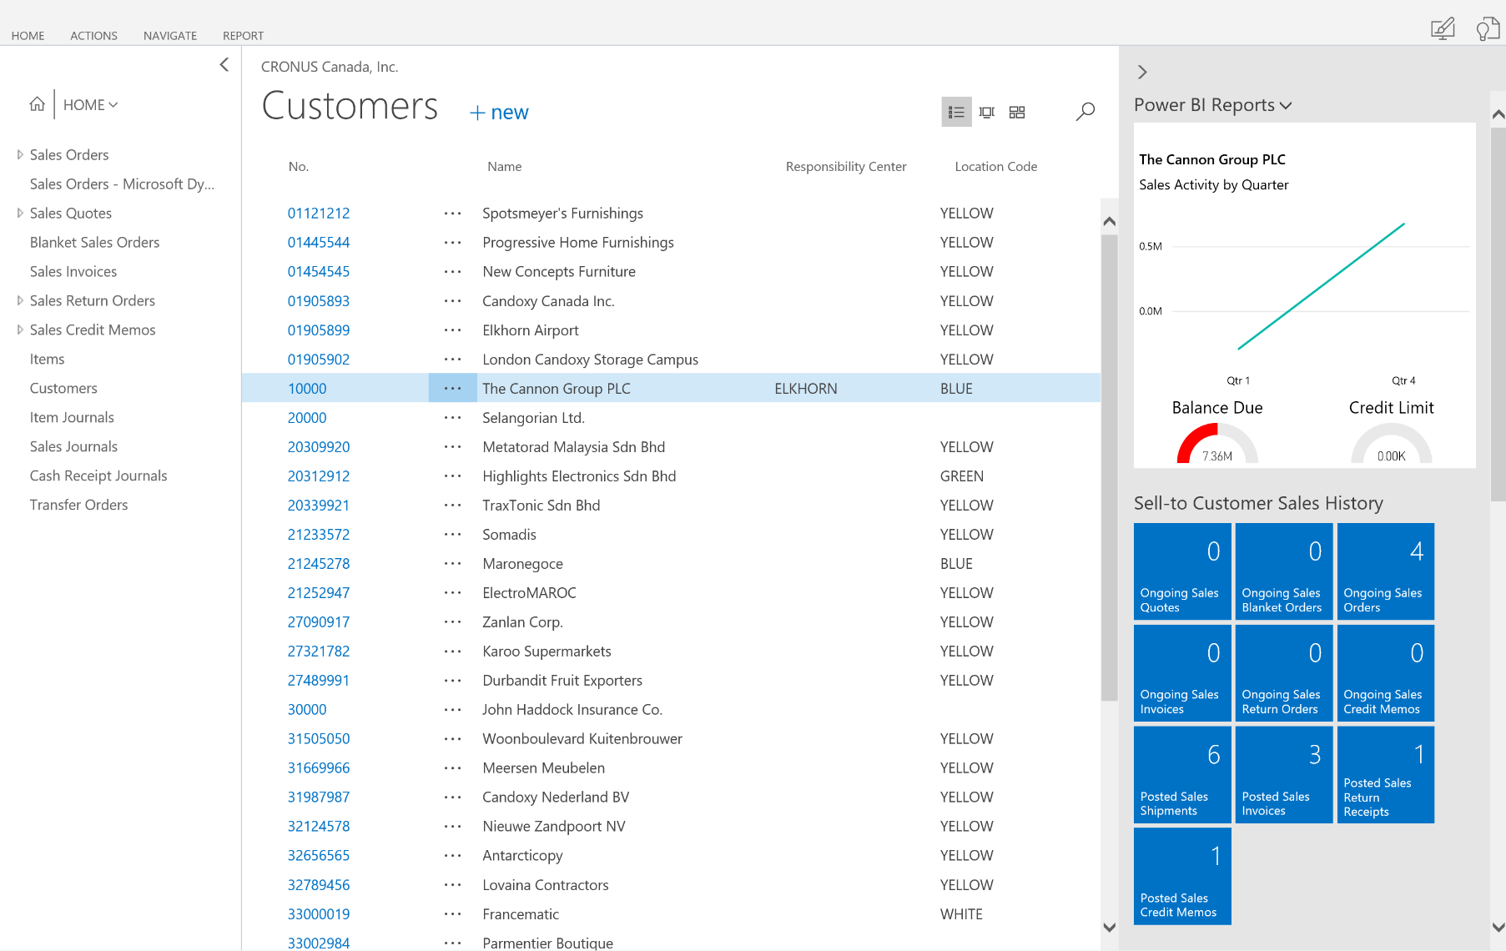
Power BI Reporting

Slide 32
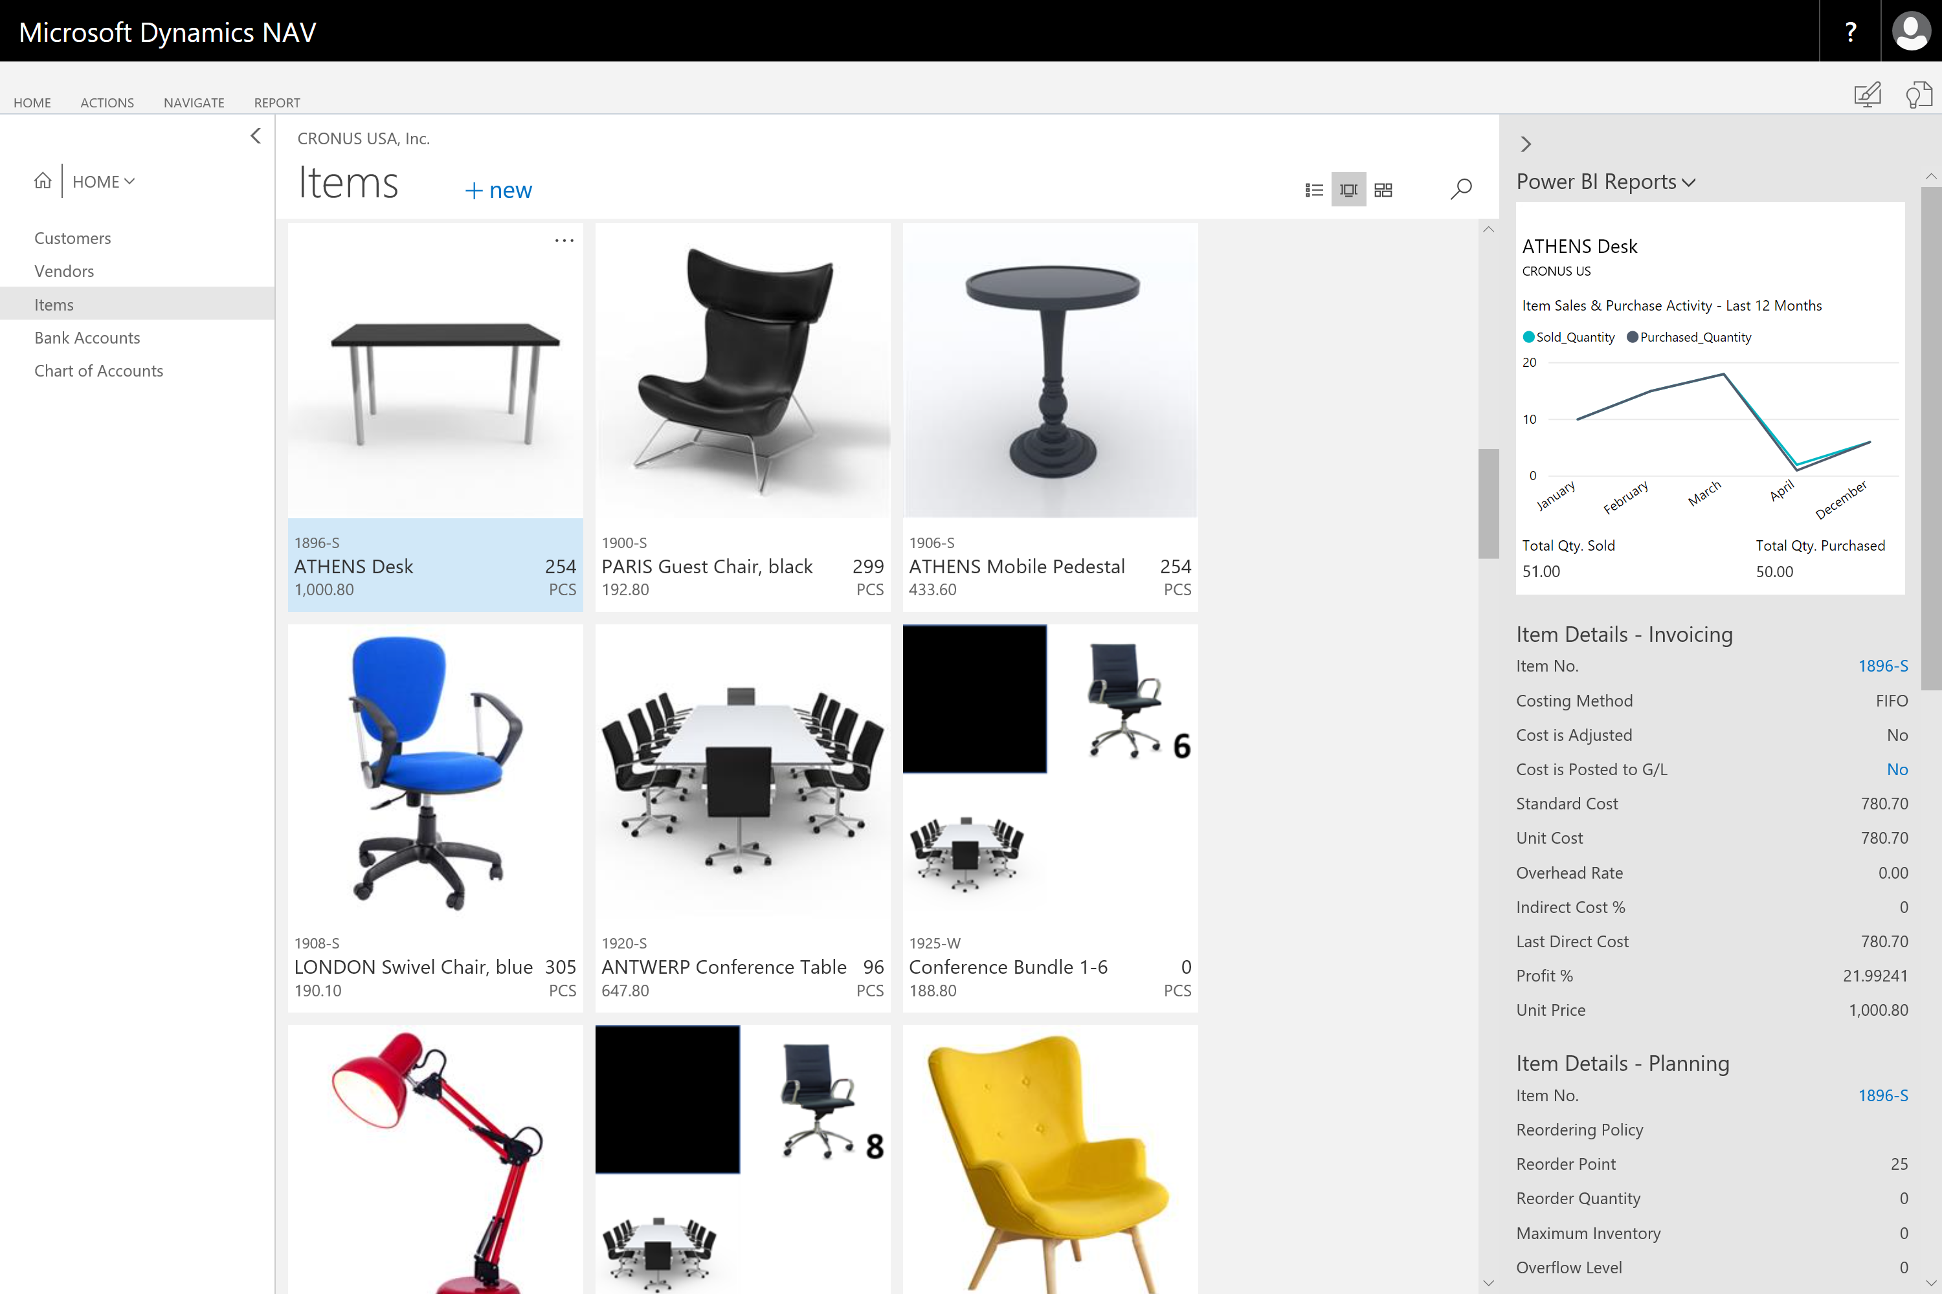
Microsoft Power BI Embed Experience

Slide 33
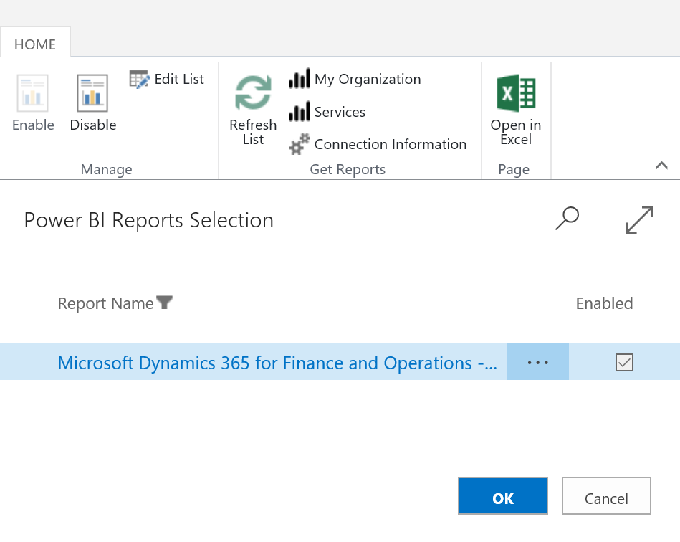
Microsoft Power BI Embed Experience
Microsoft Dynamics NAV – Items List

Slide 34
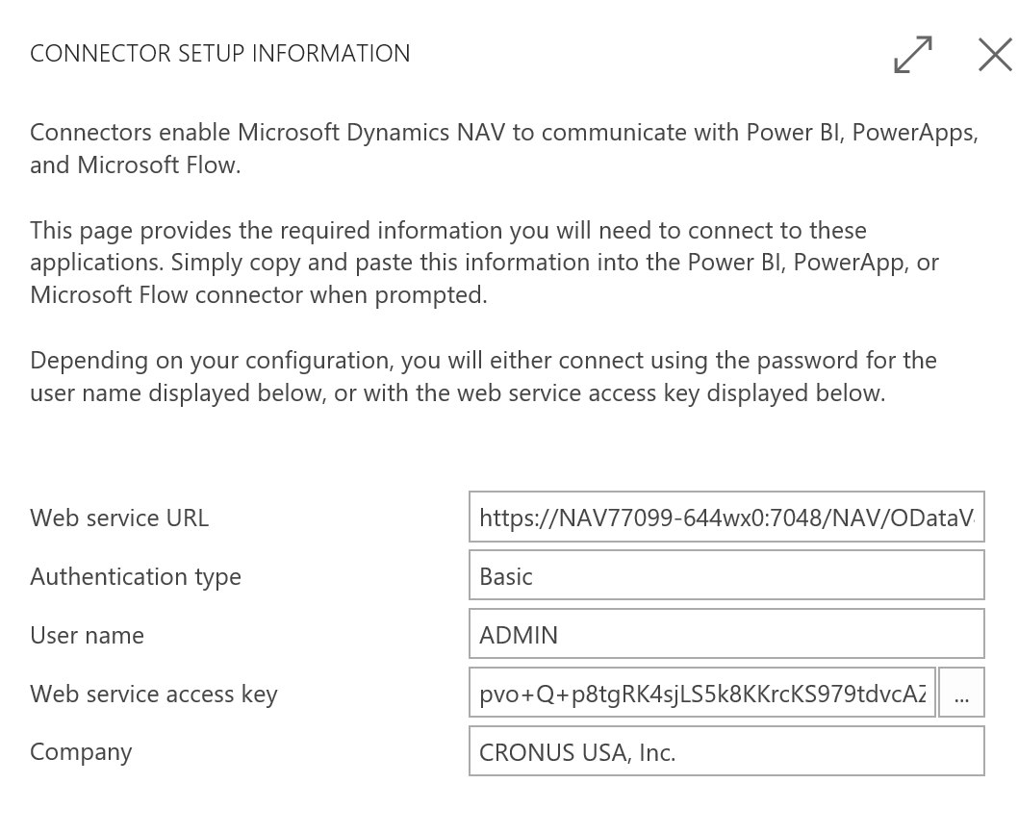
Microsoft Power BI Embed Experience
Microsoft Dynamics NAV – Items List

Slide 35
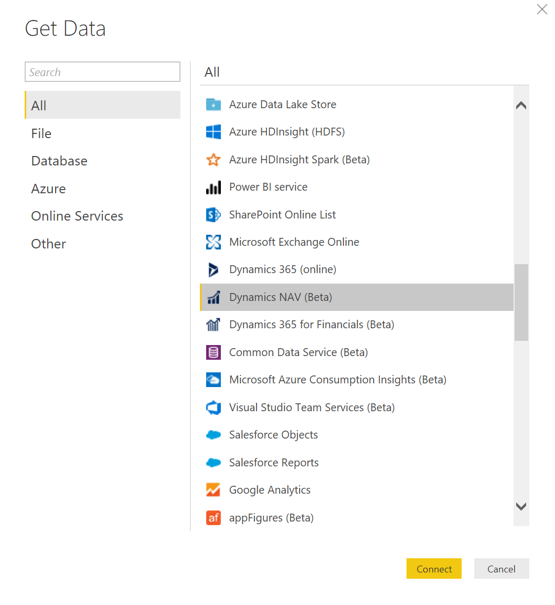
Microsoft Power BI Embed Experience

Slide 36
Create Contact Interactions in Outlook

Slide 37
Customer Benefits
Templates
Use NAV templates to create emails in Outlook
Interaction Tracking
Track the interactions on the NAV contact record

Slide 38
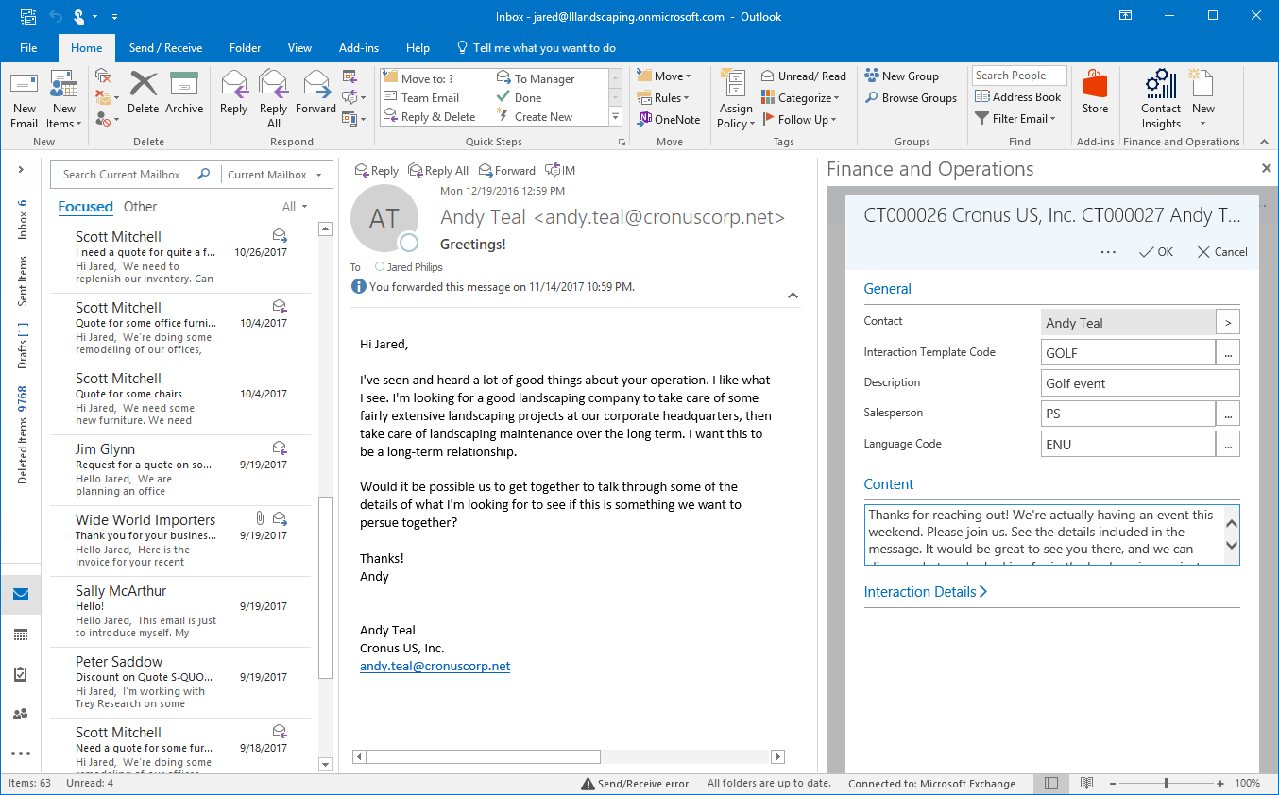
Create Contact Interactions in Outlook

Slide 39
Preconfigured Excel Reports

Slide 40
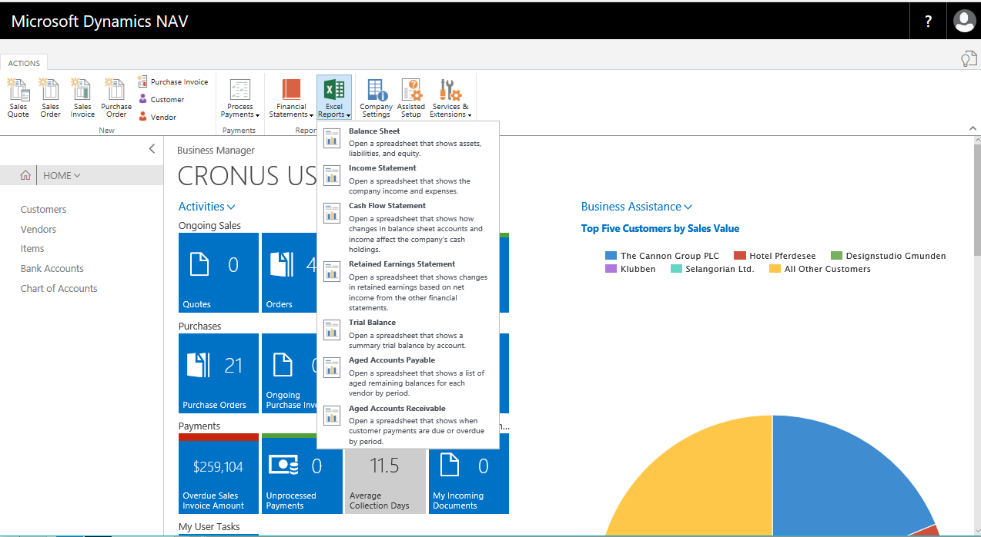
Preconfigured Excel reports

Slide 41
Edit in Excel for Journal Pages

Slide 42
Customer Benefits
Journal Pages
Edit in Excel is added to many journal pages in NAV
Update Data in NAV
Create, edit, and publish journals to NAV from Excel

Slide 43
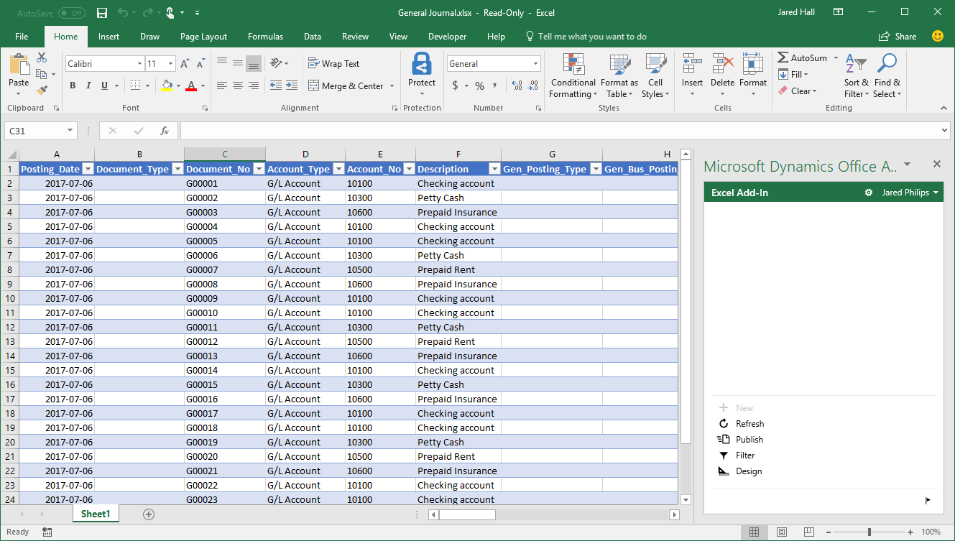
Edit in Excel for Journal Pages

Slide 44
Session refresh

Slide 45
Session refresh
Old way:
Change company requires restart of client or new login
Now:
No need to login again
Session is refreshed seamlessly for the user

Slide 46
Company Displayname

Slide 47
Company DisplayName
COMPANYNAME
Key in the Companies table
Used in many relations across the product
Used in UI – not controlled by AL
Problems with rename
Large transactions
Affects URLs
Schema changes
Company Information table
Setting the Name in Company Information also sets Display Name
Notes:
Both
Where is COMPANYNAME currently being used: Client UI, URLs, Id of company table, in AL method COMPANYNAME
Problems: Used in foreign key relationships, schema changes when renaming companies, lots of records need updating
For presentation
Screenshot of display name in the UI
Implementation

Slide 48
Report Preview

Slide 49
Benefits
Everywhere
All supported browsers
All supported mobile platforms
Embedded
Directly in the client
No need to download and install viewer apps
Interactive
Toolbar
Mouse, keyboard
Select, copy text
Hyperlinks
Modern
Innovative opportunities going forward

Slide 50
PowerShell

Slide 51
New Powershell cmdlets for server start/stop
Old way:
Set-NAVServerInstance -Start
Set-NAVServerInstance -Stop
Set-NAVServerInstance -Restart
Now:
Start-NAVServerInstance
Stop-NAVServerInstance
Restart-NAVServerInstance

Slide 52
Dynamic change of server properties
What
Dynamically change the amount of tasks that the server will process in parallel
Change the trace level to diagnose the performance issue
More properties will be added as needed
Why
We should avoid stopping the service if we can
We can turn on further diagnostics on ‘problematic’ clusters for a limited period of time
How
Server settings can be marked as dynamic – allowing you to set them through management endpoint
Event is raised allowing the server to react to the change

Slide 53
Upgrade

Slide 54
Upgrade
Schema synchronization can be done with other users online
Extensions’ costly uninstall and reinstall has been totally eliminated
Per-tenant data upgrade can be done with other users online
Upgrade can be done in a single transaction, rolls back on failures

Slide 55
Web Client Personalization

Slide 56
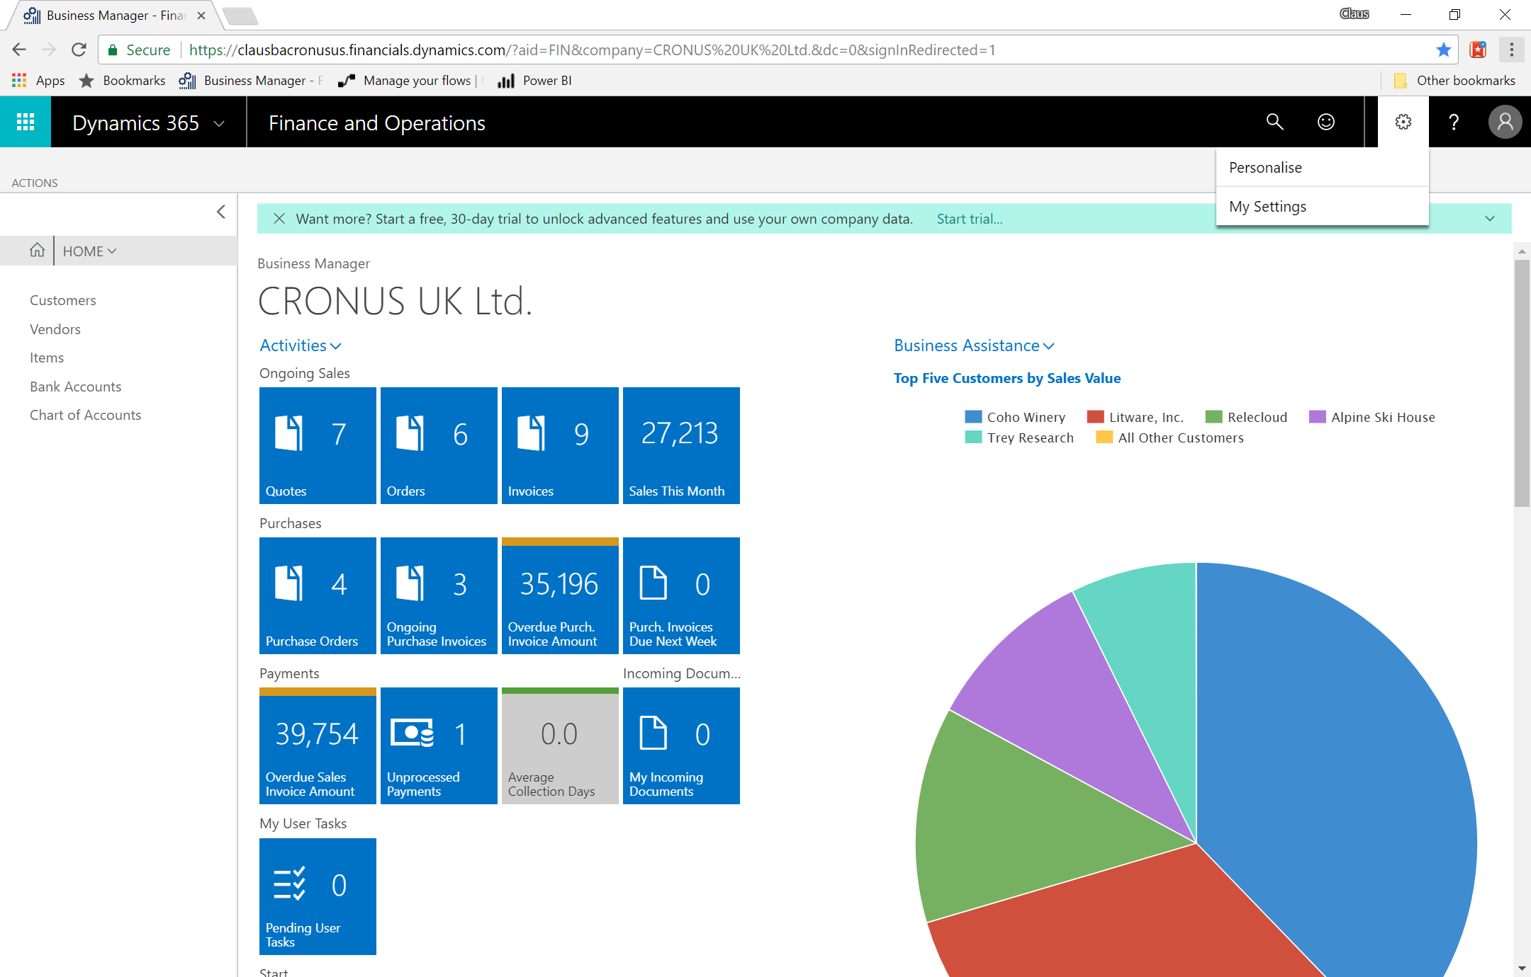

Slide 57
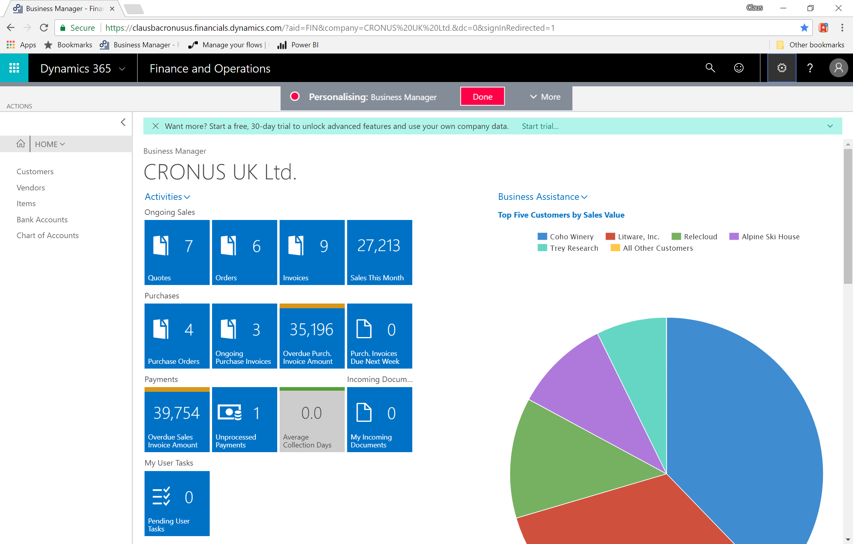

Slide 58
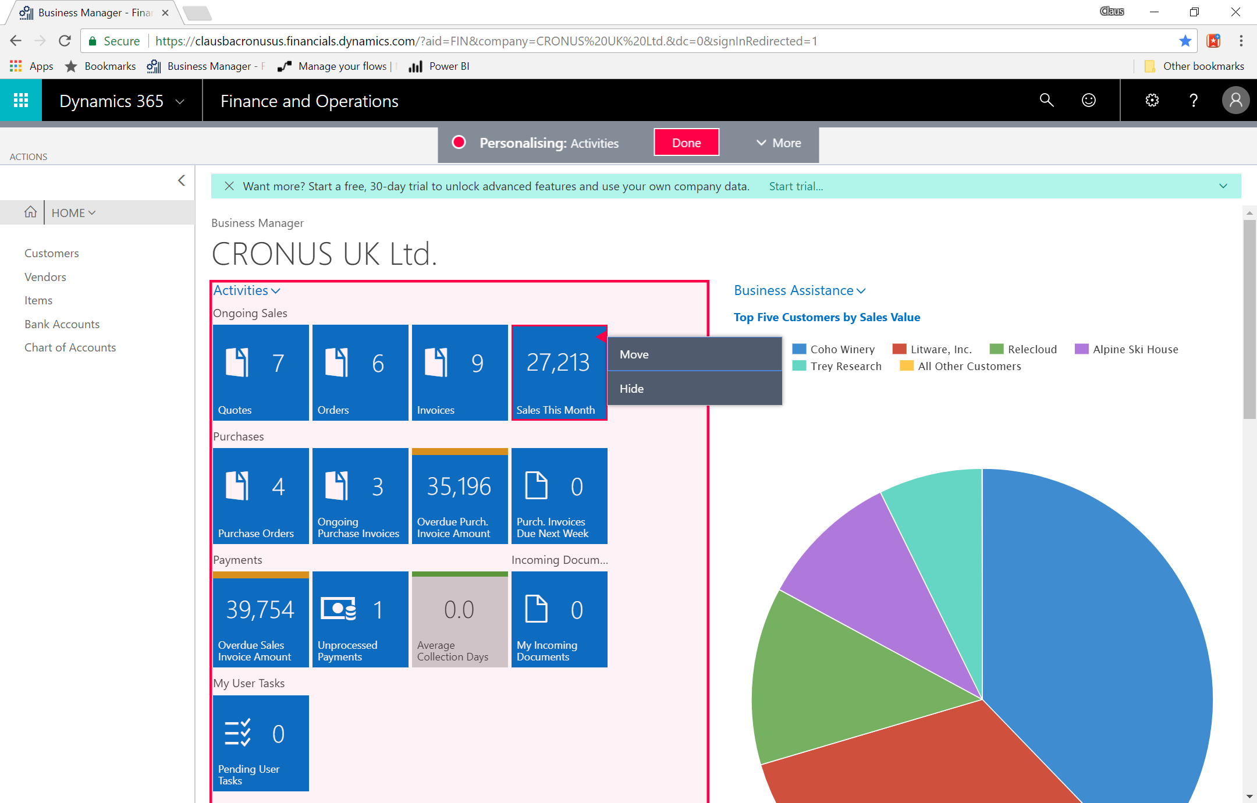

Slide 59
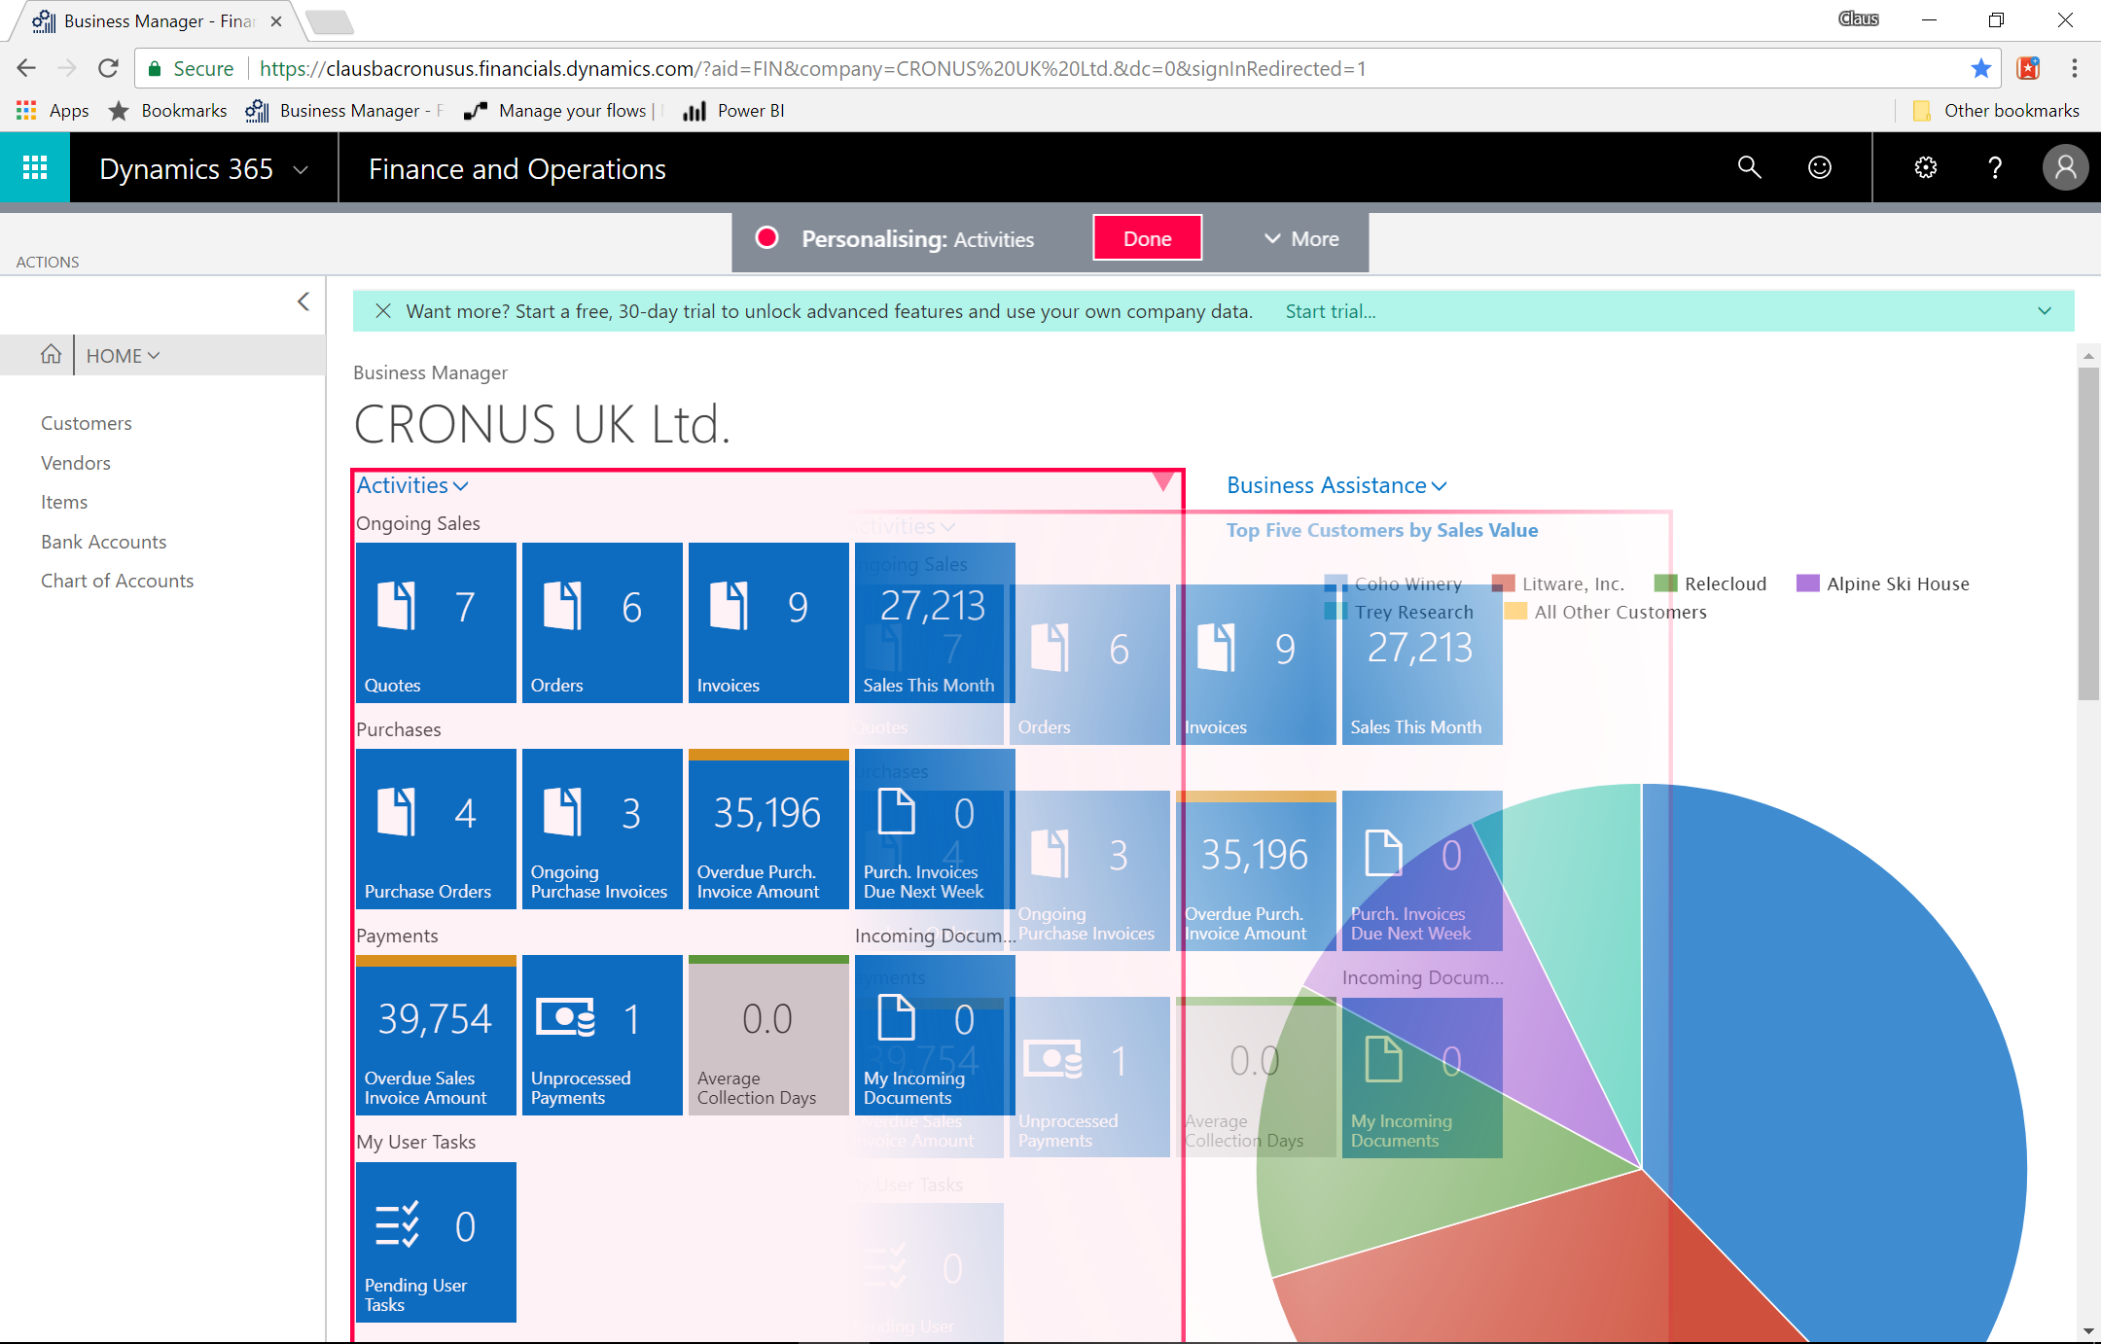

Slide 60
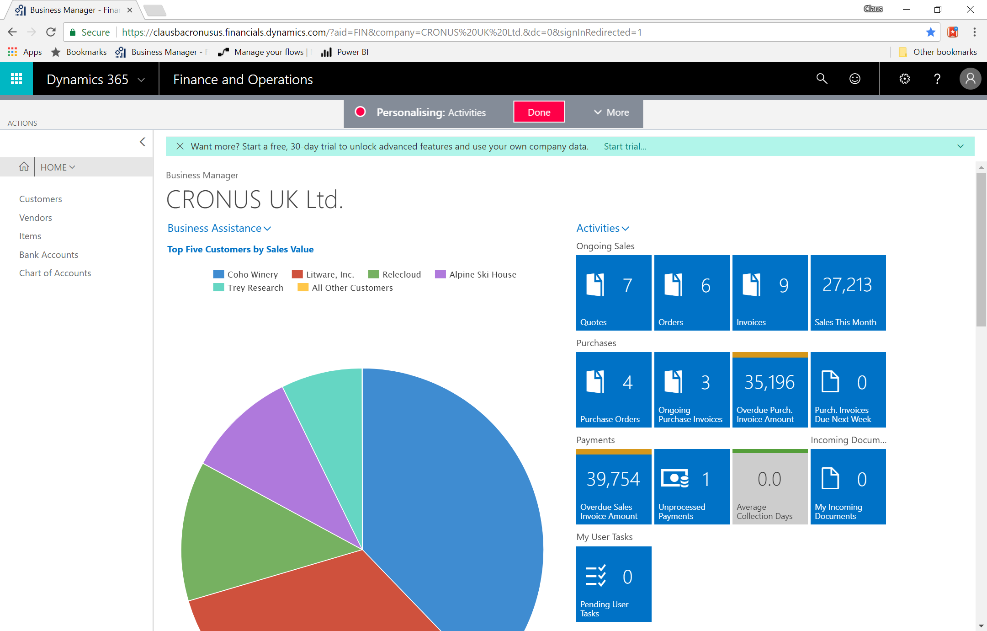

Slide 61
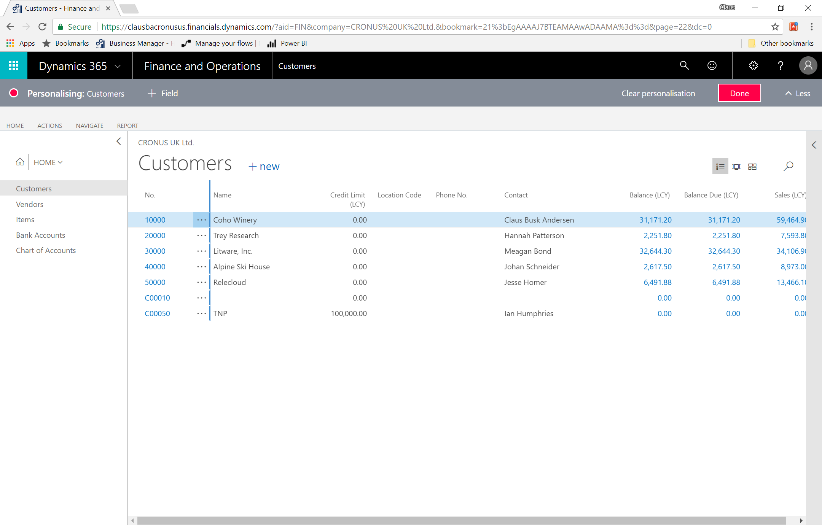

Slide 62
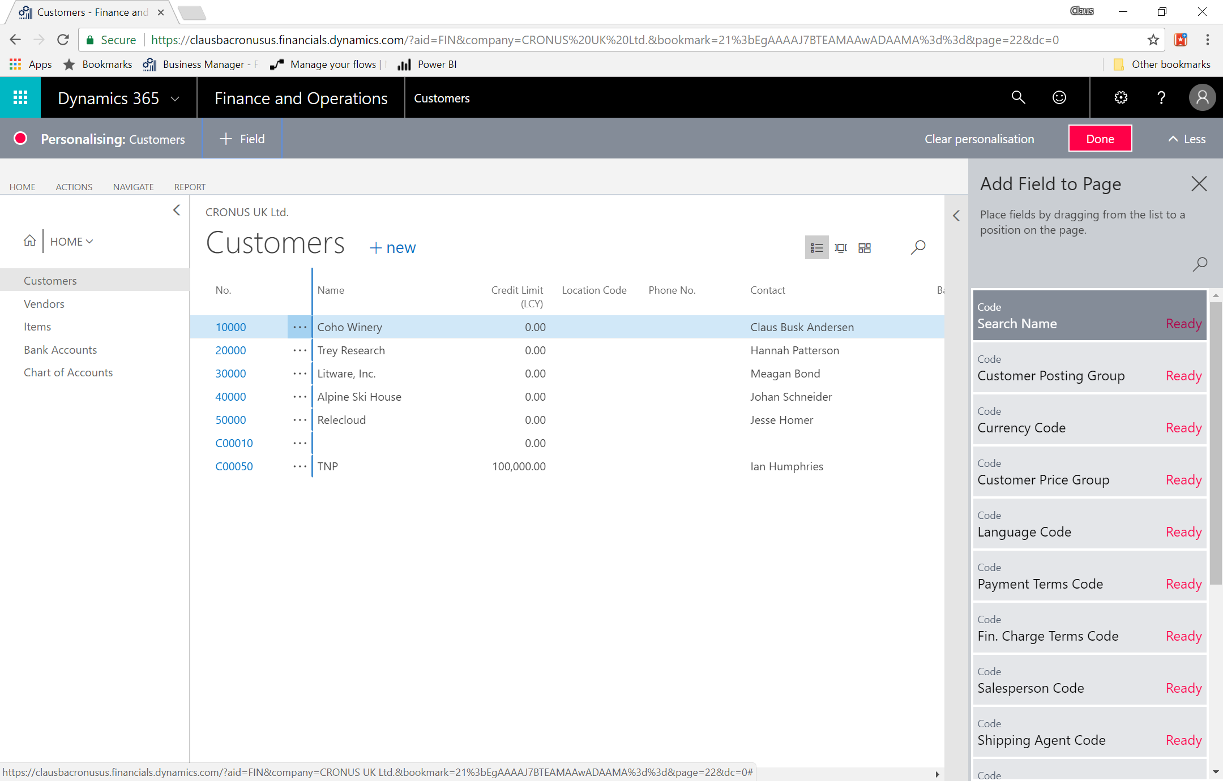

Slide 63
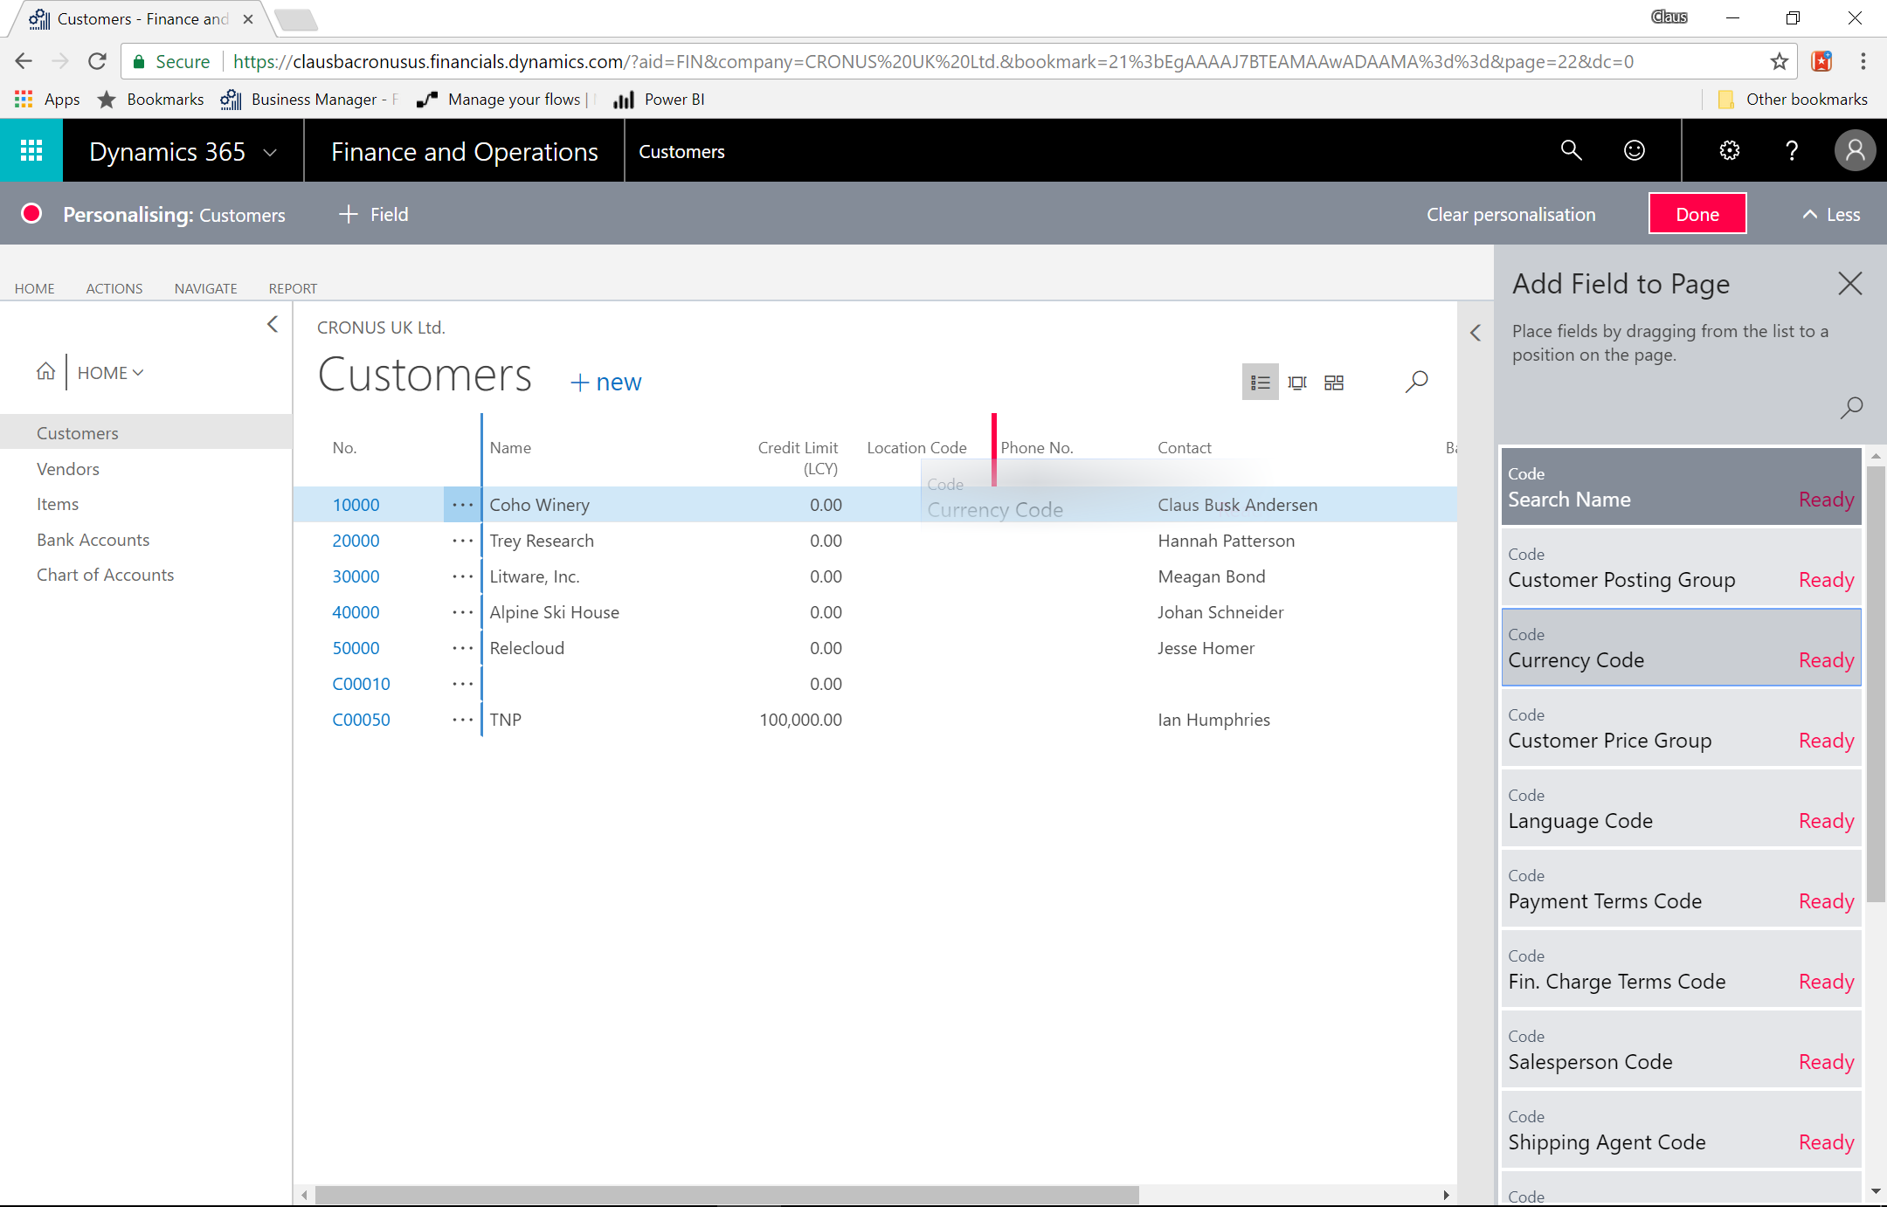

Slide 64
Developers and IT-Pro

Slide 65
Integrating and Extending
API’s
Extensions 2.0
Extensions 2.0,
API’s, etc. …
Connect
Add-On
Embed
Connected Apps Connect another service with Dynamics 365 for Financial and Operation
Add-on Apps enrich the Dynamics 365 for Financial and Operation functionality
Embed Apps provides an end-to-end solution for an industry or micro-vertical

Slide 66
API’s

Slide 67
Available APIs
COMPANY | FINANCE | SALES | PURCHASING | REPORTS
company | accounts | customers | irs1099Codes (US only) | agedAccountsPayable
companyInformation | dimensions | customerPayments | purchaseInvoices | agedAccountsReceivable
countriesRegions | dimensionLines | customerPaymentJournals | purchaseInvoiceLines | balanceSheet
currencies | dimensionValues | salesInvoices | vendors | cashFlowStatement
employees | generalLedgerEntries | salesInvoiceLines |  | incomeStatement
items | journals | salesOrders |  | retainedEarningsStatement
itemCategories | journalLines | salesOrderLines |  | customerSales
paymentMethods |  | salesQuotes |  | vendorPurchases
paymentTerms |  | salesQuoteLines |  | trialBalance
shipmentMethods |  | salesCreditMemos
taxAreas |  | salesCreditMemoLines
taxGroups
unitsOfMeasure
Notes:
Allows easy data integration using new REST APIs
Connect from outside, e.g., a different SaaS service or program, to read and write data
Built for online Microsoft Dynamics 365 for Financials and Operations, Buiness Edition, but also available for on-premise Microsoft Dynamics NAV 2018
Connection set up from within the outside service
Kept simple for now, some defaulting compared to UI UX, most are full CRUD
Connect through new /api/ endpoint
Must be enabled in the administration tool
API documentation available online
Authentication same as for OData, see more here

Slide 68
3rd party Service
Payroll, eCommerce, Migration, Expense Management…
How (Any tool. Any platform)
VS Code
Connect App
Business API’s
NAV 2018

Slide 69
Extensions 2.0 & Modern Development

Slide 70
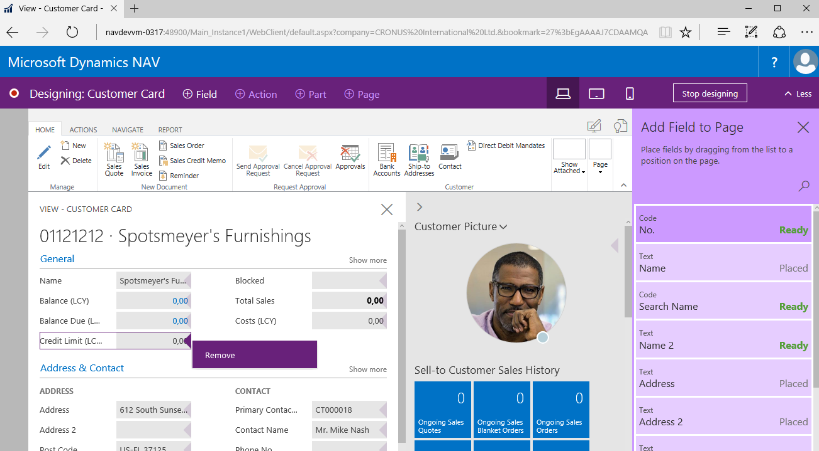
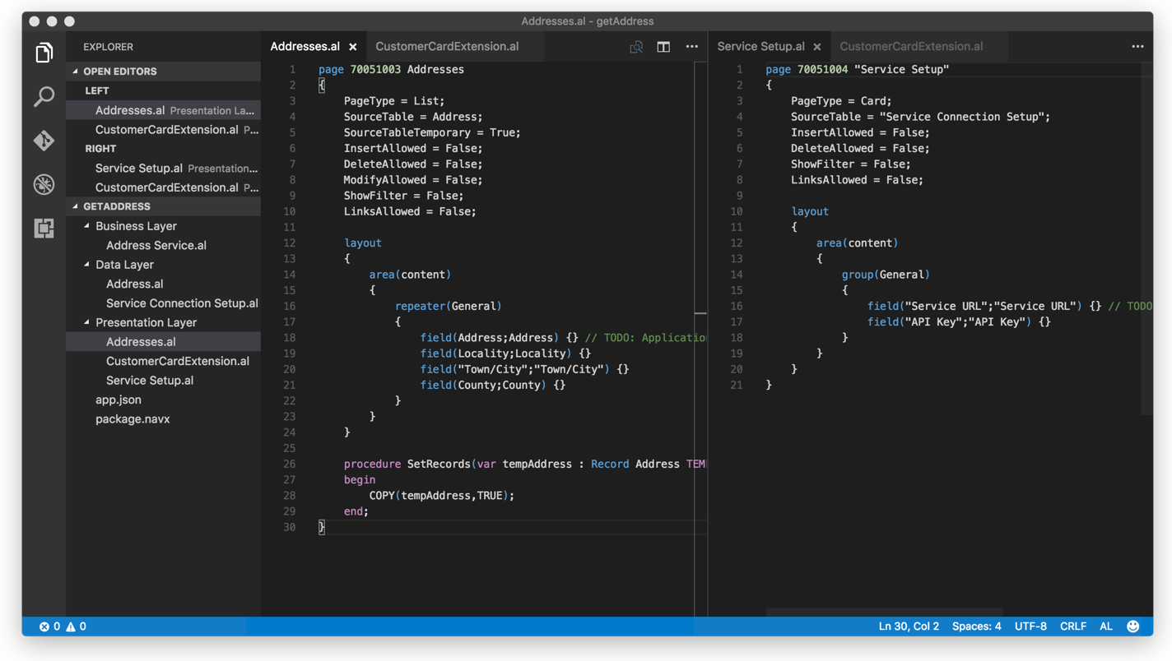
New modern developer environment
IN-APP DESIGNER
VISUAL STUDIO CODE
Go to: https://aka.ms/ModernDevTools

Slide 71
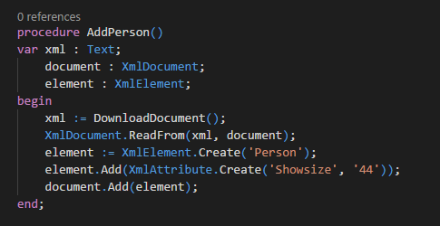
.NET Replacement
HttpClient
Json
XML
List
Directory
String
TextBuilder

Slide 72
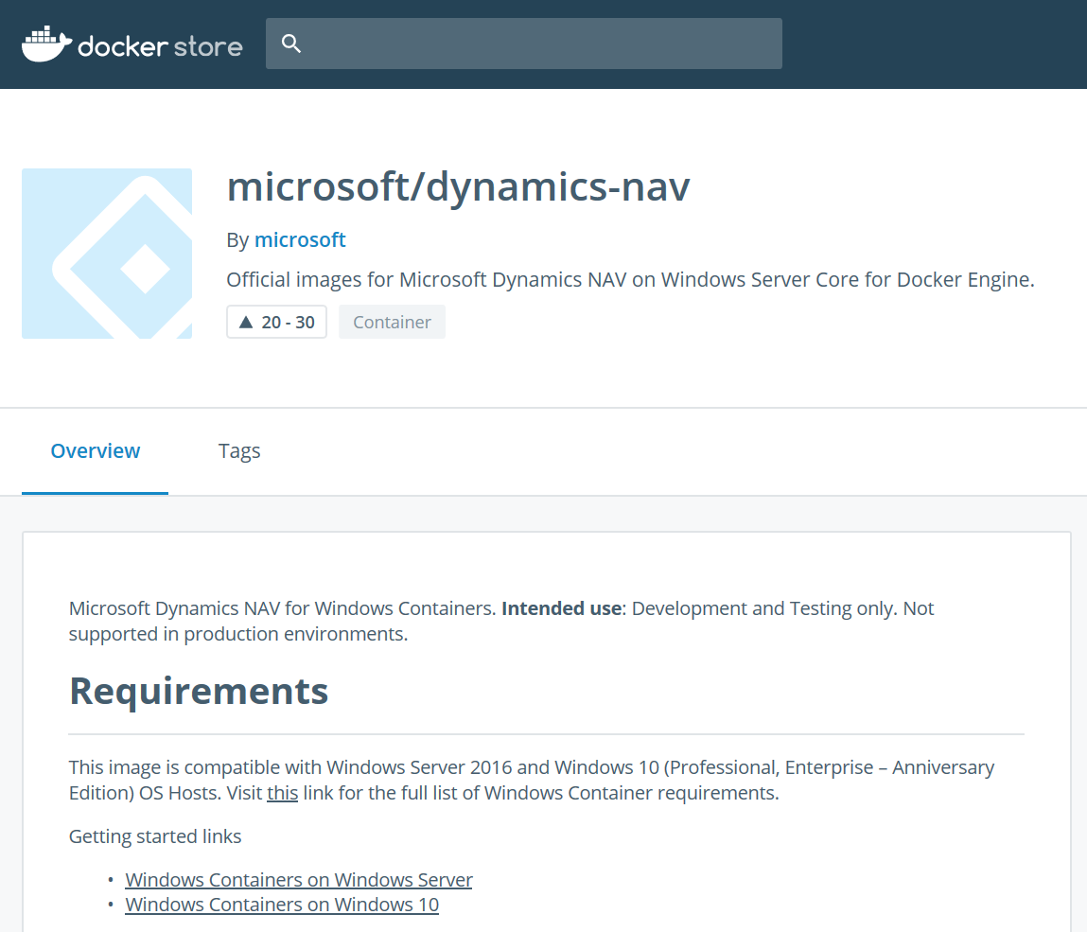
Developer Tools Release Cycle
Stable: Month minus one
Slow ring: Monthly preview
Fast ring: Bi-weekly builds
Preview of individual new components
Stable
Fast Ring
Slow Ring
Open
Insider
https://store.docker.com/community/images/microsoft/dynamics-nav

Slide 73
Simplified usage and distribution of developer tools with containers

Slide 74
Ready to Evaluate NAV 2018? Your options:
1. Request a trial license from your partner.
2. Get an Azure trial and fire up a Virtual Machine running NAV 2018.
3. Sign up for a free trial of Business Central

Slide 75
Any Questions?

Slide 76
Thank You for Attending!

