Slide 1
Reserved for Intro Picture
NAV Warehousing a 10,000 Foot View
Please contact Tim for Assistance
Kevin Fons
Sr. Application Consultant
kfons@innovia.com
John Grant
Sr. Application Consultant
jgrant@innvoia.com
Picture
Picture

Slide 2
Attendee Introductions
Show of hands:
Classic vs RTC
Using Some Warehousing (Bins, some documents)
Using Directed Pick and Put-Away
Using Barcodes and Handhelds
Thinking of implementing Warehousing
Notes:
Kevin

Slide 3
Agenda
What is Warehousing and Why use it?
Basic Setup / Locations
Bins / Bin Mandatory
Require Pick / Require Shipment
Require Receive / Require Put Away
Directed Pick and Put-Away
Top Causes of Failures of Warehousing
Notes:
Kevin

Slide 4
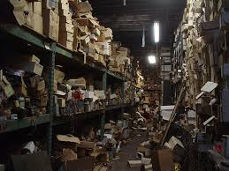
If Your Warehouse Looks Like this, You are not ready for Warehousing!
Notes:
Kevin

Slide 5
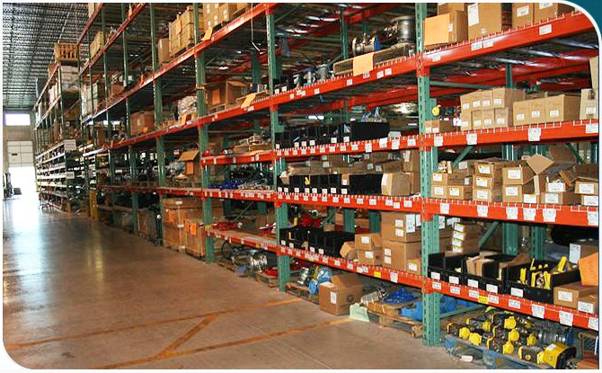
If Your Warehouse Looks Like this, Then we can talk Warehousing!
Notes:
Kevin

Slide 6
What is Warehousing / What isn’t it
NAV WMS will not organize your warehouse
Good processes and procedures must be in place
Forces discipline in system processes
Can’t find items, why is that?
Requires Accurate Inventory
Bins vs Shelf No
Notes:
Kevin

Slide 7
Why Use Warehousing
Improved efficiency of finding and putting inventory away, especially when you have items in multiple areas of the warehouse.
Improved efficiency in Handling
Decentralized processing – Use warehouse documents instead of Purchase Orders and Sales Orders for improved security and efficiency.
Split Transactions – receive and then Put-Away
Process Multiple orders at one time (Warehouse Receipt, Picks and Shipments)
Paper vs Paperless (processing with handhelds)
Notes:
Kevin

Slide 8
Warehouse Setup Page
ALWAYS change the posting policies to Stop and show first error.
Notes:
Kevin

Slide 9
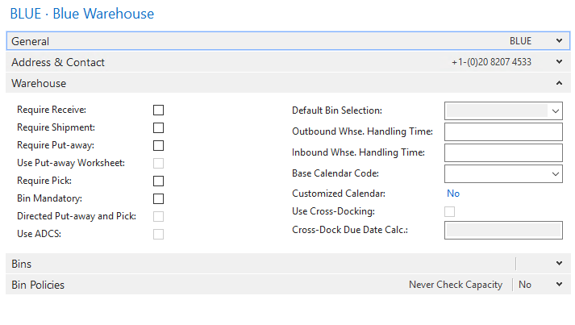
What is a Location? / Location Setups
Notes:
John

Slide 10
Bins / Bin Mandatory
Shelf is the most basic, a Shelf 2 field is an easy addition when you may only have a couple areas where stock is kept
Bins –inventory by bin, what items and how many are in each bin.
Decision is between information (shelf) and control (bins) and transactions required to maintain.
Notes:
John

Slide 11
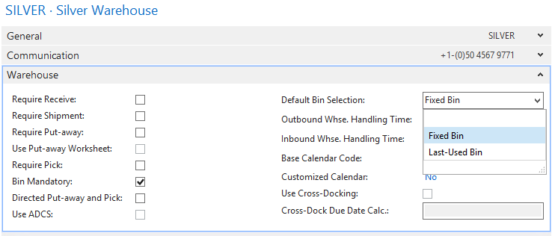
Bin Mandatory Default Bin Selection
Fixed or Last Used
Notes:
John

Slide 12
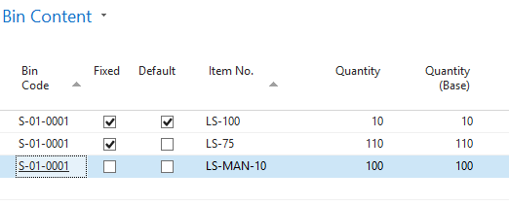
Bin Content (Content of a single Bin)
Notes:
John

Slide 13
Bin Contents (Contents of all bins)
Notes:
John

Slide 14
Fixed Bins Vs Default Bins + Dedicated
Default | Fixed
Only One “default” bin per item | An item can be fixed to more than one bin
If the item inventory goes to zero, NAV does not delete the bin content line | If the item inventory goes to zero, NAV does not delete the bin content line
The “default” assignment is a system oriented assignment where the user tells the system what bin to suggest first, and populate sales and purchase order lines. | The “fixed” assignment is a organization oriented assignment where the user tells the system additional bin(s) the item can be stored in.
Notes:
John

Slide 15
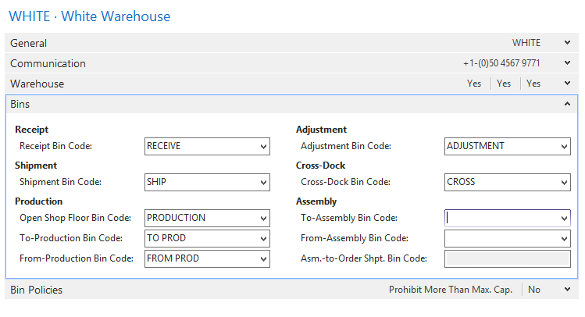
Dedicated Bins
Notes:
John

Slide 16
Require Pick
Enables Inventory Picks for Sales & Production Orders
One Pick per Sales Order or Production Order
Allows you to pick from multiple bins or change bins (without pick you need multiple lines on SO for multiple bins)
Posting the Pick will Ship the Sales Order or consume the production order material
If there is no inventory available, there is no pick line created
Notes:
Kevin

Slide 17
Require Shipment
Enables warehouse shipments (do not have to use, can still ship from sales order)
Separates shipping personnel from the Sales Order Document.
Can be used to combine multiple orders to one warehouse shipment
Posting the Warehouse shipment will Post the Sales Order
Notes:
Kevin

Slide 18
Require Shipment + Require Pick
Enables warehouse shipments and Picks
Whse Ship and Pick become mandatory
Separate documents for Picking and shipping
Allows for picking multiple orders from multiple bins.
Notes:
Kevin

Slide 19
Require Shipment + Require Pick
The Pick moves the inventory from the stocking bin to the Dedicated Shipping Bin.
The Pick is Registered to pick the inventory from the stocking bin to the Shipping Bin
The Warehouse Shipment is Posted to ship the Sales Order from the Shipping Bin.
Notes:
Kevin

Slide 20
Register vs Post
Register is a warehouse only transaction (move from bin to bin)
Posting is a Financial Inventory Transaction i.e. shipping the sales order and decreasing inventory
Notes:
Kevin

Slide 21
Require Receive
Enables warehouse receipts, separates receiving personnel from the Purchase Order Document.
Can be used to receive multiple PO’s on one receipt or split a PO into multiple receipts.
Used when you would post the receipt/PO when the material is received into the building, not when you put it away (receives direct to Bin)
Posting the receipt receives the PO
Notes:
John

Slide 22
Require Put-away with Require Receipt
Enables a Warehouse receipt with a Put Away document
The receipt is Posted to receive the inventory to the Dedicated Receive bin
Then the Warehouse Put-away is Registered to put the material away (multiple bins, change bin)
Notes:
John

Slide 23
Sales Order Warehouse Shipping Options
 | Pick | WHSE Shipment | Sales Order(s)
Bin Mandatory (Single Order) | N/A | N/A | Single Post Ships
Require Pick (order by Order) | Inventory Pick Post Ships | N/A | Single
Require Shipment (multiple orders) | N/A | Whse. Shipment Post Ships | Multiple
Pick & Shipment (multiple orders) | Warehouse Pick Register Only | Whse. Shipment Post Ships | Multiple
Notes:
John

Slide 24
Purchase Order Receiving Options
 | Put-Away | WHSE Receipt | Purchase Order(s)
Bin Mandatory (Single Order) | N/A | N/A | Single Post Receive
Require Put-Away (order by Order) | Put-Away Post Receive | N/A | Single
Require Receipt (multiple orders) | N/A | Whse. Receipt Post Receive | Multiple
Pick & Shipment (multiple orders) | Put-Away Register Only | Whse. Receipt Post Receive | Multiple
Notes:
John

Slide 25
Directed Pick: Additional Functionality Zone and Bin
Zones – Picking, Bulk, Production, Freezer
Bin Types – Pick, Put Pick, Put Away, Receive, Ship, No Type
Bin Ranking – Highest to Lowest for picking bottom bins vs top and replenishment low to high
Maximum Cubage / Max Weight – for Putaway and replenishment
Minimum Quantity / Maximum Quantity – for Bin replenishment
Warehouse Classes (Heated, Freezer, Clean Room, etc.)
Special Equipment – High lift fork truck
Bin Policies / Capacity (Never Check Cap, Allow more, Prohibit More)
Notes:
Kevin

Slide 26
Directed Pick: Additional Functionality Processing
Put Away Templates / Worksheet
FEFO Picking for lots and serial items
Bin Replenishment Min/Max quantities
Break Bulk (break down cases to each)
Cross Dock – Route material needed for shipping directly to cross dock from receiving.
Whse specific Journals / Adjustment Bin
Notes:
Kevin

Slide 27
Getting Started
Disciplined physical processes in place prior to implementing.
Warehouse Organized and Labeled
Inventory must be accurate
Determine level of control / complexity
Work with your Partner– Where do you want to be, Where do you want to go …
Notes:
John

Slide 28
Any Questions?
Notes:
John

Slide 29
Thank You for Attending!

