Slide 1

Innovia Consulting Customer Conference 2018

Slide 2
Agenda
About Insight Works
Product Overview
Dynamic Shipping Solution
Shop Floor Data Collection
Warehouse Data Collection

Slide 3
About Us
Started in 2008
Global supplier of manufacturing and distribution software for NAV
Based in Edmonton, Alberta, Canada
Remote offices in Toronto, Milwaukee, and Australia
40+ employees
World-wide client base including companies such as Ford, Honda, Daimler Trucks (Freightliner), and Honeywell

Slide 4
What we do
PROCUREMENT
INVENTORY
MANAGEMENT
RECEIVING
MANUFACTURING
SHIPPING
WAREHOUSE
MANAGEMENT
SALES
PAYROLL
MANAGEMENT
REPORTING

Slide 5



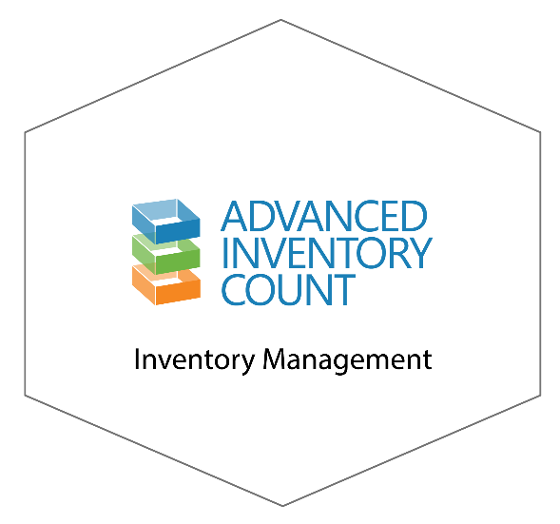
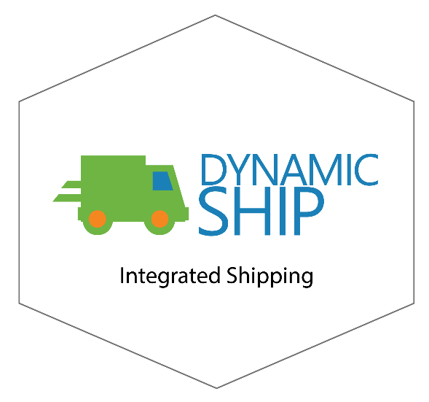



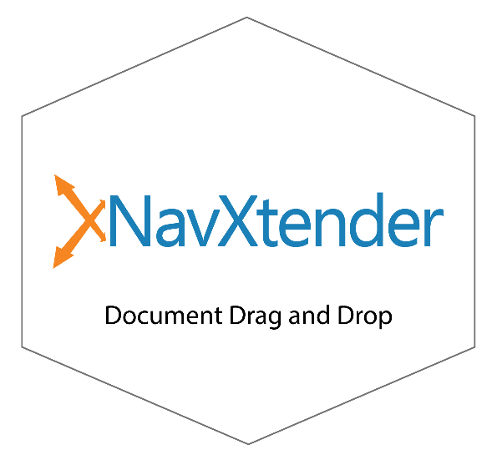

Add-ons for Business Central

Slide 6


Add-ons for Business Central
MOBILE WAREHOUSE
DATA COLLECTION
Mobile WMS
Perform all inventory and warehouse operations from hand-held devices
Support all NAV Location and item tracking configurations
Real-time access to inventory & production data
Notes:
https://www.dmsiworks.com/products/mobile-warehouse-data-collection/

Slide 7
Add-ons for Business Central
SHOP FLOOR
DATA COLLECTION
Barcoded time capture, time and attendance, and employee management solution
Eliminate manual time entry with barcode scanning for Production Orders, Jobs, Assembly Orders, and Maintenance
Notes:
https://www.dmsiworks.com/products/shop-floor-data-collection/

Slide 8
Add-ons for Business Central
INVENTORY MANAGEMENT
FOR NAV
Simplify inventory and cycle counts
Easily perform manually-entered or barcoded inventory counts and cycle counts
Automatically reconcile and post lot or serial number discrepancies
Notes:
https://www.dmsiworks.com/products/inventory-management/

Slide 9
Add-ons for Business Central
INTEGRATED
SHIPPING
Detailed package management
Integrates with all your favorite carriers
Enhanced accuracy in shipping fees based on item weight
Simple NAV interface with scanning support
Notes:
https://www.dmsiworks.com/products/integrated-shipping/

Slide 10


Add-ons for Business Central
CANADIAN
PAYROLL
Complete Canadian payroll solution
Easy to set-up and use
Track your employee time and payroll information
Support for hourly and salaried staff with multiple pay-period options
Notes:
https://www.dmsiworks.com/products/payroll/

Slide 11
Add-ons for Business Central
INSIGHT
POINT
OF SALE
Easy-to-use point of sales solution built right into Dynamics NAV
Provide a quick check-out process
Increase opportunities by tracking lost sales
Supports barcode scanning
Notes:
https://www.dmsiworks.com/products/point-of-sale/

Slide 12
Add-ons for Business Central
CONIFGURE
PRICE QUOTE
Improve your ability to accurately quote products that have multiple potential options and configurations
Create Assemble-to-Order configurations directly from quotes or orders, or create production BOMs for more complex production environments
Save significant time using pre-configured items
Notes:
https://www.dmsiworks.com/products/configurator/

Slide 13

Add-ons for Business Central
DOCUMENT
DRAG AND DROP
Attach documents to any Dynamics NAV record with drag and drop
Associate customer POs to orders; invoices to POs; quality documents to receipts; or any other file to any card in NAV.
Notes:
https://www.dmsiworks.com/products/document-drag-and-drop/

Slide 14
Add-ons for Business Central
PLANNING AND
SCHEDULING
Transforms production planning and scheduling into a responsive, repeatable, and highly accurate decision support activity
Improve customer service levels by producing more realistic production schedules
Reduce WIP, finished goods inventory, and lead times
Increase throughput, machine utilization, and inventory turns
Notes:
https://www.dmsiworks.com/products/planning-and-scheduling/

Slide 15
DEMO

Slide 16
Shop Floor Data Collection DEMO
Notes:
https://www.dmsiworks.com/products/shop-floor-data-collection/

Slide 17
Shop Floor Insight
Capabilities
Time & Attendance | Payroll Integration | Payroll Calculations
Light Shift Scheduling | Barcoded Labor Collection | Manual Time Entry
Quality Inspections | Work Instructions | Production Dispatch List
Job Dispatch List | Point-of-Use Consumption | Shop Floor Output
Linked Documents | Safety Logbook | Exception-base Approvals
Project-based Approvals | Visual Scheduler | Analysis Reporting
Notes:
https://www.dmsiworks.com/products/shop-floor-data-collection/#features

Slide 18
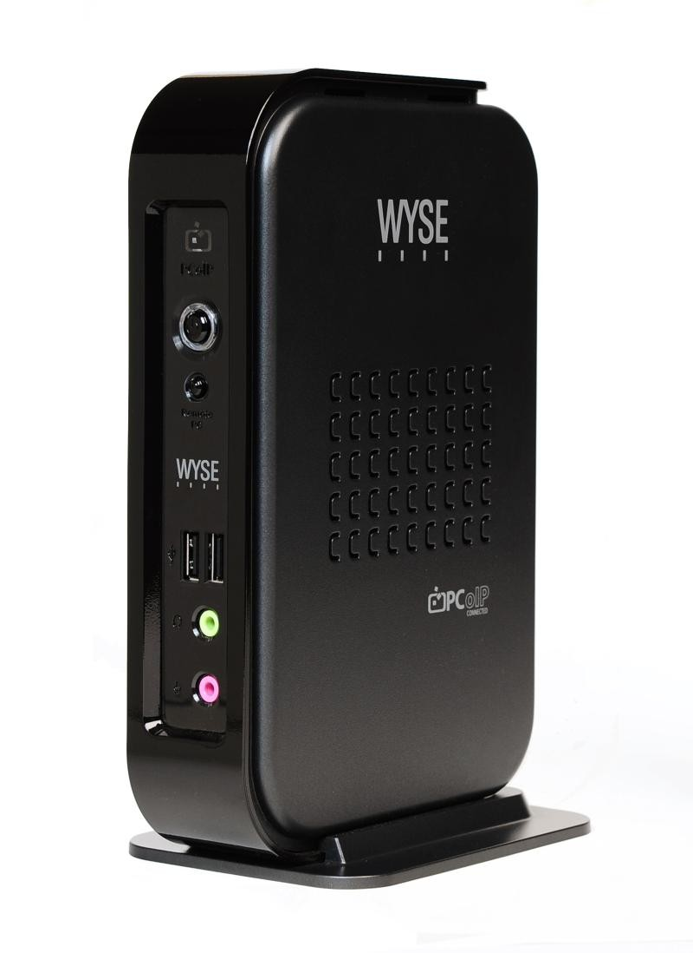
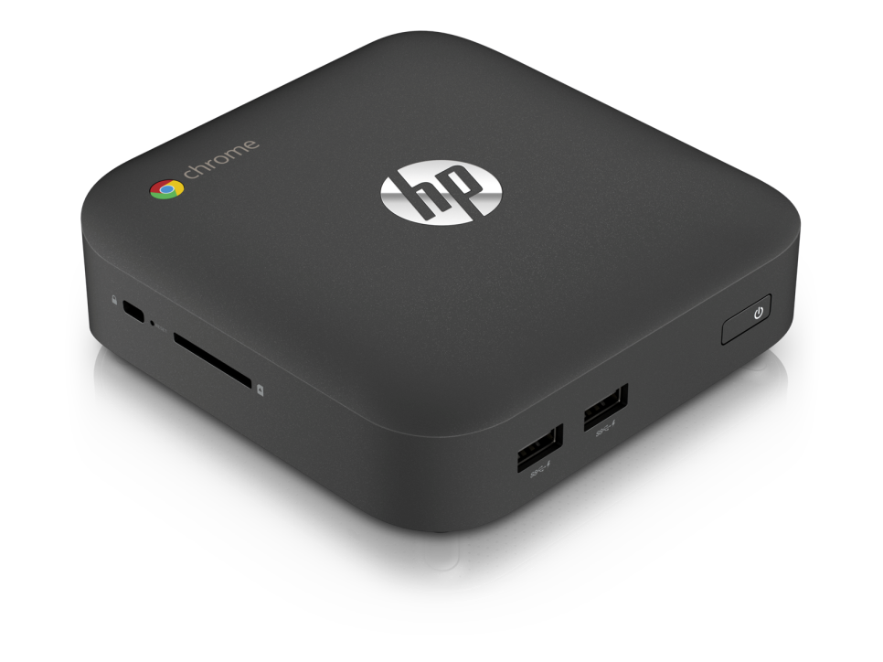
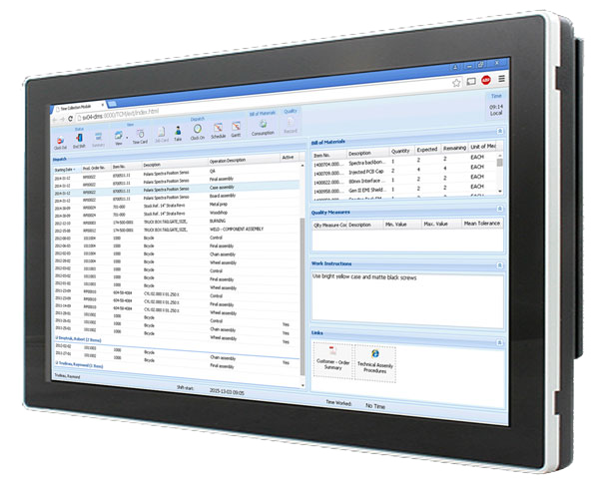

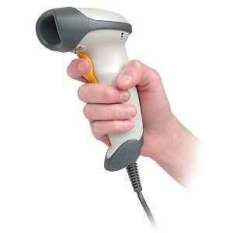
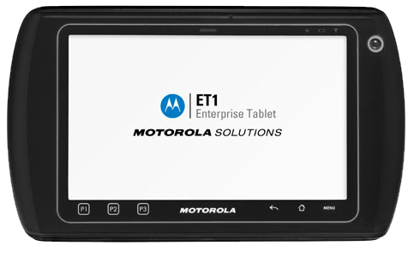
Hardware Options
Notes:
https://www.dmsiworks.com/products/shop-floor-data-collection/

Slide 19
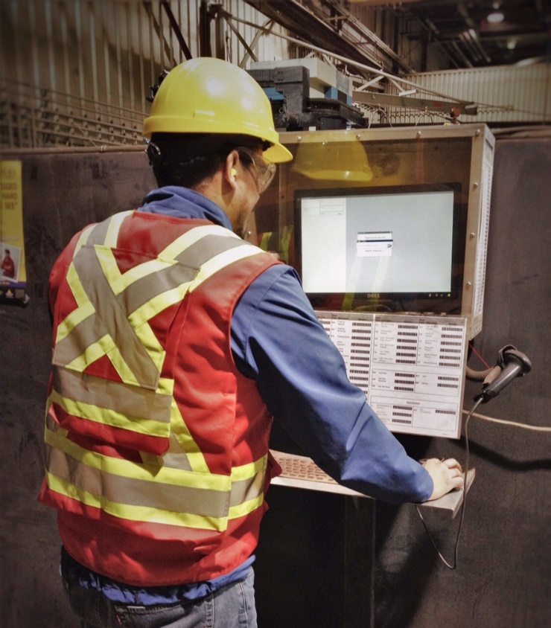
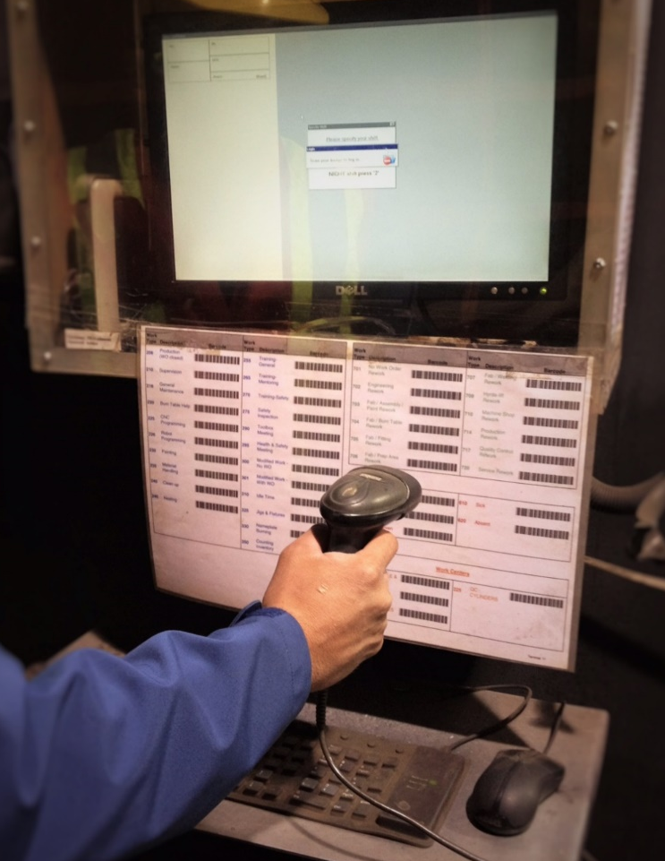
Sample Station
Notes:
https://www.dmsiworks.com/products/shop-floor-data-collection/

Slide 20
Mobile Warehouse Data Collection DEMO
Notes:
https://www.dmsiworks.com/products/mobile-warehouse-data-collection/

Slide 21
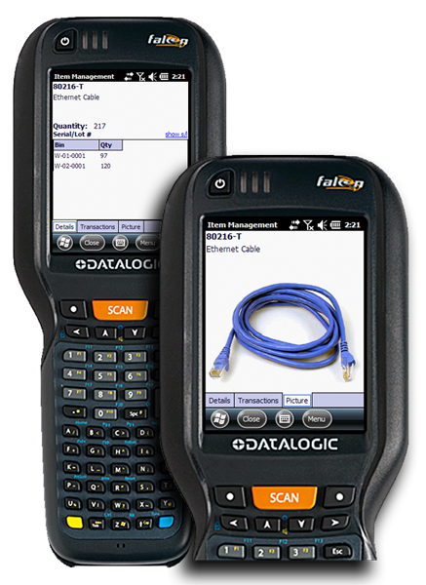
Warehouse Insight
Warehouse Insight provides mobile access to warehouse activities via barcodes.
Use the same device for any location configuration, including non-mandatory bins and directed pick
Get real-time access to NAV warehouse, inventory, and production
Perform all inventory and warehouse operations from hand-held devices
Scan directly to sales and production documents for ad-hoc picking
Capture lot and serial numbers for any transaction
Use License Plating to streamline warehouse operations
Easily customize views and menus on hand-held computers
Notes:
https://www.dmsiworks.com/products/mobile-warehouse-data-collection/

Slide 22
Warehouse Insight
Capabilities
Item Inquiry | Point of Sale Picks | Warehouse Movements
Bin Inquiry | Sales Order Picks | Inventory Movements
Sales Shipments | Inventory Picks | Production Consumption
Warehouse Shipments | Warehouse Picks | Production Output
Purchase Receipts | Inventory Put-away | Offline Scratchpad
Warehouse Receipts | Warehouse Put-away | Basic Inventory Count
Assembly Orders | Image Capture | Application Builder
Notes:
https://www.dmsiworks.com/products/mobile-warehouse-data-collection/#features

