Slide 1



Microsoft Mixed Reality

Slide 2
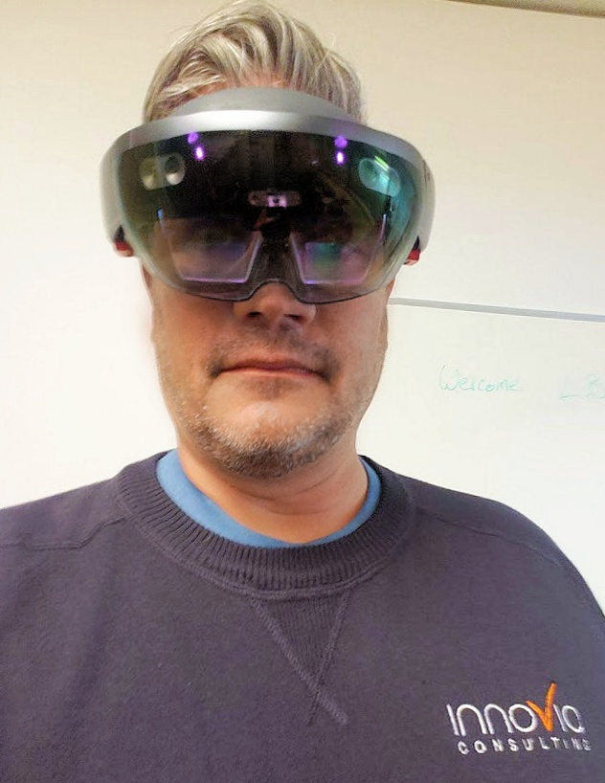

Today’s Presenter
Jeff Pergolski
Presales / TC / Customer Engagement
jpergolski@Innovia.com

Slide 3

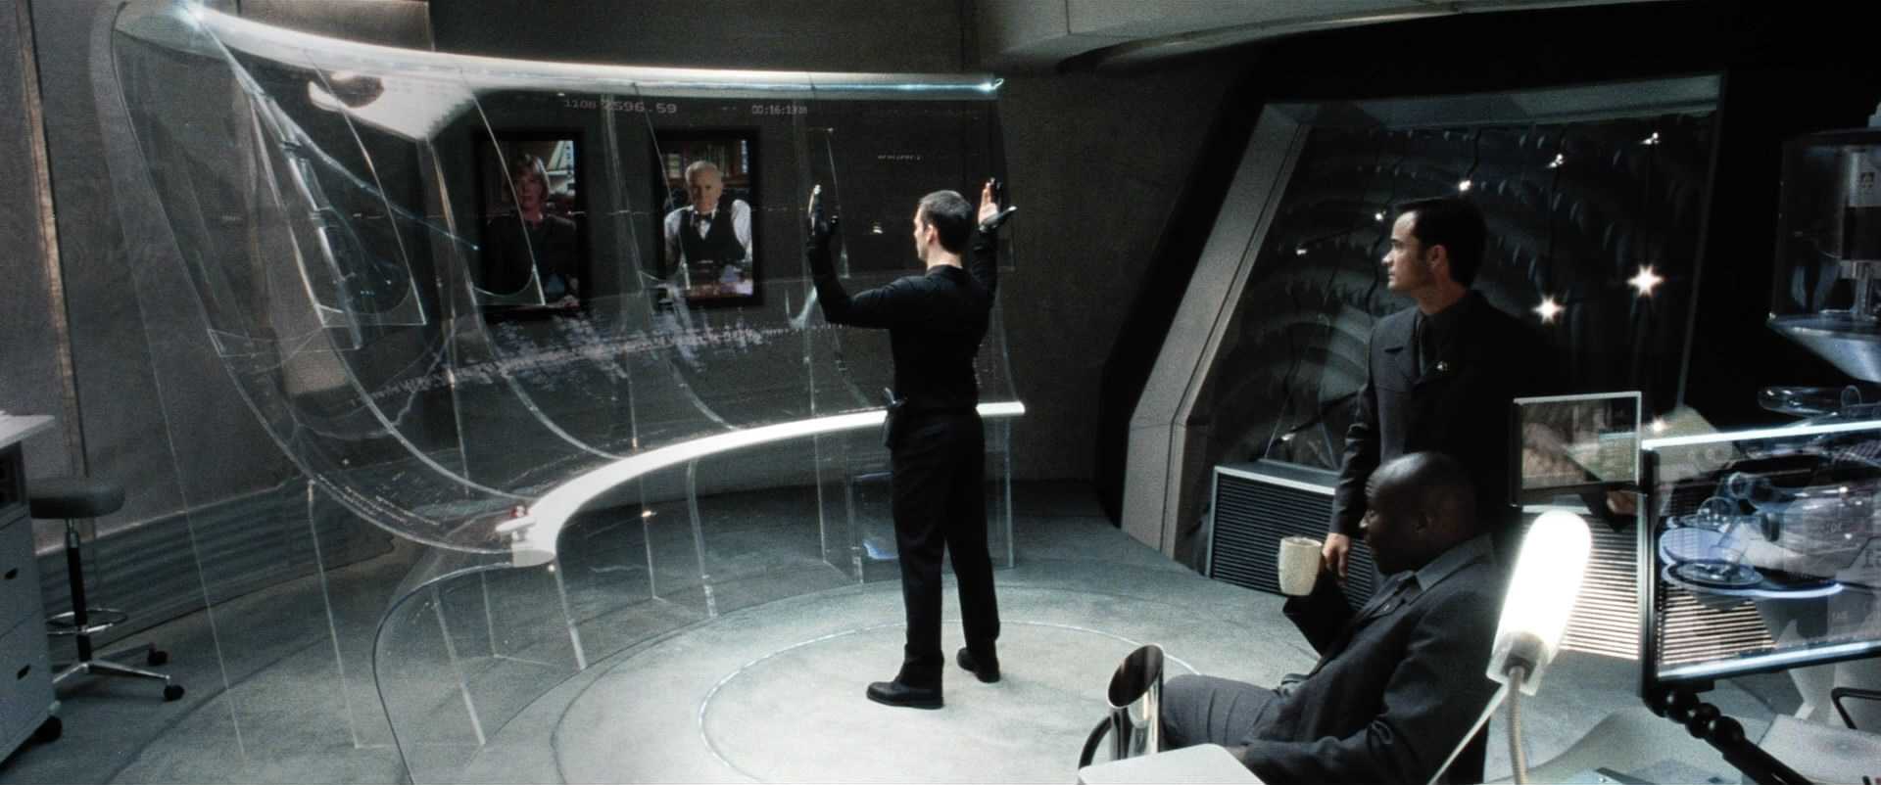
What we feel like Virtual Reality looks like

Slide 4
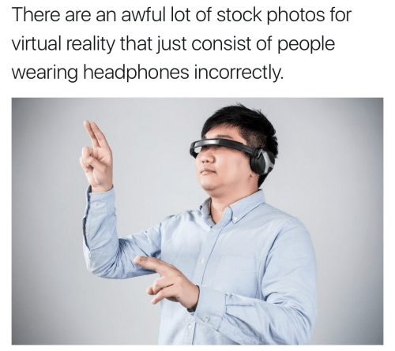
What Virtual Reality actually looks like

Slide 5
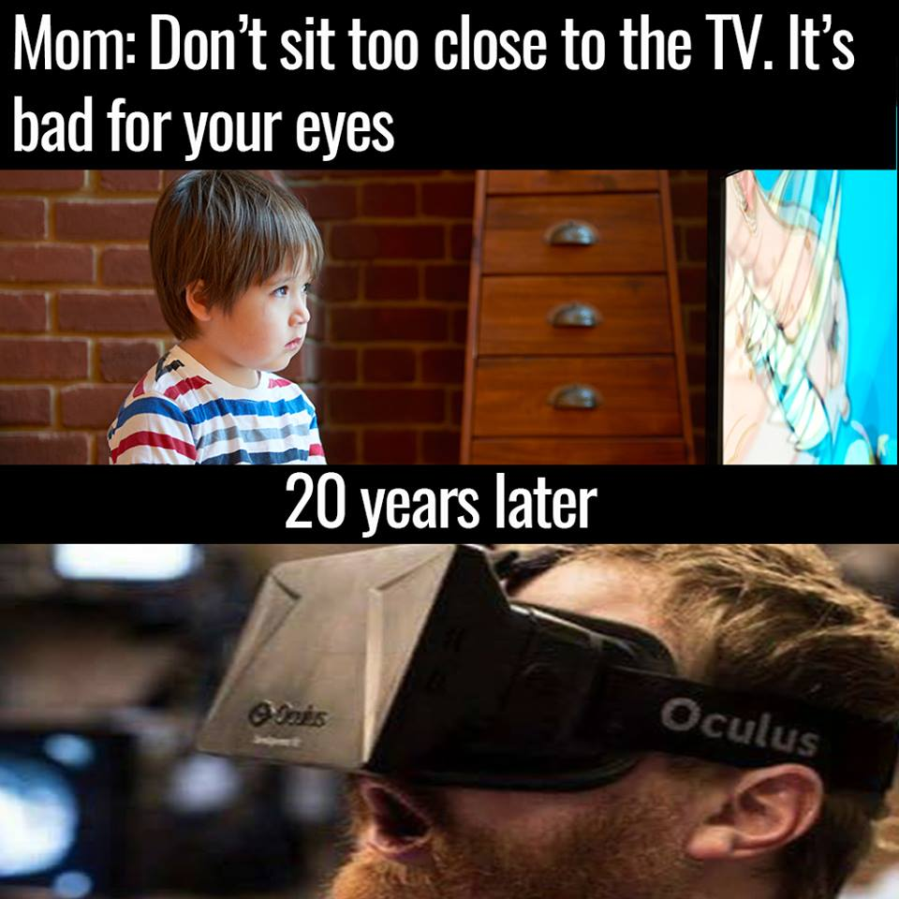
How things have changed…

Slide 6

AR / MR / VR/ even XR??????

Slide 7
Definitions
VR = Virtual Reality
AR = Augmented Reality
MR = Mixed Reality
XR = Extended Reality

Slide 8
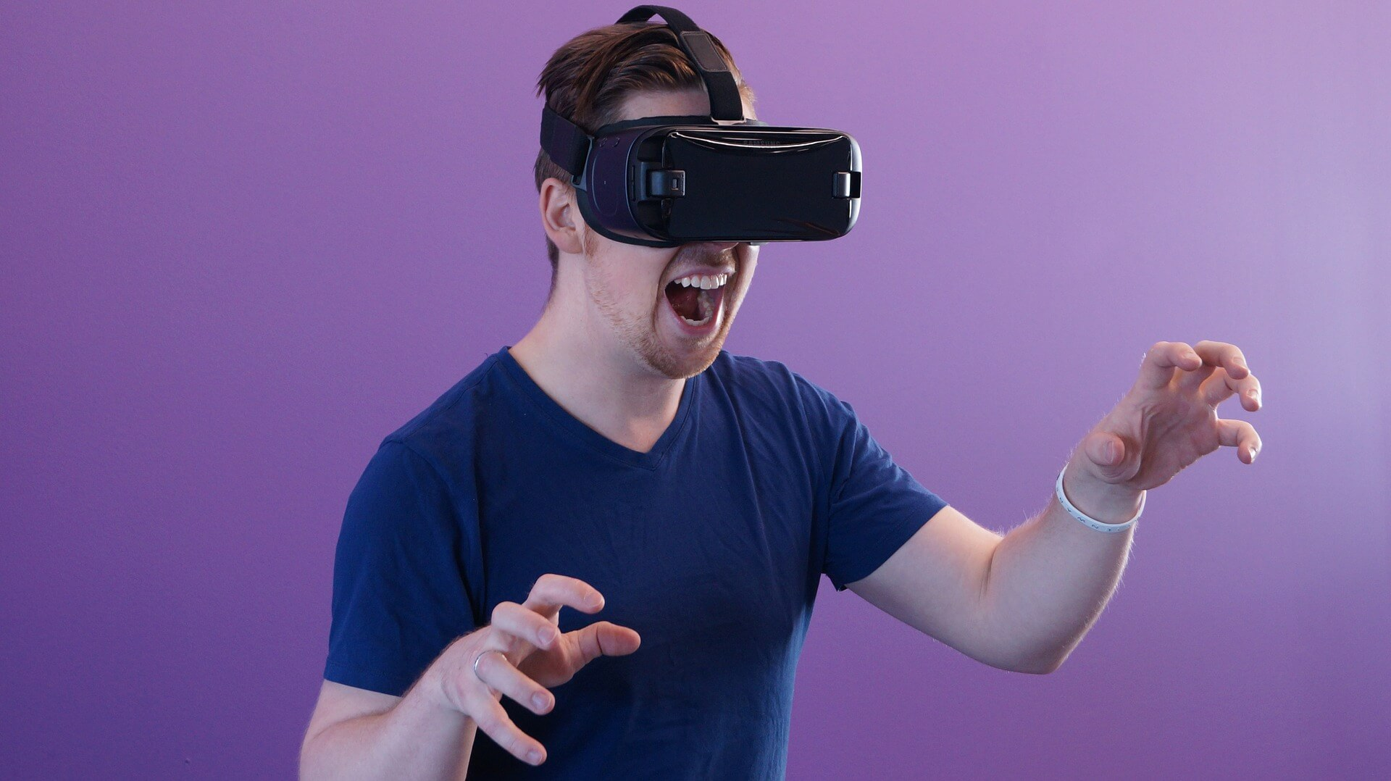
Virtual Reality
Notes:
Virtual Reality (VR)
Virtual Reality might be the one you are most familiar with.
VR is the term used to describe a three-dimensional, computer generated environment which can be explored and interacted with by a person. That person b is immersed within this virtual environment and in most cases is able to manipulate objects or perform a series of actions.
Many people know VR through the use of Head-Mounted Devices (HMD) like the Oculus Rift, HTC Vive, or Google Cardboard. If you want to know more about HMDs, check out this blog article.
What is less known by the public is that there are many different types of virtual reality systems, like VR Caves or VR theatres developed for use within scientific and engineering industries.
It makes use of an artificial environment generated by the computer in which simulates the real environment. Besides gaining an immediate acceptance in the world of computer games, it is now being used in many fields of life including architecture, medicine, military and aviation. Scientists and researchers are expecting to explore a lot in this modern technology than what we know about it today. It is a great leap in the field of 3D and a lot of work is still under progress. The discussion below is an insight into the details of this technology, its uses, advantages, disadvantages and social impacts.
Types of Virtual Reality:
There are three main types of virtual reality technology:
The one uses a helmet, ear phones and a pair of special gloves or joy sticks controlled by a computer and assisted by special sound effects and graphic images.
The one makes use of the video cameras. These cameras track the image of the participant in an artificially created virtual world. The participant can even move the objects in this world using virtual technology.
The one that makes use of the three dimensional images. The screen used is shaped in a curve. This makes the images closer to the real world. (Nigel W. John, Joanna Lang (2001). Pub game, Temple run, subway surf, Discovery VR, Orbulu, Incell VR are some examples of Virtual reality based apps in market. Moreover Virtual reality is much more beneficial for the video game industry.
Advantages of VR:
Virtual reality provides the diverse types of data available in instant forms.
It provides images from many different points of views.
It is able to demonstrate the non-visible data to the user like in case of geochemistry.
Allows a person to ‘visit’ the places normally inaccessible to individuals.
Provides an experience which can be repeated and revised.
Limitations of Virtual Reality:
It only creates imaginary world or an artificial world, but can’t deal with the real world objects.
Though having capabilities of being used for educational purposes, it devalues the importance of human connections and synergy in education.
Virtual Reality is rigid and lacks flexibility

Slide 9
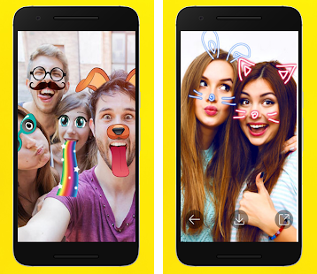
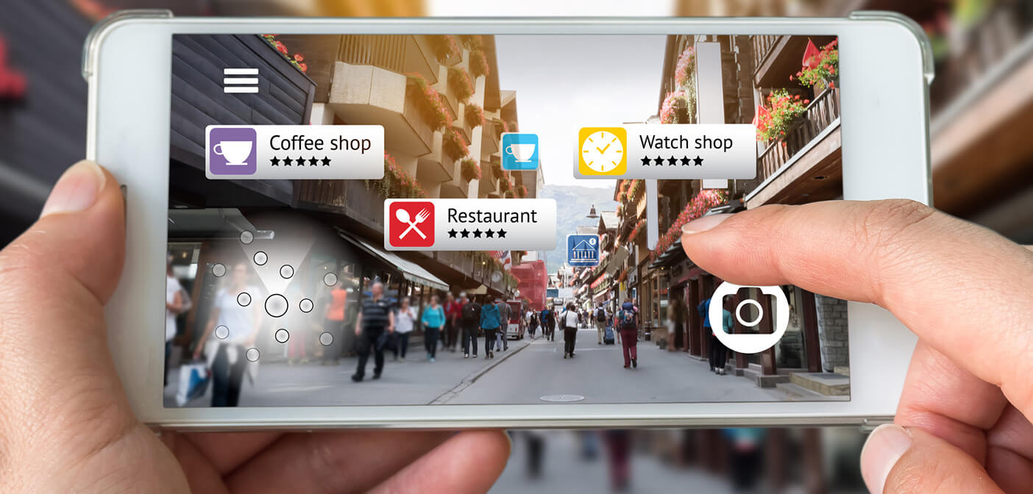
Augmented Reality
Notes:
What is augmented reality (AR)?
Augmented reality is a technology enriching the real world with digital information and media. It adds graphics, sound, feedback, and smell to the natural world as it exists. It blurs the line between what's real and what's computer-generated by enhancing what we see, hear, and feel. It may be called as an add-on pack to the VR i.e. Virtual reality. In simple words, Virtual objects overlaid on real environment in augmented reality.
It is the integration of digital information with the user's environment in real time. Unlike virtual reality, which creates a totally artificial environment, augmented reality uses the existing environment and overlays new information on top of it. Mankind never satisfies. And the concept of augmented reality itself begins with dissatisfaction with the way the world appears before us. It creates a world which is special to each one of us as if the God has listened to our wishes. SketchAR, Mondly, Pokemon Go , AutoCAD for android, Asian paints colour selection app and Snapchat are the few AR based applications which are very popular and widely used in general.
Types of augmented reality
Augmented reality is basically divided into four different categories as follows:
Marker Based augmented reality It uses interfaces like camera or some type of visual marker such as QR/2D code to produce result when the marker is sensed by a reader.
Marker-less augmented reality Marker less AR uses a GPS, digital compass, velocity/accelerometer which is embedded in the devices to provide data based on user’s location.
Projection based augmented reality It includes the projection of artificial light on real world objects. This artificial light senses a human touch and accordingly the miracle happens!
Superimposition based Augmented reality Superimposition based augmented reality either partially or fully replaces the original view of an object with a newly augmented view of that same object.
Advantages of augmented reality (AR):
Increase Sales: Apps such as lens-kart are AR based app which enables the customer to check if the product justifies his/her need or not. Hence AR helps in increasing sales by increased customer interaction. A recent start-up called “StyledotMe” got the momentum in jewellery industry.
Enriches Content: Unlike VR, AR is much more interactive with the real world which enriches the experience and content both at the same time
It can be used for training and skill development applications in various industries such as military, loco-pilot training, nuclear plant trainings etc. As it is having human interaction with virtual and real world as well.
Despite of having these advantages, augmented reality also have some cons mentioned below:
Limitations of Augmented reality
In some specific cases, it becomes too ambiguous to implement. As the number of layers increases, sometimes it looks not mixing of not fulfilling the exact environment needs and loses its user friendly charm.
Content may obscure or narrow a user’s interests or tastes.
Privacy control is a big challenge with AR.

Slide 10
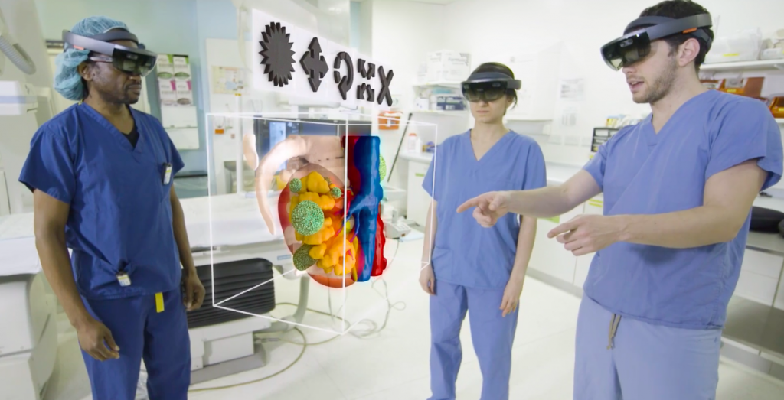
Mixed Reality
Notes:
What is mixed reality?
Mixed reality is the combination of what is best in VR and AR respectively. It’s a blend of best features of Virtual reality and augmented reality. Mixed reality indicates videos where VR-content is integrated into a real time linear video. Mixed reality (MR) not just overlays but anchors virtual objects to real world objects and allows the user to interact with combined virtual/real objects.
Simply, mixed reality is that mixed reality is a type of hybrid system that involves both physical and virtual elements. Many experts describe mixed reality as the sliding scale between a fully physical environment with no virtual elements, and a completely virtual environment. For instance, while it uses a headset just like VR, seeing through a translucent viewport or glass, it also projects visuals on top of our environment.
Microsoft CEO sees mixed reality as the key technology that would shape the future in the decades to come.
Major advantages of mixed reality:
What make MR stand out are its highly interactive aspect, and the realistic rendering of the projection it adds to our surroundings. Instead of depending solely on remote controllers or phone screens, we can interact with the immersive content using natural body and finger gestures.
Mixed reality eliminates the disadvantages of both VR and AR.
Disadvantages of Mixed reality:
Equipment cost for MR is too expensive
Large file sizes and low resolution content problems
It may affect the social life adversely just like a bad addiction
For using Mixed reality in business, one needs a sound technical team as well otherwise issues may not be addressed at a time
Some exclusive applications of Mixed Reality:
Mixed reality can take interactive product content management (IPCM) to some other level.
Mixed reality allows a global workforce of remote teams to work together and tackle an organization's business challenges.
Mixed reality helps manufacturing sector a lot by creating mock-ups of processes.
In health sector, MR can do better with the help of smart glasses. Surgeries have become too much easy and flexible.
MR will make us move from e-learning to simulation based learning, which ultimately will transform the way of modern education.

Slide 11
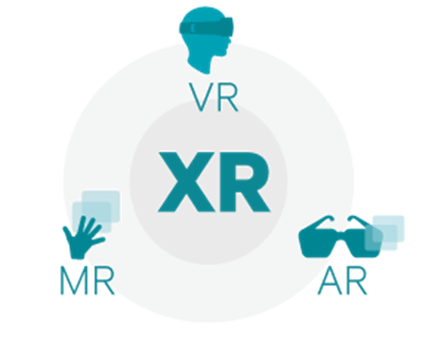
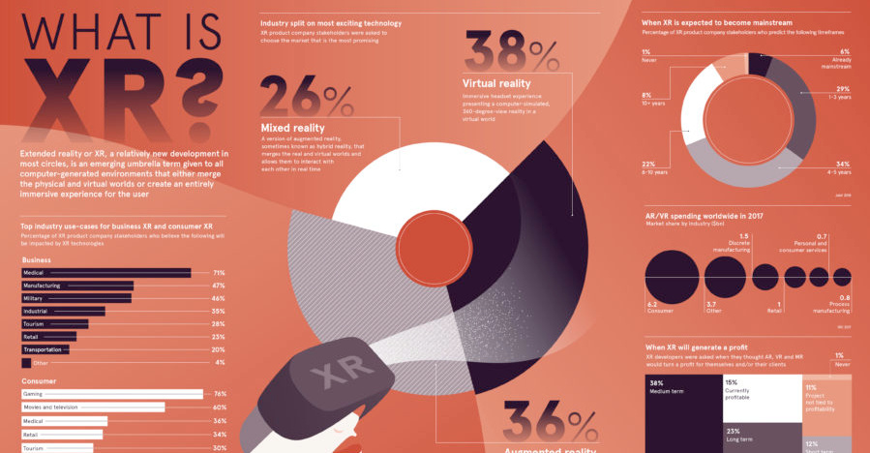
Extended Reality
Notes:
A glance at current use cases shows the potential for XR across industries:
Entertainment
XR brings immersive experiences to the entertainment world, and offers consumers an opportunity to virtually experience live music and sporting events from the comfort of their VR headset. While a majority of market share leans heavily towards entertainment, it’s not the only one gearing up for a virtual expansion.
Marketing
Virtual realities have opened new ways for brands to engage with consumers, offering immersive ways to interact with new products.
Training
Extended reality opens new avenues for training and education. People who work in high-risk conditions – like chemists and pilots – can train in safety from a more conventional classroom setting. Medical students, meanwhile, can get hands-on practice on virtual patients.
Real Estate
Property managers can streamline the rental process by allowing potential tenants to view properties virtually, while architects and interior designers can leverage XR to bring their designs to life.
Remote Work
XR removes distance barriers, allowing remote employees to seamlessly access data from anywhere in the world.
Extended reality is not without its challenges. The spread of data presents a new layer of vulnerability for cyber attacks, while the high cost of implementation is a barrier to entry for many companies.
But even these challenges can’t slow the progress of XR, and the question remains: how will businesses define reality five years from now?
Extended Reality
Extended Reality (XR) is the umbrella term used for VR, AR, and MR, as well as all future realities such technology might bring. XR covers the full spectrum of real and virtual environments.
The use of an umbrella term speaks to the future of XR as a fundamental shift in the way people interact with media. In the future, instead of saying “I’m using AR to attend a business meeting” – it will just be another day at the office. People will interact with the real and virtual worlds in seamless ways, without mention of extended reality’s distinct categories and their underpinning technology.
To use an umbrella term is to recognize the intersection of these technologies, and the many ways they will work together to disrupt our everyday tasks.

Slide 12
Overly complicated?

Slide 13
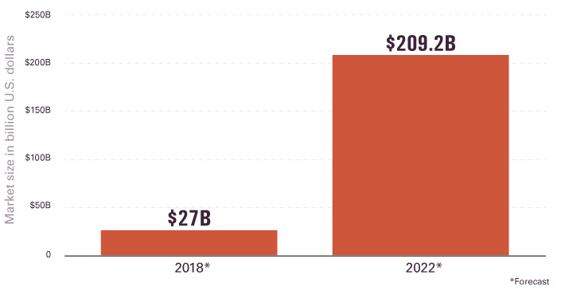
Business Use Case
Notes:
Mixed reality for business
With the growing applications and uses of these non-physical realities, enterprise-level implementation has already started taking its form. Mixed reality is geared up to completely redefine the way an enterprise works. Processes are going to be streamlined, and the way employees engage with their work is going to take an all-new form.
Mixed reality experience can provide enterprise employees with the best of both digital and physical world. It is through mixed reality that users can view digital objects in the actual surrounding, allowing voice-based or gesture inputs for interaction.
Here is the possible scope and applications of mixed reality in businesses:

Slide 14
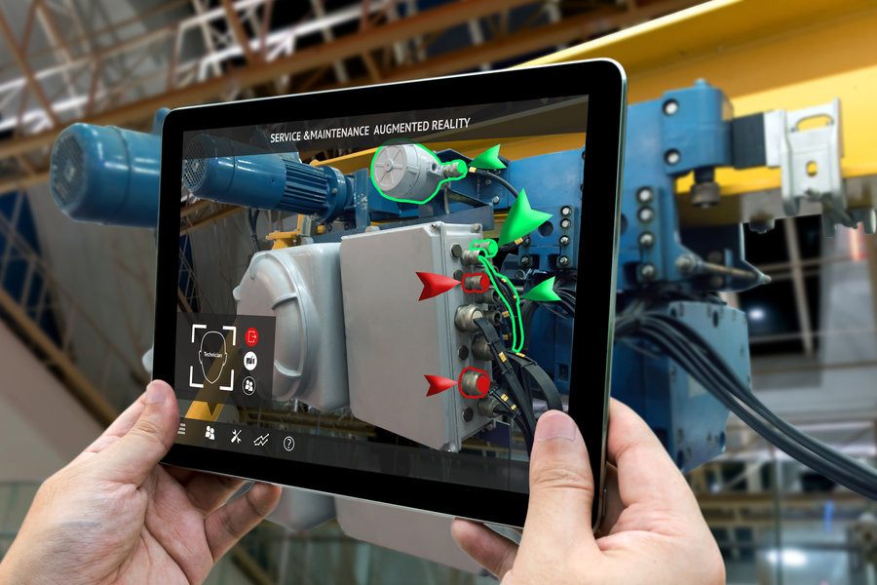
Remote Guidance
Notes:
Remote guidance
In fields such as medicine, infrastructure, operations, sales, and business, tapping into the expertise of professionals or experts is vital. There might be various situations when an enterprise needs an expert on site to deal with complex issues. But this can be costly, and the expert may have a tight schedule that makes it difficult to come to your office. This can be mitigated with mixed reality, as experts can give instructions or advice to deal with the issue even if they are not onsite. One possible example is an experienced surgeon giving guidance to the available medical staff at the hospital in carrying out an emergency operation.

Slide 15
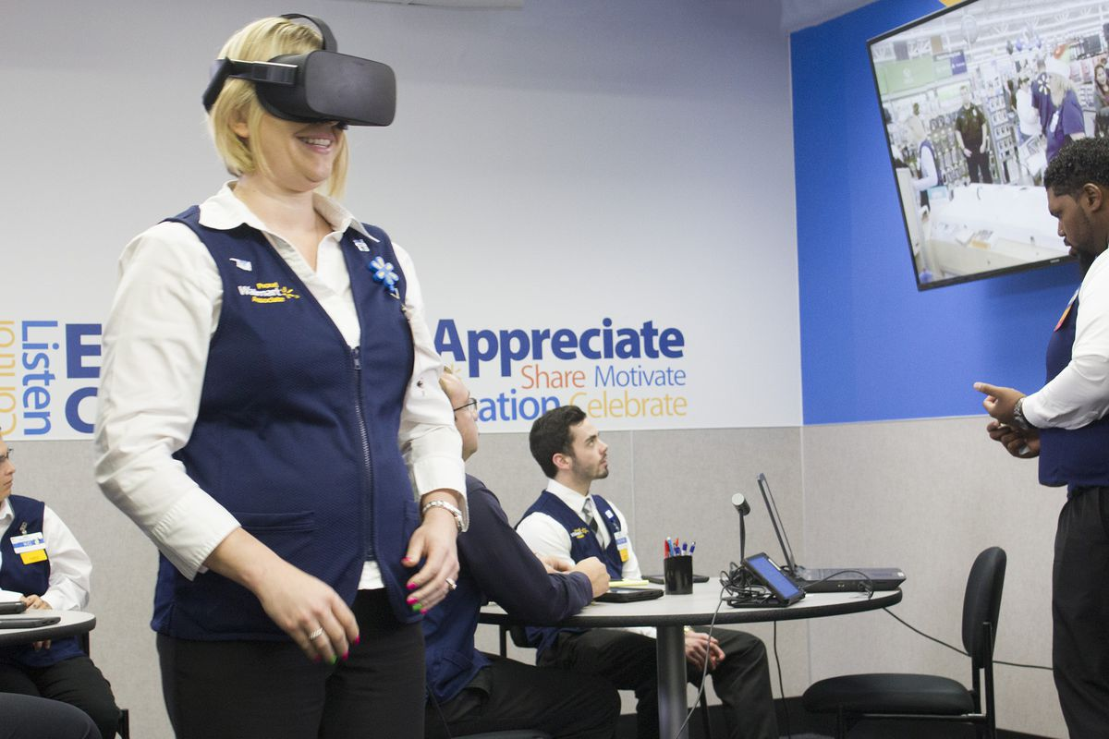
Training
Notes:
Real-time training
Training and education stand out as one of the most important applications of mixed reality. It allows an enterprise to train newly recruited staff in a real-world training scenario through MR. Mixed reality makes it really easy to understand and analyze the topic. For example, understanding an industrial plant can now be done in a classroom, without having to visit the site. Similarly, a car’s engine can be easily understood through MR, without even having a real engine onsite.

Slide 16
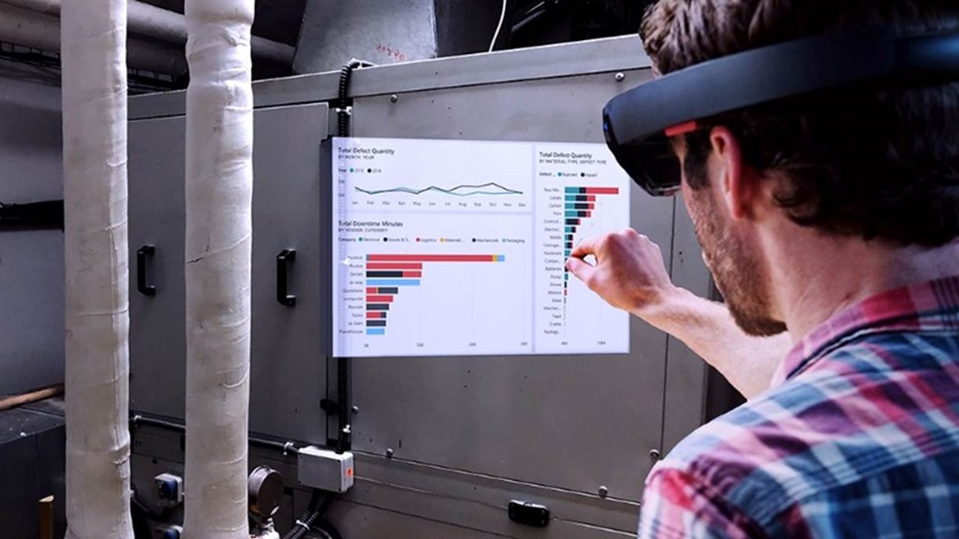
Reports and Analytics
Notes:
Reports and analytics
Through mixed reality, business leaders or concerned teams can simultaneously view and analyze business trends through real-time reports and analysis. Through gesture or voice-based inputs, users can design process flows and get the reports and analytics on the changes made.

Slide 17
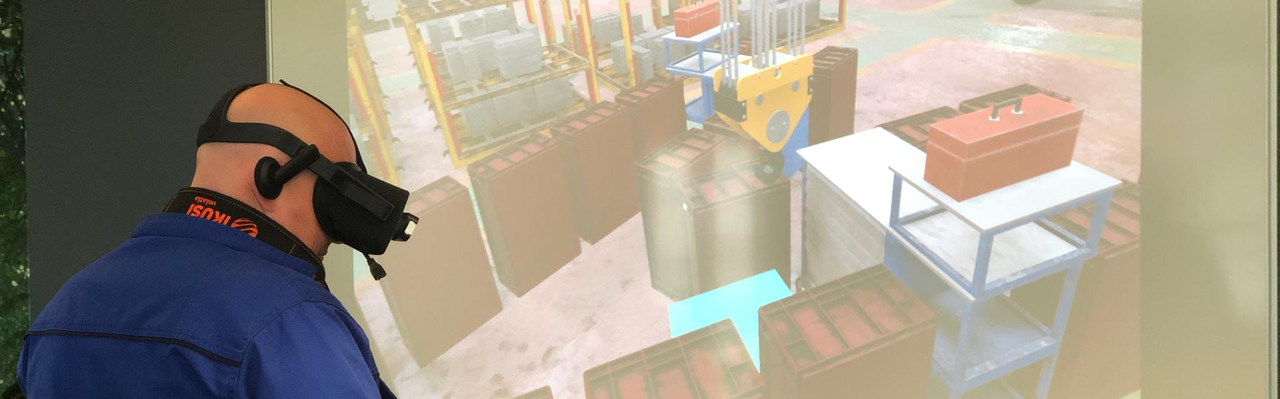
Operations
Notes:
Operations
Operations in any business refer to the employees devoted to the production or delivery of services and products. Operations plays a vital role in various sectors including IT, banking, food service, and the retail industry. By implementing mixed reality, companies can boost employee productivity and streamline operations. Field service employees, technicians, factory workers, and system operators can manage operations in a much better way using mixed reality.

Slide 18
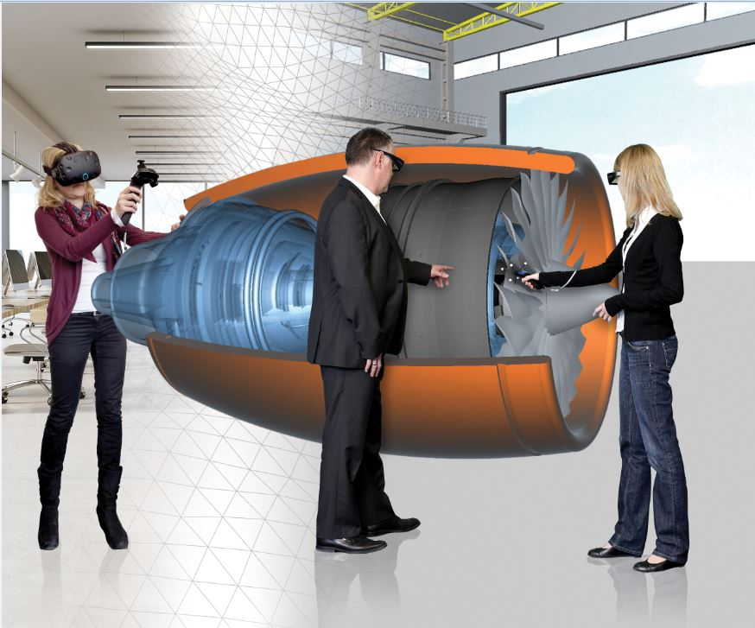
Prototyping
Notes:
Prototyping
Mixed reality has the ability to completely redefine prototyping at an enterprise level. The UI and UX workflows will not just be confined to flowcharts and sample image models, rather they can be brought to real life through mixed reality applications. End users or clients can also view the real-time flow of the product using MR projections. This way, costs involved in various phases of development can be brought down along with the making of better prototypes.
Apart from these, better communication and collaboration, effective results, and reduced costs and time are few other essential advantages of implementing mixed reality in business.
Considering all the applications and advantages of mixed reality, businesses should be embracing it. Many leading enterprises and organizations have already started implementing mixed reality to find possible ways to integrate it into their business processes and operations. If mixed reality is properly adopted and implemented at an enterprise level, mankind can soon witness the biggest fundamental shift in the way we interact with machines. Instead of using keyboards, mouse, or any other physical device to interact with the systems, we will be using holograms or virtual input systems.

Slide 19
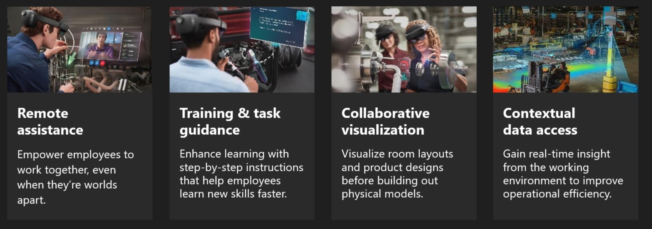

Slide 20
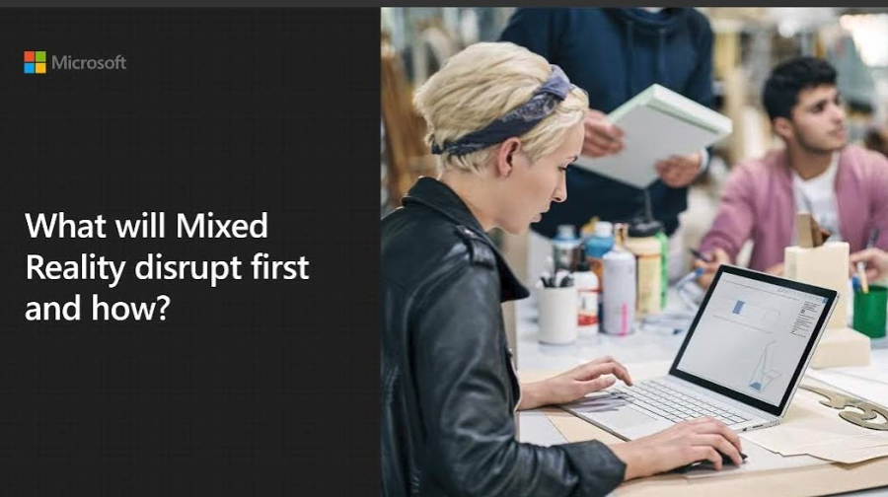

Slide 21
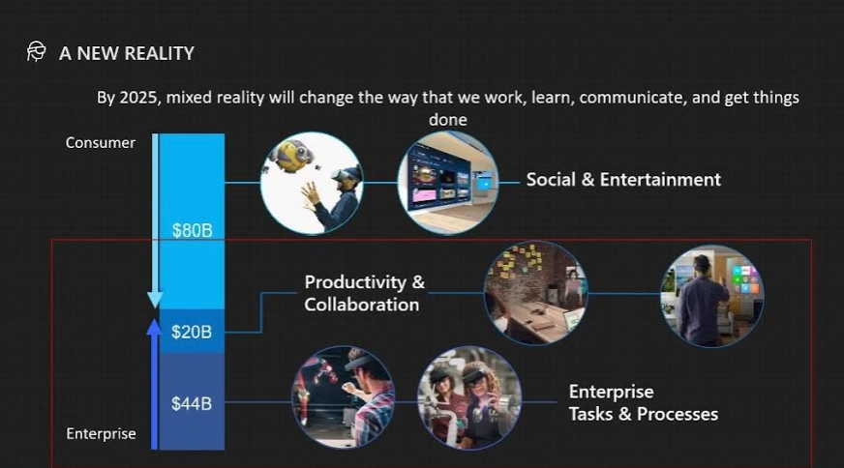

Slide 22
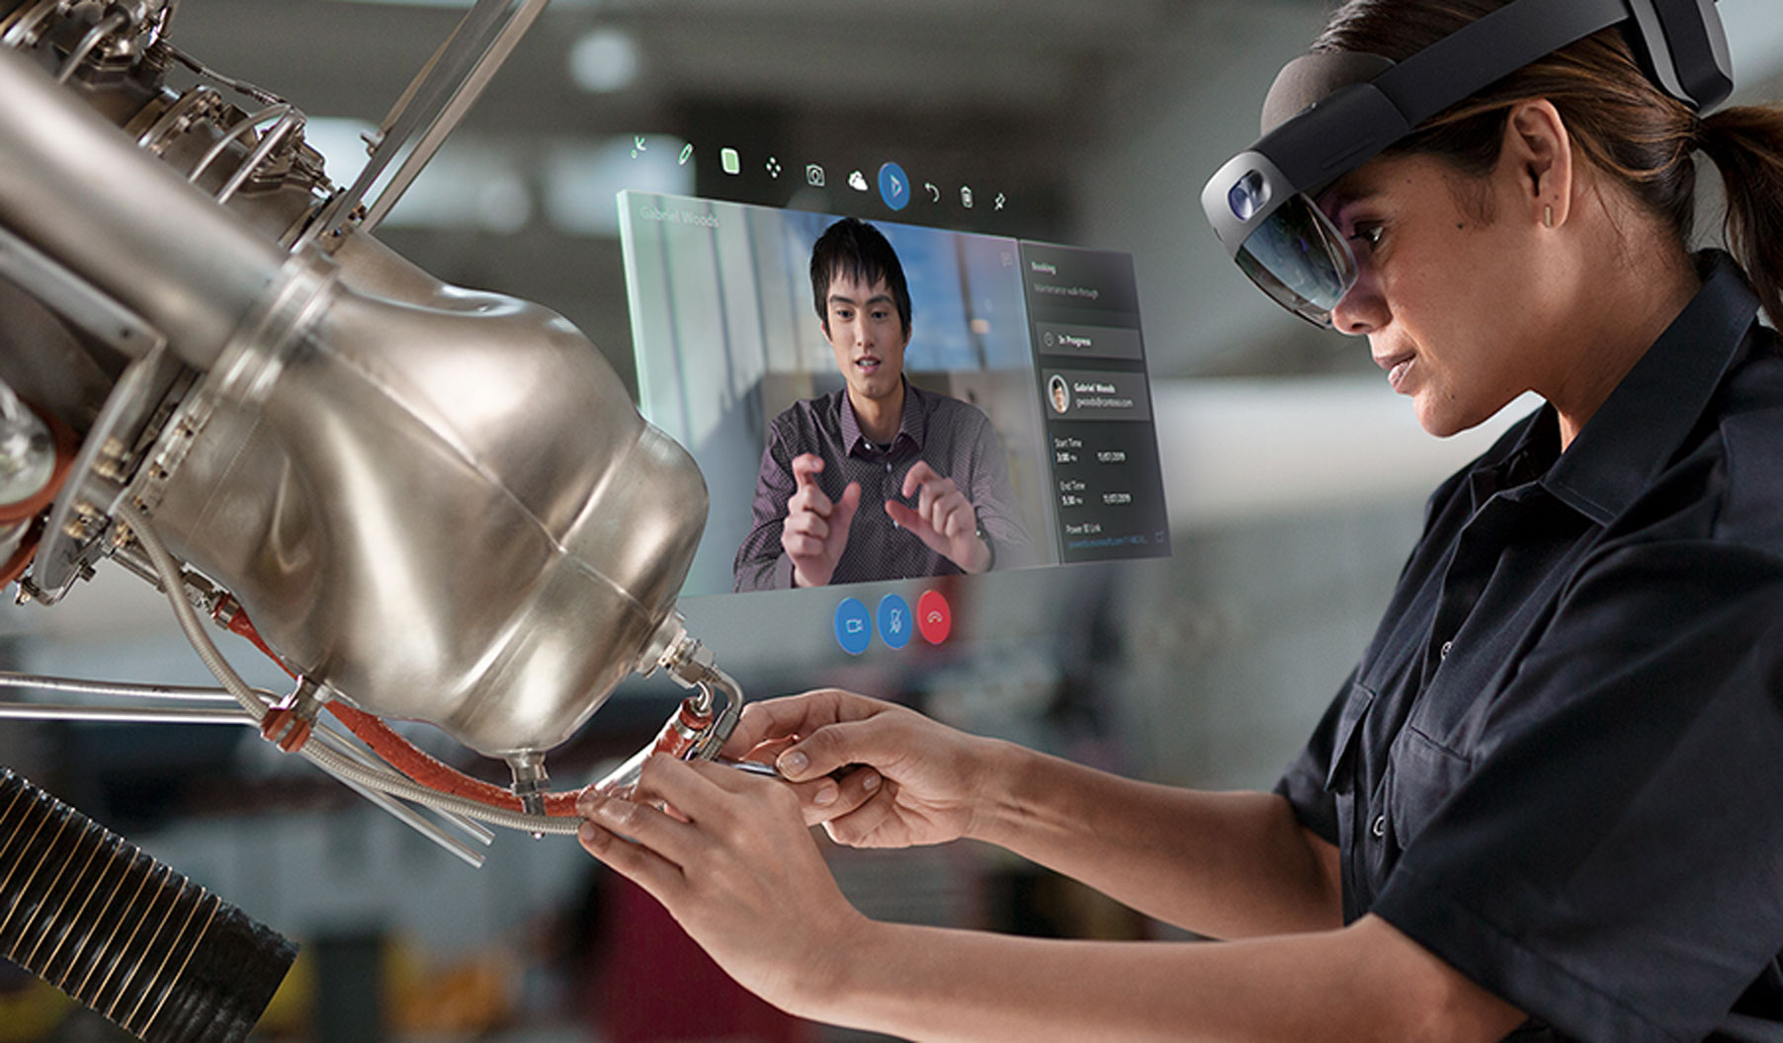
Current offerings from Microsoft: Remote Assist
Notes:
Remote Assist
Microsoft Layout
Layout input tool
Azure Mixed Reality
Azure Mixed Reality Services
Windows Mixed Reality Headsets
Hololens 1
Hololens 2
Microsoft Guides

Slide 23
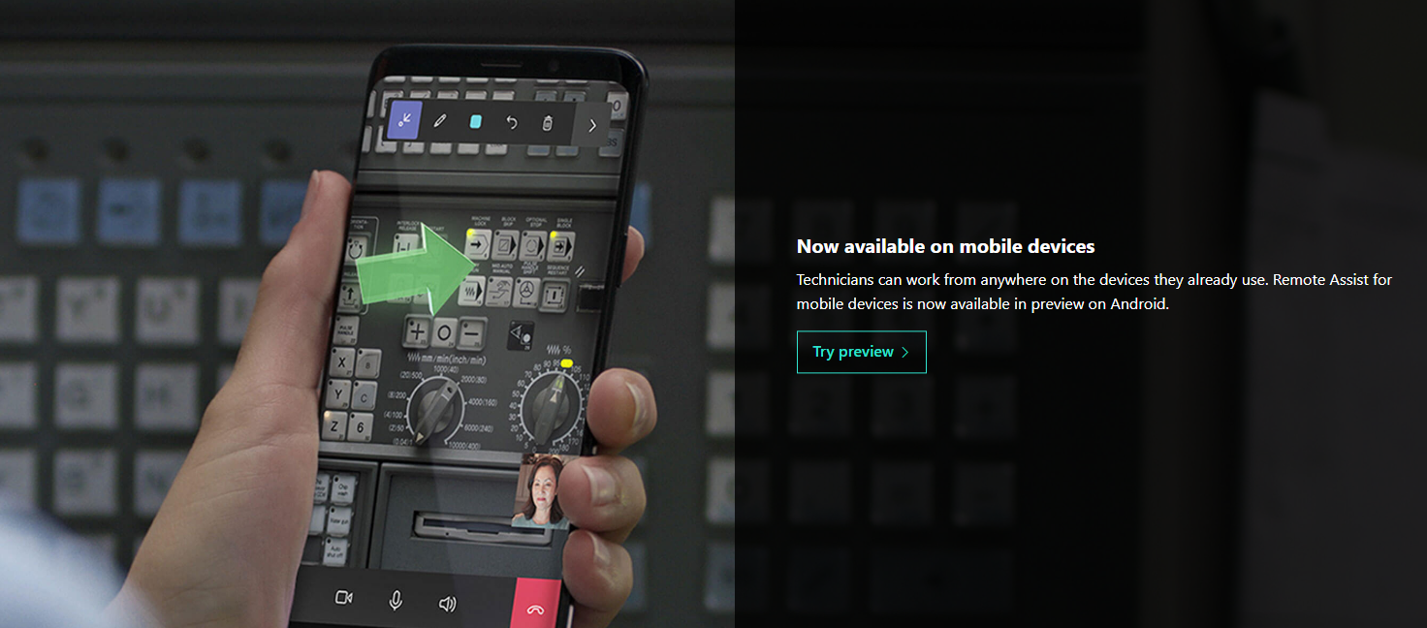
Current offerings from Microsoft: Remote Assist
Notes:
Remote Assist
Microsoft Layout
Layout input tool
Azure Mixed Reality
Azure Mixed Reality Services
Windows Mixed Reality Headsets
Hololens 1
Hololens 2
Microsoft Guides

Slide 24

Current offerings from Microsoft: Remote Assist
Notes:
Remote Assist
Microsoft Layout
Layout input tool
Azure Mixed Reality
Azure Mixed Reality Services
Windows Mixed Reality Headsets
Hololens 1
Hololens 2
Microsoft Guides

Slide 25
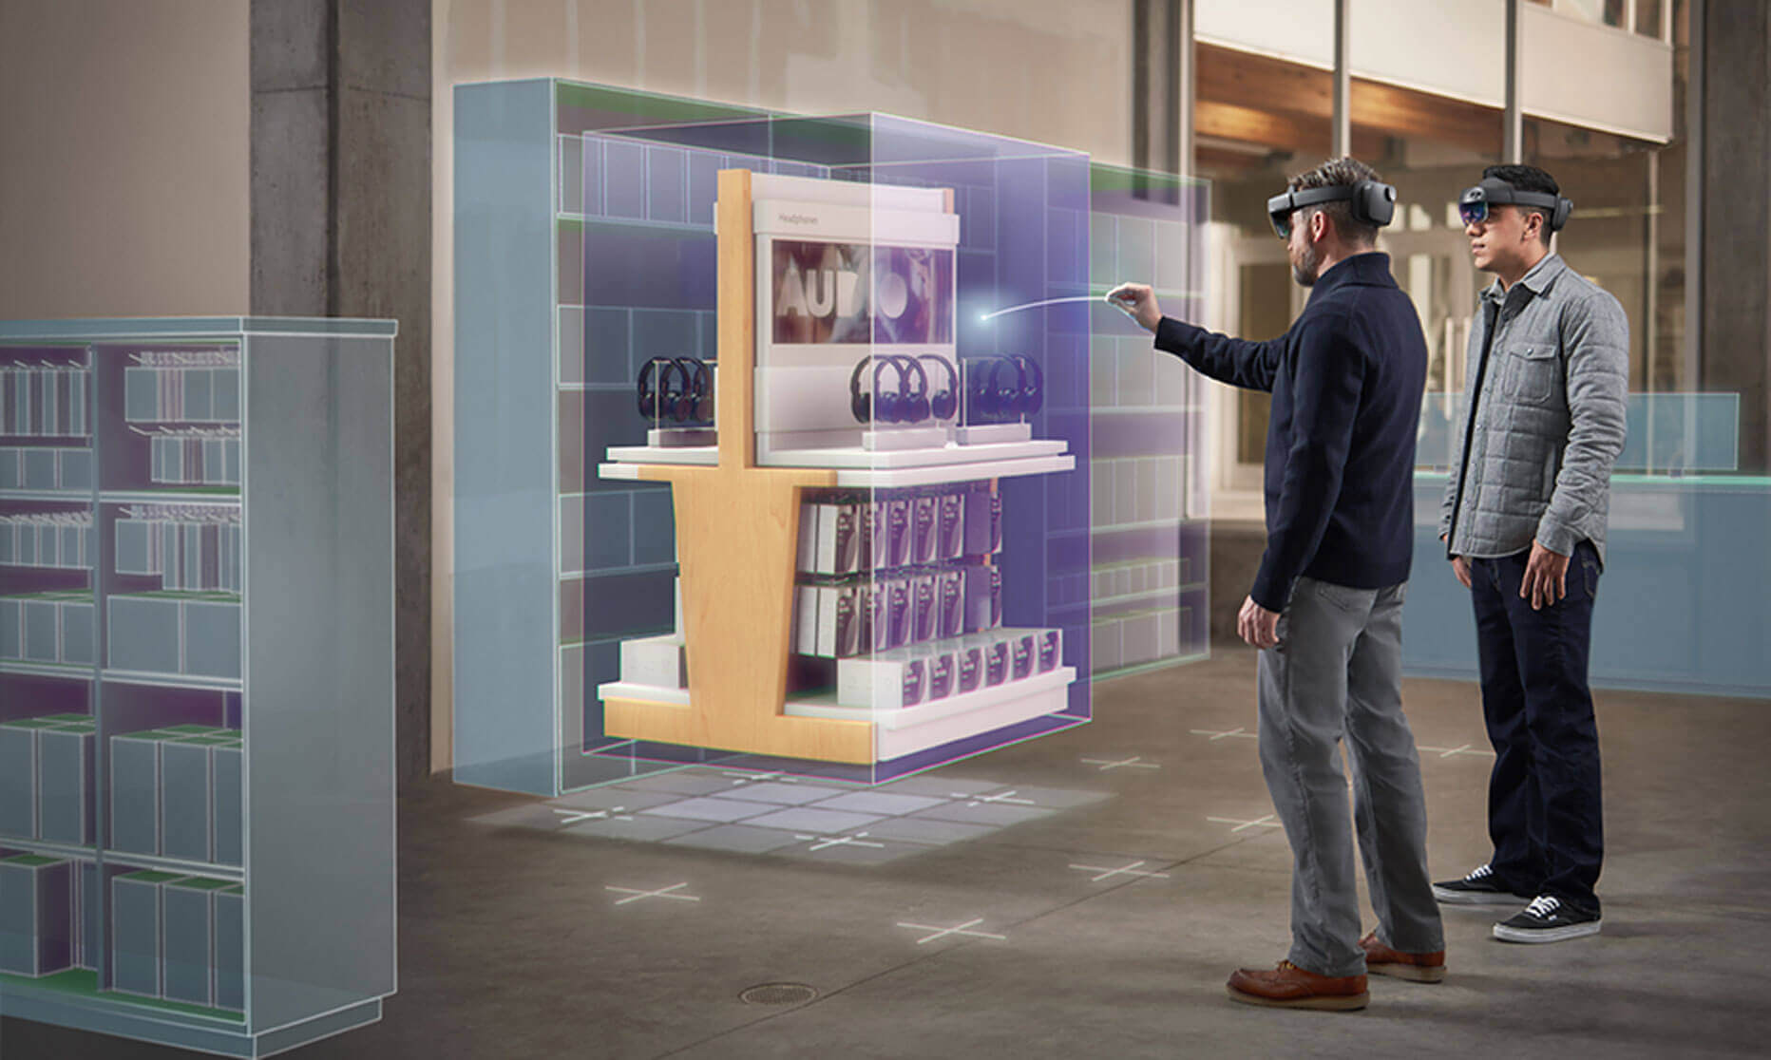
Current offerings from Microsoft: Layout
Notes:
Remote Assist
Microsoft Layout
Layout input tool
Azure Mixed Reality
Azure Mixed Reality Services
Windows Mixed Reality Headsets
Hololens 1
Hololens 2
Microsoft Guides

Slide 26
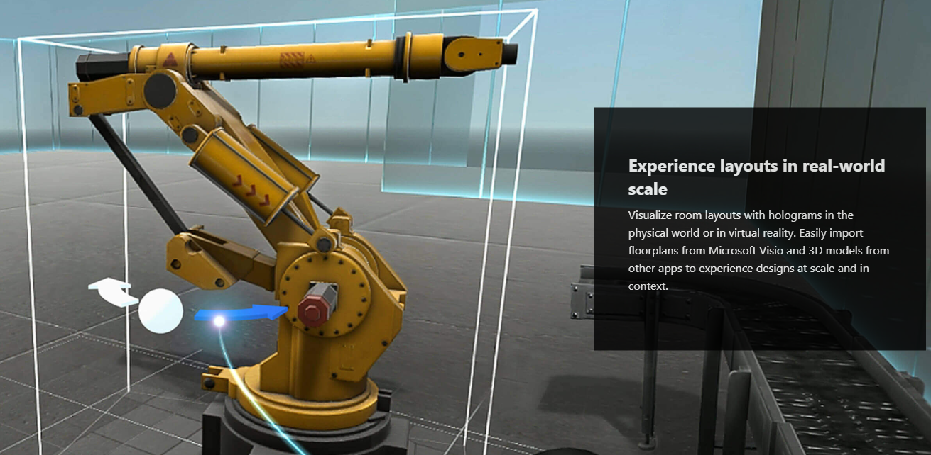
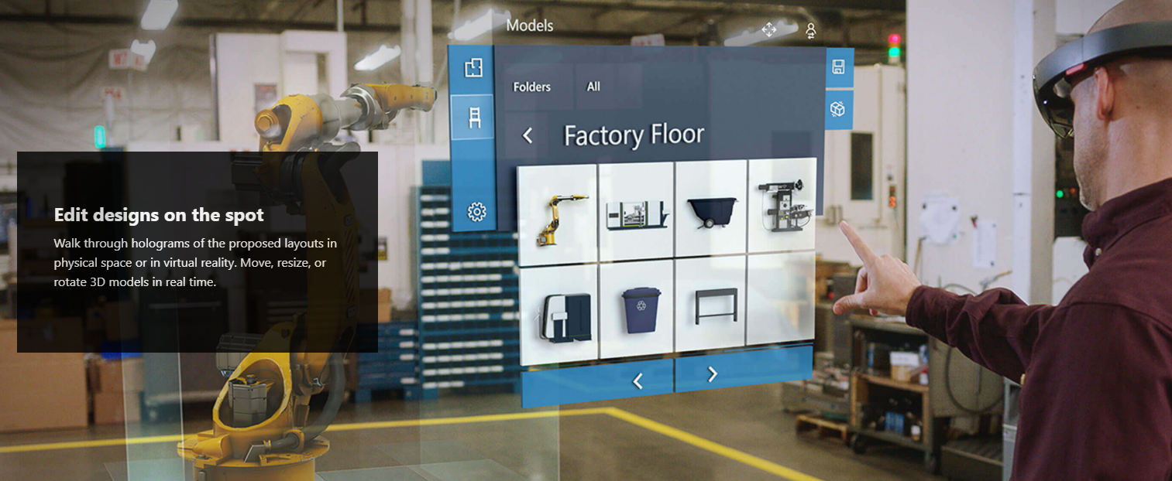
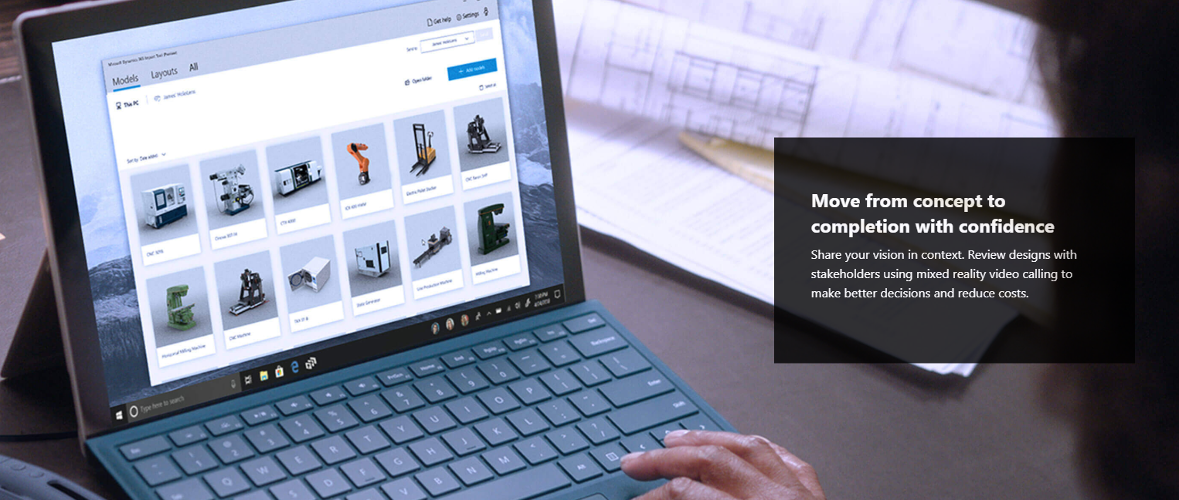
Current offerings from Microsoft: Layout
Notes:
Remote Assist
Microsoft Layout
Layout input tool
Azure Mixed Reality
Azure Mixed Reality Services
Windows Mixed Reality Headsets
Hololens 1
Hololens 2
Microsoft Guides

Slide 27

Current offerings from Microsoft: Layout
Notes:
Remote Assist
Microsoft Layout
Layout input tool
Azure Mixed Reality
Azure Mixed Reality Services
Windows Mixed Reality Headsets
Hololens 1
Hololens 2
Microsoft Guides

Slide 28
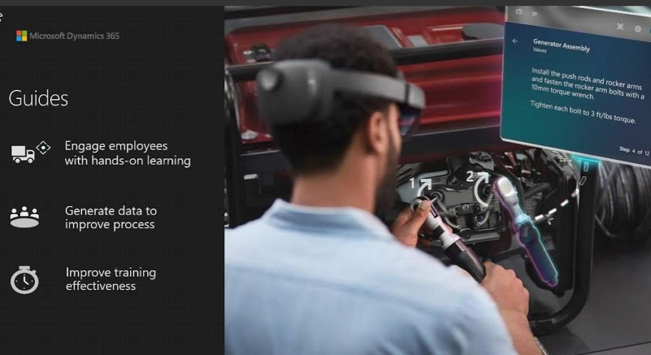
Microsoft Options: Guides

Slide 29
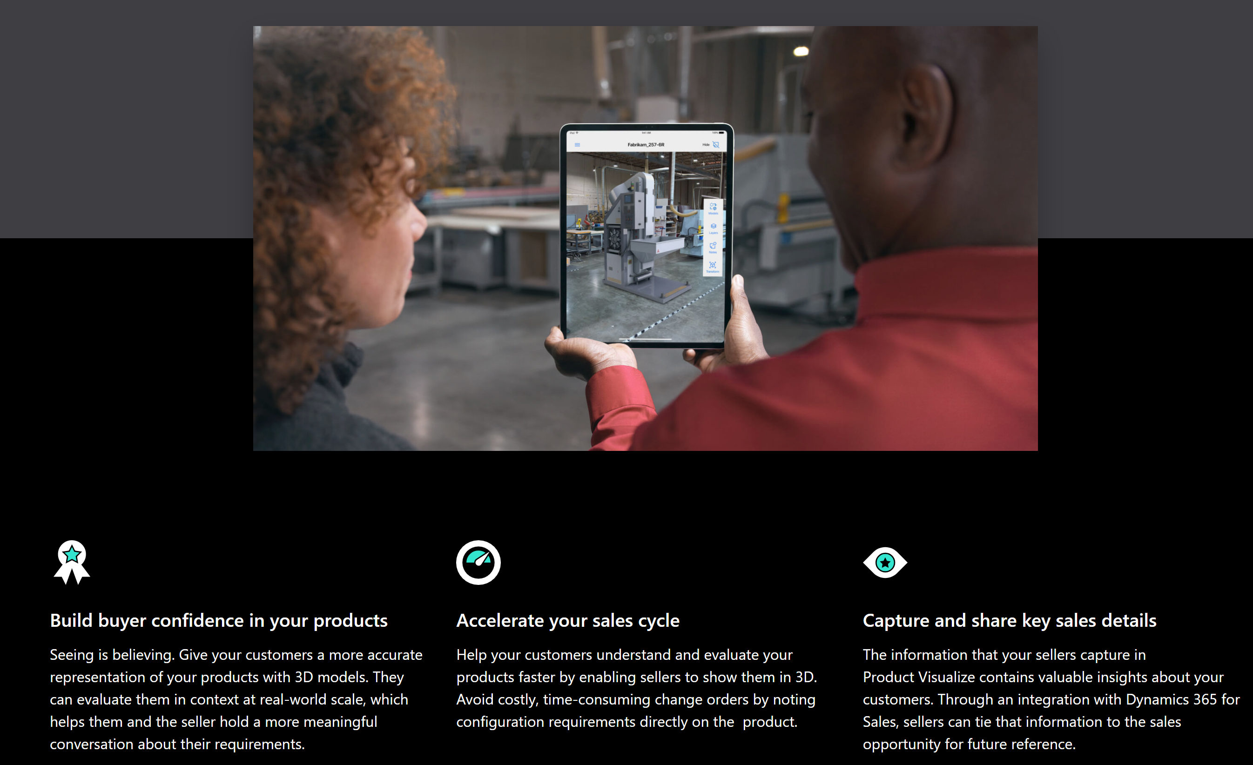
Microsoft Options: Product Visualize
Notes:
Dynamics 365 Product Visualize^{Preview}
Help your sellers meet their customers’ needs faster with mixed reality. Using Product Visualize, now in preview for iOS, sales representatives can place a 3D digital twin of a product in their customer’s environment, let them explore it as if it’s physically there, and make detailed notes about their requirements.

Slide 30
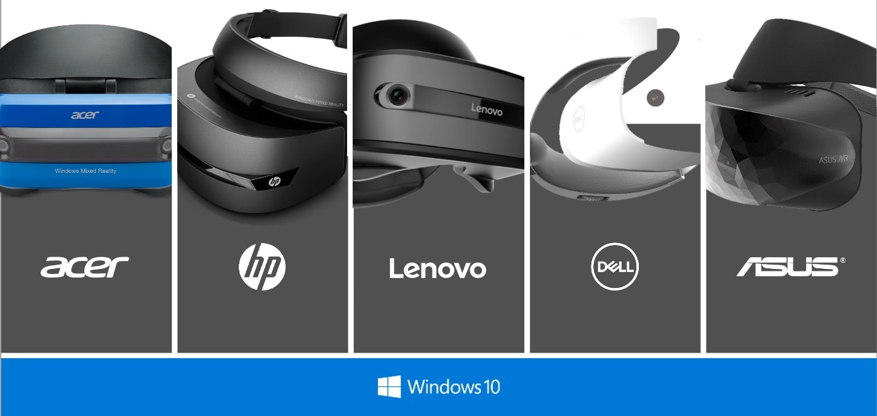
Windows Mixed Reality Headsets

Slide 31
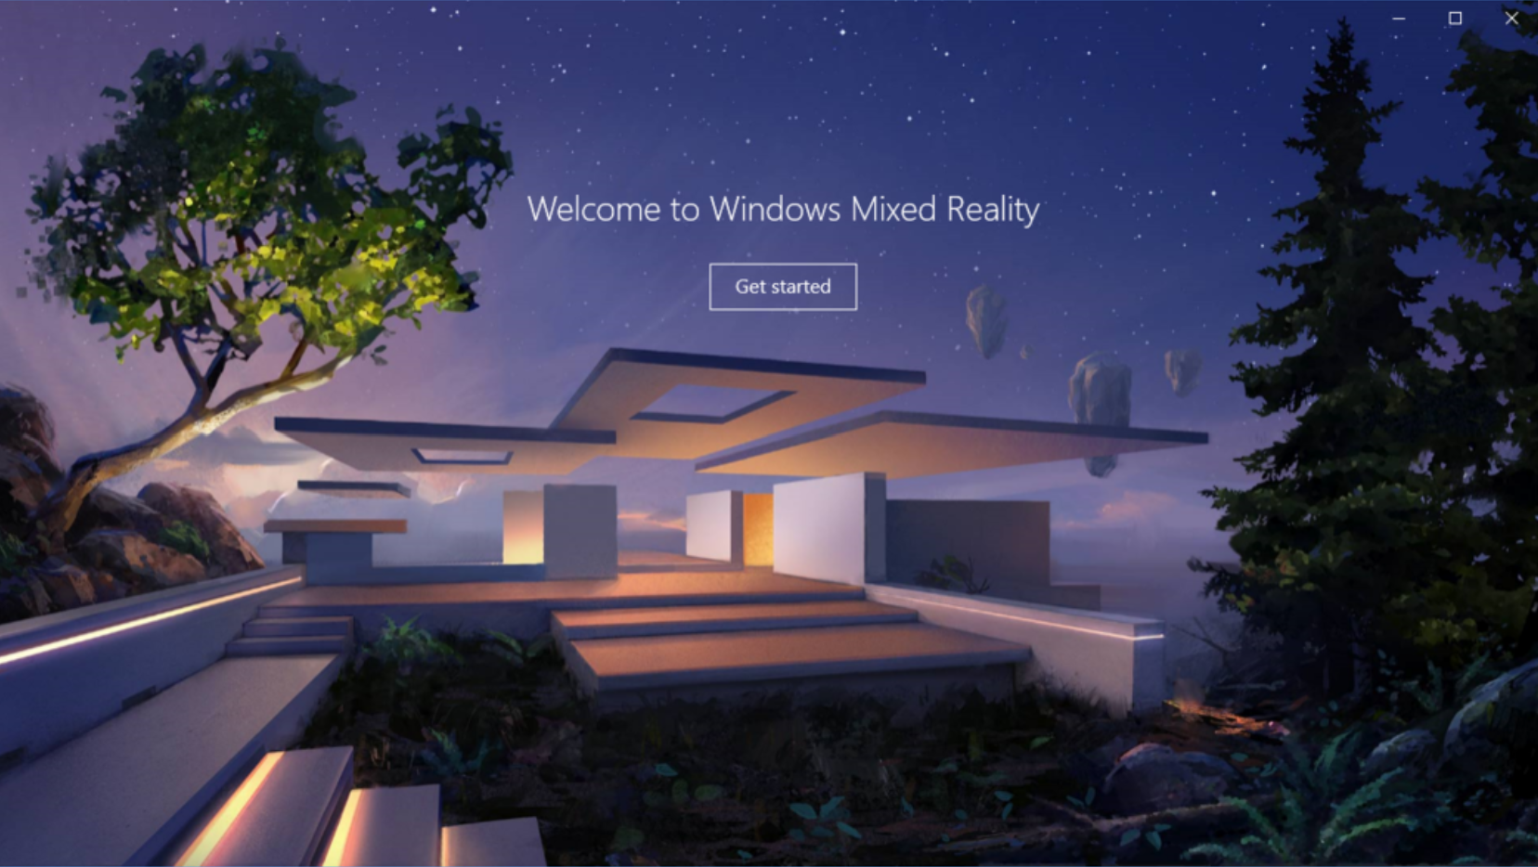
Windows Mixed Reality Portal

Slide 32
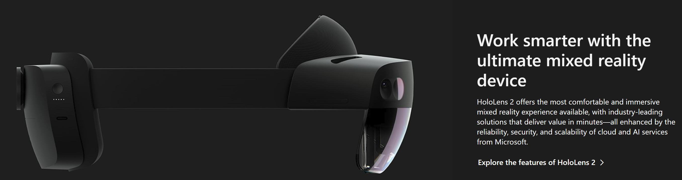
Microsoft Hololens 2

Slide 33
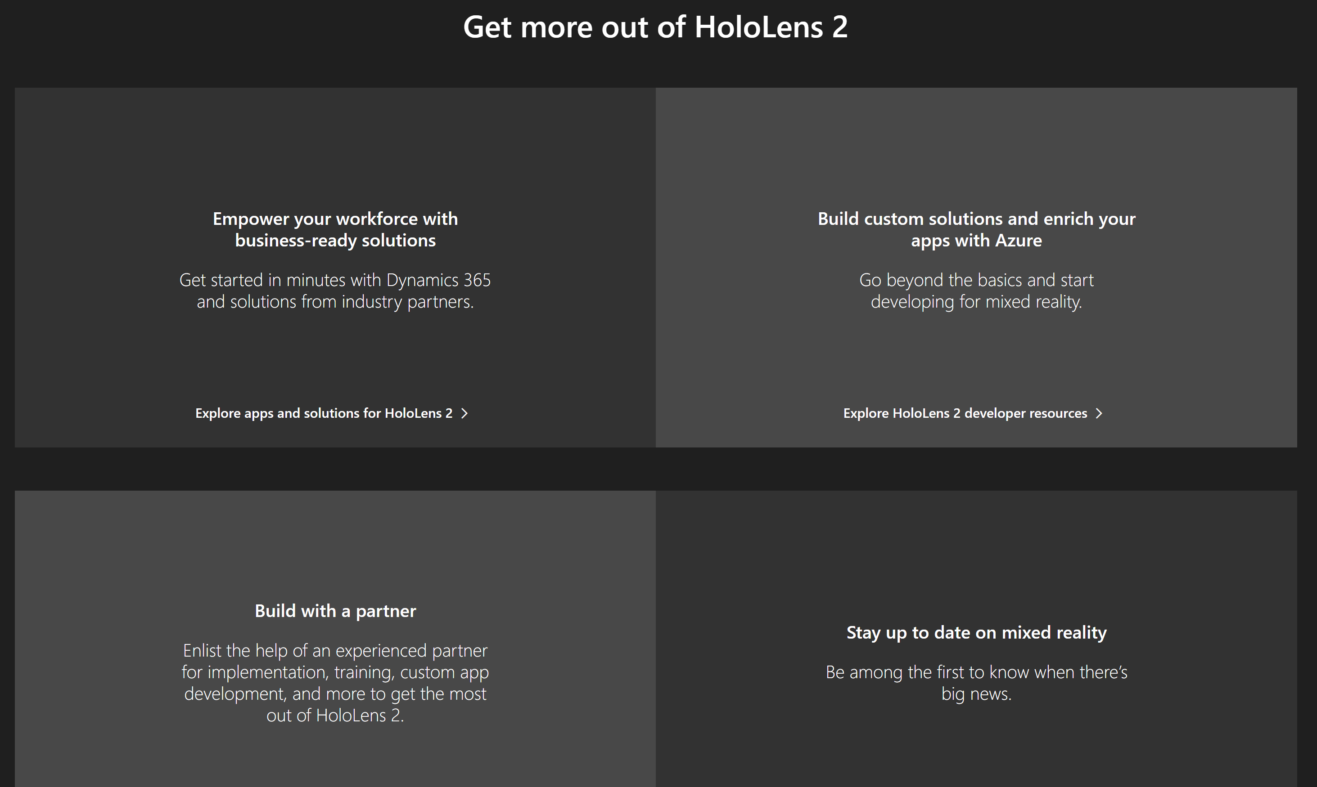
Microsoft Hololens 2

Slide 34
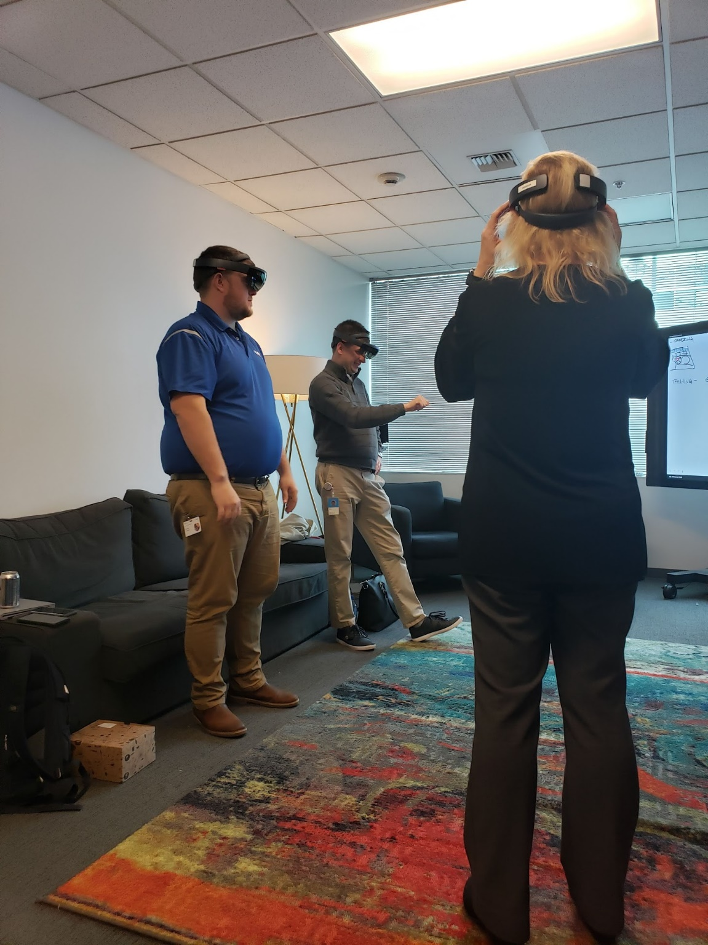
Hololens Projects

Slide 35
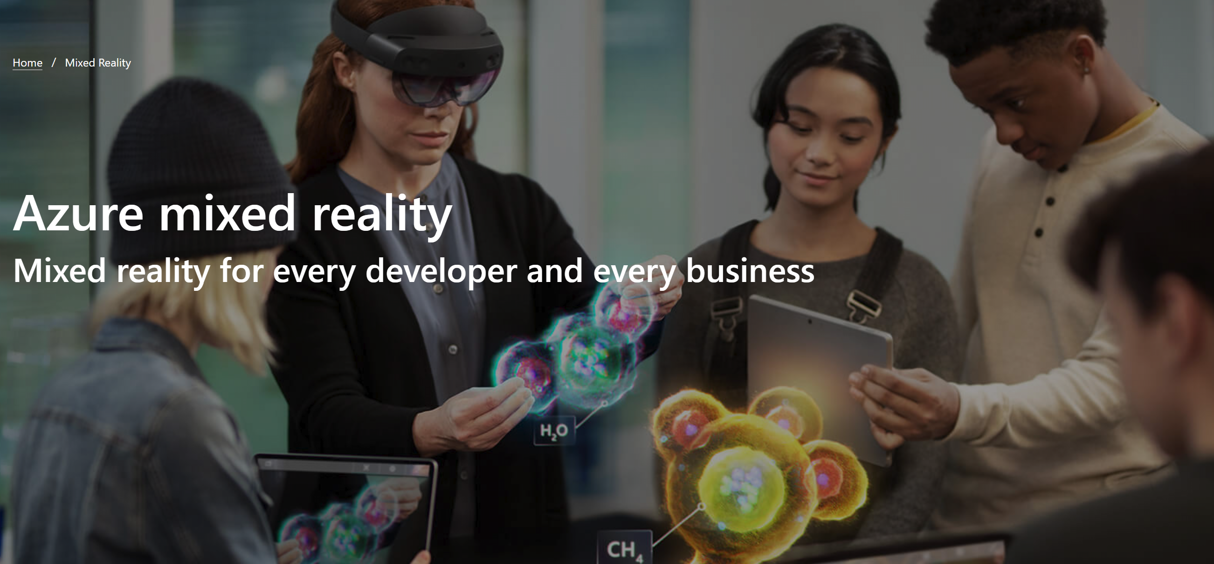

Slide 36
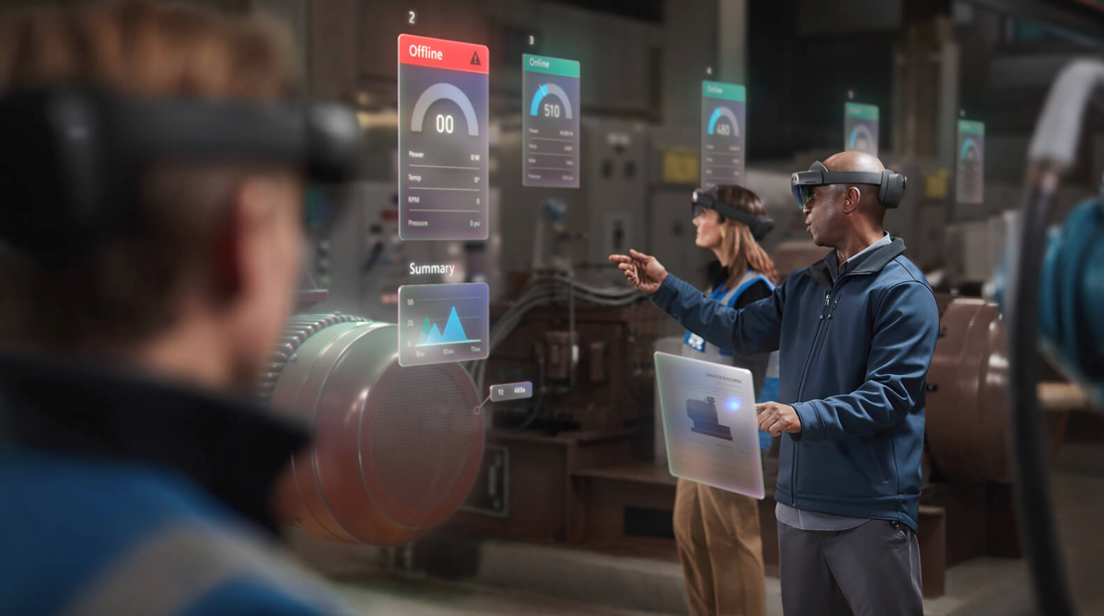
Notes:
SPATIAL ANCHORS (in preview now)
See how it works
Build multi-user, cross-platform apps. Create persistent spatial anchors in the real world and attach digital content to those anchors. Enable wayfinding. With Azure Spatial Anchors Preview, you have all of these capabilities at your fingertips. Watch them come together in a common scenario—architecture design review.
Build apps that use your world as a canvas
Map your space and connect points of interest to create wayfinding experiences, and place shareable, location-based holograms with no environmental setup or QR codes required.
Infuse AI and integrate IoT data
Accelerate your mixed reality development with pre-built cloud integrations for managing identity, storage, security, and analytics. Easily infuse artificial intelligence (AI) and integrate IoT services to visualize data from IoT sensors as holograms.

Slide 37
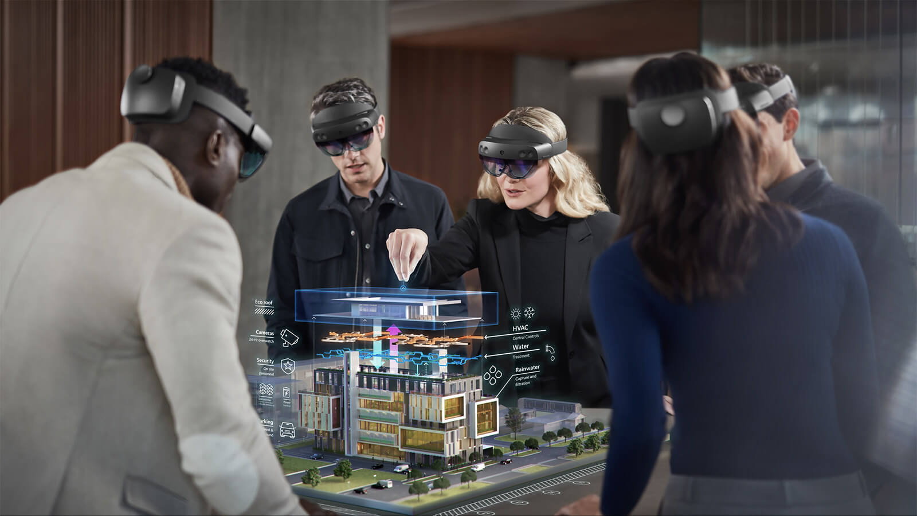
Notes:
Remote Rendering ^{PREVIEW}
Render high-quality, interactive 3D content, and stream it to your devices in real time
Why does high-quality, interactive 3D content matter?
In scenarios where every detail matters—industrial plant management, design review for assets like truck engines, pre-operative surgery planning, and more—3D visualization brings that detail to life. It’s what helps designers, engineers, doctors, and students better understand complex information and make the right call.
Today, to run high-quality 3D models on mobile devices and mixed reality headsets, you often need to “decimate” 3D models and simplify them enough to run on target hardware. But this simplification can result in a loss of important detail that’s needed in key business and design decisions.
Bring interactive, high-quality 3D models to untethered devices with every detail intact and no compromise on quality using Azure Remote Rendering Preview.

Slide 38
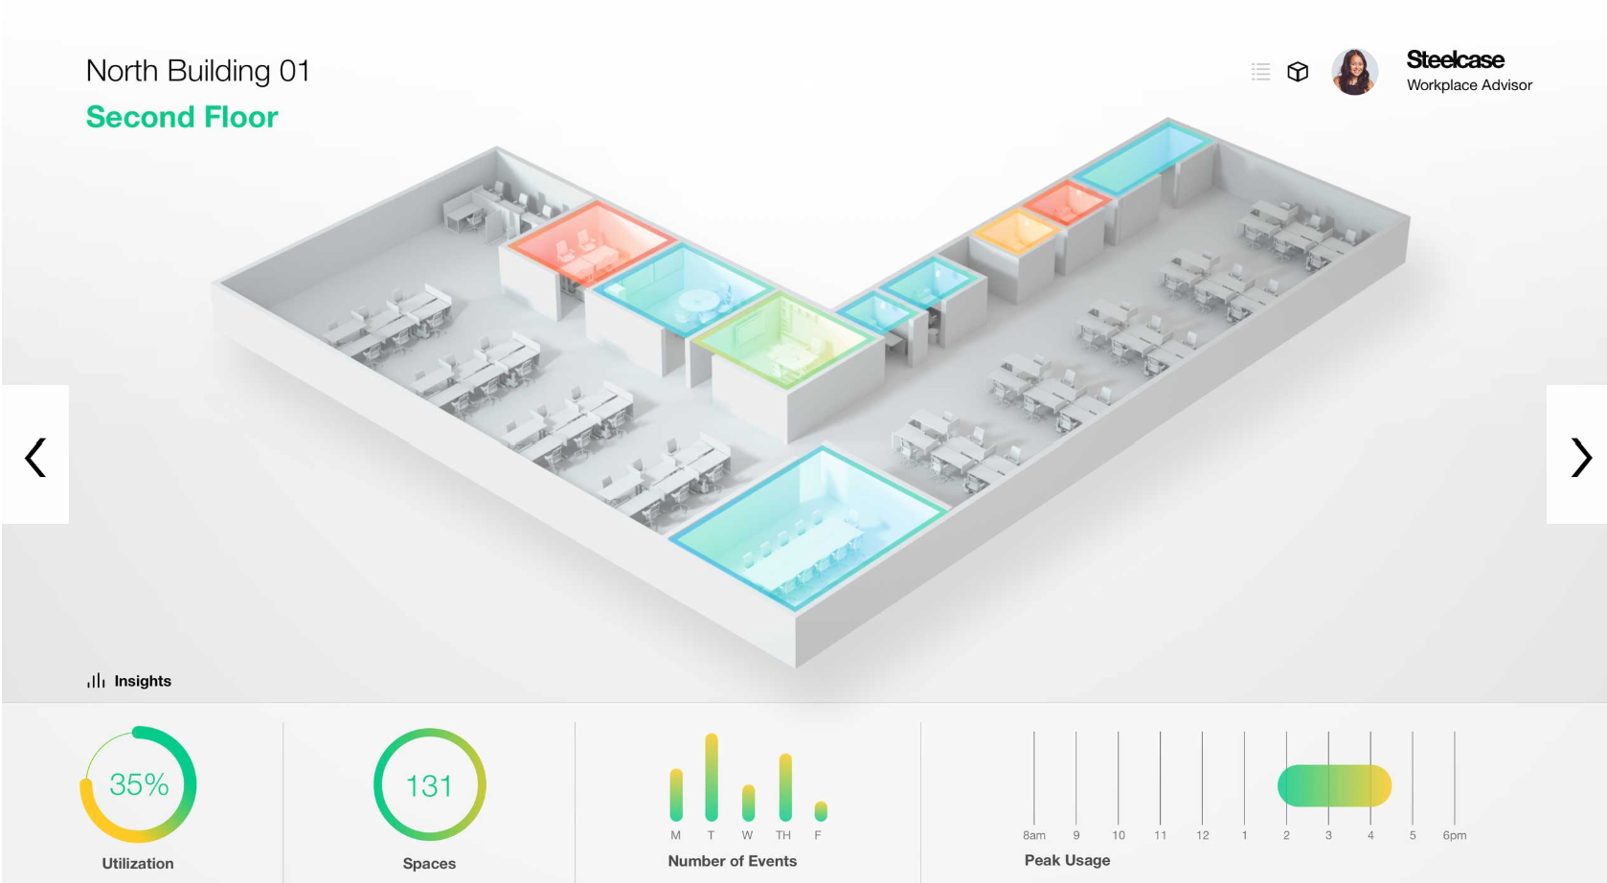
Notes:
Azure Digital Twins ^{PREVIEW}
Model and interact with the real world
Build contextually-aware IoT solutions
Azure Digital Twins is a platform that provides organizations with the foundation they need to create the next generation of IoT solutions. Throughout our journey in IoT, we’ve learned that many digital transformation stories can be simplified by having context about the physical world prior to connecting devices. With Azure Digital Twins organizations can do just that; build repeatable, scalable experiences that correlate data from digital sources and the physical world. This video describes how Azure Digital Twins enables a comprehensive digital model of the relationships and interactions between people, places, and devices that can be applied to any physical environment.
Build digital twin solutions that better serve people’s needs
Virtually replicate the physical world by modeling the relationships between people, places, and devices in a spatial intelligence graph. Create uniquely relevant experiences by correlating data across the digital and physical worlds. Discover opportunities to improve consumer experiences, create new efficiencies, and improve the spaces in which people live, work, and play.

Slide 39
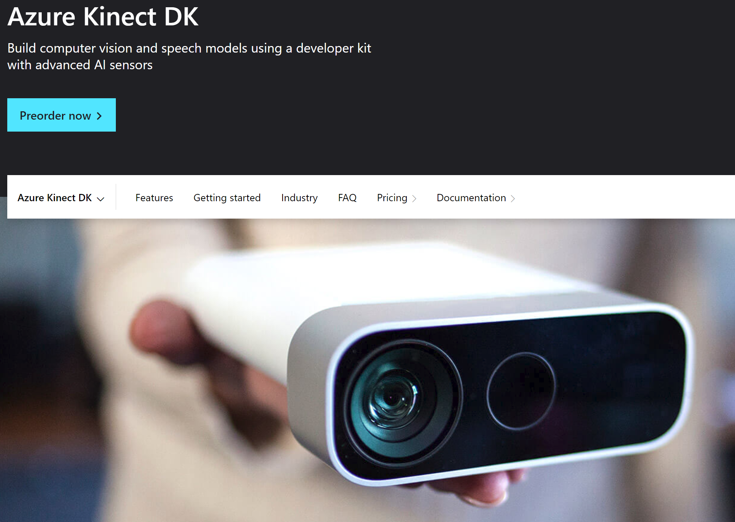
Notes:
Build your way with a versatile sensing device
Azure Kinect DK is a developer kit and PC peripheral with advanced artificial intelligence (AI) sensors for sophisticated computer vision and speech models. It combines a best-in-class depth sensor and spatial microphone array with a video camera and orientation sensor—all in one small device with multiple modes, options, and SDKs.

Slide 40
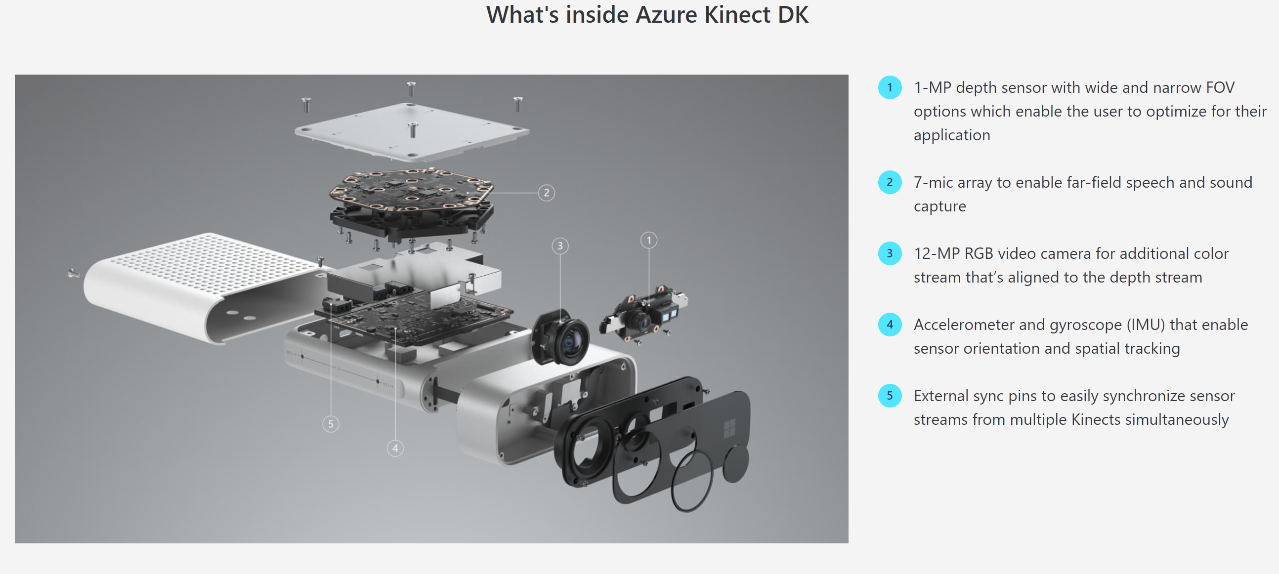

Slide 41

Demo?

Slide 42


Any Questions?

Slide 43
Thanks for Joining Us
Jeff Pergolski
jpergolski@Innovia.com

Slide 44
Thank You
For Joining Us

