Slide 1
Set Up For Success : Reviewing Manufacturing Best Practices

Slide 2
Today’s Presenter
John Grant
Senior Application Consultant
jgrant@innovia.com

Slide 3
NAV/BC MFG Best Practices
Session Objectives
NAV functionality used with specific types of MFG
Lessons Learned
Share tips from implementing NAV Manufacturing
Gaps
Input from you
Notes:
We help small and medium size businesses leverage technology to become more productive and profitable. (Give examples of what we do for some of these companies.)

Slide 4
Manufacturing Types
Make to Stock
Make to Order / Build to Order
Process
Assemble to Order
Engineer to Order
Notes:
We help small and medium size businesses leverage technology to become more productive and profitable. (Give examples of what we do for some of these companies.)

Slide 5
Make To Stock Profile
Production lead times outside of sales lead times
Customer contract
Seasonal demand
Business strategy
Notes:
We help small and medium size businesses leverage technology to become more productive and profitable. (Give examples of what we do for some of these companies.)

Slide 6
Make To Stock Functionality
Planning Worksheet
Item Planning Setups
Forecasting
Flushing Methods – Material and Labor
Notes:
We help small and medium size businesses leverage technology to become more productive and profitable. (Give examples of what we do for some of these companies.)

Slide 7
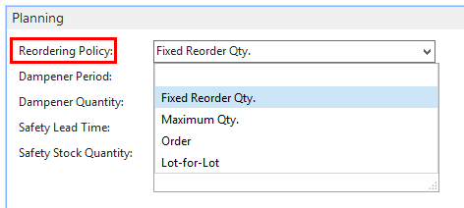
Reorder Policies
Notes:
We help small and medium size businesses leverage technology to become more productive and profitable. (Give examples of what we do for some of these companies.)

Slide 8
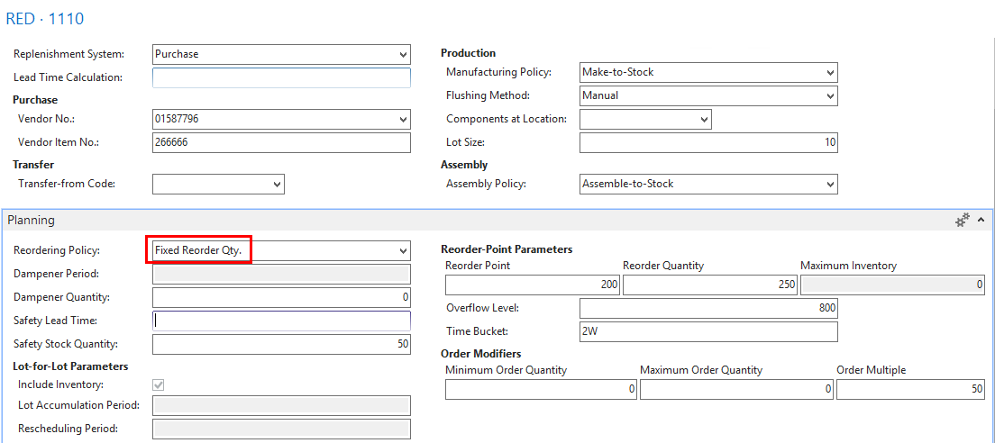
Reorder Policies – Fixed Reorder Qty.
Notes:
We help small and medium size businesses leverage technology to become more productive and profitable. (Give examples of what we do for some of these companies.)

Slide 9
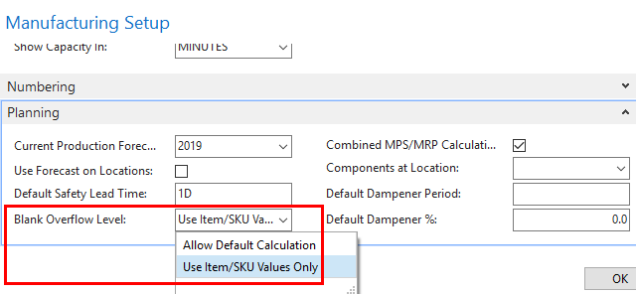
Overflow Level
Quantity you allow projected inventory to exceed the Reorder Point
Fixed Reorder Qty. reordering policy
Overflow level = Reorder Quantity + Reorder Point +(Minimum Order Quantity + Rounded up to nearest order multiple)
Maximum Qty. reordering policy
Overflow level = Maximum Inventory + (Minimum Order Quantity + rounded up to nearest order multiple)
Notes:
We help small and medium size businesses leverage technology to become more productive and profitable. (Give examples of what we do for some of these companies.)

Slide 10
Time Bucket
Used for Reordering policies that use a reorder point
Collect demand events within the time window to make a joint supply order
The time-bucketed concept reflects the manual process of checking the inventory level on a frequent basis rather than for each transaction
Example: All item needs from one vendor to place a weekly order
Safety Stock Exception Warning
Notes:
We help small and medium size businesses leverage technology to become more productive and profitable. (Give examples of what we do for some of these companies.)

Slide 11
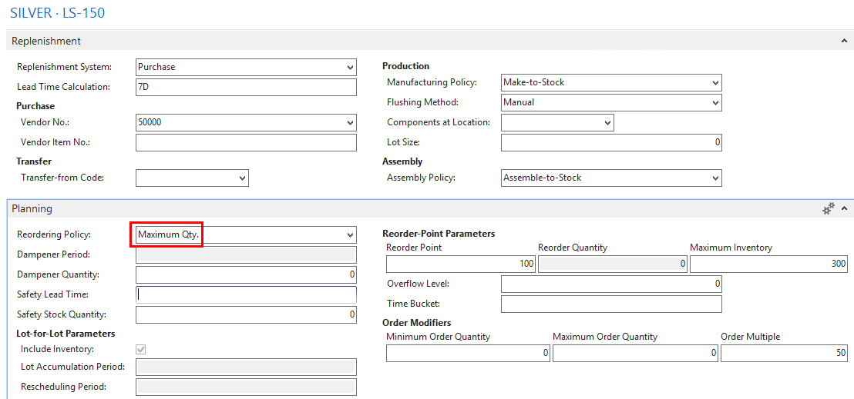
Reorder Policies – Maximum Qty.
Reorder Policies
Notes:
We help small and medium size businesses leverage technology to become more productive and profitable. (Give examples of what we do for some of these companies.)

Slide 12
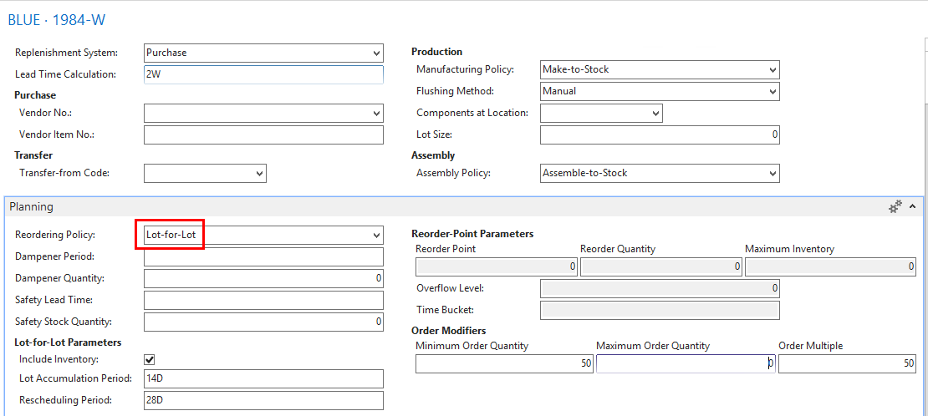
Reorder Policies – Lot-for Lot
Notes:
We help small and medium size businesses leverage technology to become more productive and profitable. (Give examples of what we do for some of these companies.)

Slide 13
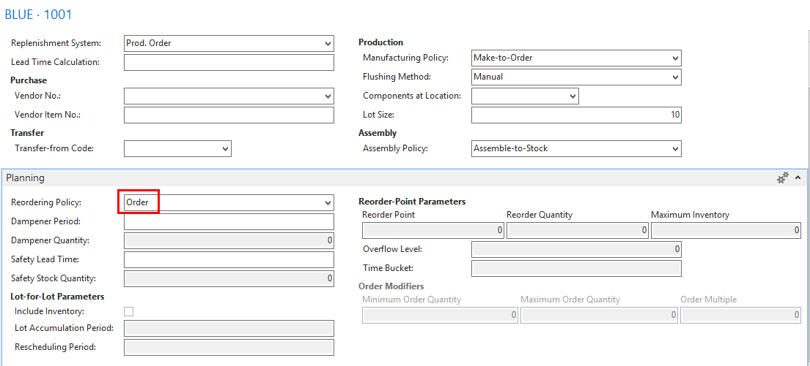
Reorder Policies - Order
Notes:
We help small and medium size businesses leverage technology to become more productive and profitable. (Give examples of what we do for some of these companies.)

Slide 14
Make To Stock Gaps
By-Products
Dynamic Planning Fields
Forecasting is Manual
Manage Tools, Dies, Molds
Notes:
We help small and medium size businesses leverage technology to become more productive and profitable. (Give examples of what we do for some of these companies.)

Slide 15
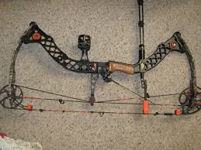
Make To Order / Build To Order Profile
Product manufactured when order is taken / Configurator
Customers order to specifications / options
Multiple Production Orders / BOM Levels
Notes:
We help small and medium size businesses leverage technology to become more productive and profitable. (Give examples of what we do for some of these companies.)

Slide 16
Make To Order / Build To Order Functionality
Routing Type / Lot Size
Bill of Material Lead Time Offset
Material Rounding
Constraint Scheduling
Notes:
We help small and medium size businesses leverage technology to become more productive and profitable. (Give examples of what we do for some of these companies.)

Slide 17
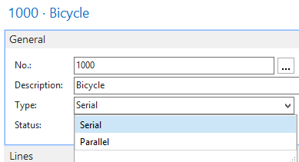
Routings
Routing Type
Notes:
We help small and medium size businesses leverage technology to become more productive and profitable. (Give examples of what we do for some of these companies.)

Slide 18
Routings
Routing Type - Serial
Notes:
We help small and medium size businesses leverage technology to become more productive and profitable. (Give examples of what we do for some of these companies.)

Slide 19
Routings
Routing Type - Parallel
Notes:
We help small and medium size businesses leverage technology to become more productive and profitable. (Give examples of what we do for some of these companies.)

Slide 20
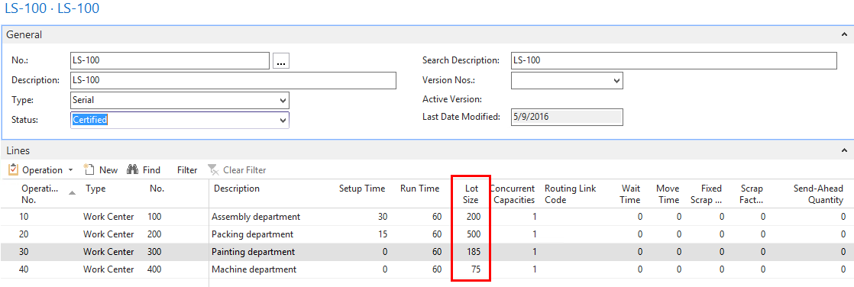
Routings
Lot Size Send Ahead
Flushing Routing Link Code
Concurrent Capacities Version
Notes:
We help small and medium size businesses leverage technology to become more productive and profitable. (Give examples of what we do for some of these companies.)

Slide 21
Bill of Materials
Lead Time Offset
Notes:
We help small and medium size businesses leverage technology to become more productive and profitable. (Give examples of what we do for some of these companies.)

Slide 22
Bill of Materials
Rounding
Notes:
We help small and medium size businesses leverage technology to become more productive and profitable. (Give examples of what we do for some of these companies.)

Slide 23
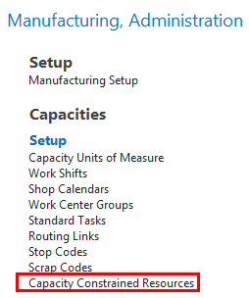
Constraint Scheduling
Notes:
We help small and medium size businesses leverage technology to become more productive and profitable. (Give examples of what we do for some of these companies.)

Slide 24
Manufacturing Policy
Notes:
We help small and medium size businesses leverage technology to become more productive and profitable. (Give examples of what we do for some of these companies.)

Slide 25
Make To Order / Build To Order Gaps
By-Products
Dynamic Planning fields
Forecasting is Manual
Manage Tools, Dies, Molds
One constraint – time
Notes:
We help small and medium size businesses leverage technology to become more productive and profitable. (Give examples of what we do for some of these companies.)

Slide 26
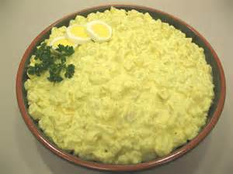
Process Profile
Food, Beverage, Chemical, Pharmaceutical, Formulas, Recipes
Compressed Lead Times To Produce / Shelf life constraints
Notes:
We help small and medium size businesses leverage technology to become more productive and profitable. (Give examples of what we do for some of these companies.)

Slide 27
Process Functionality
Bill of Material Header Unit of Measure Code
Production Families
Notes:
We help small and medium size businesses leverage technology to become more productive and profitable. (Give examples of what we do for some of these companies.)

Slide 28
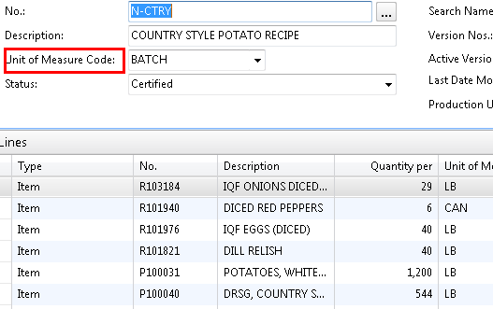
Bill of Material
Notes:
We help small and medium size businesses leverage technology to become more productive and profitable. (Give examples of what we do for some of these companies.)

Slide 29
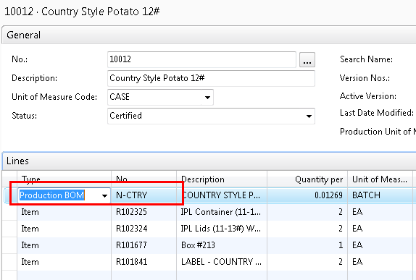
Bill of Material
Notes:
We help small and medium size businesses leverage technology to become more productive and profitable. (Give examples of what we do for some of these companies.)

Slide 30
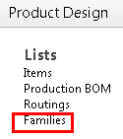
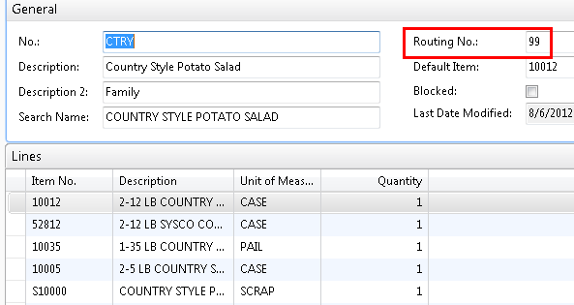
Families Bill of Material
Notes:
We help small and medium size businesses leverage technology to become more productive and profitable. (Give examples of what we do for some of these companies.)

Slide 31
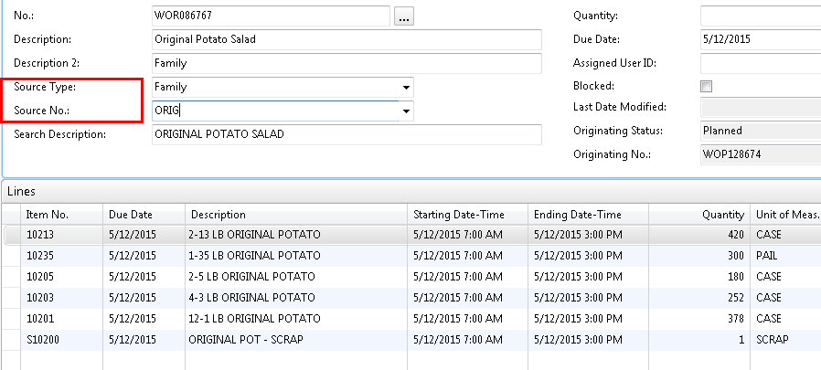
Families Production Order
Notes:
We help small and medium size businesses leverage technology to become more productive and profitable. (Give examples of what we do for some of these companies.)

Slide 32
Process Gaps
Dynamic Planning fields
Planning With Families Manual
Forecasting is Manual
One constraint – time
Scrap
Notes:
We help small and medium size businesses leverage technology to become more productive and profitable. (Give examples of what we do for some of these companies.)

Slide 33
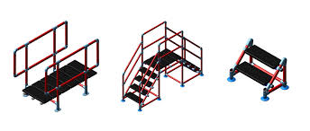
Assemble To Order Profile
Purchase all components
Medium / Long Build Times
Multiple Production Orders
Difficult to measure progress
Launch Production Orders throughout
Purchasing long lead time Items
Notes:
We help small and medium size businesses leverage technology to become more productive and profitable. (Give examples of what we do for some of these companies.)

Slide 34
Assemble To Order Functionality
Machines with Work Centers – Assigning Work
Progress on Work
Alternate Routings and Bill of Material
Using Bill of Material Templates/Phantoms
Notes:
We help small and medium size businesses leverage technology to become more productive and profitable. (Give examples of what we do for some of these companies.)

Slide 35
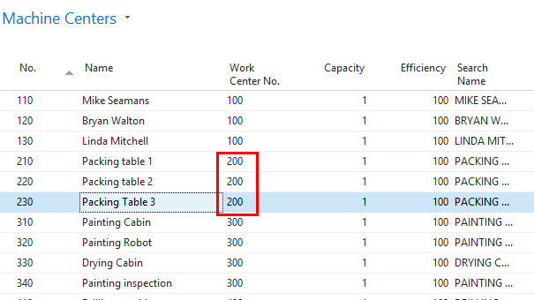
Work Centers / Machine Centers
Move work from a Work Center to a Machine Center
Notes:
We help small and medium size businesses leverage technology to become more productive and profitable. (Give examples of what we do for some of these companies.)

Slide 36
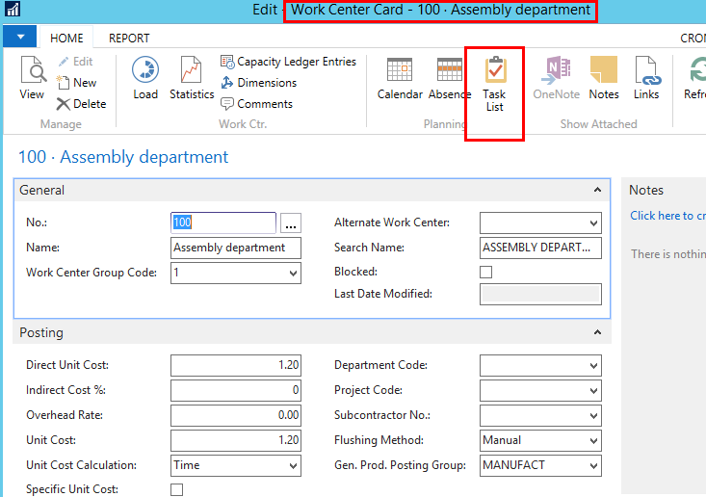
Production Planner Updating Work Center to Machine Center
Notes:
We help small and medium size businesses leverage technology to become more productive and profitable. (Give examples of what we do for some of these companies.)

Slide 37
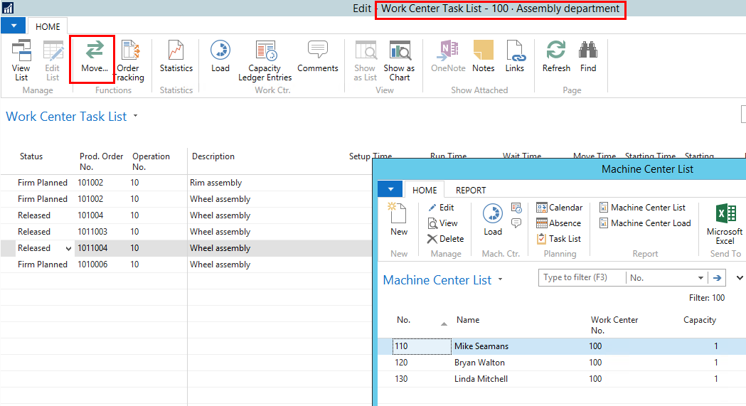
Production Planner Updating Work Center to Machine Center
Notes:
We help small and medium size businesses leverage technology to become more productive and profitable. (Give examples of what we do for some of these companies.)

Slide 38
Progress on Work
Notes:
We help small and medium size businesses leverage technology to become more productive and profitable. (Give examples of what we do for some of these companies.)

Slide 39
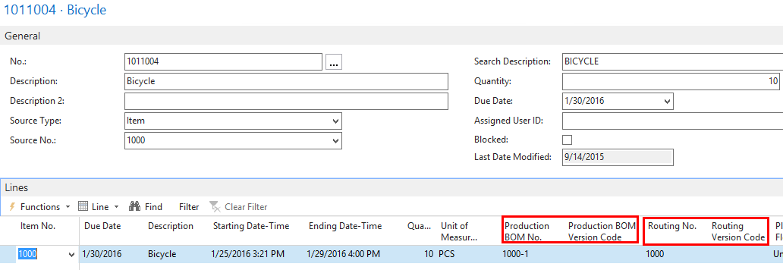
Alternate Routings / Alternate Bills of Material
Notes:
We help small and medium size businesses leverage technology to become more productive and profitable. (Give examples of what we do for some of these companies.)

Slide 40
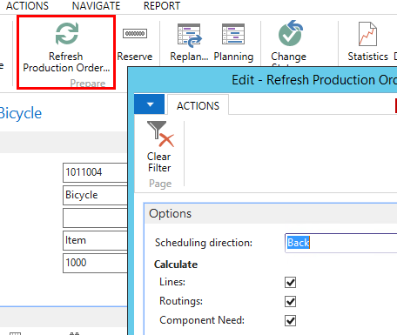
Alternate Routings / Alternate Bills of Material
Notes:
We help small and medium size businesses leverage technology to become more productive and profitable. (Give examples of what we do for some of these companies.)

Slide 41
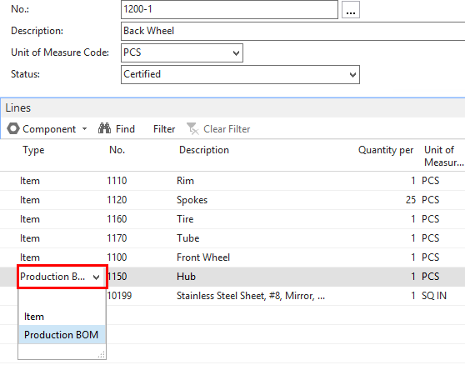
Bill of Material Templates / Phantoms
Notes:
We help small and medium size businesses leverage technology to become more productive and profitable. (Give examples of what we do for some of these companies.)

Slide 42
Assemble To Order Gaps
Dynamic Planning fields
Forecasting is Manual
Manage Tools, Dies, Molds
One constraint – time
Refreshing Released Production Orders - changes
Notes:
We help small and medium size businesses leverage technology to become more productive and profitable. (Give examples of what we do for some of these companies.)

Slide 43
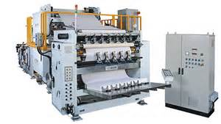
Engineer To Order Profile
Long Build Times (weeks / months)
Multiple Production Orders Required
Require Measure Progress During Build
Launch Production Orders throughout
Purchasing long lead time Items
Notes:
We help small and medium size businesses leverage technology to become more productive and profitable. (Give examples of what we do for some of these companies.)

Slide 44
Engineer To Order Functionality
Jobs / Integration to Planning
Multiple Production Orders / Re-Plan
Launch Production Orders throughout
Planning Worksheet
Notes:
We help small and medium size businesses leverage technology to become more productive and profitable. (Give examples of what we do for some of these companies.)

Slide 45
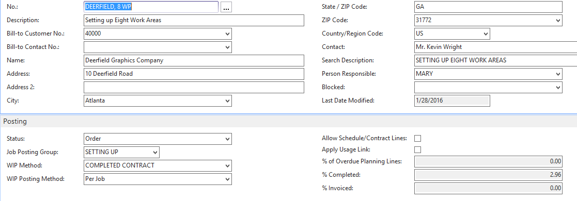
Jobs
Notes:
We help small and medium size businesses leverage technology to become more productive and profitable. (Give examples of what we do for some of these companies.)

Slide 46
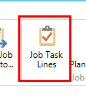
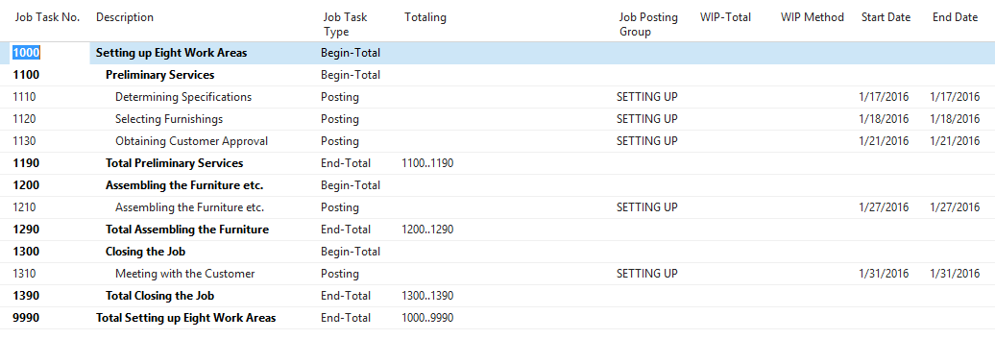
Jobs Task Lines
Notes:
We help small and medium size businesses leverage technology to become more productive and profitable. (Give examples of what we do for some of these companies.)

Slide 47
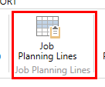
Jobs Planning Lines
Notes:
We help small and medium size businesses leverage technology to become more productive and profitable. (Give examples of what we do for some of these companies.)

Slide 48
Jobs Resource Lines / Time
Notes:
We help small and medium size businesses leverage technology to become more productive and profitable. (Give examples of what we do for some of these companies.)

Slide 49
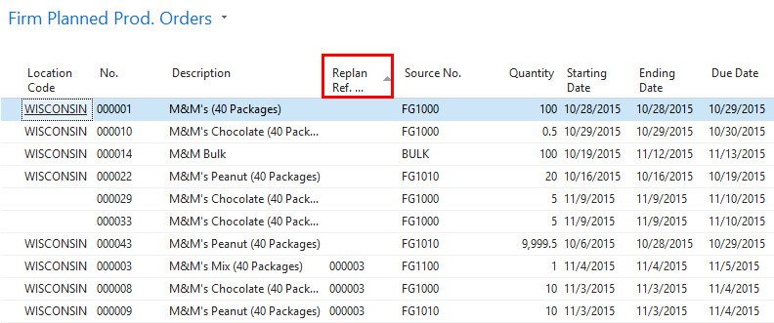
Re-Planning
Notes:
We help small and medium size businesses leverage technology to become more productive and profitable. (Give examples of what we do for some of these companies.)

Slide 50
Engineer To Order Gaps
Manage Tools, Dies, Molds
Job % completed – how best to determine good/bad day
One constraint – time
Refreshing Released Production Orders
Jobs scheduling of Time
Notes:
We help small and medium size businesses leverage technology to become more productive and profitable. (Give examples of what we do for some of these companies.)

Slide 51
Production Planner Sample Work Flow
Production Orders Created as FIRM PLANNED
Use the Change Production Order Status Screen
Firm Planned through a Start Date
Sort by Start Date
Using the above select the Pproduction Order - run Shortage List
Change Status to RELEASED based on Shortage List
Notes:
We help small and medium size businesses leverage technology to become more productive and profitable. (Give examples of what we do for some of these companies.)

Slide 52
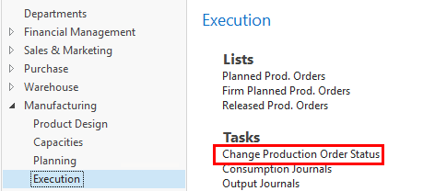
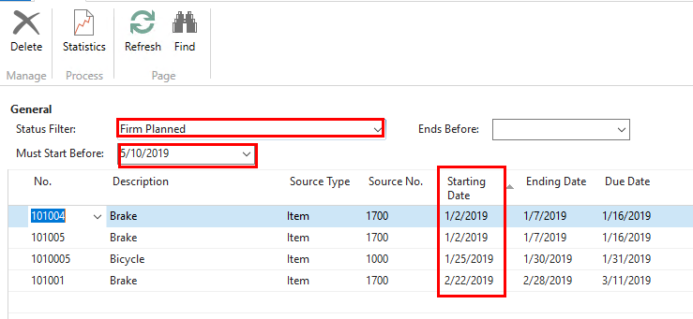
Production Planner Sample Work Flow
Notes:
We help small and medium size businesses leverage technology to become more productive and profitable. (Give examples of what we do for some of these companies.)

Slide 53
Production Planner Sample Work Flow
Notes:
We help small and medium size businesses leverage technology to become more productive and profitable. (Give examples of what we do for some of these companies.)

Slide 54
Production Due Date
Production Order
Assembly Order

Slide 55
Planning Worksheet – Purchase
Prod. Order
Safety Lead Time 2D
Purchase Item
Lead Time

Slide 56
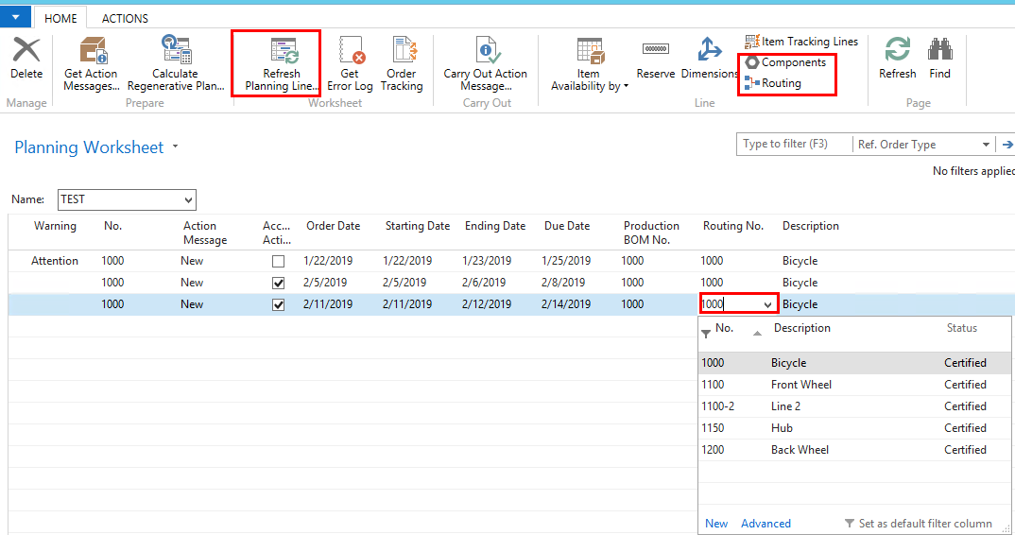
Planning Worksheet – Prod. Order
Change Routing / Bill of Materials
New Prod Order
Notes:
We help small and medium size businesses leverage technology to become more productive and profitable. (Give examples of what we do for some of these companies.)

Slide 57
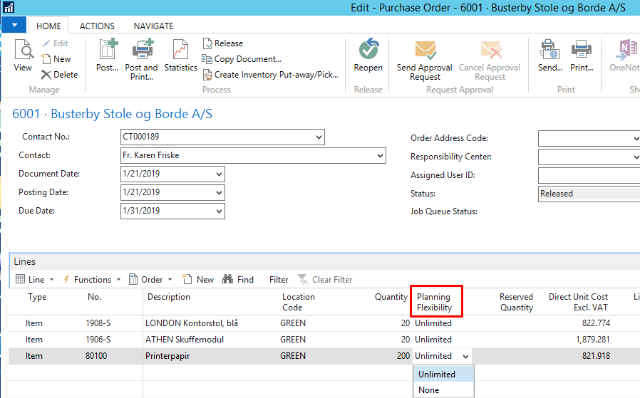
Planning Worksheet – Prod. Order
Purchase Order Planning Flexibility
Notes:
We help small and medium size businesses leverage technology to become more productive and profitable. (Give examples of what we do for some of these companies.)

Slide 58
Any Questions?

Slide 59
Thanks for Joining Us
John Grant
Senior Application Consultant
jgrant@Innovia.com

Slide 60
Thank You
For Joining Us

