Slide 1
Put an end to the Hassle of your Month End Close

Slide 2
Today’s Presenters
Jenny Hollingsworth
Senior Application Consultant
jhollingsworth@innovia.com
Marlene Mankin
Application Consultant
mmankin@innovia.com

Slide 3
Agenda
Update/Lock Down Posting Dates
Month End Tasks
Month End Sub-Ledger Reconciliation

Slide 4
Task: Update/Lock Down Posting Dates
General Ledger Setup: Update for Adj Cost/Post Cost
Allow Posting From: 01/01/21
Allow Posting To: 02/28/21
User Setup: Update users who can only post in current month.
Allow Posting From: 02/01/21
Allow Posting To: 02/28/21
Example: Today is 02/01/21
Notes:
Update Company Wide Posting Date Ranges
Update the allowed posting date range which all users can post transactions.
**IMPORTANT**
The Allow Posting From date is utilized in the adjusting and posting of inventory cost. So, during month end, if inventory adjustments are being made, this date must remain open for the prior month.
Example: Today is 02/01/21. We are still working on closing the books and making month end adjustments for January. The Allow Posting From should remain open from 01/01/21. Until all inventory adjustments are made, once inventory is reconciled, this date should then be updated to 02/01/21.
Click the “General Ledger Setup” option from the location Financial Management/Setup/Administration to view the general ledger setup page.
Allow Posting From: Enter the default posting date that ALL users company-wide can start posting transactions.
Allow Posting To: Enter the default posting date that ALL users company-wide can post transactions through.
Click the OK button.
Update User Specific Posting Date Ranges
If certain users are allowed the wide range of posting dates that is setup on General Ledger Setup for transactions, update the user’s default posting dates which is considered the date range that only that user can post transactions. This posting date range overrides the company posting date range.
Example: Today is 02/01/21. We are still working on closing the books and making month end adjustments for January. In General Ledger Setup, the Allow Posting From should remain open from 01/01/21 until all inventory adjustments are made. If users can no longer post into January, their date range should be entered here with an Allow Posting From 02/01/21 to Allow Posting To 02/28/21.
Click the “User Setup” option from the location Administration/Application Setup/Users to view the user setup page.
Click the Edit List button on the ribbon.
Allow Posting From: Enter the default posting date that the user can start posting transactions.
Allow Posting To: Enter the default posting date that the user can post transactions through.
Click the OK button.
To simplify the process of updating user posting dates, use RapidStart.
Create a configuration package called MONTH-END.
Add table 91 – User Setup.
Go to Table button, Fields option.
On the ribbon, click Clear Included to clear all fields from the export.
Place a checkmark in the Include Field column for Allow Posting From and Allow Posting To.
Click the OK button.
Click the Excel button, Export to Excel option.
Open Excel file.
Update Allow Posting From and Allow Posting To fields.
Save Excel file.
Click the Excel button, Import from Excel option.
Once imported, click the Functions button, Apply Data option.
Check the user setup page for updates.

Slide 5
Task: Complete Transactions
Post sales invoices for all items shipped
Post customer payments received
Post purchase invoices for all items received
Post vendor payments
Calculate & Post Depreciation on Fixed Assets
Post all month end recurring/reversing general journals

Slide 6
Task: Finish Completed Production Orders
Review all Released Production Orders
Review Finished Quantity and Remaining Quantity
Production Order Statistics: Review Expected Cost to Actual Cost
Does data look accurate? YES
Run “Change Status” function to update to Finished.
If Costing Method <> Standard or Average, then function updates Output item ledger entry with Actual Cost.
If Costing Method = Standard, then function posts all variance entries to general ledger.

Slide 7
Task: Inv - Run Adjust Cost/Post Cost Functions
Best Practice: Always run Adjust Cost – Item Entries & Post Inventory to G/L batch jobs, EVEN if you have Automatic Cost Posting checked in Inventory Setup
One final catch all for the month
Must be ran to close Inventory Period
Run functions from Inventory Periods
Notes:
Click the “Inventory Periods” option from the location Financial Management/Inventory/Costing.
Run Adjust Cost – Item Entries
At the end of each period, run “Adjust Cost – Item Entries”. This function adjusts inventory values in values entries so that you use the correct adjusted cost for updating the general ledger and so that sales and profit statistics are up to date. The cost adjustment forwards any cost changes from inbound entries, such as those for purchases or production output, to the related outbound entries, such as sales or transfers. This function processes only item value entries that have not yet been adjusted throughout the month.
Click the “Adjust Cost – Item Entries” option from the ribbon.
Post to G/L: Place a check mark in this field.
Note: This option is only available if “Automatic Cost Posting” is check marked in Inventory Setup. If it is not, then the “Post Inventory Cost to G/L” function will need to be ran next.
Click the OK button.
Run Post Inventory Cost to G/L
At the end of each period, run “Post Inventory Cost to G/L”. Unless you have selected the “Automatic Cost Posting” check box in the Inventory Setup window, inventory costs are not recorded dynamically in the general ledger, and COGS is not calculated in connection with a sale. Therefore, you must post to the general ledger manually by running the Post Inventory Cost to G/L batch job to update the general ledger.
Click the “Post Inventory Cost to G/L” option from the ribbon.
Posting Method: Click the drop-down arrow and select the “Per Entry” option.
Post: Place a check mark in this field.
Click the Preview button to post to the general ledger and preview the report.
Note: This report may be long, you will not want to print this report.

Slide 8
Task: Close Inventory Period
Inventory Periods can only be closed if the following statements are true:
There are no open outbound item ledger entries, meaning negative inventory, in that period.
The cost of all items has been adjusted using the “Adjust Cost – Item Entries” batch job.
Run “Close Inventory Period – Test” to review any issues with closing the period.
Inventory Periods can be reopened.

Slide 9
Task: Close Inventory Period
Notes:
Click the “Inventory Periods” option from the location Financial Management/Inventory/Costing.
Run Close Inventory Period – Test Report
Select the inventory period in which to close. (Highlight the line.)
Click the Test Report button on the ribbon.
Preview/Print Test Report.
Close Inventory Period
Once inventory has been reconciled, the inventory period should be closed so adjustment entries are no longer posted to the closed period.
Select the inventory period to close and click the Close Period button on the ribbon.
Click the Yes button.

Slide 10
Task: Jobs – Update Job Item Cost
Update Job Item Cost Function
Must be ran after “Adjust Cost – Item Entries” to update the job ledger entries associated to item ledger entries.
Jobs Setup – Automatic Update Job Item Cost
If checked, system will update job ledger entries automatically after “Adjust Cost – Item Entries” is ran.
Optionally, schedule function to run automatically from the Job Queue
Notes:
Click the “Update Job Item Cost” option from the location Jobs/Periodic Activities.
Update Job Item Cost
No filters are required.
Click the OK button to run the function.
Update could also be scheduled to run in the job queue.

Slide 11
Task: Jobs – Calc. WIP & Cost Recognition Functions
Run Job Calculate WIP
Based upon WIP & Cost Recognition methods, WIP & Cost Recognition will be calculated for the period.
Entries can be reviewed in the WIP Entries page
Run Job Post WIP to G/L
WIP & Cost Recognition entries calculated will be posted to the general ledger.
Entries can be viewed in the WIP G/L Entries page.
Run functions from Job WIP Cockpit
Notes:
Job – WIP Reconciliation
At the end of each period, verify that the job ledger matches the general ledger job WIP g/l accounts.
Run Job Calculate WIP
Click the “Job Calculate WIP” option from the location Jobs/Periodic Activities to calculate WIP and Recognized cost for each job.
Posting Date: Enter the last day of the prior period.
Status Filter: Click the drop-down arrow and select the “Open” option.
Click the OK button.
Run Job Post WIP to G/L
Click the “Job Post WIP to G/L” option from the location Jobs/Periodic Activities to post calculated WIP and Recognized cost to the general ledger.
Reversal Posting Date: Enter the last day of the prior period.
Click the OK button.

Slide 12
Task: Bank Account Reconciliation
Bank Account Reconciliation Options
Import Bank Statement utilizing Data Exchange Definitions
Import Bank Statement utilizing Bank Data Conversion Services
Perform bank reconciliation manually utilizing Suggest Entries
Bank Reconciliation with Auto Match
Setup option on General Ledger Setup
Notes:
There are 3 options for your Bank Reconciliation:
1. Import the bank statement using the Data Exchange Definitions – the Data Exchange allows you to define how the bank statement looks for import.
2. Import utilizing the Bank Data Conversion Services – this is a global service provider which has setup the Conversion of the data for you for specific banks. You can view the list of Banks available through the drop down on the Bank NAV -Data Conversion on the Bank account.
3. 3rd option would be to Perform the bank rec manually utilizing the Suggest entries
If you want to us the Auto Matching – you can set this up in the General Ledger. ‘Bank Recon. With Auto Match’ - this is, also, selectable in the ribbon.

Slide 13
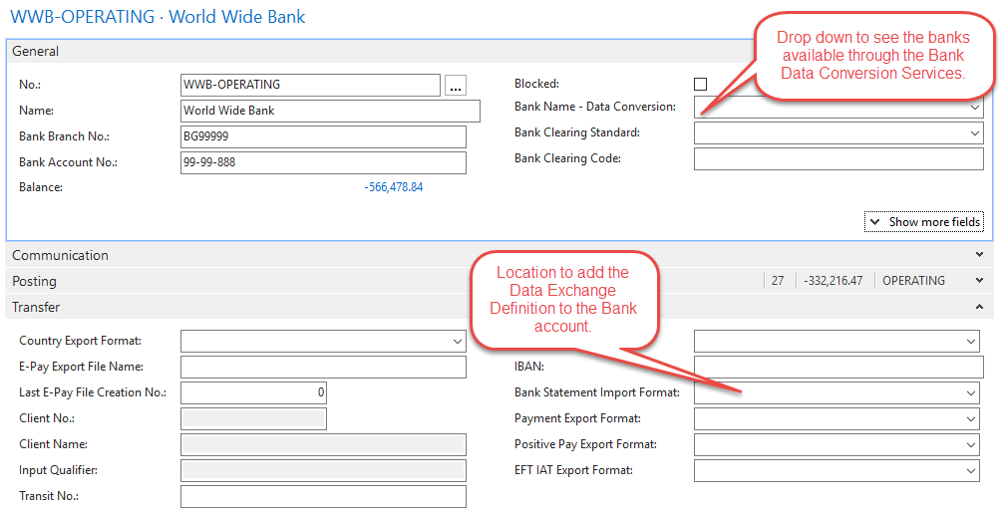
Task: Bank Account Reconciliation
Notes:
Marlene

Slide 14
Task: Foreign Currency
Update Exchange Rates – Manually or Automatic
New functionality: Currency Exchange Rate Services
Setup from any Web source that provides information in the acceptable format.
Bank of Canada website is available free of charge
How to setup: https://www.encorebusiness.com/blog/free-exchange-rates-dynamics-nav-business-central/
Run Adjust Exchange Rates Function
Updates LCY amounts for exchange rates after entries are posted
Updates Add’l Reporting Currency on GL
Post unrealized gains/losses
Notes:
Updating of Exchange Rates
Manually
Automatically: Now available
Setup from any Web source that provides information in the acceptable format.
Bank of Canada website is available free of charge
How to setup: https://www.encorebusiness.com/blog/free-exchange-rates-dynamics-nav-business-central/
Adjust Exchange Rates Function
Updates LCY amounts for posted entries if exchange rate changes are made after entries are posted.
Update Additional reporting currency amounts on general ledger entries.
Adjustment for customers and vendors
Posts the amounts to Unrealized Gains or Losses accounts
Post the balancing entries to AR or AP
Adjustments can be viewed in the Exchange Rate Adjustment Register

Slide 15
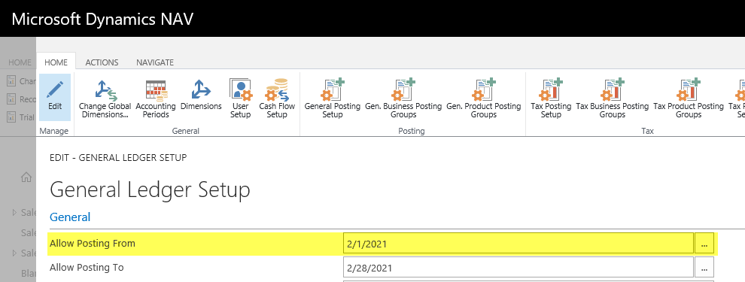
Task: Update General Ledger Setup Posting Dates
General Ledger Setup: Update for new month
Allow Posting From: 02/01/21
Allow Posting To: 02/28/21
Example: Today is 02/01/21
Notes:
Update Company Wide Posting Date Ranges
Update the allowed posting date range which all users can post transactions.
Example: Today is 02/01/21. We are done closing the books and making month end adjustments for January. The Allow Posting From should be updated to 02/01/21.
Click the “General Ledger Setup” option from the location Financial Management/Setup/Administration to view the general ledger setup page.
Allow Posting From: Enter the default posting date that ALL users company-wide can start posting transactions.
Allow Posting To: Enter the default posting date that ALL users company-wide can post transactions through.
Click the OK button.

Slide 16
Reconcile: Inventory
Run Inventory to G/L Reconcile Report
Totals $ based on the item’s value entry table.
Notes:
Run Inventory to G/L Reconcile Report
First, run the Inventory to G/L Reconcile Report for a total item value entry balance by inventory posting group.
Click the “Inventory to G/L Reconcile” option from the location Financial Management/Inventory/Reports.
As of date: Enter the last day of the prior period.
Inventory Posting Group: Run this report once each inventory g/l account to get totals per inventory g/l account. Filter on all inventory posting groups posting to the same g/l account.
Click the Print or Preview button.
Scroll to the last page and note the totals of the following columns:
Inventory Valuation: This is the Total Value of Inventory. The total should tie to the Inventory g/l account(s) plus the Inventory Interim g/l account(s).
Excludes Production WIP
Includes Invoiced Inventory
Includes Received not Invoiced Inventory
Received Not Invoiced: This is the Value of Inventory that has been Received but not Invoiced. The total should tie to the Inventory Interim g/l account(s).
Includes purchased items (This amount should tie to the Inv. Accrual (Interim) g/l account(s).
Includes production output on “Released” production orders that have not been “Finished”. (This amount will be included on the Production – WIP reconciliation and tie out to the Production – WIP g/l account(s).
Shipped Not Invoiced: This is the Value of Inventory that has been Shipped but not Invoiced. The total should tie to the Cost of Goods Sold Interim g/l account(s).
Includes all items shipped not invoiced.
Total Expected Cost: This is the sum of Received not Invoiced and Shipped not Invoiced columns.
Expected Cost to be Posted: If there is a $ value in this column, the “Post Inventory to G/L” function must be run.
Invoiced Value to be Posted: If there is a $ value in this column, the “Post Inventory to G/L” function must be run.

Slide 17
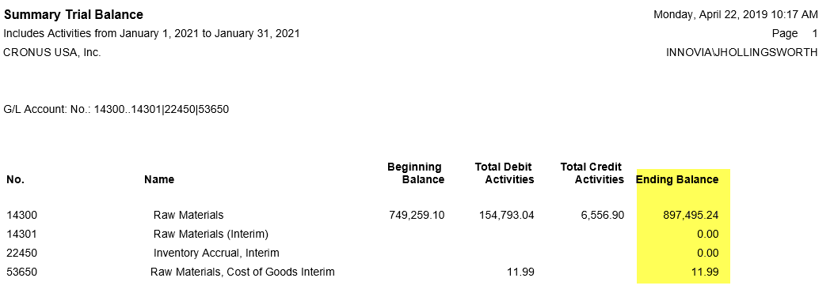
Reconcile: Inventory
Run Trial Balance Detail/Summary
Totals amount due from items based on the g/l entry table.
Notes:
Run Trial Balance Detail/Summary Report
Next, run the Trial Balance Detail/Summary Report for the g/l account balance at the period end for the following accounts:
Inventory
Inventory Interim
Cost of Goods Sold Interim
Inv. Accrual (Interim)
Click the “Trial Balance Detail/Summary” option from the location General Ledger/Reports/Financial Statement.
Click the Trial Balance Detail/Summary button on the ribbon.
No. Filter: Click the drop-down arrow and select or enter the g/l account number(s).
Date Filter: Enter a filter to display all data for the period. (EX: 01/01/21..01/31/21)
Click the Print or Preview button.
Compare $ amounts on each report by inventory posting group. $ Amounts should match.

Slide 18
Reconcile: Production Order WIP
Run Inventory Valuation – WIP Report
Totals $ based on the item ledger entry table for consumption and capacity ledger entry table for labor.
Notes:
Run Inventory Valuation – WIP Report
Click the “Inventory Valuation – WIP” option from the location Financial Management/Inventory/Reports.
Ending Date: Enter the last day of the prior period. (Ex: 01/31/21)
Status: Click the drop-down arrow and select the “Released” option.
Click the Print or Preview button.
Scroll to the last page and note the TOTAL cost posted to G/L.

Slide 19
Reconcile: Production Order WIP
Run Trial Balance Detail/Summary
Totals amount due from consumption, output, and capacity (labor) based on the g/l entry table.
Notes:
Run Trial Balance Detail/Summary Report
Next, run the Trial Balance Detail/Summary Report for the production WIP g/l account balance at the period end.
Click the “Trial Balance Detail/Summary” option from the location General Ledger/Reports/Financial Statement.
Click the Trial Balance Detail/Summary button on the ribbon.
No. Filter: Click the drop-down arrow and select or enter the production WIP g/l account number(s).
Date Filter: Enter a filter to display all data for the period. (EX: 01/01/21..01/31/21)
Click the Print or Preview button.
Compare the total $ amounts on each report. $ Amounts should match.

Slide 20
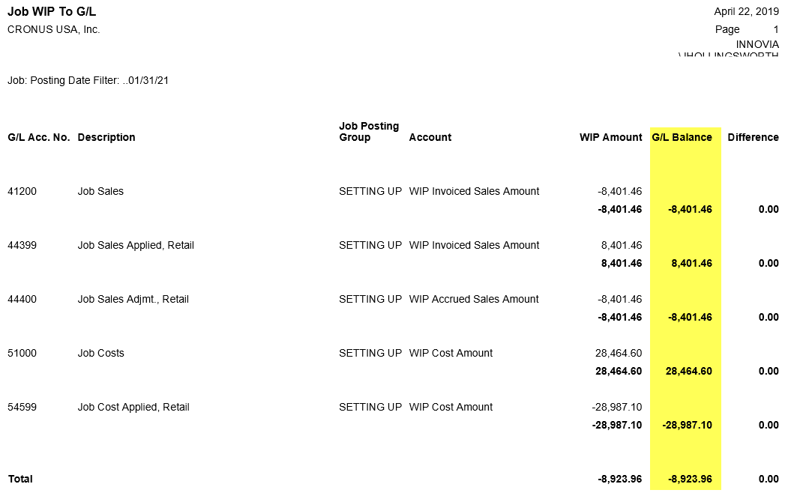
Reconcile: Job WIP
Run Job WIP to G/L Report
Totals $ based on the job ledger entry table for sales and costs posted to job.
Notes:
Run Job WIP to G/L Report
Click the “Job WIP to G/L” option from the location Jobs/Reports.
Status Filter: Click the drop-down arrow and select the “Open” option.
Posting Date Filter: Enter a filter to display all data THROUGH the period end. (EX: ..01/31/21, two periods before the date means display balance at date, all data through the entered date)
Click the Preview button.
Scroll to the last page and note the TOTAL G/L Balance.

Slide 21
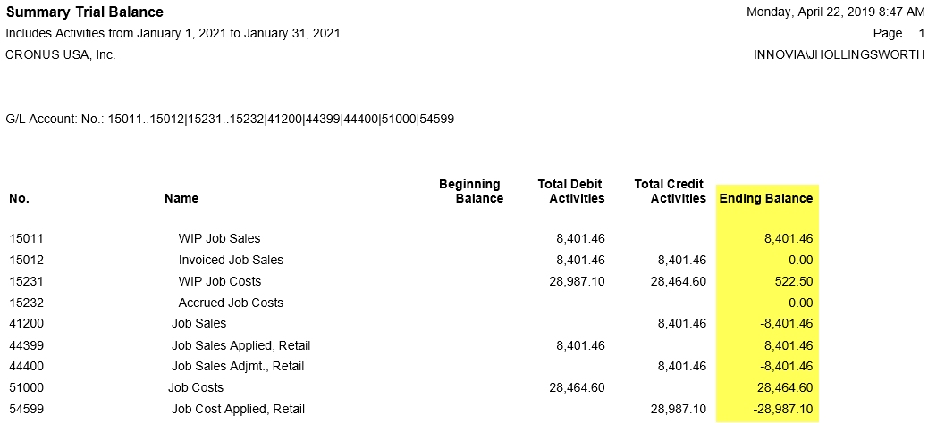
Reconcile: Job WIP
Run Trial Balance Detail/Summary
Totals $ based on the g/l entry table.
Notes:
Run Trial Balance Detail/Summary Report
Next, run the Trial Balance Detail/Summary Report for the job WIP g/l account balance at the period end.
Click the “Trial Balance Detail/Summary” option from the location General Ledger/Reports/Financial Statement.
Click the Trial Balance Detail/Summary button on the ribbon.
No. Filter: Click the drop-down arrow and select or enter the job WIP, Cost, & Sales g/l account number(s).
Date Filter: Enter a filter to display all data for the period. (EX: 01/01/21..01/31/21)
Click the Print or Preview button.
Compare the total $ amounts on each report. $ Amounts should match.

Slide 22
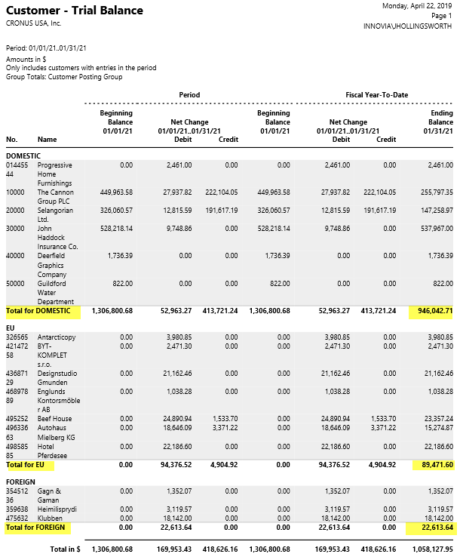
Reconcile: Accounts Receivable
Run Customer – Trial Balance Report
Totals amount due from customers based on the customer ledger entry table.
Notes:
Run Customer – Trial Balance Report
At the end of each period, verify that the customer ledger matches the general ledger accounts receivable g/l accounts.
First, run the Customer – Trial Balance Report for a total customer ledger entry balance by customer posting group.
Click the “Customer – Trial Balance” option from the location Financial Management/Receivables/Reports.
Date Filter: Enter a filter to display all data for the period. (EX: 01/01/21..01/31/21)
Click the Print or Preview button.
Note the TOTAL accounts receivable due per customer posting group.

Slide 23
Reconcile: Accounts Receivable
Run Trial Balance Detail/Summary
Totals amount due from customers based on the g/l entry table.
Notes:
Run Trial Balance Detail/Summary Report
Next, run the Trial Balance Detail/Summary Report for the accounts receivable g/l account balance at the period end.
Click the “Trial Balance Detail/Summary” option from the location General Ledger/Reports/Financial Statement.
Click the Trial Balance Detail/Summary button on the ribbon.
No. Filter: Click the drop-down arrow and select or enter the accounts receivable g/l account number(s).
Date Filter: Enter a filter to display all data for the period. (EX: 01/01/21..01/31/21)
Click the Print or Preview button.
Compare $ amounts on each report by customer posting group. $ Amounts should match.

Slide 24
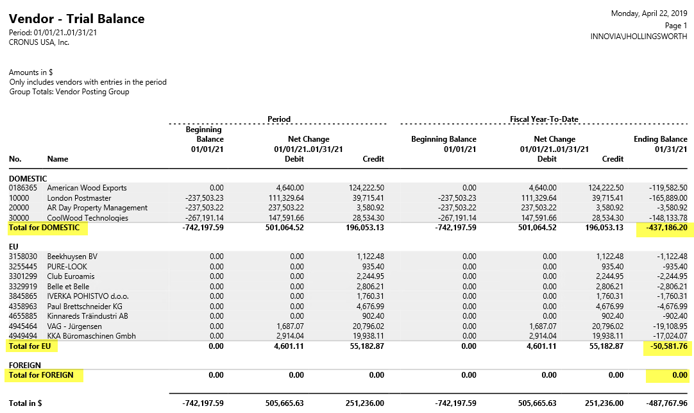
Reconcile: Accounts Payable
Run Vendor – Trial Balance Report
Totals amount due from vendors based on the vendor ledger entry table.
Notes:
Run Vendor – Trial Balance Report
At the end of each period, verify that the vendor ledger matches the general ledger accounts payable g/l accounts.
First, run the Vendor – Trial Balance Report for a total vendor ledger entry balance by vendor posting group.
Click the “Vendor – Trial Balance” option from the location Financial Management/Payables/Reports.
Date Filter: Enter a filter to display all data for the period. (EX: 01/01/21..01/31/21)
Click the Print or Preview button.
Note the TOTAL accounts payable due per vendor posting group.

Slide 25
Reconcile: Accounts Payable
Run Trial Balance Detail/Summary
Totals amount due from vendors based on the g/l entry table.
Notes:
Run Trial Balance Detail/Summary Report
Next, run the Trial Balance Detail/Summary Report for the accounts payable g/l account balance at the period end.
Click the “Trial Balance Detail/Summary” option from the location General Ledger/Reports/Financial Statement.
Click the Trial Balance Detail/Summary button on the ribbon.
No. Filter: Click the drop-down arrow and select or enter the accounts payable g/l account number(s).
Date Filter: Enter a filter to display all data for the period. (EX: 01/01/21..01/31/21)
Click the Print or Preview button.
Compare $ amounts on each report by vendor posting group. $ Amounts should match.

Slide 26
All details from this presentation provided in PowerPoint notes section on each slide!

Slide 27
Thanks for Joining Us
Jenny Hollingsworth
Senior Application Consultant
jhollingsworth@innovia.com
Marlene Mankin
Application Consultant
mmankin@innovia.com

Slide 28
Thank You
For Joining Us

