Slide 1


THE SUPPLY CHAIN COMPETITIVE ADVANTAGE
Luc Larocque
Vice-President, Sales

Slide 2

THE SUPPLY CHAIN COMPETITIVE ADVANTAGE
A critical shift in the world of logistics and supply chain is impacting the way you manage inventory:
  Real-time communication
  Omni-channel distribution
  Compliance regulations
  Business competitive advantage.
COMPANY PRESENTATION >> OVERVIEW

Slide 3
Challenges
Retail stores are closing
Meanwhile, consumer consumption is higher than ever
Warehouses are nearly doubling in size every year
Many operations are running 24/7
Need to cope with as much as 30% returns (i.e. apparel)
They are not building any more roads
Amazon, Walmart are setting the standards
By 2020 …
  60% of orders will be delivered the same day
  40% of orders will delivered within 2 hours
The “Pizza Challenge”
COMPANY PRESENTATION >> CAPABILITIES

Slide 4

SOLOGLOBE IS NOW PART OF THE GENERIX GROUP
Sologlobe has joined the Generix Group family thereby substantially increasing their global footprint.
Sologlobe also becomes the exclusive distributor and integrator of the Generix Group solutions in the North American market.
Notes:
(3 – Minutes)
A quick introduction to Sologlobe and myself…
Sologlobe…
I (Stefan) have been working with supply chain companies since 1998 and have experience with numerous different industries. Regardless of the industry inventory accuracy, real-time visibility and event tracking is always a key decision making factors to why organizations purchase best-of-breed WMS Systems.

Slide 5
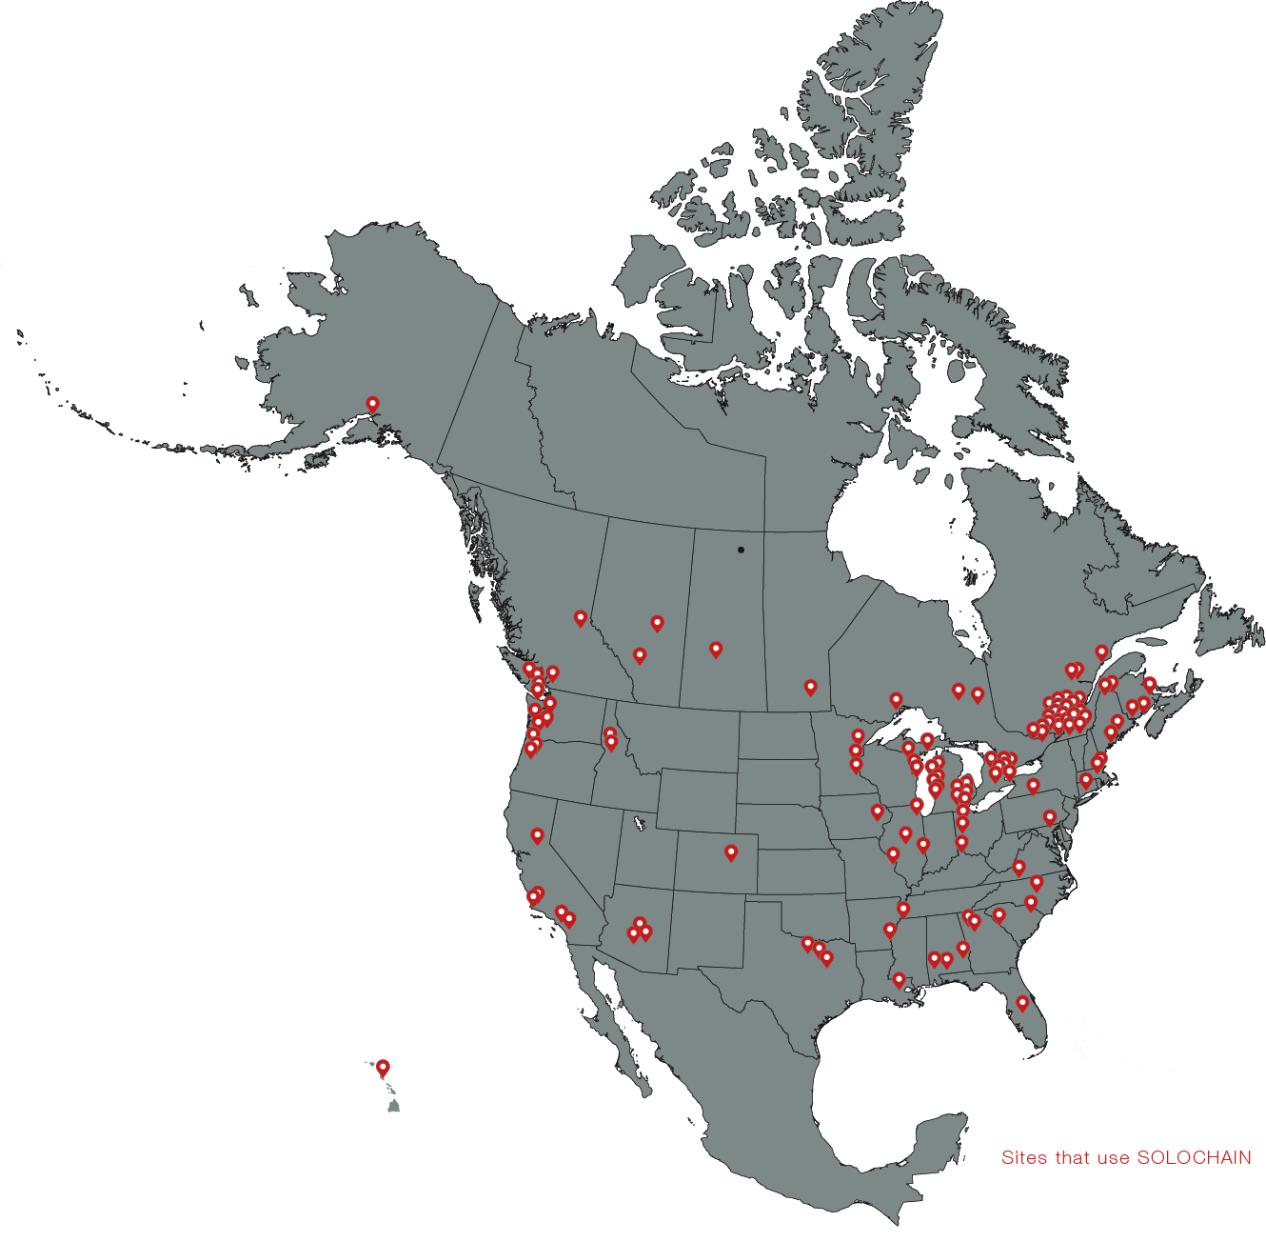

ABOUT GENERIX NORTH AMERICA, formerly Sologlobe
For over 20 years, Sologlobe, a Montreal based company, has been designing, developing, implementing and supporting the Solochain platform of Supply Chain Execution (SCE) solutions in the Warehouse Management System (WMS), Manufacturing Execution System (MES) and Enterprise Asset Management (EAM) space.
Over time, Sologlobe has earned an impressive list of customers in the United States and Canadian markets based on a strong reputation for the quality and versatility of its product with a proven implementation methodology.

Slide 6
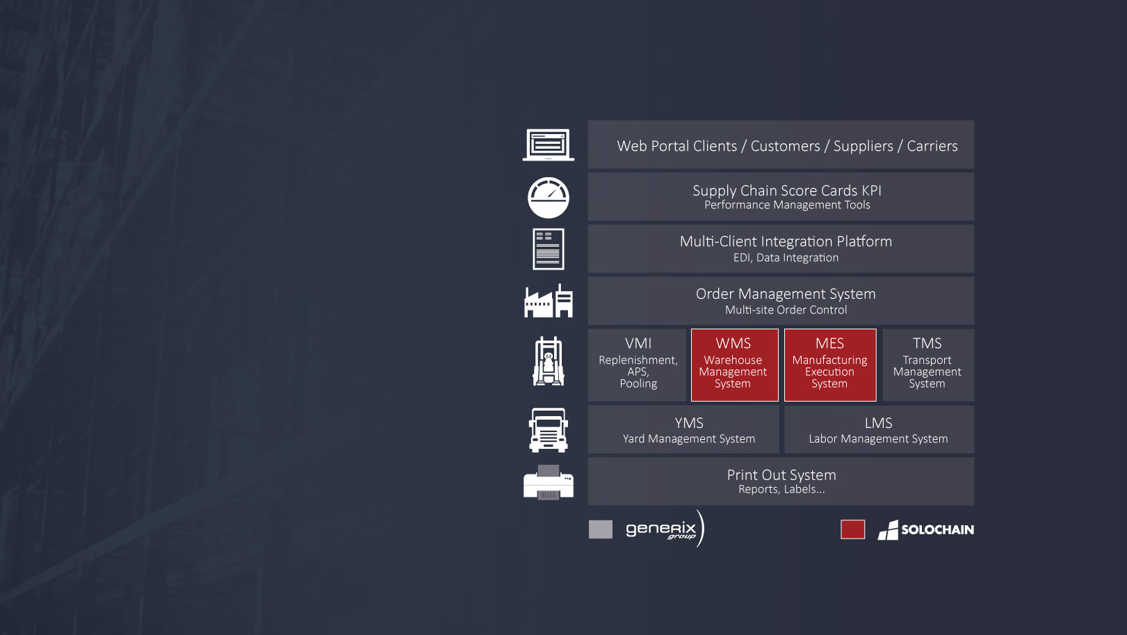
A COMPLETE SUPPLY CHAIN SOLUTION
By adding the Generix Group products to the existing Sologlobe product suite, we now offer a complete solution to help businesses realize the ultimate digital supply chain.
Notes:
(3 – Minutes)
A quick introduction to Sologlobe and myself…
Sologlobe…
I (Stefan) have been working with supply chain companies since 1998 and have experience with numerous different industries. Regardless of the industry inventory accuracy, real-time visibility and event tracking is always a key decision making factors to why organizations purchase best-of-breed WMS Systems.

Slide 7
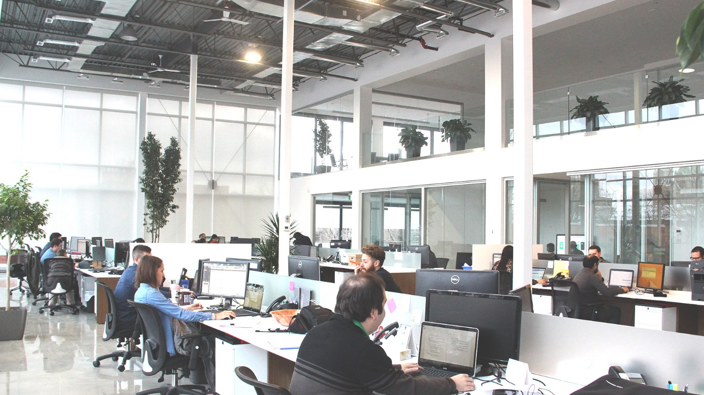
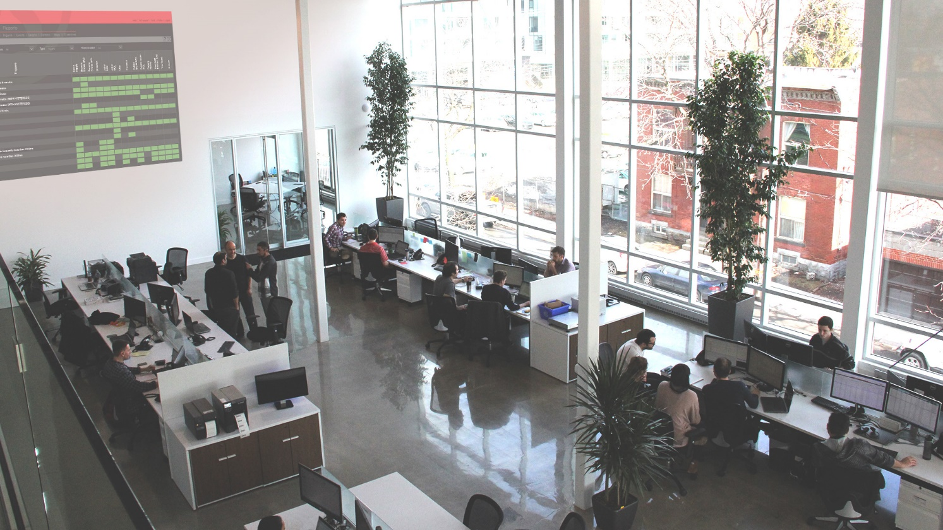
HEAD OFFICE
COMPANY PRESENTATION >> OVERVIEW

Slide 8














NAV Customers

Slide 9
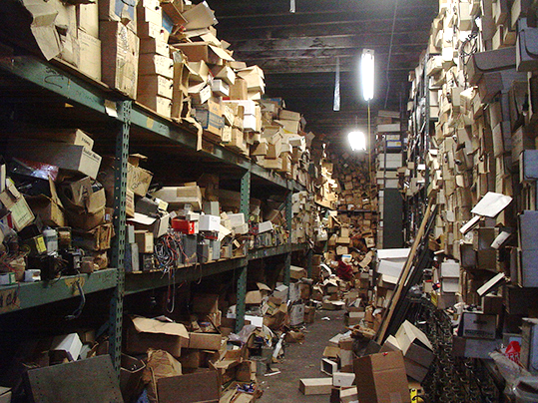

Slide 11
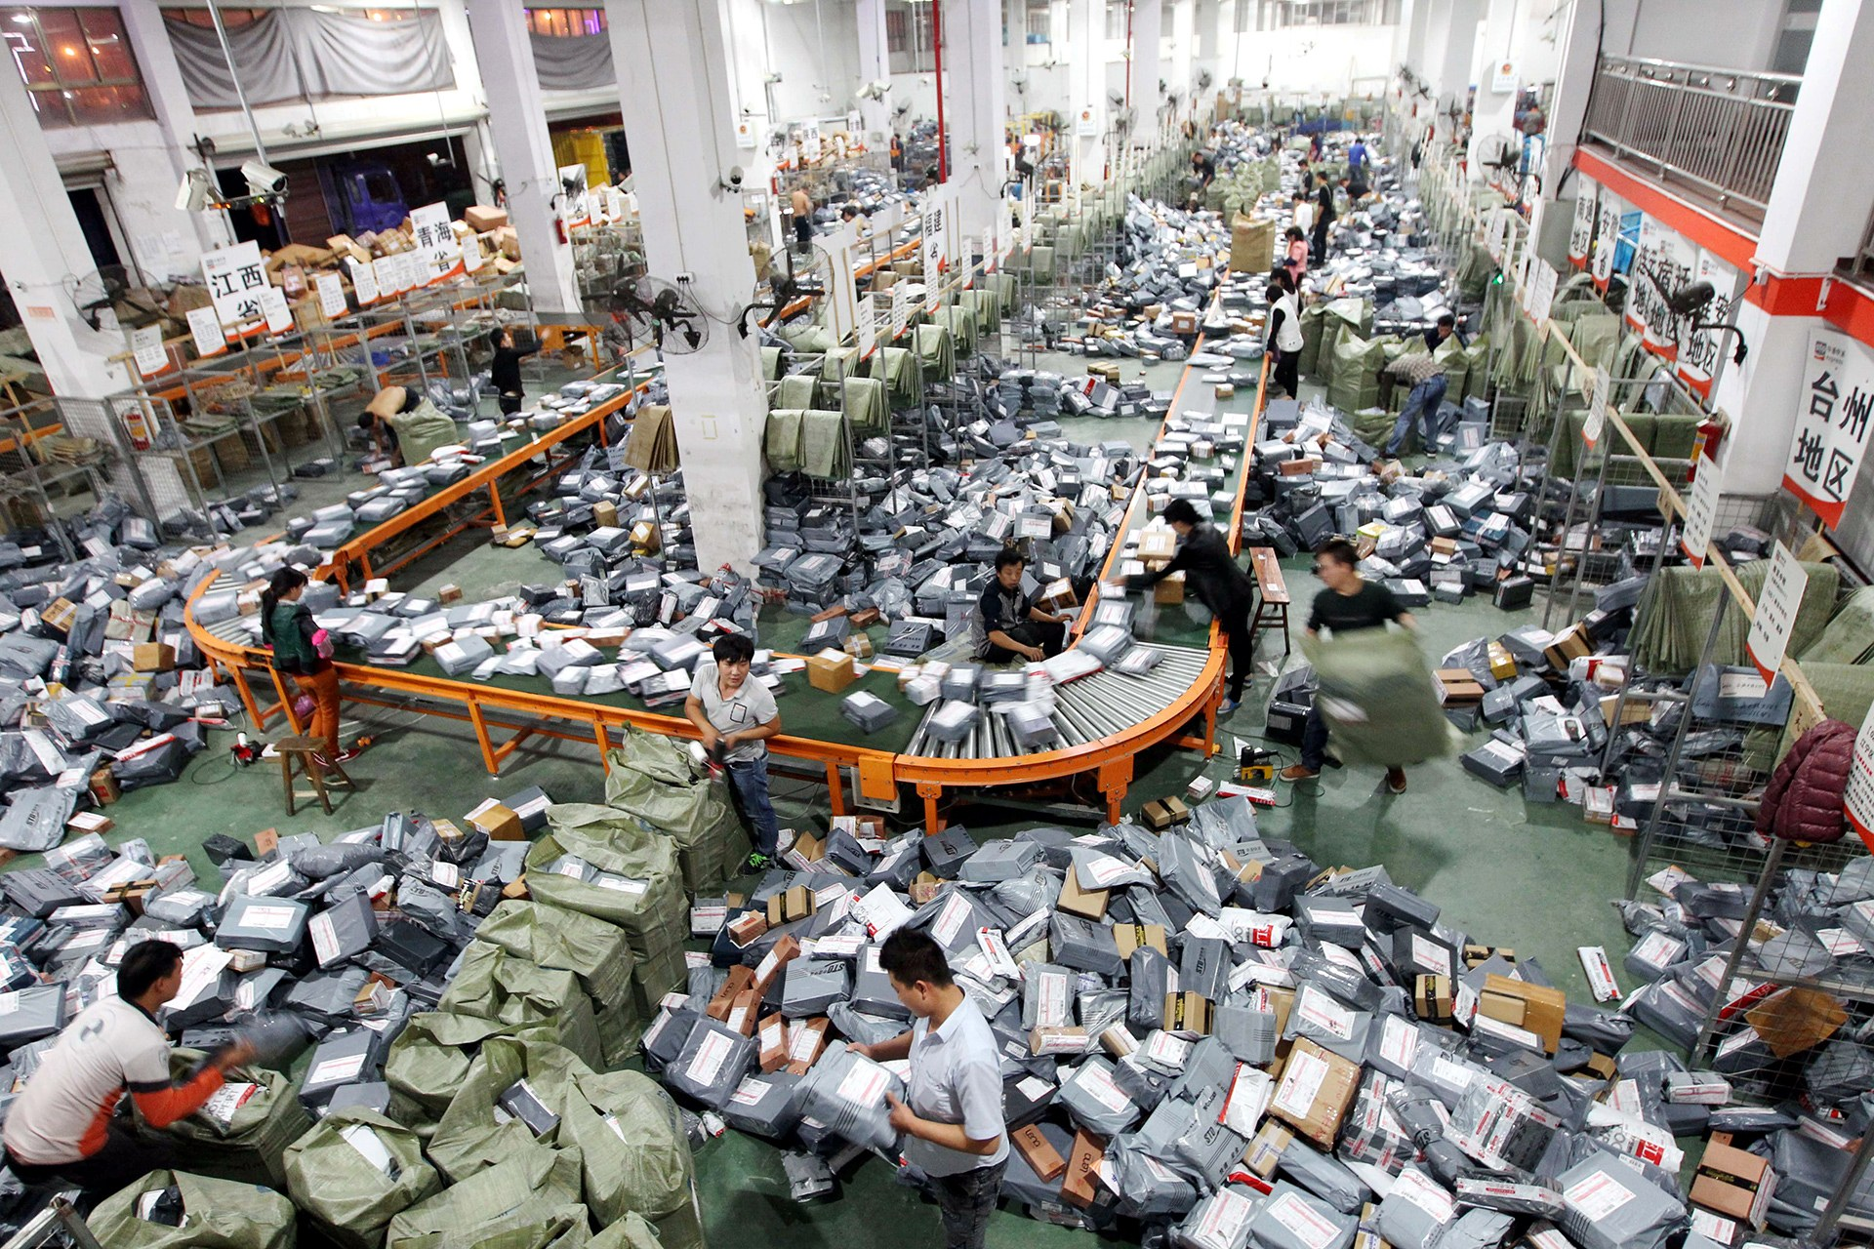

Slide 12
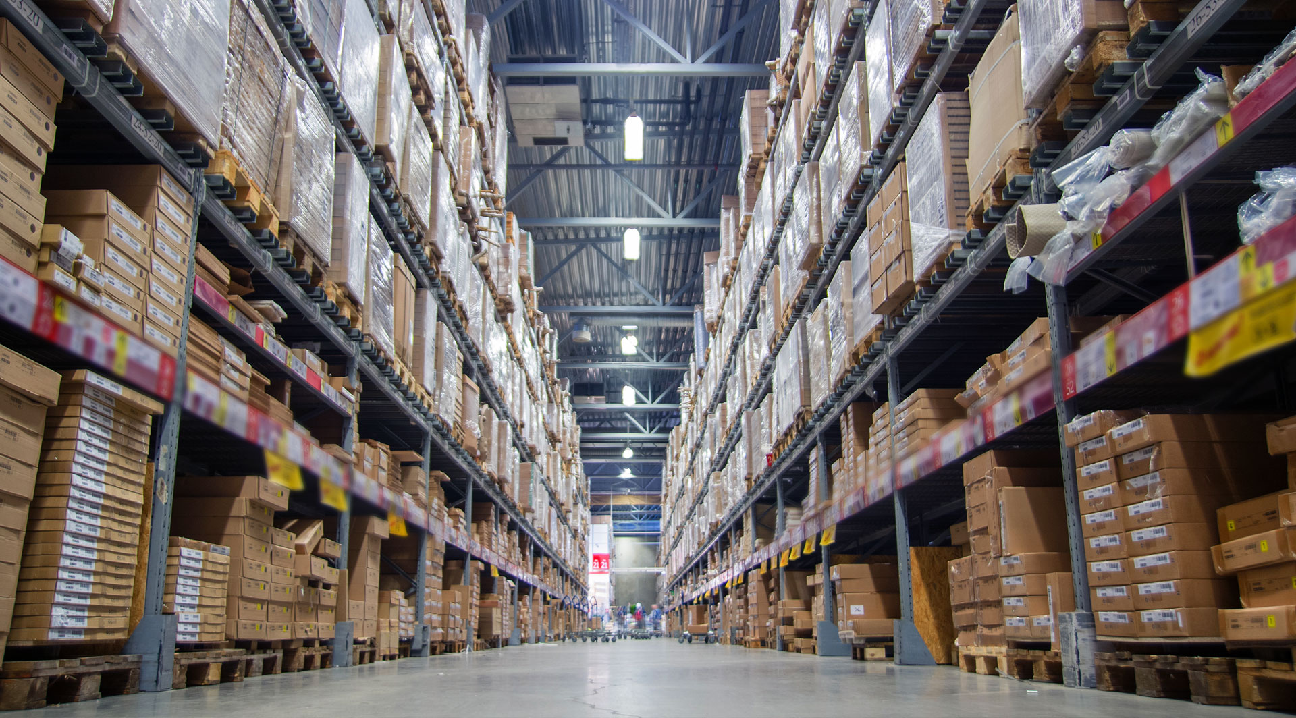

Slide 13
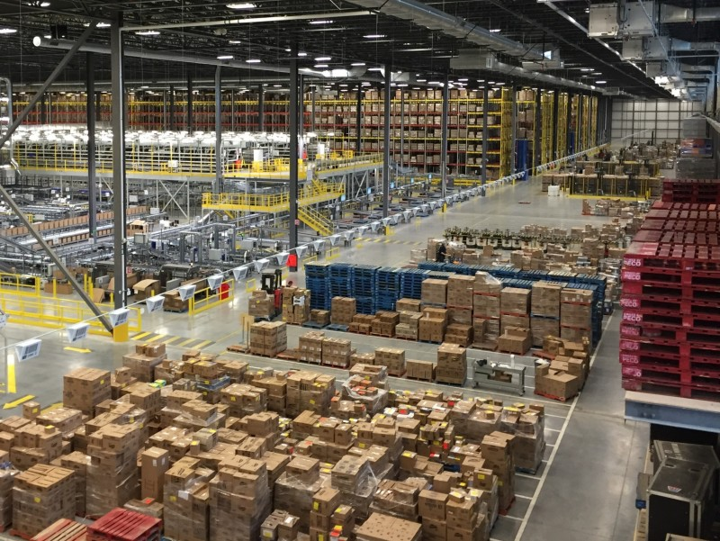

Slide 14
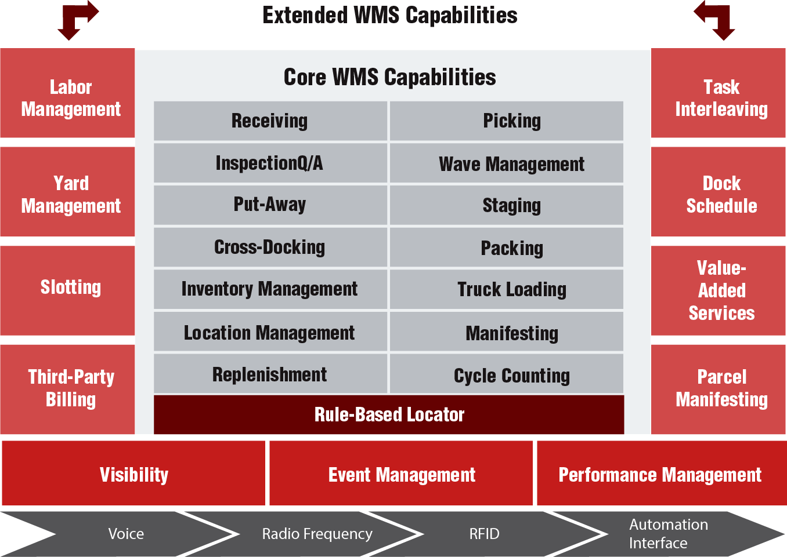
THE WMS LANDSCAPE
COMPANY PRESENTATION >> CAPABILITIES

Slide 15
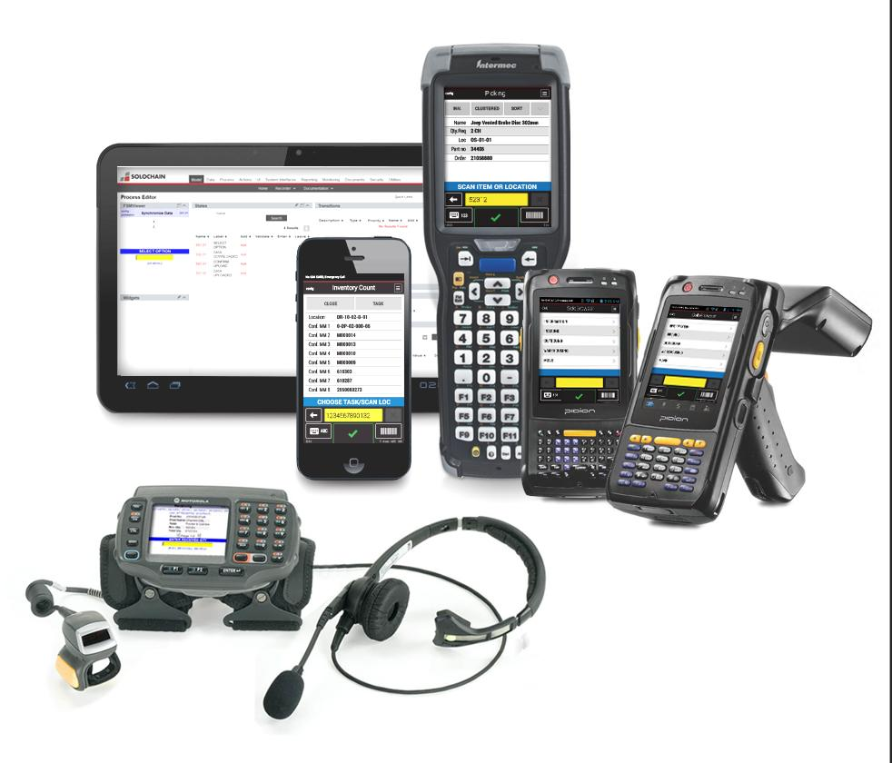



MOBILITY
Mobility is a cornerstone of supply chain execution using barcodes and RFID. Solochain process mapper provides all the flexibility to configure or customize existing processes or create new ones for mobile users
Available online or offline
Multiple input include keyboard, touchscreen, voice, scan and camera
Multiple platforms include native web, iOS, Android and .Net
COMPANY PRESENTATION >> CAPABILITIES

Slide 16

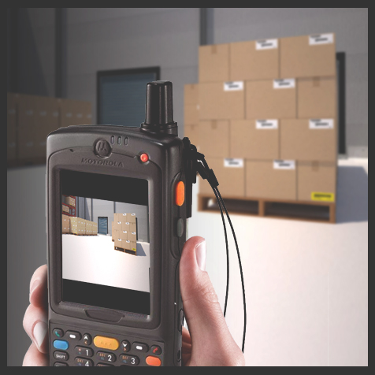
MOBILITY
COMPANY PRESENTATION >> CAPABILITIES

Slide 17
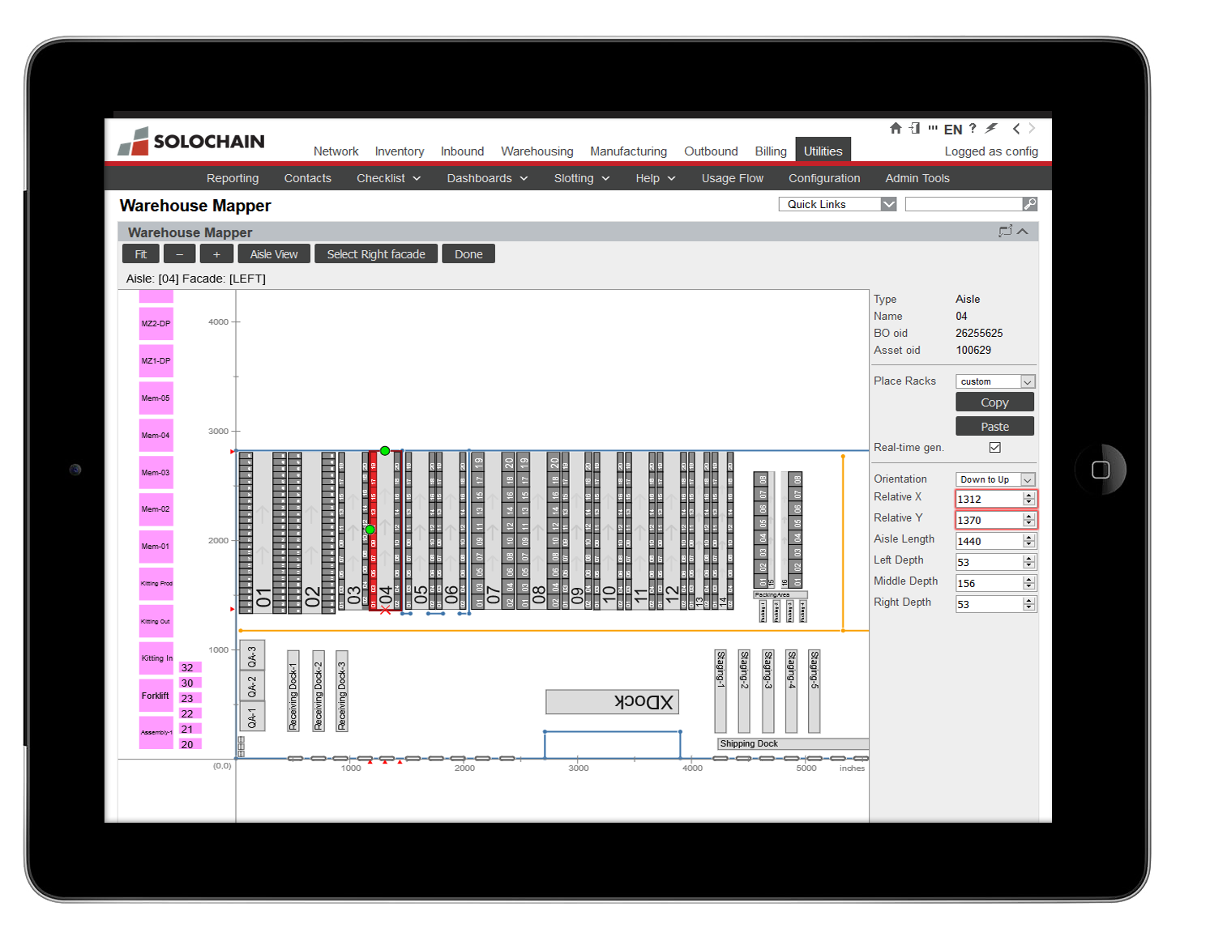
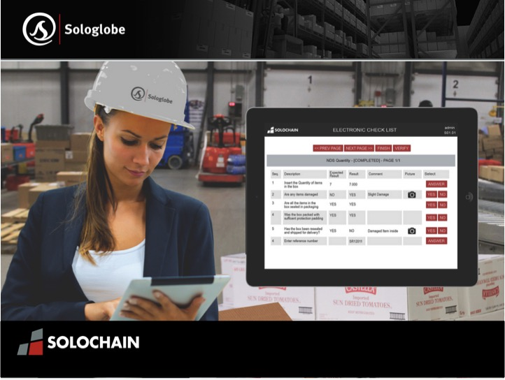
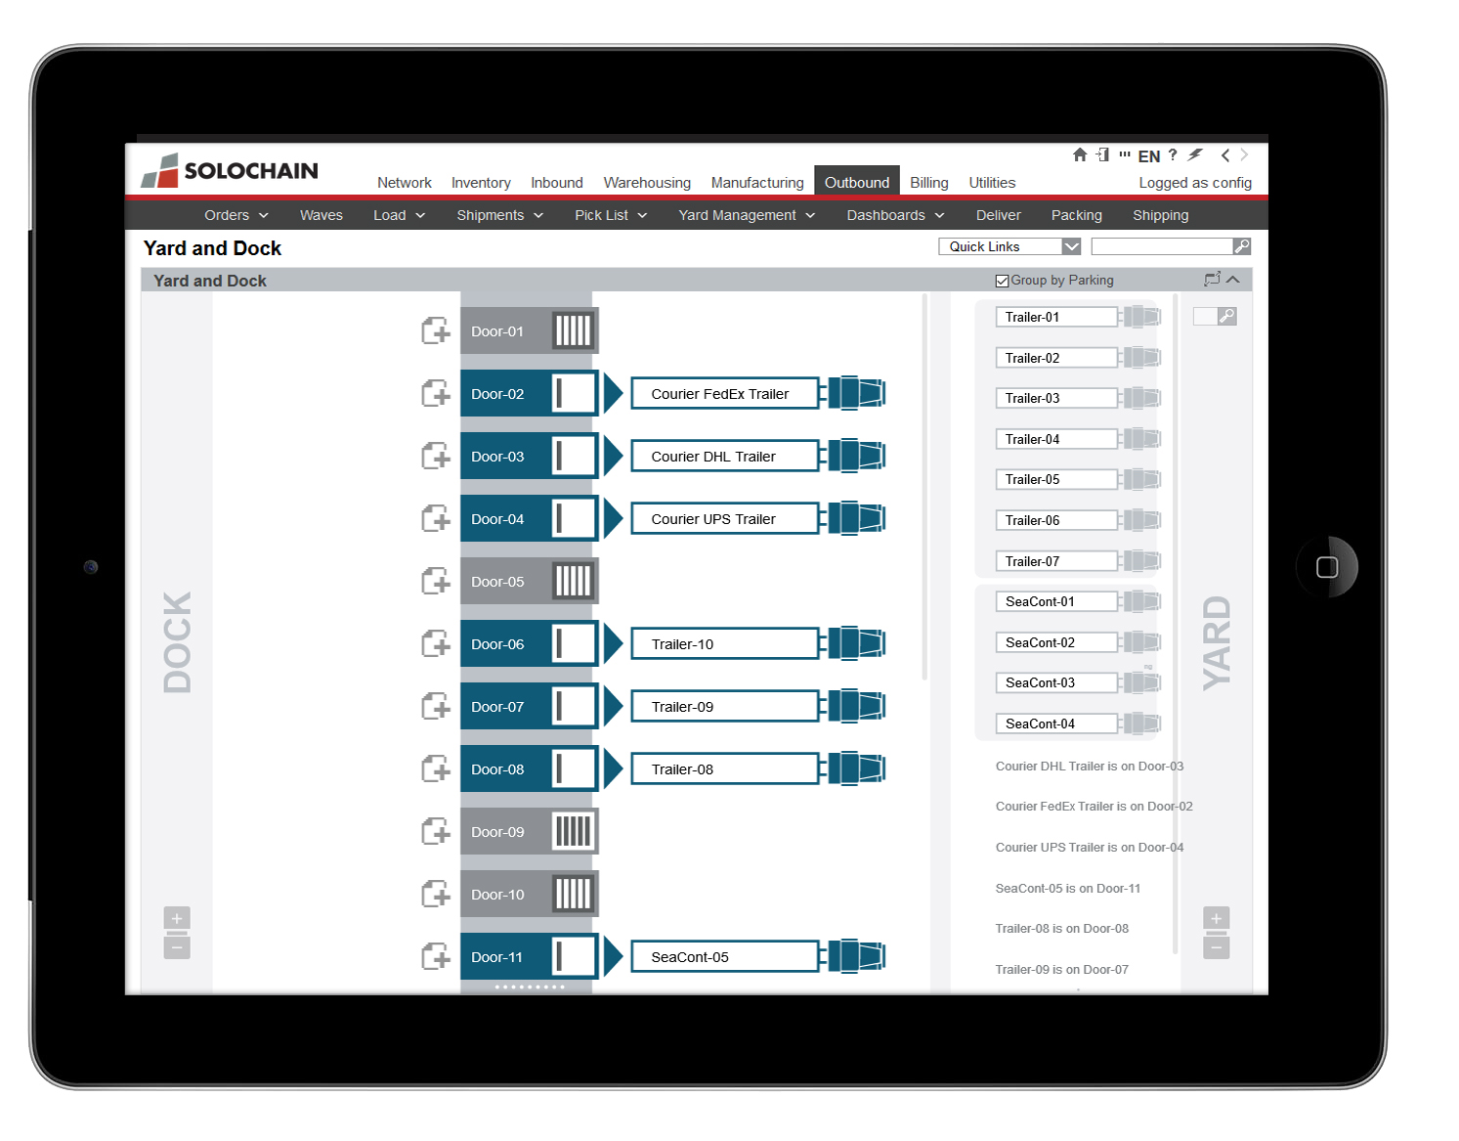
MOBILITY
COMPANY PRESENTATION >> CAPABILITIES

Slide 18
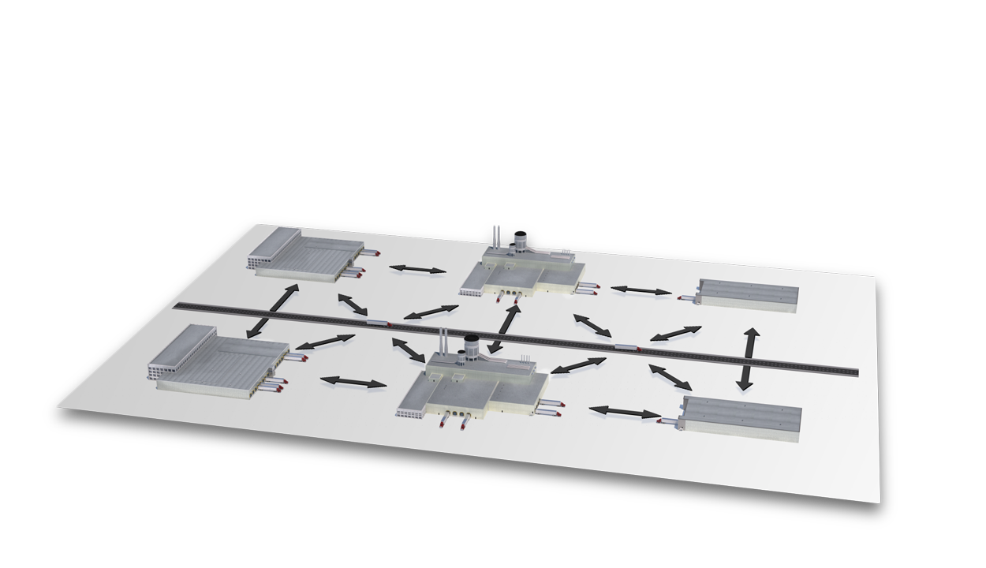
Multi-Site Management
- Manage an infinite number of sites on the same application
- Sites can be configured to implement an integrated logistics and manufacturing chain
- Every site is defined with its own business rules and attributes
- Suppliers and customers can be integrated through an information or transaction portal

Slide 19
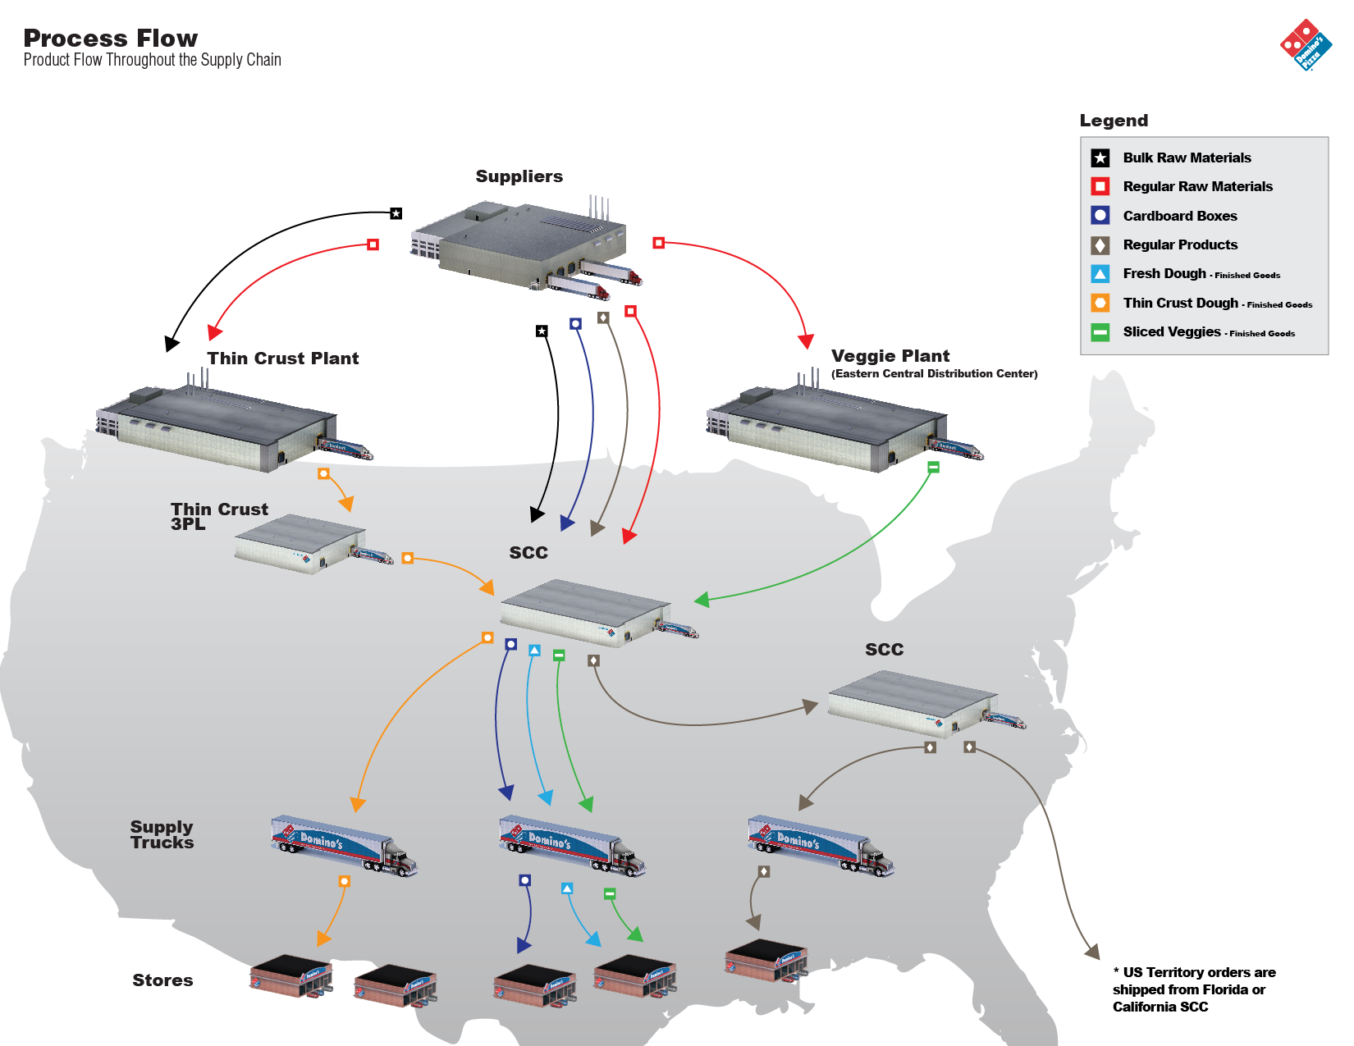
Best-of-Breed Warehouse Management System Benefits
Introduction:
A Warehouse Management System (WMS) tracks inventory, and inventory attributes from the time it is received until it is consumed, or shipped. A WMS also manages orders and inventory movements throughout the supply chain providing robust real-time user and time stamped audit trails.
Key Benefit Overview:
ERP Integration
Inventory Management
Traceability
Order Management
Picking Methods
Customer Compliance
KPI Reporting
COMPANY PRESENTATION >>

Slide 20

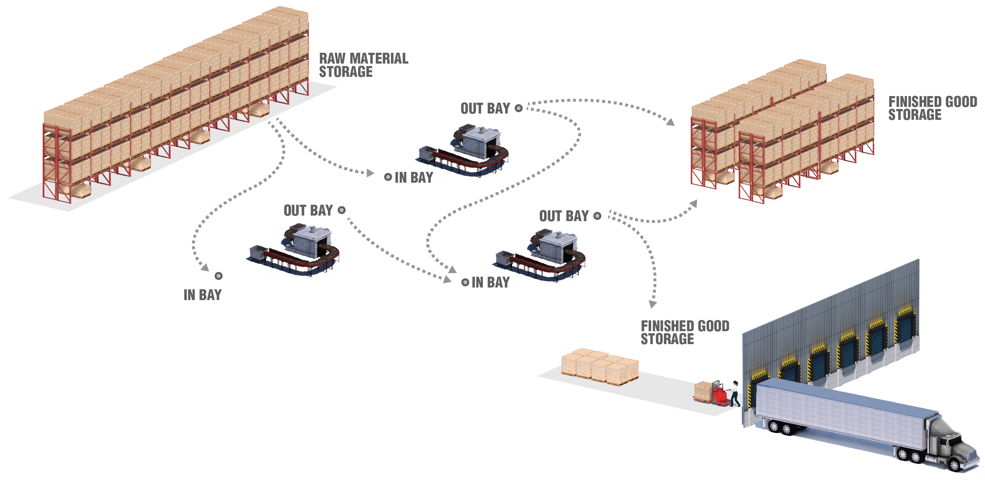
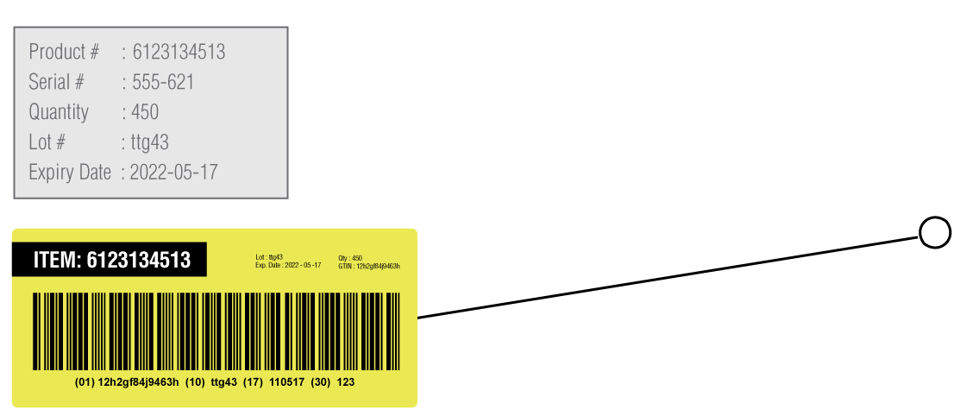
Raw Material, Component and Finished Good Tracking
Notes:
(3 – Minutes)
Manufacturing companies use work orders to pick and move raw material to production lines to produce components or finished goods.
As components or finished goods are produced the raw materials are consumed. If lot numbers, expiry dates or serial numbers are managed the audit trail starts when the raw materials is received, and continues when the raw material is picked and move to the production line and consumed against a specific work order.
This process creates the genealogy used to track the raw materials to components or finished goods and to the work order and production line(s) used in the manufacturing process.
Use Manufacturing Flow Image to point out movement.

Slide 21
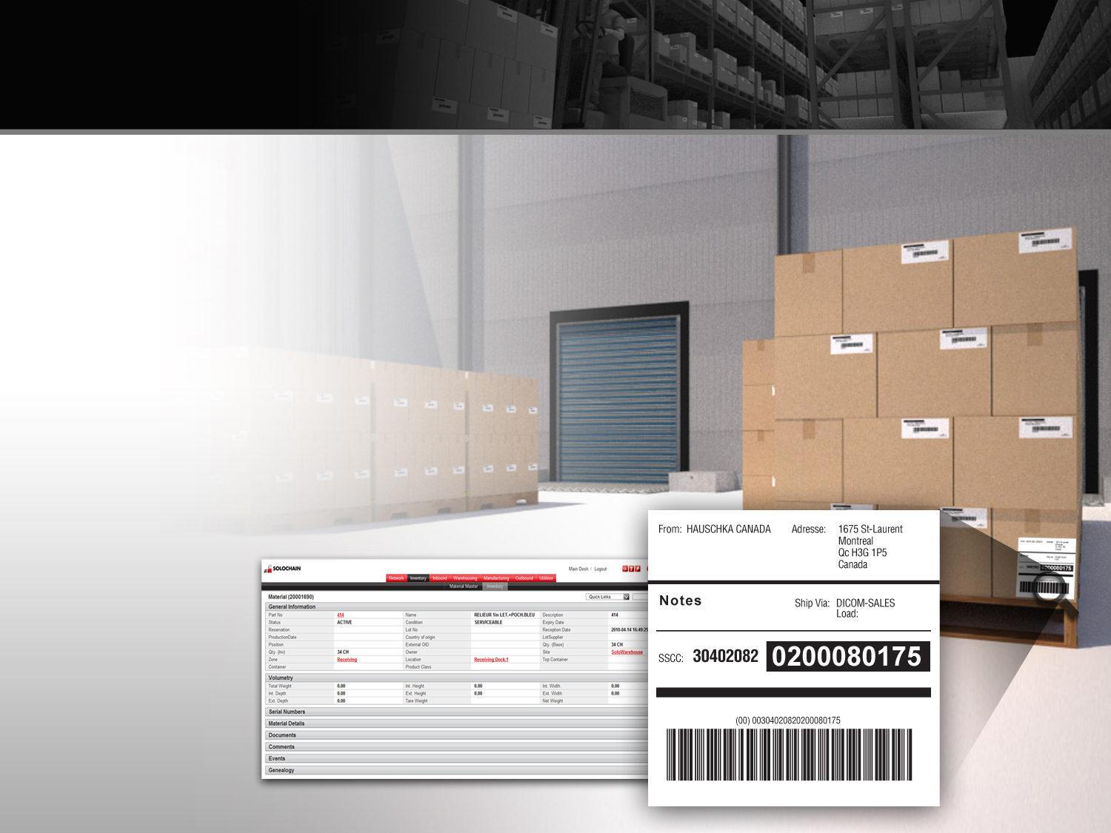
Lot Tracking
Managing Lot Numbers
SOLOCHAIN™ records all inventory instances and assigns them to a unique license plate. All related tasks and inventory operations are instantaneously recorded giving you:
Detailed Lot Number Tracking
Dynamic FIFO, FEFO , LEFO Management
Unlimited information attributes can be tracked
Complete event recording
Complete KPI Management

Slide 22
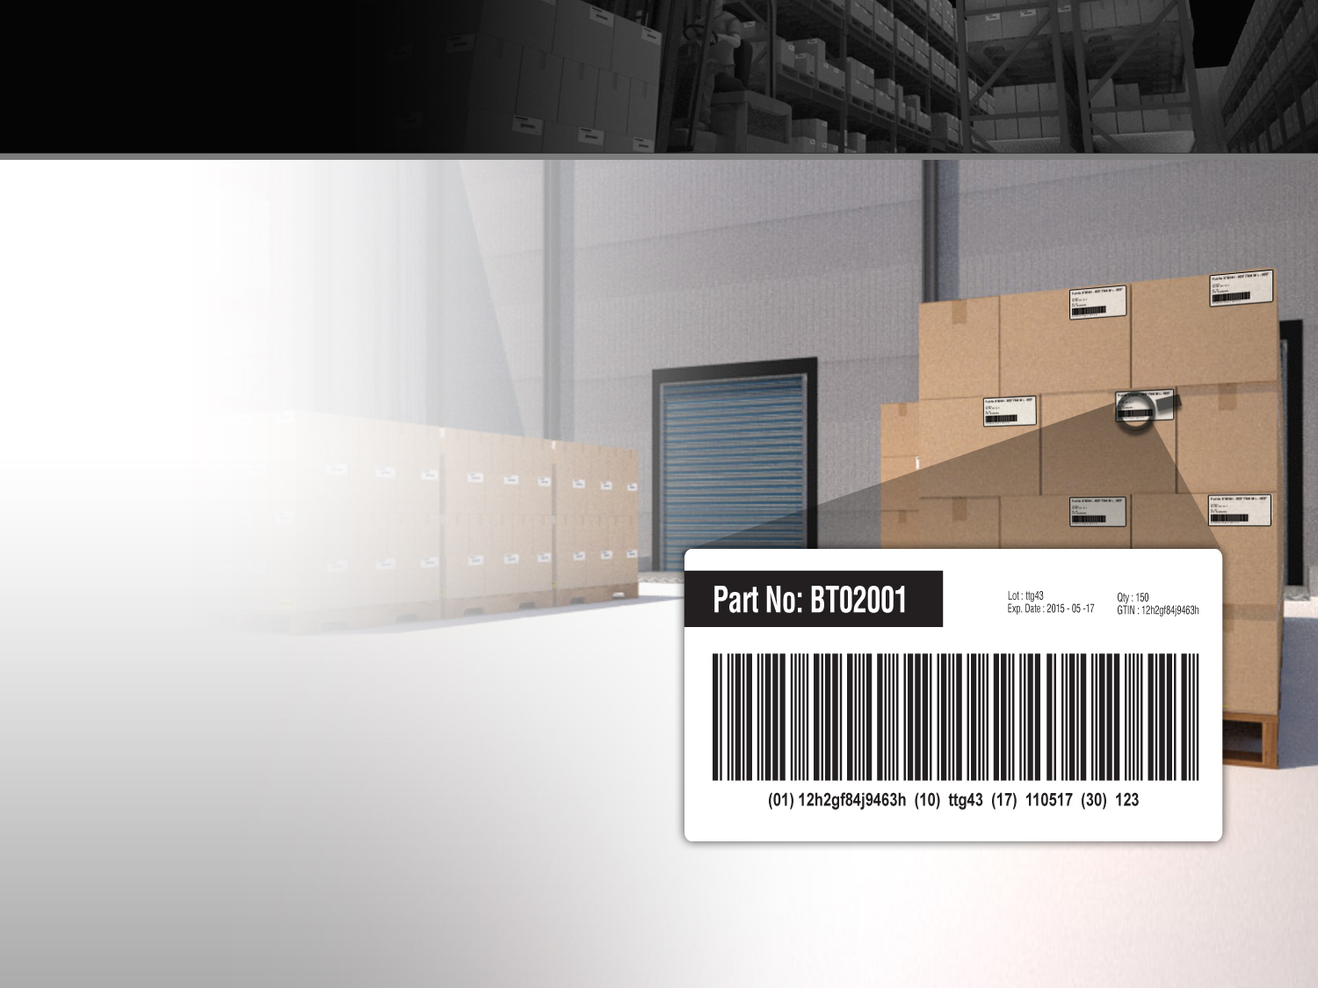

GS1-128
GS1-128 barcodes are used to encode trade item data for logistics units such as :
Cartons
Cases
Pallets
Returnable assets
Specific information can also be encoded in GS1-128 barcodes to add security and sustainability to your supply chain.
Best Before Date
Batch/Lot Number
Serial Number
The GS1 System’s Serial Shipping Container Code (SSCC) are examples of the data that can be encoded in a GS1-128 barcode.
Notes:
GS1-128 barcodes are used to encode trade item data for logistics units such as cartons, cases, pallets, and returnable assets that are not intended to pass through retail point-of-sale (POS). The use of this symbology supports fast and accurate tracking of inventory, adding visibility to your supply chain.
Specific information can also be encoded in GS1-128 barcodes to add security and sustainability to your supply chain. Best Before Date, Batch/Lot Number, Serial Number, the GS1 System’s Serial Shipping Container Code (SSCC) are examples of the data that can be encoded in a GS1-128 barcode.
The combination of unique identification and standardized data content make GS1-128 barcodes invaluable for sharing rich data content between trading partners across wide sectors in the supply chain, bringing retailers, healthcare providers, manufacturers, and logistic service providers together to collaborate and improve the supply chain.

Slide 23
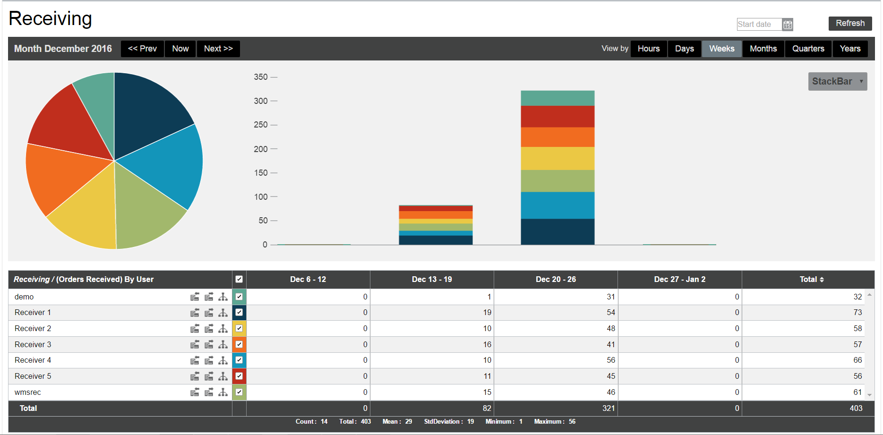
KPIs

Slide 24
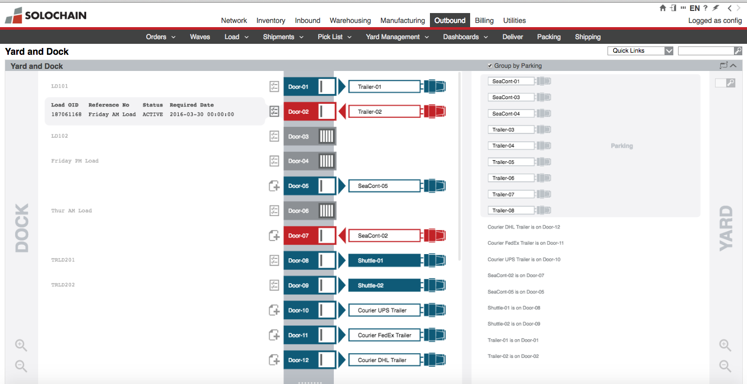
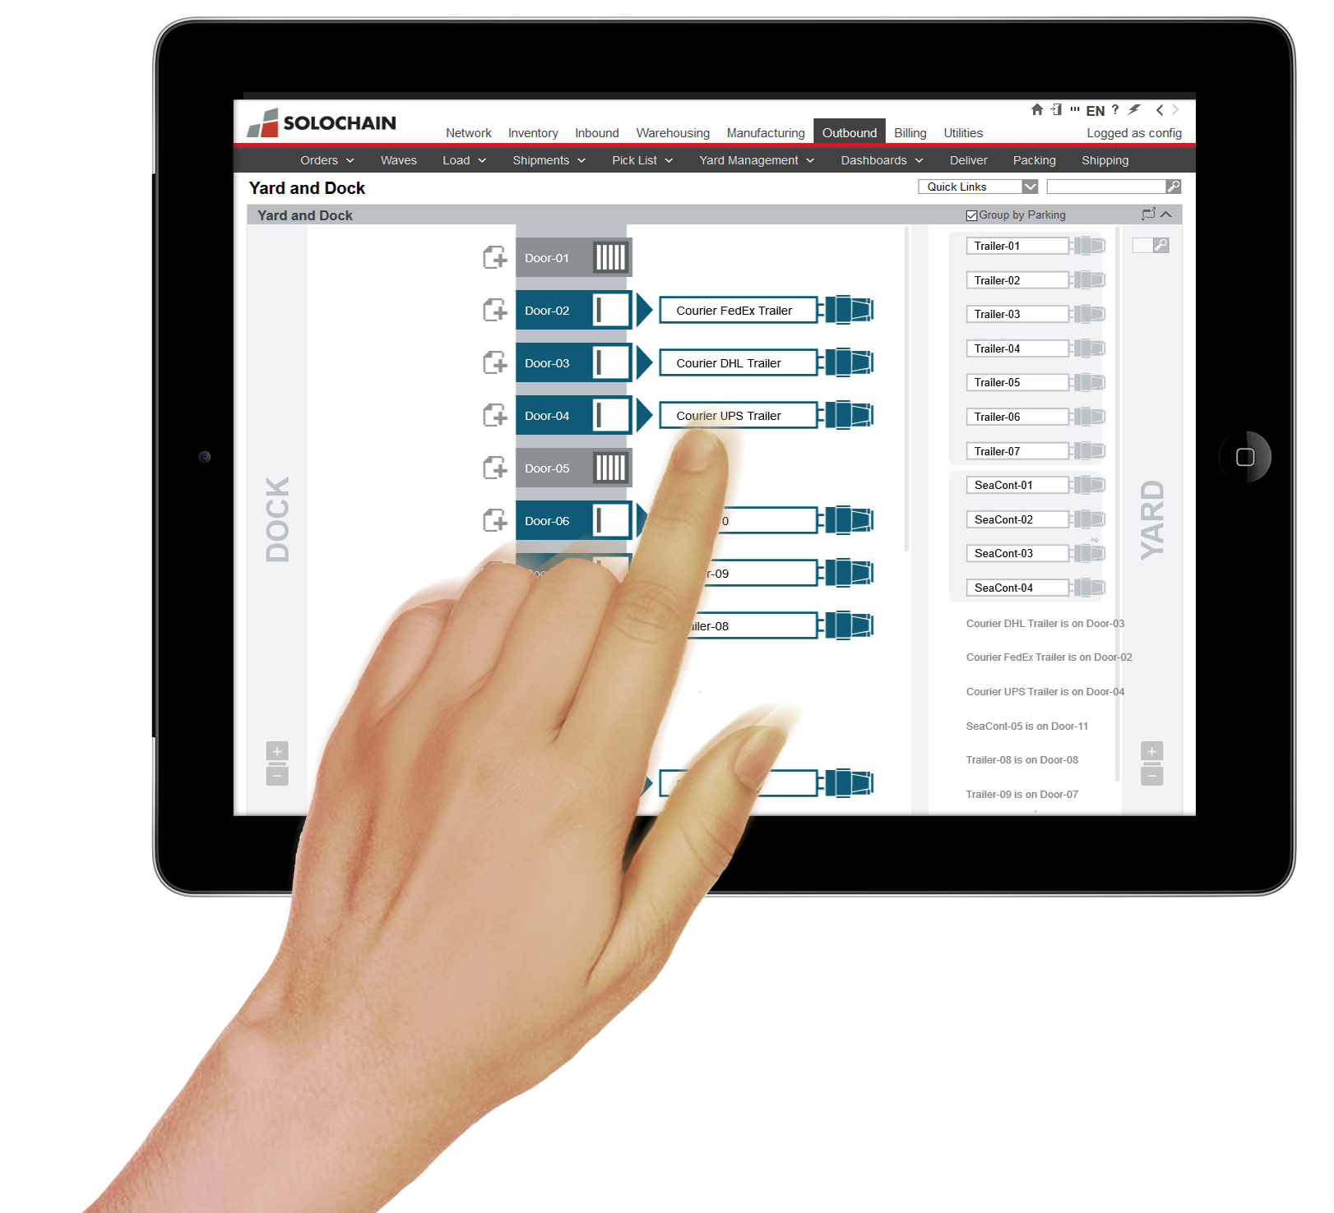
NEW MODULE – DOCK MANAGEMENT
COMPANY PRESENTATION >> CAPABILITIES

Slide 25
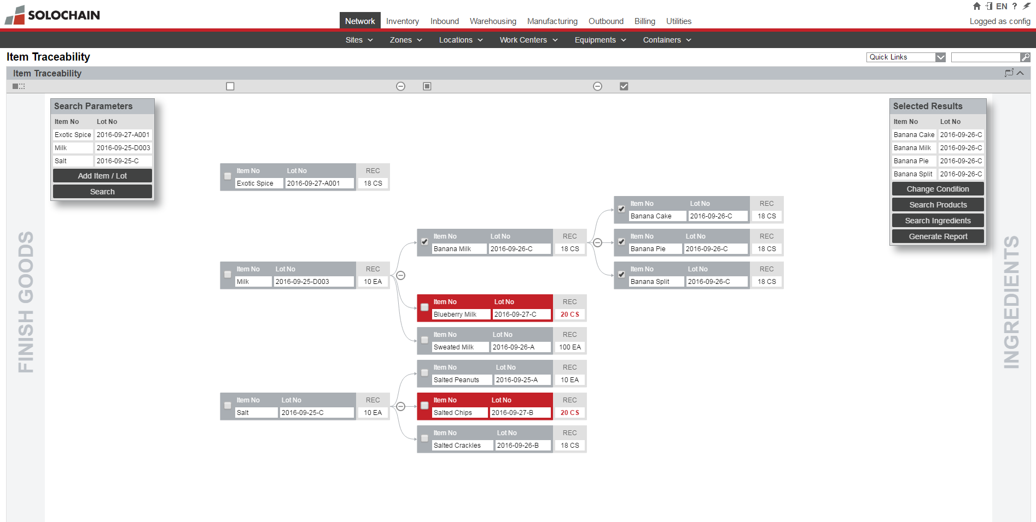
MODULE – TRACEABILITY DYNAMIC REPORTING
COMPANY PRESENTATION >> CAPABILITIES

Slide 26
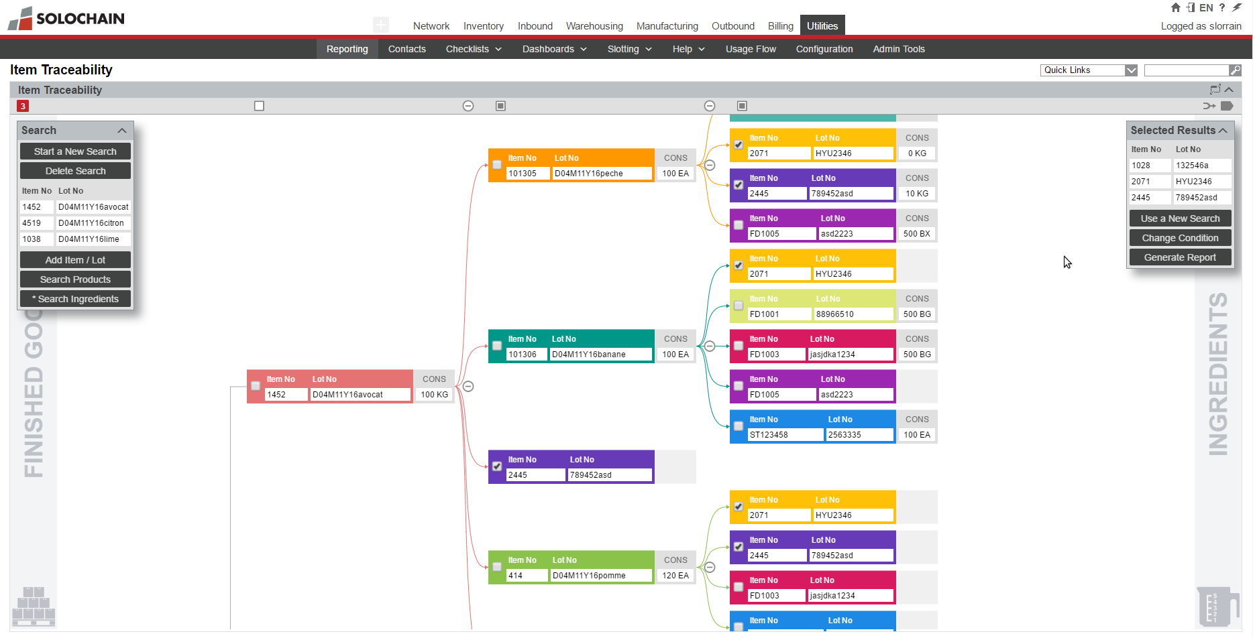
Item Traceability

Slide 27
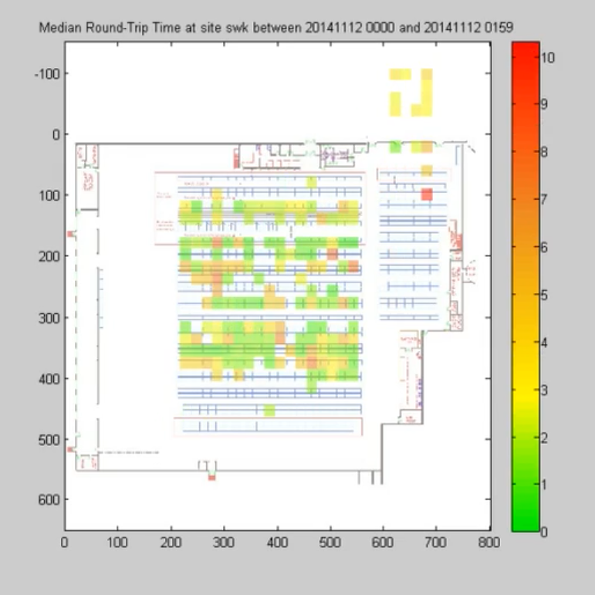
HEAT MAPS ANALYTICS
COMPANY PRESENTATION >> CAPABILITIES

Slide 28
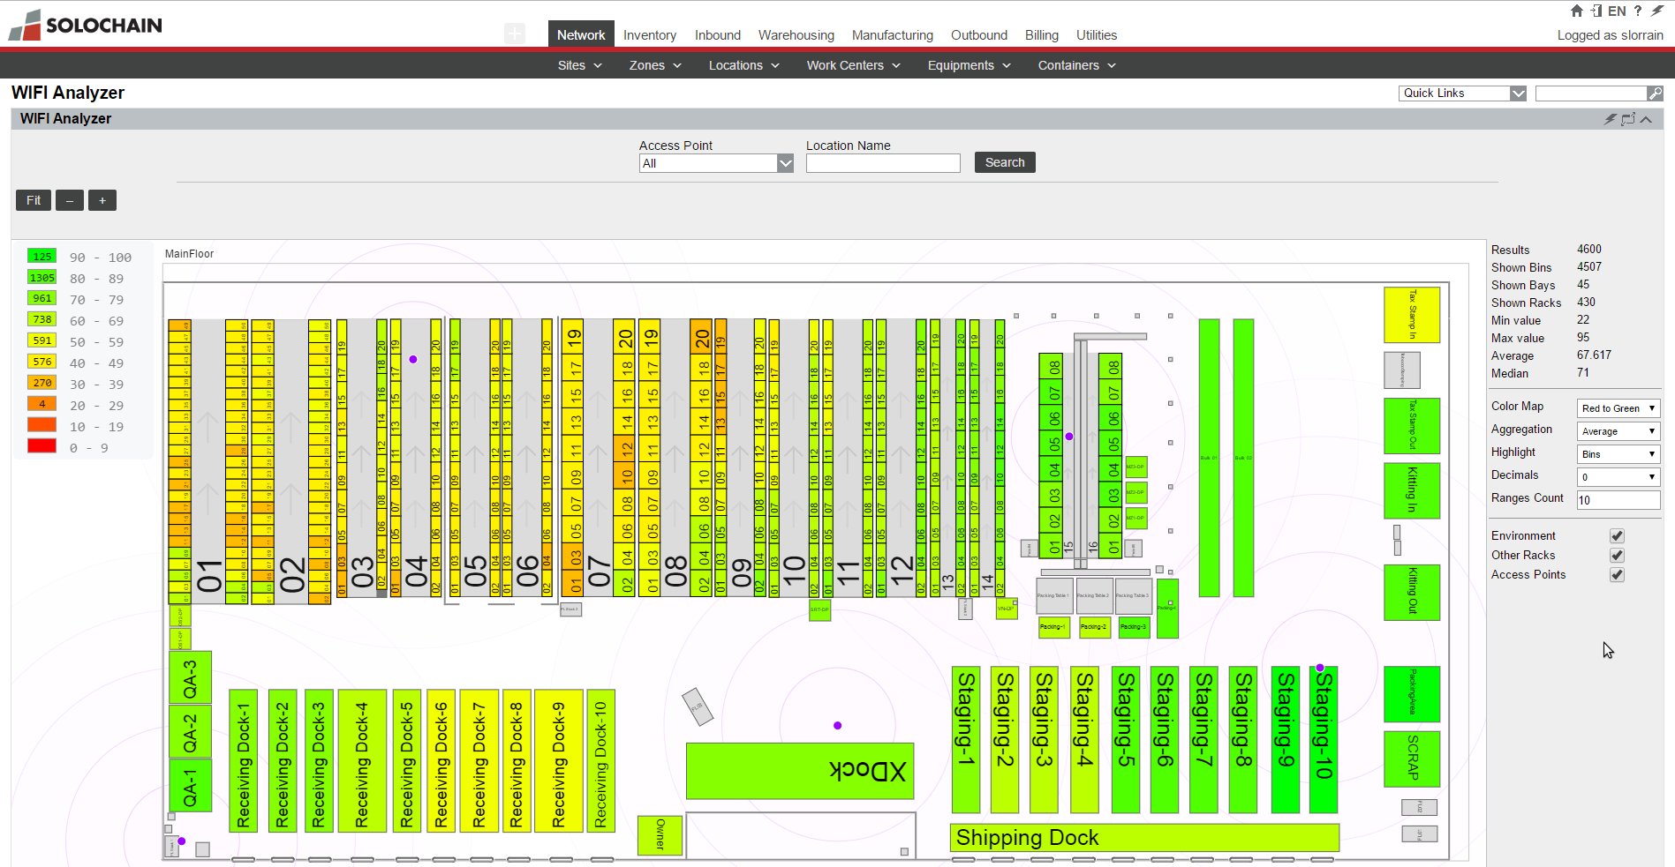
Wi-Fi Analyzer

Slide 29
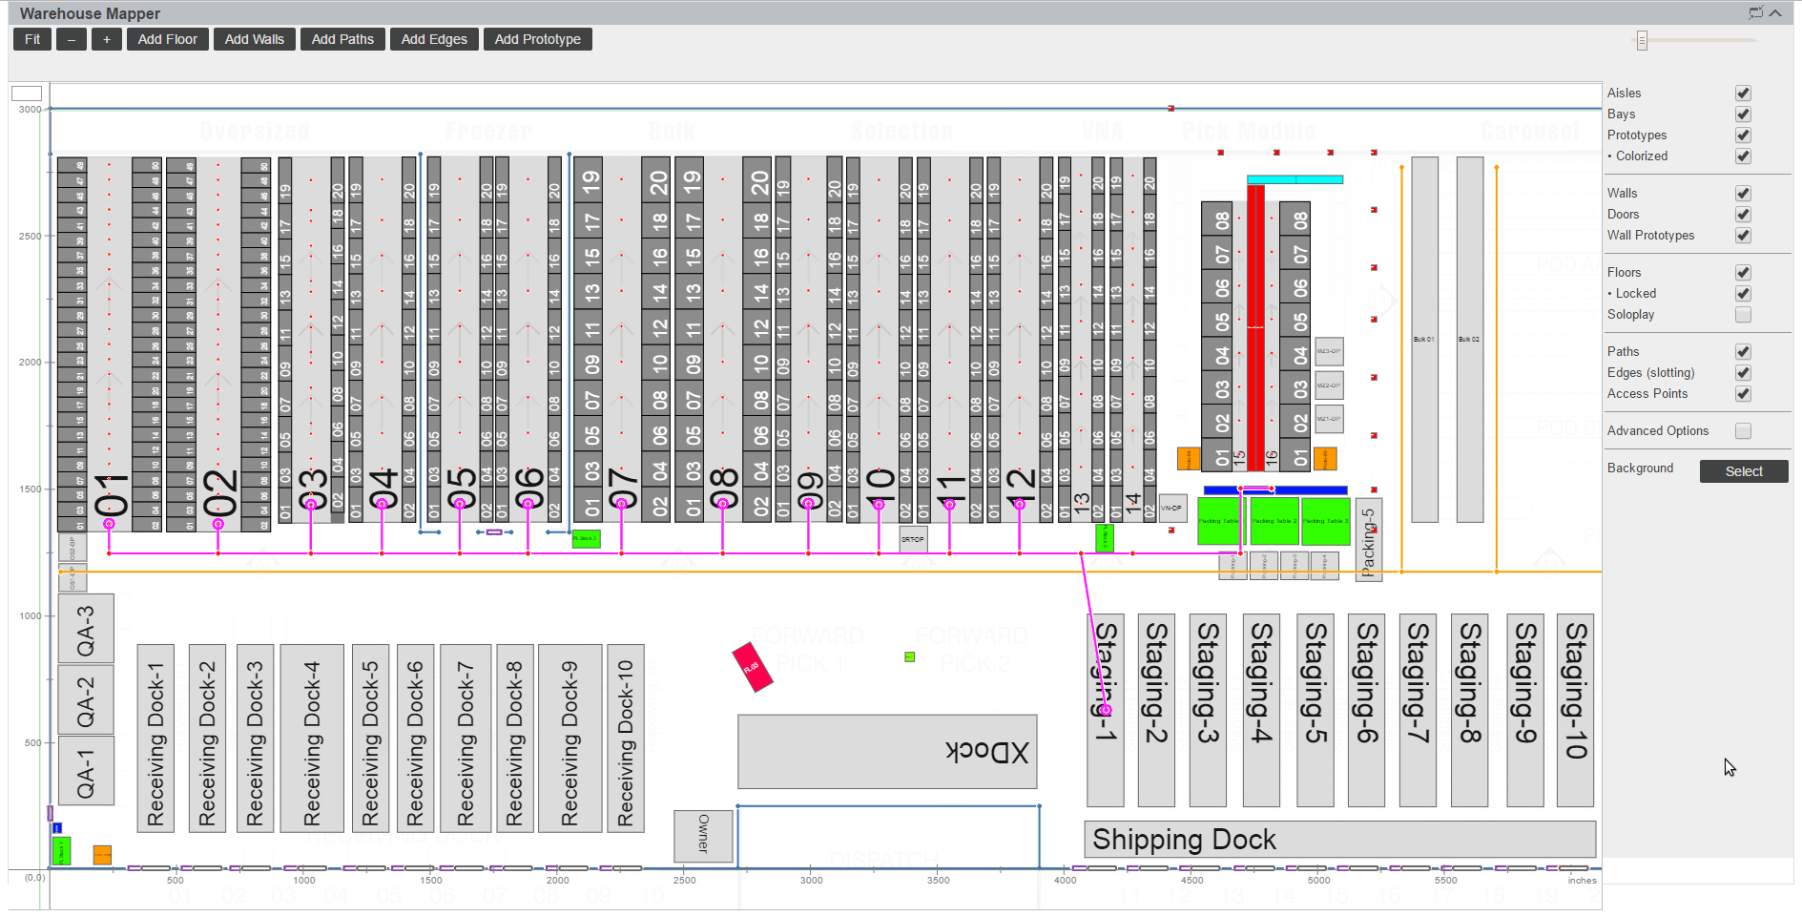
Warehouse Mapper

Slide 30
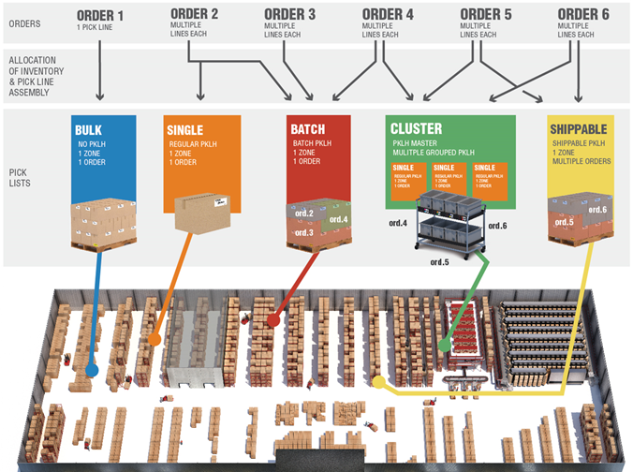
Picking methods

Slide 31
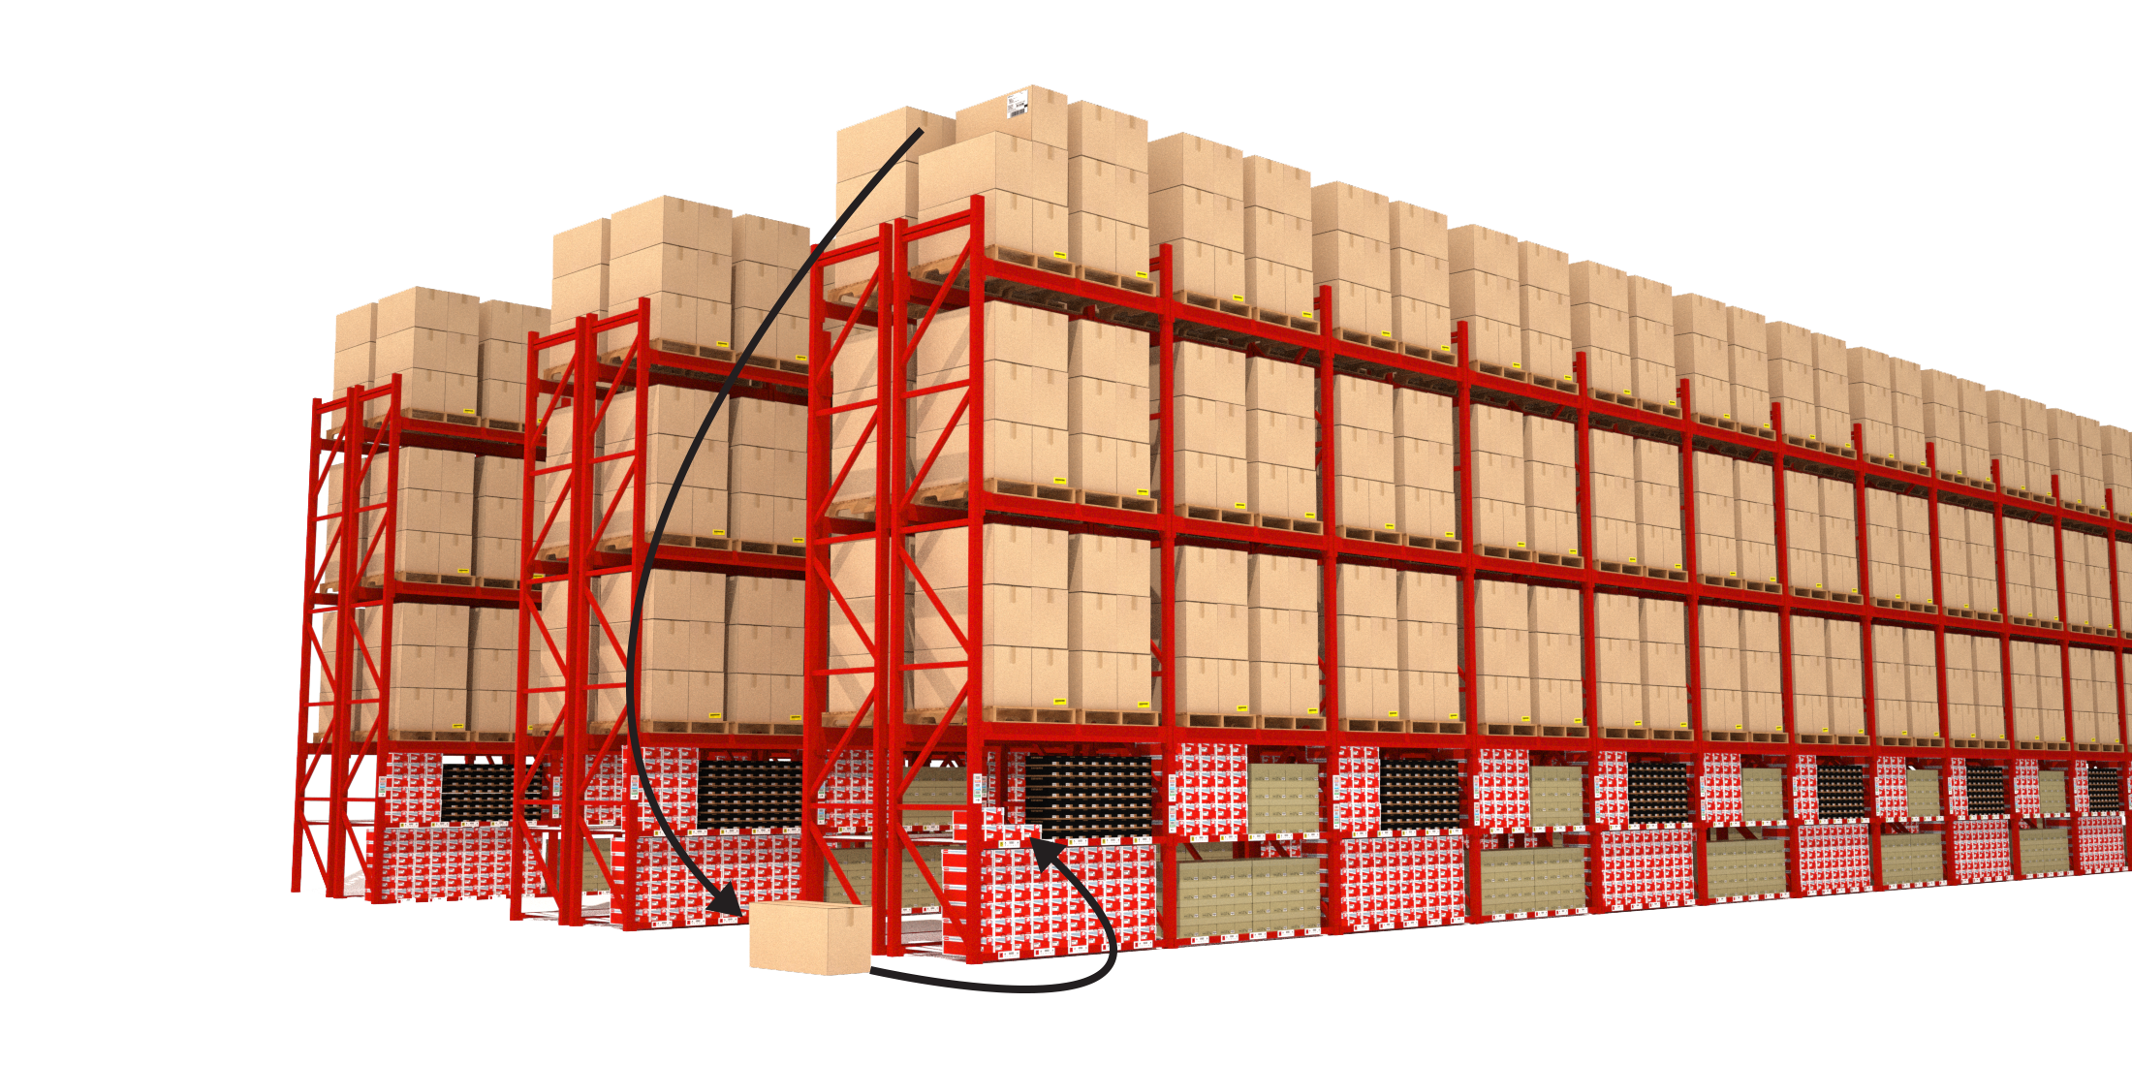
Item Slotting
To Picking Locations, By Material Type, By Reach, By Quantity
Notes:
(3 – Minutes)
Item Slotting provides information based on item quantities and the number of reaches done. These values help determine how items/inventory should be slotted within the warehouse.
Based on historical data Slotting can also help determine if seasonal items should be moved closer to the shipping docks, or moved to the back of the warehouse until next years orders pick-up!

Slide 32
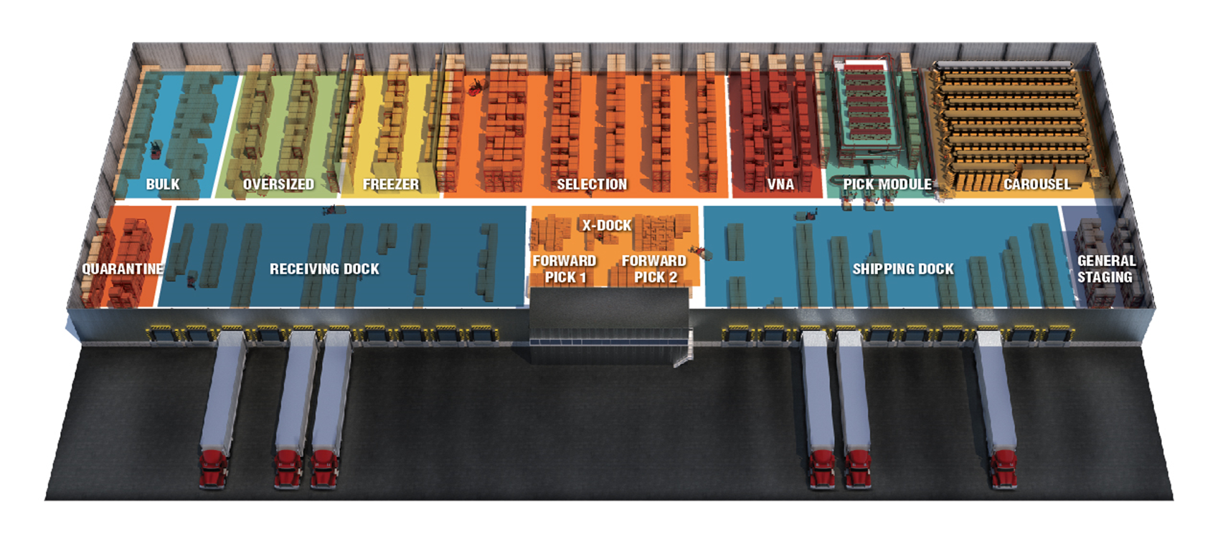
Location Level Stock Counting

Slide 33
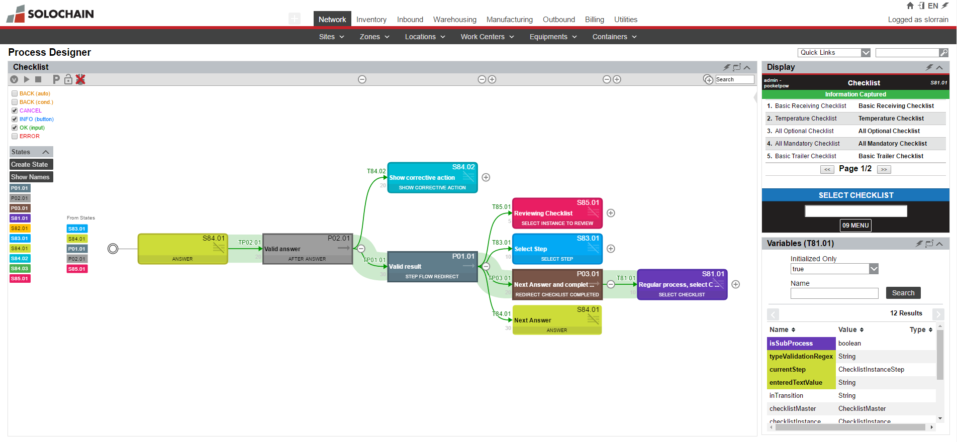
Process Designer

Slide 34
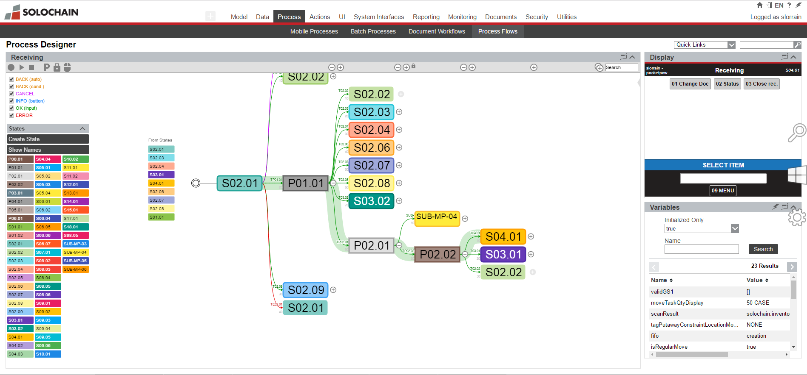
Process Designer

Slide 35
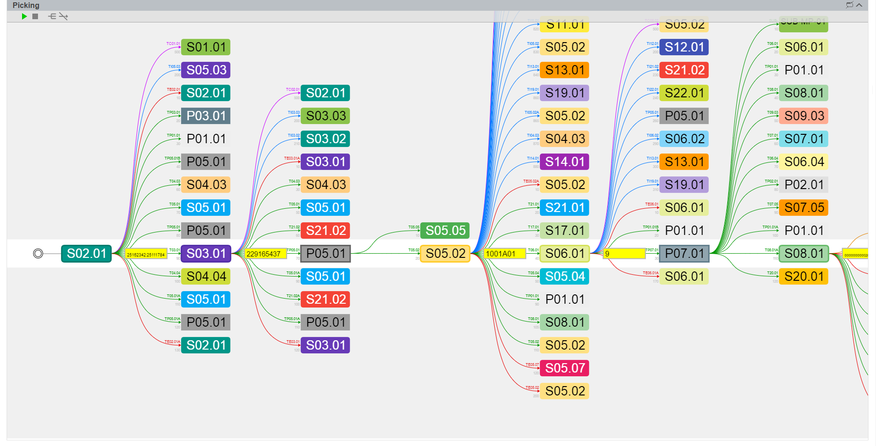
Picking

Slide 36
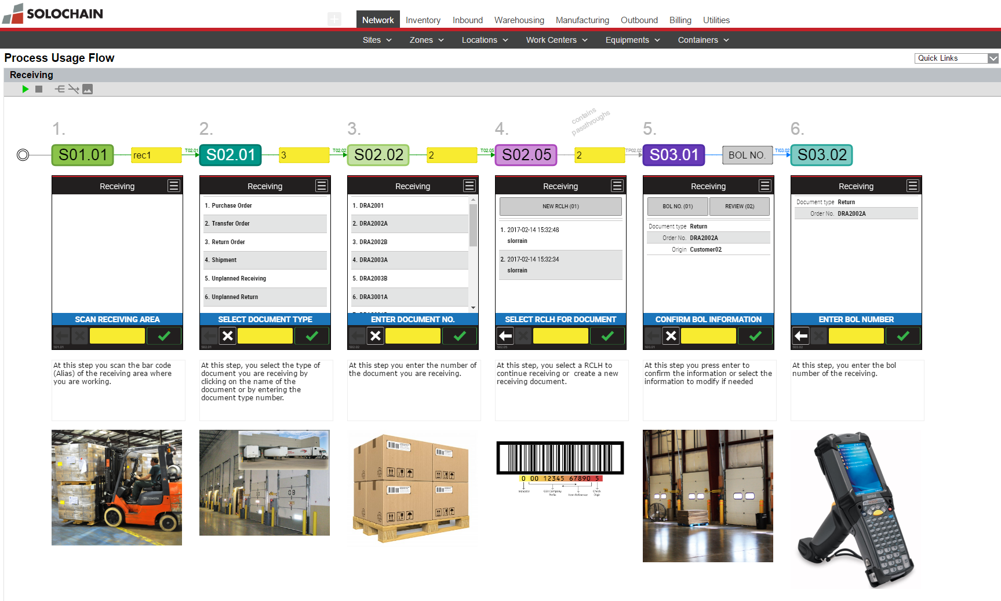
Process Usage Flow

Slide 37
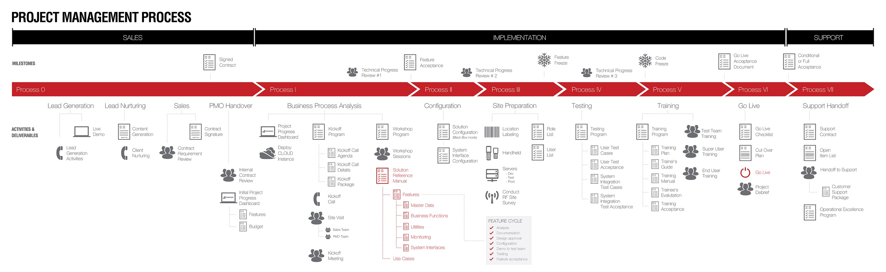
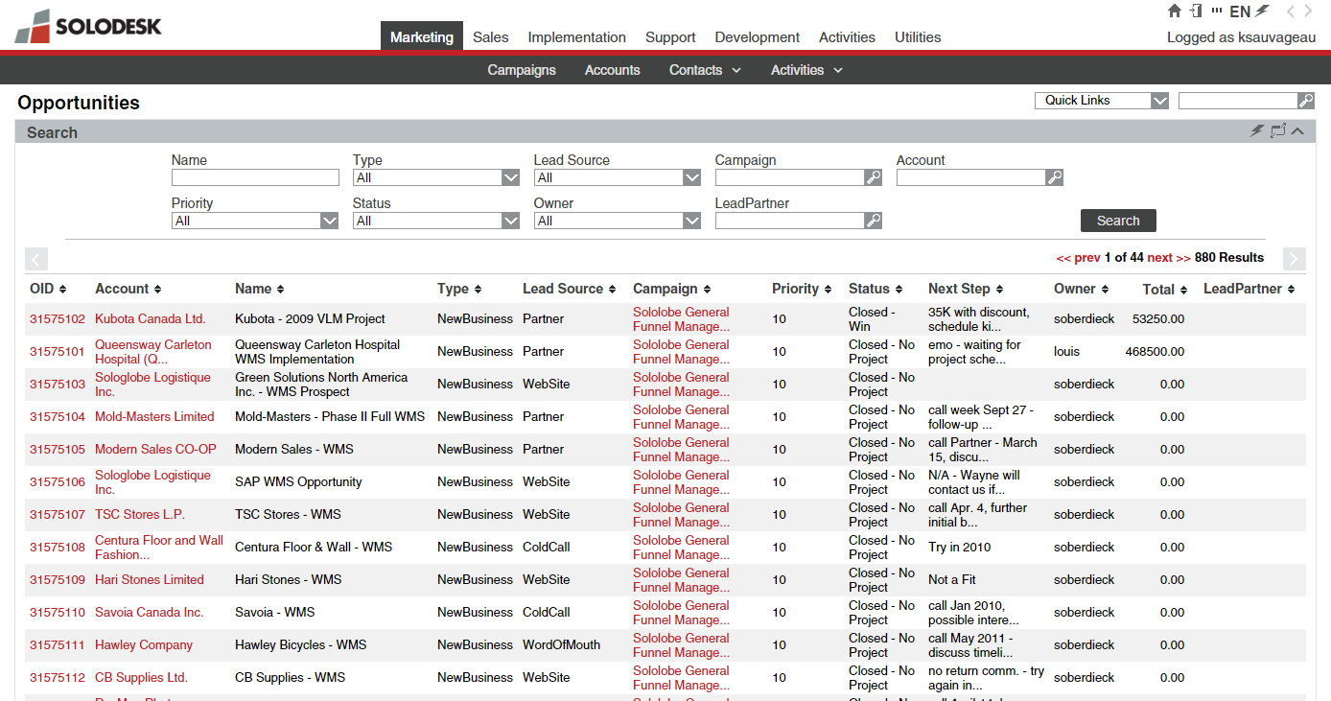
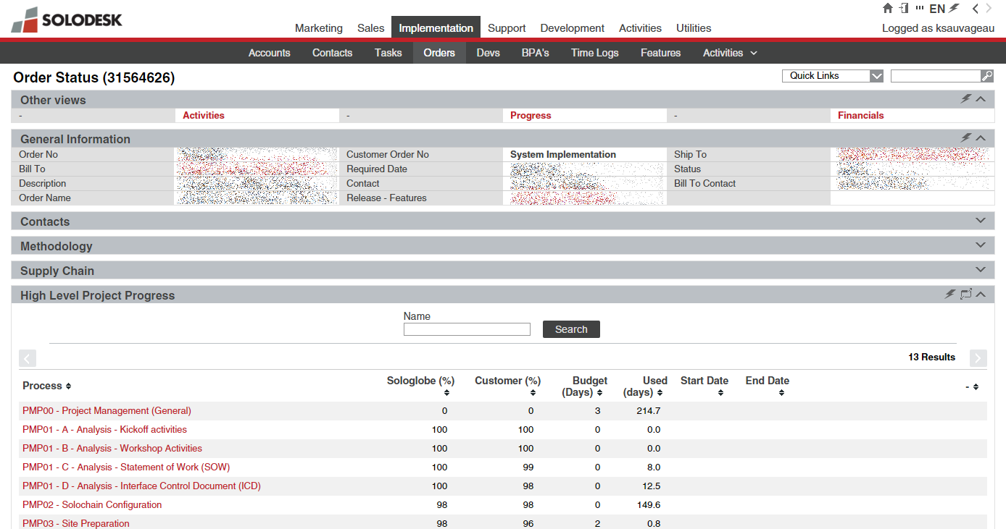
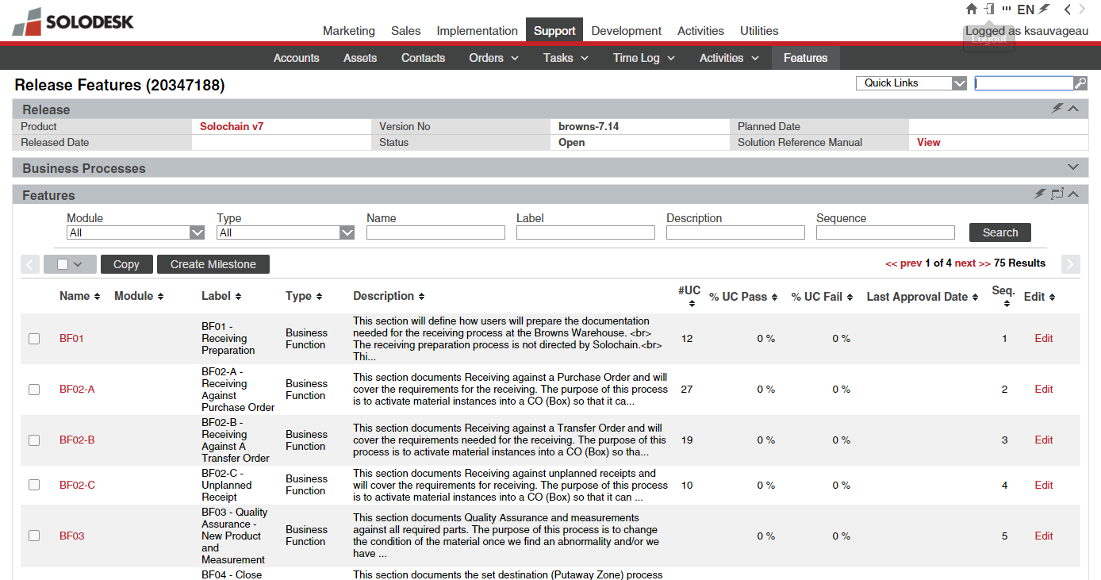
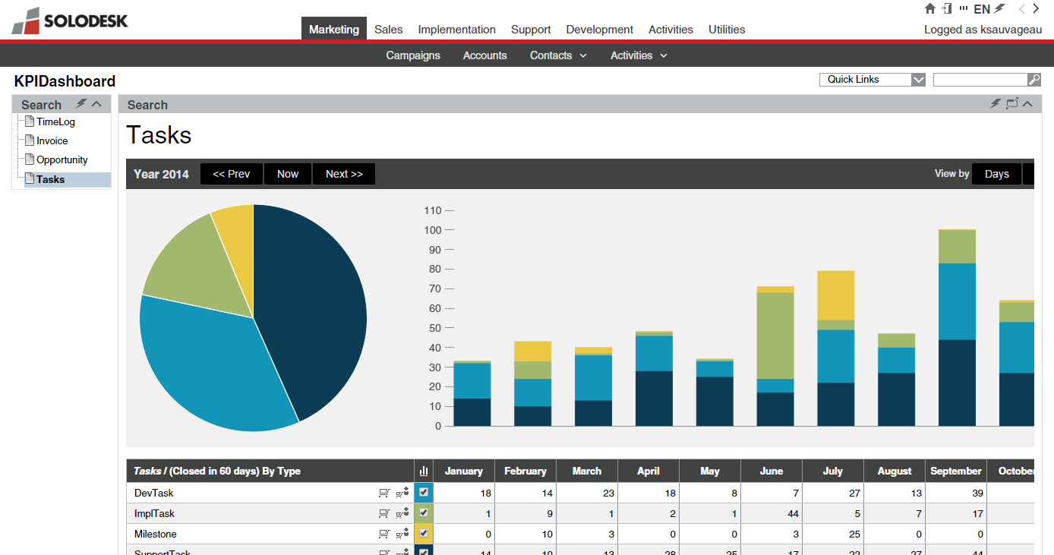
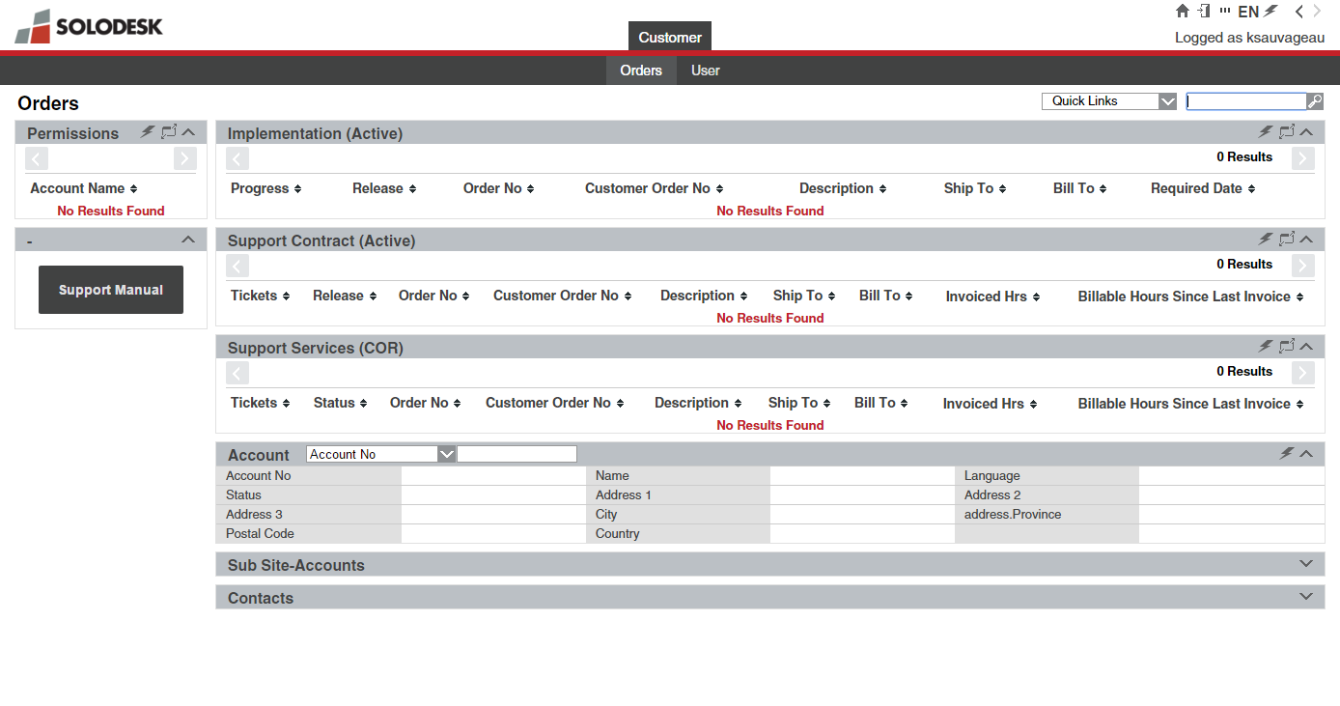
IMPLEMENTATION METHODOLOGY
Proven methodology tightly coupling our product (SOLOCHAIN) implementation with our in house customer support portal (SOLODESK)
OPPORTUNITY AND CONTRACT MANAGEMENT
PROJECT TRACKING & MANAGEMENT
FEATURES AND USE CASE MANAGEMENT
WEEKLY PROGRESS MONITORING
CUSTOMER SUPPORT PORTAL
COMPANY PRESENTATION >> CAPABILITIES
COMPANY PRESENTATION >> OPERATIONAL LANDSCAPE >> IMPLEMENTATION METHODOLOGY

Slide 38
QUESTIONS ?
Luc Larocque
Vice-President Sales
luc.larocque@generixgroupnorthamerica.com
514-938-4562

