Slide 1
How to become paperless and achieve a fast ROI
Notes:
Hello, thank you for joining our presentation. I’d like to thank Angie Doorn and Innovia for the opportunity to present to you today. My name is Sandra Cummins and I am the account manager at Equisys.
Today’ I am going to discuss some of the challenges we hear from customers that are using paper based and inefficient electronic filing systems and the benefits they realized when switching to an electronic document management system. You will learn how to move beyond paper and inefficient filing systems while quickly recovering your investment.

Slide 2
Agenda
Introduction
The problem with traditional file storage
How document management solutions can help
Solution overview
Summary and next steps
Notes:
I’ll start with an introduction of Equisys and the history of Zetadocs and then move into a discussion of the costs and frustrations of paper based and other storage methods. We will then show you how document management solutions can be used to increase efficiency and customer response times while also reducing your costs.
We will follow with an overview of how document management solutions work within NAV and then close with a summary.

Slide 3
Introduction
Offices in London, UK and Alpharetta, GA
Founded 1987, over 60,000 customers worldwide
History of product leadership
Zetafax, Zetadocs for NAV, Zetadocs Expenses
Special focus on Microsoft Dynamics
Over 5000 companies use Zetadocs
Partnership with Microsoft (Zetadocs Express)
Notes:
To give you a little back ground of our company, Equisys was founded 30 years ago. Our History of leadership in the document managing delivery and approval space started with our fax solution. Business owners we talked to were experiencing several challenges when they attempted to become paperless and needed a network fax solution. We developed Zetafax followed by Zetadocs for NAV.
In 2007, we entered into an agreement with Microsoft to develop a document management software that integrates directly into NAV. Microsoft chose to work with us as there was a growing need of Companies looking for software that could help eliminate paper based processes and provide solutions to help with the challenge of sending out a large volume of invoices.
ZetaDocs was one of the first NAV add-ons to achieve Certified for Microsoft Dynamics accreditation and as part of our partnership with Microsoft, we strive for and earn certification every year.
Similar to most organization that use NAV , we had a reliance on paper before we designed our document management software with NAV users like you in mind and hopefully this all demonstrates our credentials within this field

Slide 4
Question of the day
Notes:
To kick things off, I’d like to ask everyone to take a moment to think about the volume of documents, especially paper documents that your team processes every day. Is the paper within your organization on top of your finance team or Is your finance team on top of paper?
When organizations initially start researching a document management solution, it is often because they are facing challenges like the picture on the screen. Documentation such as Customer POs, Vendor Invoices, or Quality Assurance Certificates need to be stored. The process of filing and retrieving these paper documents is slow and laborious, it can lead to hours spent individually filing important documents with the hopes that someone can retrieve those documents at a later date.
Think about the amount of space you are using to store paper documents including the folder space you are using to store documents electronically. With paper, often times companies are faced with the decision to either rent additional storage space or utilize valuable office space. In fact, some companies we have spoken with spend over 30K a year in offsite storage fees. How much storage space are you using in your office?

Slide 5
Paper – what is it costing your business?
68% of paper used in an office is wasted*
1.5 hours per week wasted by workers looking for documents and information misplaced or lost**
That equates to hundreds of millions’ worth of time wasted a week
20% of workers recreate documents they can’t find***
*Source: ORS Group
** Source: EDM
*** Source: Workfront
Notes:
To expand on that picture with the stack of paper, here is some other information you might not be aware of.
[CLICK] The average office worker uses 10,000 sheets of paper per year, and, it is estimated that 68% of these are wasted. Reasons for wasted paper include printing documents unnecessarily, printing several copies of the same document to be filed in multiple areas, and misplacing printed documents.
[CLICK] According to a study by EDM Group, the average employee wastes 1 and a half hours per week looking for documents and information that has been misplaced or lost at work.
[CLICK] This equates to hundreds of millions of dollars a week. Think about how much time your staff wastes every week looking for supporting information in a file cabinet or in a network folder: is it more than 1.5 hours? What about the other people in your company? How much is this costing you?
[CLICK] Then, when employees can’t find what they are looking for, 1 in 5 end up recreating those documents again.
This all demonstrates that it is not simply the cost of purchasing paper and toner, but the time and money that is wasted through the use of iinefficient filing systems that effect your team’s productivity.

Slide 6
The Challenges with File Storage
Notes:
To help illustrate the challenges of an inefficient storage system I am going to run through a typical work flow, one I am sure you are all familiar with - the purchase to pay process. Even though I’m showing a work flow on the purchasing side, this applies to the sales side and other processes as well. For ex. Sales Invoicing,
Proof of Delivery Tracking and collections management.
Every organization has a its own unique requirements, as we walk through the purchase process over the next few slides, some of the steps may not apply to your work flow, but you’ll get the idea.

Slide 7
Typical document flow
Vendors
Your Company
Customers
RFQ
Quote
Quote
Purchase Order
Purchase Order
Order Confirmation
Order Confirmation
Back Order
Signed Confirmation
Shipping info
Shipping info
Invoices
Invoices
Remittance Payment
Remittance Payment
Purchase Side
Operations
Sales Side
Notes:
As I’m going thru, think about how you are storing these files in your organizations.
A purchase order cycle usually starts with a quote request that eventually will lead to a payment. Through the process, several documents are often exchanged, for example purchase orders, order confirmations, purchase receipts and invoices, just to name a few. When we are talking with customers, these are the most common documents being passed back and forth around the office.
Throughout the work flow, email communication and attached documents need to be stored in a way that they can be retrieved at a later date to show that the purchased goods or service have been received so that payment can be approved.
Now if you switch it over to the sales side.
Notice how many of these documents will also need to be captured on the sales side to assist your reps as they communicate with your customers to make sure payment is made in a timely manner. Now think about other documents finance uses.

Slide 8
Paper-based document flow for purchase order
Notes:
So let’s take a deeper look at an example of a paper based Purchase order process.
A request for some good or service is received by the purchasing team who then contacts a vendor or vendors in order to receive a proposal. Once the Vendor proposals are received, a copy of the proposal is typically filed in one or possibly more filing cabinets or network folders. Once approved, a purchase order will be sent to the vendor, which once again, will need to be filed along with the quote. The vendor may send an order confirmation notice, which means another trip to the filing cabinet or network folder. Eventually your order will ship and be received within the warehouse. The packing slip and vendor invoice documents will need to be stored with the other relevant information that had been received. Now that all of the documents have been received, one or more members of your staff will make multiple trips to multiple locations to store the supporting documents.
As you can see from all the arrows going in different directions, there are many steps in the process. Now your organization may not go through all of these steps, but is easy to see how a paper based system is:
Costly -Storage space and Equipment to maintain
Time Consuming
Filling and retrieving paper documents is slow as it requires a trip to one or possibly more filing cabinets or network folders
Delays in accessing this information can lead to customer or vendor service issues such as
Poor response times – because employees don’t have access to the files they need causing them to put vendors (or customer) on hold.
Not having access to the right information can also lead to delays in the approval process which can cause an organization to loose out on any potential early payment discounts
Finally, this type of system is Unsecure
Documents can get lost or misfiled

Slide 9
How document management changes everything
Easy access
Quick search and retrieval
Better collaboration
Increased security
Less physical space required
Disaster recovery
Notes:
So how does an electronic document management system change this process?
Electronic Document Management can streamline your work flows by making sure everyone can easily store files against the relevant transaction within NAV so they are instantly accessible on screen
This can Strengthen vendor relationships by giving users immediate access to the information they need to answer any vendor or customer questions, without having to contact the finance team or search through mountains of paper files. This can be especially useful during an audit and helps your team focus on interacting with customers to ensure customer retention.
A good document management solution will reduce the cost of each transaction because less physical space is required to store files and no paper and toner is used throughout the process.
When your business can automate aspects of the operations that tend to be time-consuming like invoicing, billing, and payments, you will be able to focus on other activities while it efficiently takes care of these tasks for you. While these time-consuming tasks are very important to the business, they do take you away from what makes you money.
Automation is one of the most beneficial aspects of the online world and provides you with a way to secure important documents from theft or disasters such as fire or floods.

Slide 10
Document Management Enabled Purchase Order Cycle Flow
Quote Received and Approved
Purchase Order Delivered
Order Confirmation Received
Request for Quote Delivered
Shipment & Packing Slip Received
Invoice Received
Document Archive
Payment Entered
Payment Approved
Billing Inquiries
Notes:
Let’s look at the same purchase process we just reviewed where a document management system has been deployed.
The request for purchase is received by the finance team. That information is then sent to a vendor who will then provide a quote that will be entered into NAV as a purchase order. The relevant quote can easily be stored against the PO. When the purchase order is sent out, the email will automatically be archived against the PO in NAV. Later the order confirmation, Packing Slip and Invoice can now be stored electronically against the relevant transaction within NAV.
Through out this process if there is ever a question regarding a transaction, all the supporting information will be directly accessible from within NAV.
As you can see, all the supporting documents to the transaction are stored in one place, requiring only one member of your staff to store these documents.

Slide 11
Typical Scenarios
Sales
Electronic Invoicing
Proof of Delivery Tracking
Collections Management
Customer Service
Compliance
Statement Delivery
Purchasing
Issuing Purchase Orders
Supplier Invoice Processing
Supplier Invoice Approval
Remittance Advice Notification
Expense Management
Notes:
Now let’s look at some typical scenarios where a document management system can be deployed
Electronic invoicing: Generating, sending and filing invoices becomes a faster and more efficient process using a document management solution.
One of our Customers was sending a 100 invoices a day, when they started using Zetadocs, the time it took them to deliver invoices was cut in half. They have told us that using Delivery saves their team one day per week by delivering all of their sales order confirmations, purchase orders and invoices electronically.
Proof of Delivery Tracking: Almost inevitably, some customers, and suppliers will ask about a payment or whether goods have been delivered or invoiced correctly. For them, their overriding concern is that the issue should receive prompt attention and be resolved quickly. With a document management system, invoices and proof of delivery documents received from suppliers can be entered into NAV and then captured and filed automatically in SharePoint. A barcode sticker can be applied to each supplier invoice so that a stack of invoices can be scanned and automatically split, filed and linked to the appropriate transactions in NAV and this applies to other related documents, such as the purchase orders originally issued or packing slips.
We have another customer that was making 120 deliveries on an average day. What was once a time-consuming task to manually file and retrieve delivery notes is now streamlined using Zetadocs Capture. Once their delivery notes have been signed by their customers, they are scanned into the Zetadocs POD queue, which automatically attaches the signed document to the relevant transaction in NAV. Their accounts and customer services teams save precious hours because they can view these documents directly from within NAV.

Slide 12
What to look for in a document management solution
File structure
Searching
Ease of use
Anywhere access
Integration with NAV
Scanning
Security
Notes:
Before we move into the demo, we wanted to give you some tips of things to consider when investigating a doc mgmt solution based on conversations with our customers over the years.
Starting with file structure, How is your system storing files, is it just storing out to a drive with a tag that goes back to the transaction.
Or is it grouping all supporting docs for a customer into one folder that you can easily access.
When looking at doc mgmt solutions, you want to look for something that is accessible, something where people can easily find a document.
Search, do you have to go search in another area, with some document management solutions, you have to go out of NAV, does the document management software you are considering integrate with NAV?
How Easy it is to store and retrieve documents, this is probably the most important of all of these. If it’s not easy for your users, they will not adopt the solution. Don’t want to invest in software that is not fully utilized
Can your finance and sales team access the system from their home office? For your sales team, if they are at a customer site, can they pull up supporting files to answer customer ques?
Security: Whether you have 20 employees or a thousand, it can sometimes be difficult to keep security of information in check. Permissions are truly necessary in this regard, as they allow you to choose who has the ability to view, delete or change archived files and documents, and who does not. The best document management systems allow administrators to set specific permissions for every employee, helping to keep control and protect important documents from being altered.
I am now going to pass this over to Mitch who is going to show you how a document management system actually works.

Slide 13
Tips for a successful implementation
Identify the type of document management system you are looking for
Which departments can benefit
Determine who will need access to the system and how they will be retrieving information
Review your requirements for the present and the future
Test, test and test again
Overlooking the total cost of ownership
Notes:
Difficulty defining goals for document management: When people start planning to implement a document management system, many haven’t thought through what they want to accomplish. It’s a good idea to take the time to define a few basics, including which departments the system is primarily intended for, the document types your company handles and the specific business processes you’re aiming to improve.
Forgetting about the user experience: When companies start looking at document management software, they may initially focus on the back end and overall functions and features. Make sure to ask yourselves, “How well would this system work for our average user?” Having the best functionality isn’t worth much if half of the people on your team can’t figure out how to use it. Keep in mind that document management is a cross-platform application that everyone should be able to use. To get the most from document management, it needs to be usable for everybody, from accountants to sales people to factory workers.
A limited perspective on how to use document management: Some of the most common oversights come from making a decision based on current requirements, rather than thinking about your organization’s long-term needs. A lot could change in your company, and your document management system should be robust and flexible enough to keep up with that evolution. Perhaps right now your company has a pressing need for an efficient way to store and retrieve documents. Later on, you might also need to electronically sending batches of invoices only to discover that the software you chose doesn’t have what you need to set up batch delivery.
Test, Test and Test again: We always recommend testing a document management solution within your test database before going live. Testing is often glossed over, but it’s a great way to avoid surprises during the go live that could cause business disruptions at a client or system wide level.
Overlooking the total cost of ownership: This mistake is common to a variety of IT projects. Try not to mistake the initial purchase price for the total cost of ownership. Look into the future and figure out what you’ll spend on your current system compared to the time and cost savings of an electronic system. As with any investment, taking the long view is essential to making the right choice.

Slide 14
Demo

Slide 15
Document management examples
Fund and donation Management
Goods received note capture
Leasing agreements
Statements and reminders
Proof of Delivery tracking
Contracts of employment
Credit extension agreements
Return merchandise authorisations
Credit application forms
Job sheets
Compliance Documents
Maintenance contracts
Order amendments
Payment approvals
Picking lists
Electronic Invoicing
Expense claims
Goods received notes
Remittance advices
Order confirmations
Notes:
Here are some examples to illustrate how it can be used above and beyond common sales and purchasing documents

Slide 16
Zetadocs for NAV
Compatibility:
Microsoft Dynamics NAV 2009 RTC
Microsoft Dynamics NAV 2013
Microsoft Dynamics NAV 2015
Microsoft Dynamics NAV 2016
Microsoft Dynamics NAV 2017
NAV Tablet client
NAV Web client
NAV Windows client (ClickOnce)
Archive:
SharePoint Online (Office 365)
SharePoint On Premise
Network folders (File server)

Slide 17
Expense management
For better business
Notes:
Practically every company incurs employee expenses.
If you have people in your organisation who travel regularly, a wallet stuffed with receipts can be a common sight. What’s more, mobile employees are highly dependent on their Smartphones to enable them to be productive while they’re out of the office. Zetadocs Expenses enables users to submit an expense report when incurring an expense rather than leaving everything to an end of month chore. Putting expenses on screen is a better way of managing expenses. It helps eliminate paper and streamlines time consuming expense report processing.

Slide 18
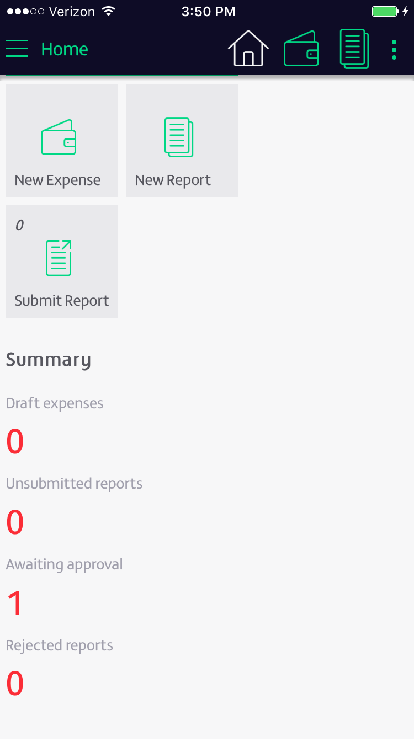
1. Capture
Android and Apple (iOS)
Enforce Policies
Integration within NAV
Notes:
let’s take a step through how it works.
Zetadocs Expenses is simple to use and instantly accessible via our mobile app or the web. When your team incurs an expense, they can simply snap a photo of their receipt and enter thier expense information on their smartphone.
Expense types match NAV GL codes and corporate policies are enforced by allowing you to set up soft and hard spending thresholds. If an expense exceeds a threshold, the user will receive a warning, which carries through to the approvers. Greater control saves time for approvers and the finance team, and helps reduce expenditures. Zetadocs supports expense claims, mileage claims and expenses incurred by various payment methods, including company credit cards.

Slide 19
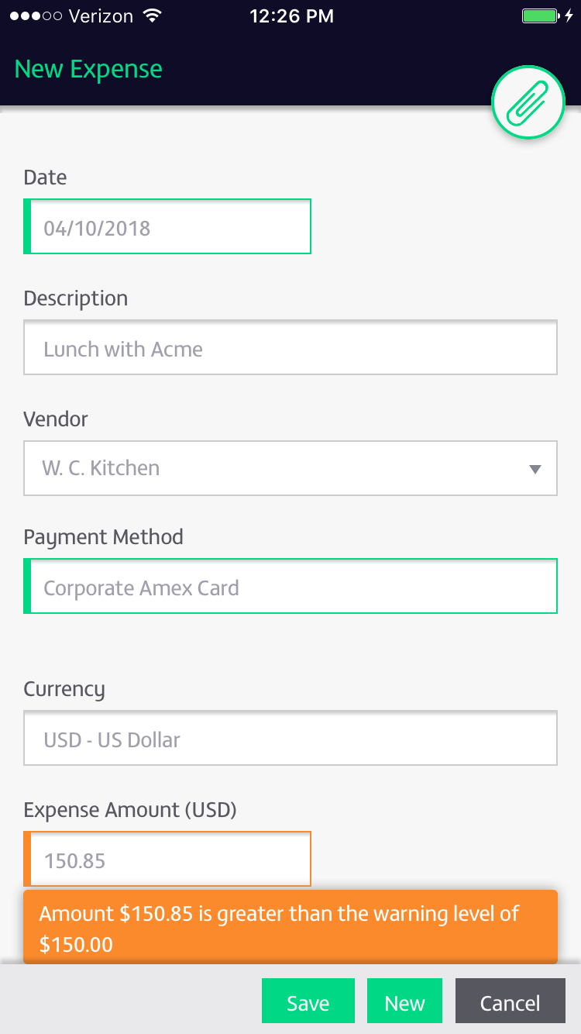

Slide 20
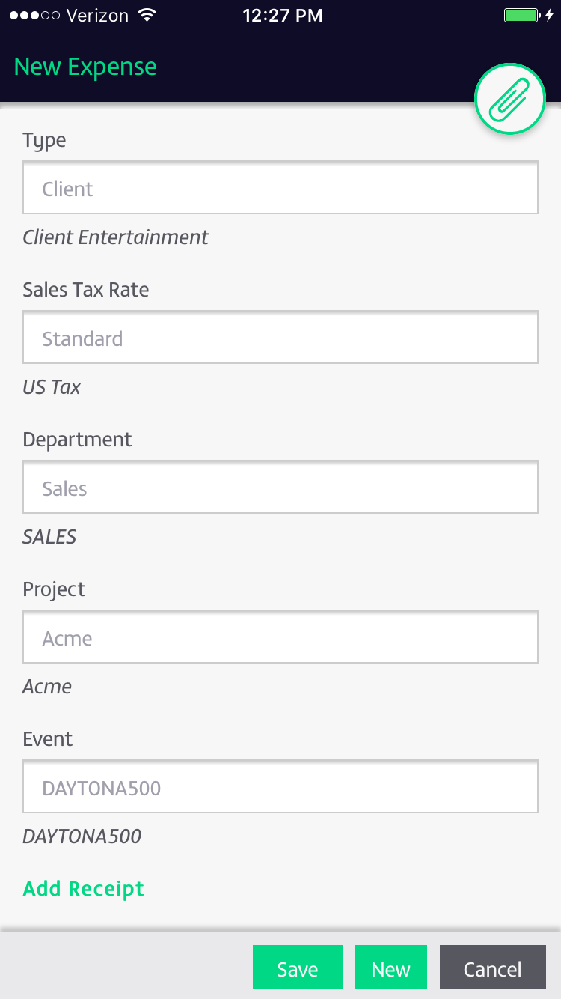

Slide 21
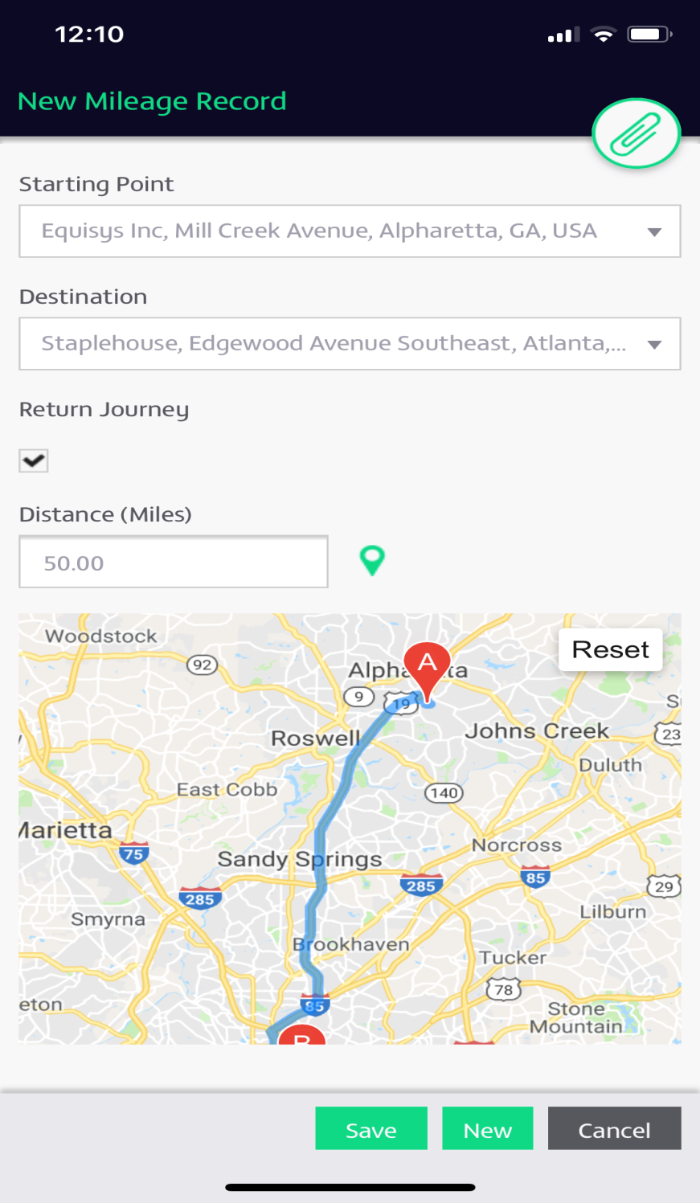

Slide 22
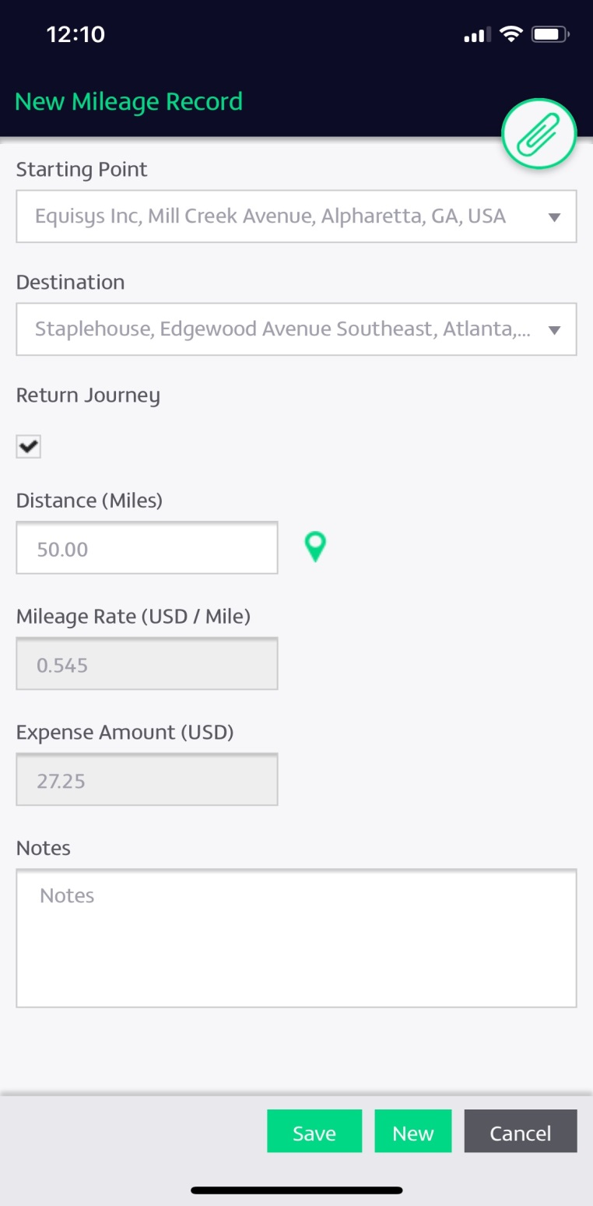

Slide 23
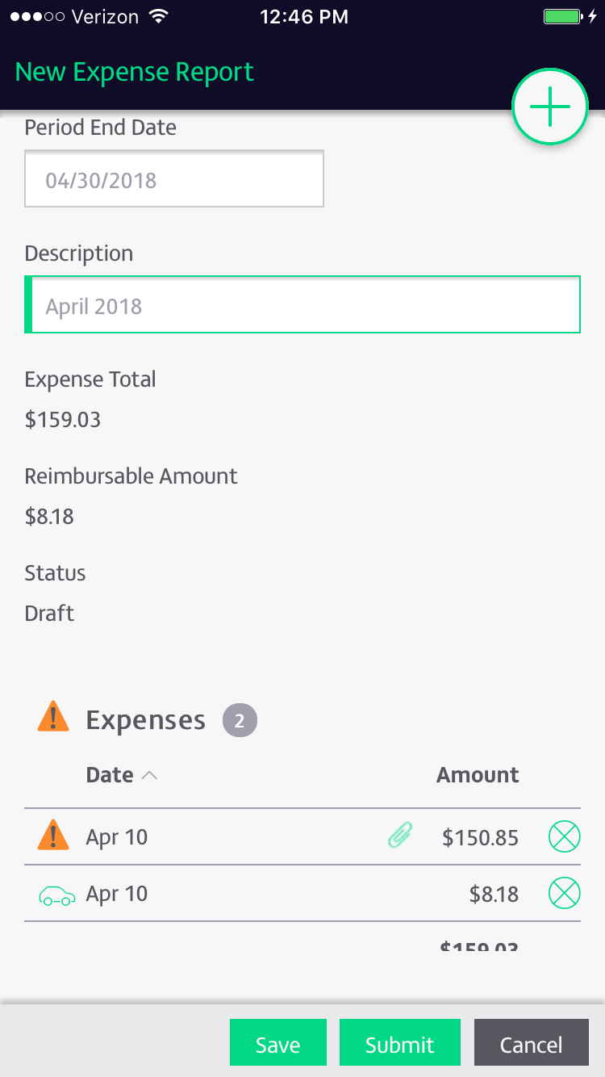

Slide 24
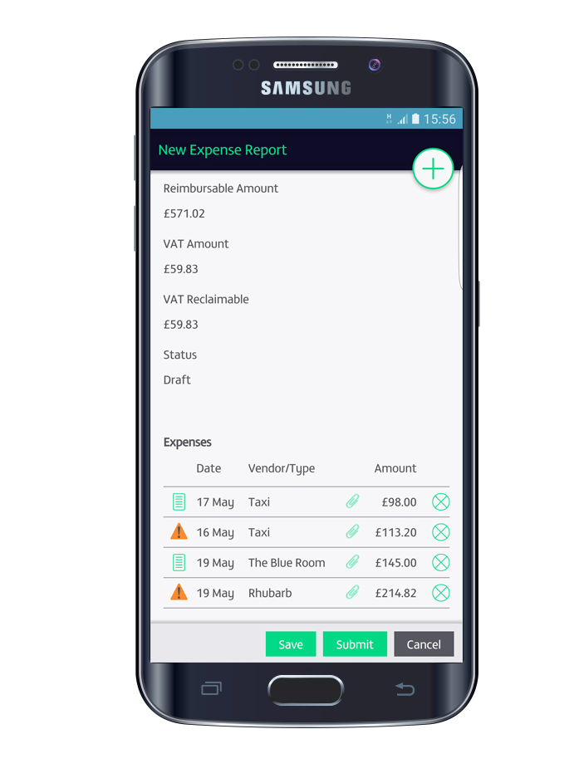
2. Submit
Gather expenses quickly
Phones, iPads, Tablets, PC
Track the approval
Notes:
When you’re ready to submit an expense report, entered expenses can be easily attached to the created report and then submitted for approval. This saves time and nothing gets forgotten when the time comes to submit your expense report. And, users can track the approval status of their report on their phone, tablet or PC

Slide 25
3. Approve
Email notification
Expense limits
Multiple approvers
Notes:
Approvers are notified automatically to approve expense claims, and can do so from a phone, tablet or their PC. They receive an email notification of an expense task and click on the link which takes them to their dashboard on the Zetadocs Expenses site. From there they can approve and process the expense. Using web services the expense information is passed over to NAV, which can be set up to automatically create a purchase invoice for example, It can also tie back to journal entries or jobs, it’s set up based on your preference.

Slide 26
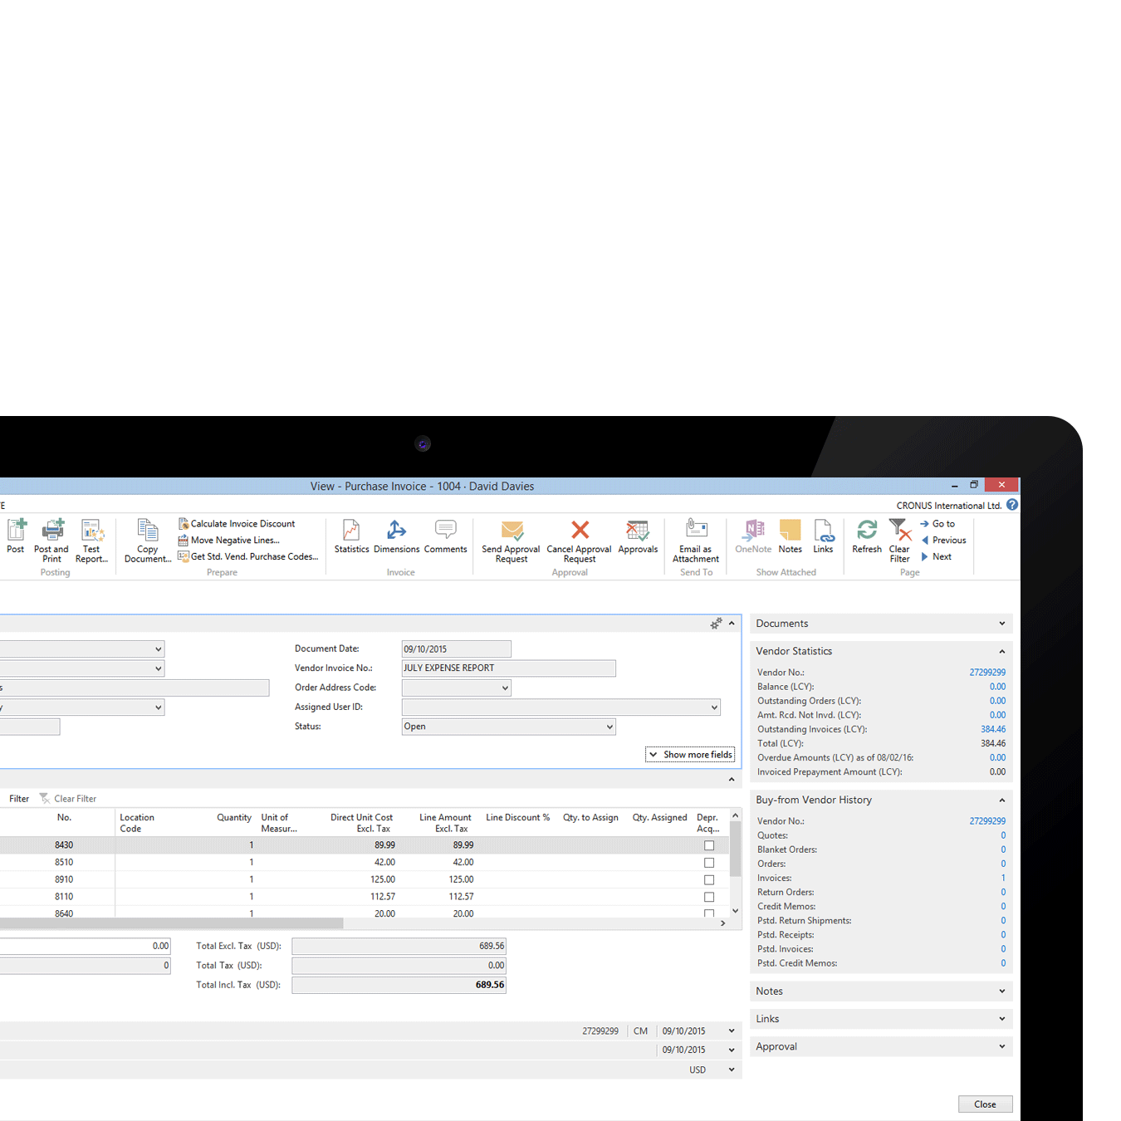
4. Reconcile and reimburse
Automatic export to NAV
Uses your cost codes
Reconcile credit cards
Notes:
Seamless integration with Dynamics NAV allows approved expense reports to be automatically exported without the need to rekey.
All expenses are coded using NAV business data, with the expense types that users select being mapped directly to NAV general ledger codes.
With the system you can reconcile credit card statements and split out reimbursable and non-reimbursable expenses.

Slide 27
Why Zetadocs Expenses?
Faster finance
Complete control
Reduce expenditure
Seamless integration
Expenses can be submitted from any device at any time
Photo receipts and automatic reminders ensure nothing gets lost or forgotten
Apply company spending policies to limit expenditure
A role-based approach helps delineate workflow, understand bottlenecks, speed up processing
Costs are kept to budget as company policies per spending type can be enforced
Separation of sales tax improves value added tax (VAT) recovery on expenses
Genuine integration with Dynamics NAV means the end of rekeying, saving valuable time
Smoothly reimburse expenses and reconcile company credit cards
Notes:
Zetadocs Expenses can help finance teams save time while also provide greater control over the Empense approvals process.
Since it is a cloud based service, built on Windows Azure it’s available anytime from anywhere
[CLICK]
It provides centralized control over the capture, submission, approval and reimbursement of travel and entertainment (T&E) expenses.
[CLICK]
Costs can be kept to budget and company policies are enforced, such as the spending limit for each type of expense and allowable submission time.
[CLICK]
Zetadocs Expenses seamless integration with Dynamics NAV saves time rekeying and improves the speed and accuracy of processing expenses. Approved claims are exported automatically and credit card statements can be reconciled.

Slide 28
What to do next
Promotional Pricing
25% discount on the purchase of Zetadocs solutions thru 5/31
Determine requirements for increased functionality
Zetadocs Delivery ROI calculator bit.ly/zetadocsroi
Notes:
For Innovia customers, we are offering a 25% discount on the purchase of Zetadocs solutions thru 5/31. If you are interested in discovering how Zetadocs meets your requirements, feel free to reach out to your Innovia rep to schedule a call or personalized demo with us.
Determine how much you could be saving by using the Zetadocs ROI Calculator on our website.

Slide 29
A better way…
Can your business profit from document management?
Visit zetadocs.com
Watch the short videos and other webinars
Speak to your Innovia rep or contact us
Notes:
So, do you think paper has had its day? It’s time consuming and costly, can cause issues with providing services to your vendors and customers and has a negative impact on virtually every business process. There is a better way.
I hope that this presentation has given everyone ideas for areas in which a document management solution can streamline processes within your organization. If you have any specific requirements that you would like to discuss, please contact your account manager at Innovia. To learn more, the short videos on the ZetaDocs website can be viewed anytime, and we list of calendar of upcoming webinars as well as links to past webinars.

Slide 30
Contact me
Sandra Cummins
Equisys Inc
www.equisys.com
scummins@usa.equisys.com
678-942-7218

Slide 31
@equisysplc
linkedin.com/company/equisys
youtube.com/equisysplc
equisys.com/blog
equisys.com/blog/rss/943
zetadocs.com
Notes:
Goodbyes etc
LEAVE ON SCREEN

