Slide 1
Dynamicweb PIM
General introduction
Innovia 2018

Slide 2

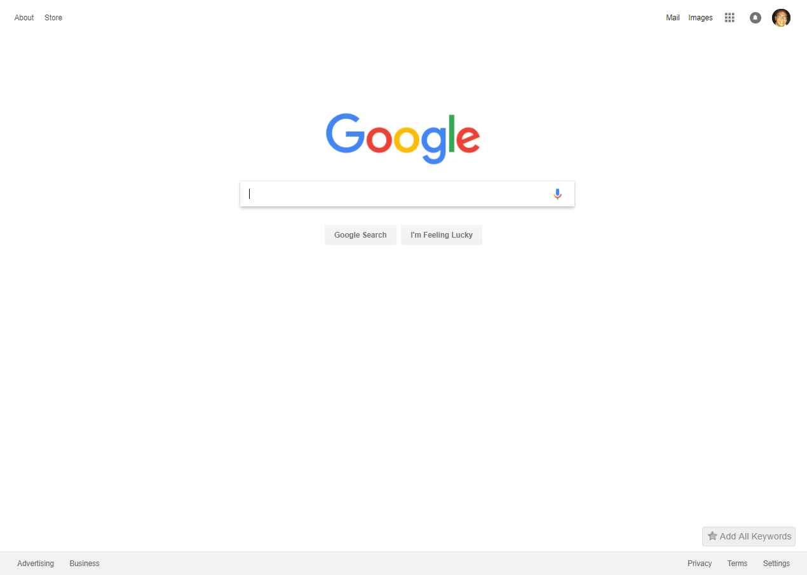



How we Search

Slide 3
Description
Hierarchy
Keywords
Copy
Attributes
PRODUCT INFORMATION
Specs
Features
Meta data
Video
Images

Slide 4




DIY PIM

Slide 5
What is
PIM?
Enrich products, content and assets
Translation & market dependencies
Validation and product overview
Digital hub for multiple channels
Notes:
What is PIM ?
PIM is the synonym for ”Product Information Management”, and it is a software solution there help companies to control and maintain their product data
Today's Companies need to get their product faster to market and be international, and therefore they need PIM solutions to support that challenge

Slide 6

Manage product
content & assets
Input
PIM
Distribution
Product Information is stored and maintained one place
Intelligent handling of product information, assets, references based on inherency
Product “On-Boarding” from multiple sources like ERP, Excel, Suppliers etc
Deliver “Digital asset” to PIM channels with correct formats and consistency
Suppliers
Excel
Import
Export
Ecommerce
Mobile
PIM
Text, video & pictures
Local databases
Integration
DAM
Print
Self-service portals
ERP systems
Import
Export
3rd Party Marketplace
DBS
Notes:
Typical diagram of a PIM system, with its various type of Input sources and Distribution channels
LEFT: Show different types of Input sources
In most setup’s, ERP typically are the MAIN source to the PIM system, mainly with Product number, Product name, EAN no., etc.
Additional sources (like Suppliers), can then append information to the existing products in PIM
RIGHT: Show different types of Distributions channels
Ecommerce, I don’t know any PIM setup, there not distribution product data to that Channel
Print channel, could be for producing “Catalogs”
Self-service channel, Website where users can access Product content within PIM, for Download
MIDDEL: PIM system, where Product data are organized and stored in a “neutral format”
PIM are centralized Product data for controlling and maintenance
Need Database for fast access to data
Need convert functionality for both Import and Export data
Need Image conversion tool, to support various Images formats to distribution channels
For some PIM systems, it is needed to invest in additional software, like DAM software for converting Images to correct format

Slide 7
Validation and
overview
Brand
Manager
Product
Manager
Tech. Engineer
Marketing Manager
Input
PIM
Distribution
Give users complete overview of product status, change history, missing data and assets
User specific search and workflows
Change notification functionality to inform responsible persons
Suppliers
Excel
Import
Export
Ecommerce
Mobile
PIM
Text, video & pictures
Local databases
Integration
DAM
Print
Self-service portals
ERP systems
Import
Export
3rd Party Marketplace
DBS
Notes:
Product data will be in different status through the workflow, therefor it’s important that users can keep track and have overview of Products status
Workflow and overview example:
It is important, that PIM systems have good Search functionality, there can be setup individually to meet the users need.
Logical and configurable overview of Product content, so users quickly can get focus on relevant content
Validation of Product content
Automatically check and validation of Product content, and notification hereof, is also important to have in a PIM solution
Notification system
Possible to define Notifications, based on status, validation, etc., there send out messages
Proofing
Some PIM systems have approved facilities built-in so that external users can be in the approval loop

Slide 8












Enrich and translate
Brand
Manager
Product
Manager
Tech. Engineer
Marketing Manager
Input
PIM
Distribution
Enrich product content in an easy and structured way
Handle language specific content in one central place via inherency
Handle product relationships and market/language variance
Suppliers
Excel
Import
Export
Ecommerce
Mobile
PIM
Text, video & pictures
Local databases
Integration
DAM
Print
Self-service portals
ERP systems
Import
Export
3rd Party Marketplace
DBS
Notes:
Enrich tools and functionality
We now have our Product data organized and stored in central location, and gives overview for users to control and maintain their product information
Amount of enrichment work they have to do, depends on how much data there are get from Input sources
Organizing of Products in PIM, are typically following the “MAIN source” category/grouping of products (typically ERP)
Product will must be organized to optimized for enrichment work
PIM systems should be able to maintain and collect product variants and languages
Example of optimization, PIM should maintained
Language-dependent fields are typically defined as inheritance from Default language
Variant dependent fields must be maintained from a common central location, typical MAIN product there collect all variants

Slide 9
Multi-channel distribution
Brand
Manager
Product
Manager
Tech. Engineer
Marketing Manager
Input
PIM
Distribution
Product data is distributed to multiple channel with various content, called “Omni-Channel publication”
Product data quality becomes more important - PIM content is “the single source of truth”
Distribution of product data can both be scheduled or triggered "on demand"
Suppliers
Excel
Import
Export
Ecommerce
Mobile
PIM
Text, video & pictures
Local databases
Integration
DAM
Print
Self-service portals
ERP systems
Import
Export
3rd Party Marketplace
DBS
Notes:
Wee now have Enriched and Qualified Product data in PIM, in a “neutral format”, and ready for exporting to Distributions channels
Distribution channels need to be defined
Each distributions channel typically need individual setup, with different connection type and content structure
Example: Export to Ecommerce are not same format used for producing Catalogs
Channel specific content
In traditional PIM solutions, it is not possible to “direct interact” or make direct connect to “channel specific content”

Slide 10
PIM benefits
Faster and inexpensive to implement
Manage extensive relationsships
Proof in LIVE frontend preview
Access from both Frontend and Backend

Slide 11
Data Sources
All-In-One Platform
Channels
  Personalization
Website
Mobile
ERP / CRM / PIM
Content
Ecommerce
Marketing
PIM
Online
Store
Self Service
Portal
  Development Platform
Suppliers
  Integration Framework
Email Marketing
Social
Media

Slide 12


Typical PIM
setup
1
2
3 separate applications and integrations between ERP, PIM and Ecommerce
Means multiple systems that require separate handling and expertise, and typically more technical experience
ERP
3
PIM
Ecommerce

Slide 13
Inexpensive implementation
One digital platform = no integration work
Easier to implement = cheaper
Open framework for integration to external sources
Standard Integration framework to Dynamics AX, NAV and D365
1
ERP
PIM + Ecommerce

Slide 14



Extensive
relationships
Brand
Manager
Product
Manager
Tech. Engineer
Marketing Manager
Input
Distribution
All content is in one platform – not only products
Organize, add, relate & group product data
Manage ecommerce relationships directly from PIM to
  Markets
  Languages
  Related products
  Ecommerce structure
  Items (CMS)
Suppliers
Excel
Ecommerce
Mobile
PIM
Text, video & pictures
Local databases
Publish
Print
Enrich • Control
Translate
ERP systems
Self-service portals
3rd Party Marketplace

Slide 15
PIM
management

Slide 16
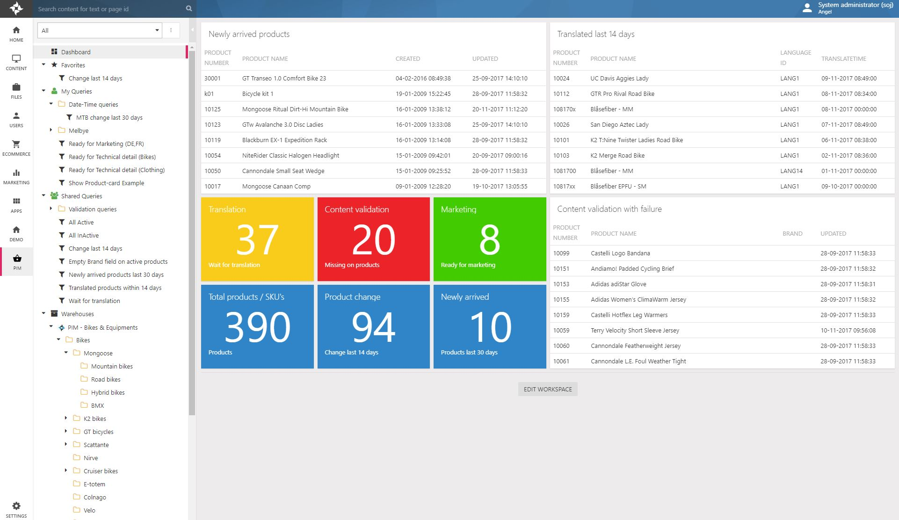
Configurable
dashboard
User setup, there are individual configured for their needs
Dashboard can contain various type of Widgets and setups
Display of Widgets content, can be individual configured

Slide 17
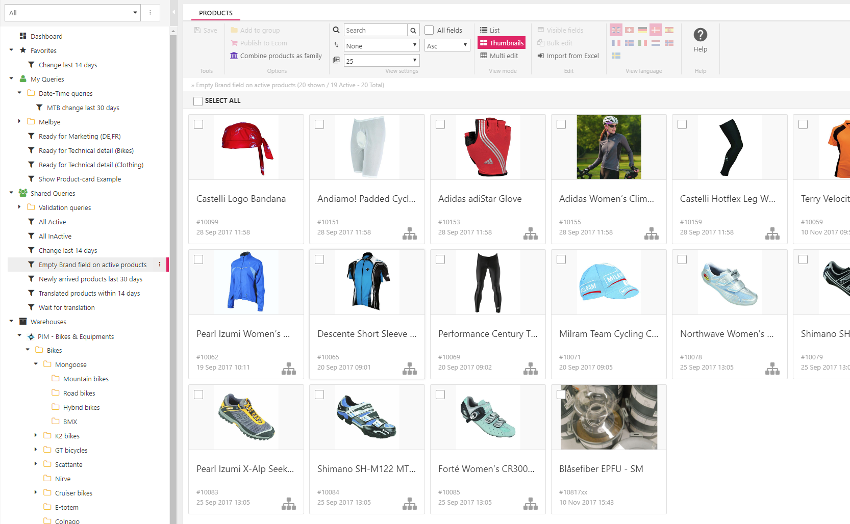
Search across
with Queries
Queries structure ..
“Shared Queries” are available for all PIM users
“My queries” and “Favorites” are individual User queries
Organize queries into groups, are possible in Shared- & My queries

Slide 18
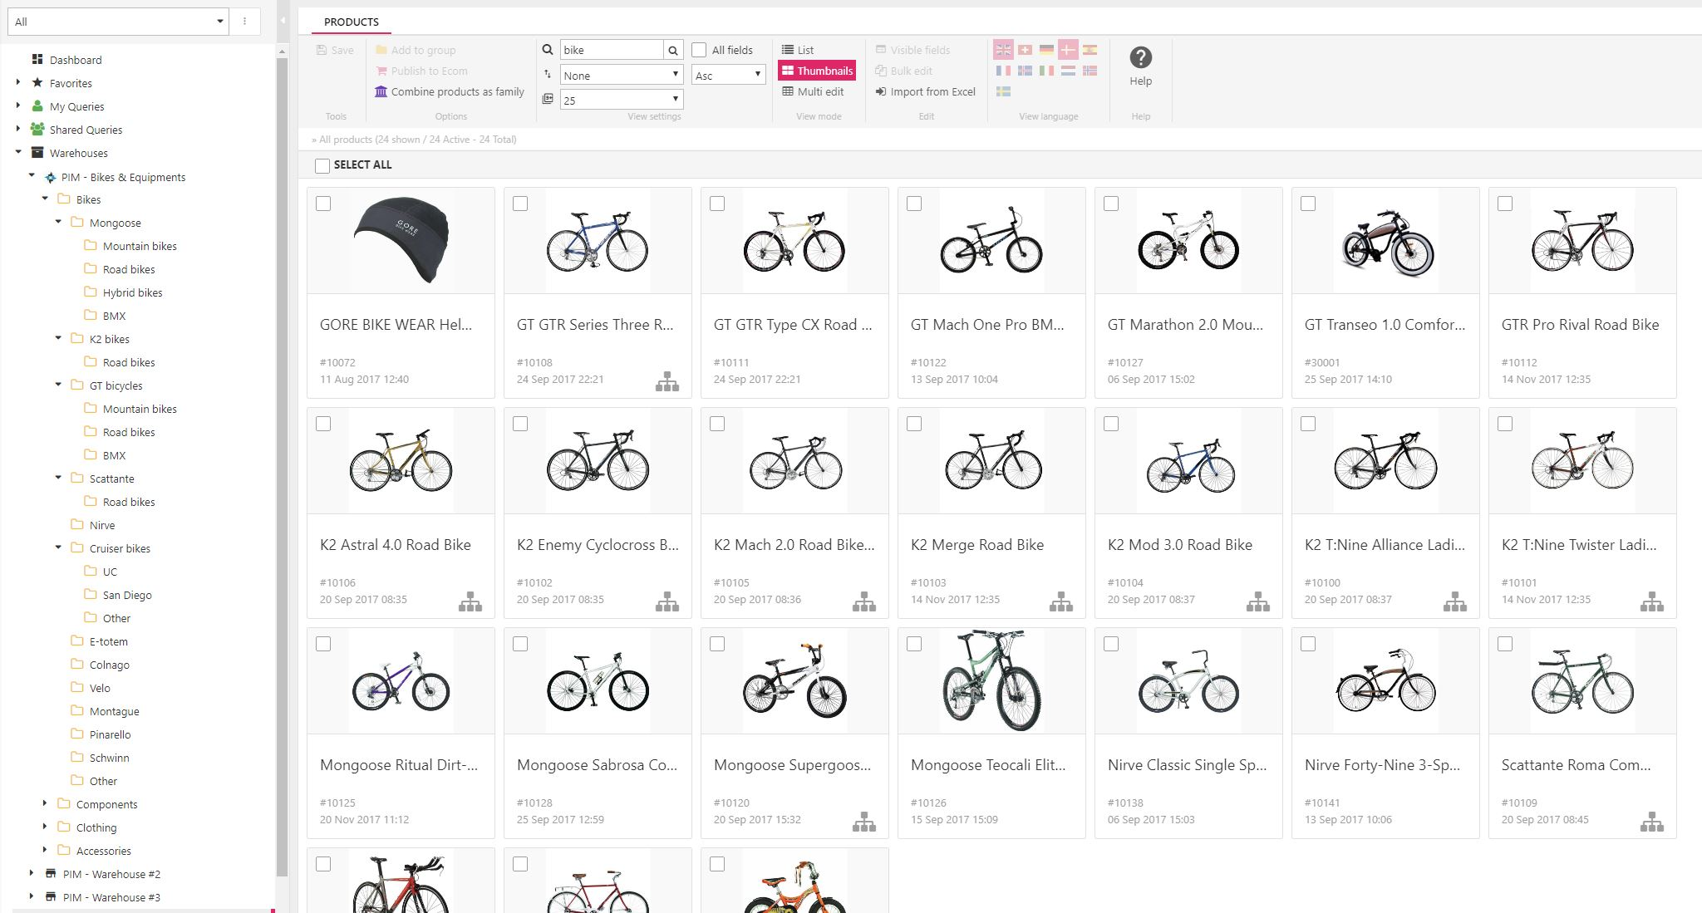
Warehouse
group structure
Group structure …
Products are related to Groups, optimize enrichment process
ProductCategory fields can variate in Group structures
Default values can be defined in Group Structures. Products are automatically enriched with this

Slide 19
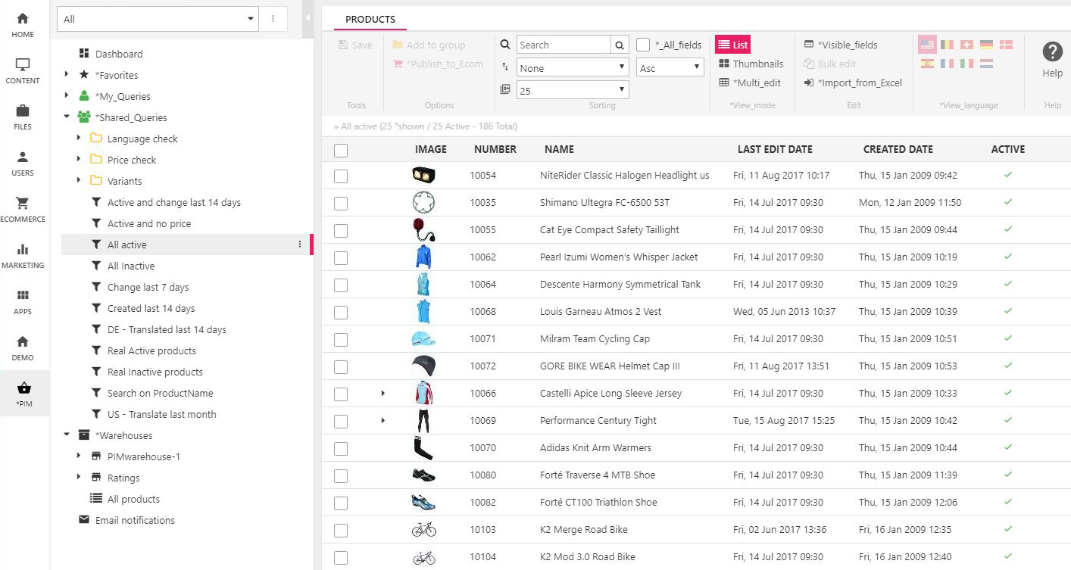
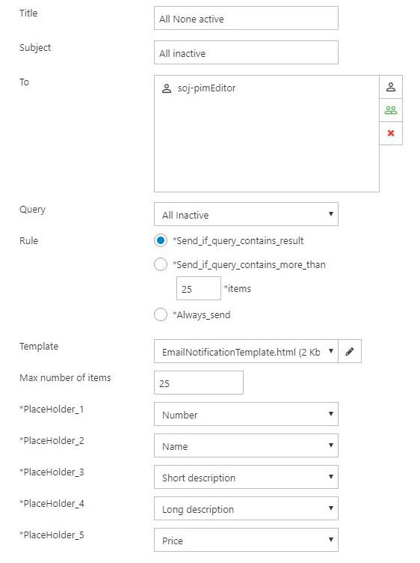
Product monitoring
2
Use ‘Smart Search’ to define dynamic product lists – i.e. latest product changes, products with incomplete data etc.
Choose between ‘list view’ or ‘Thumbnails’
Setup automatic email notifications when search is changed – i.e. new products, translations etc.
1
3

Slide 20
PIM
enrichment

Slide 21
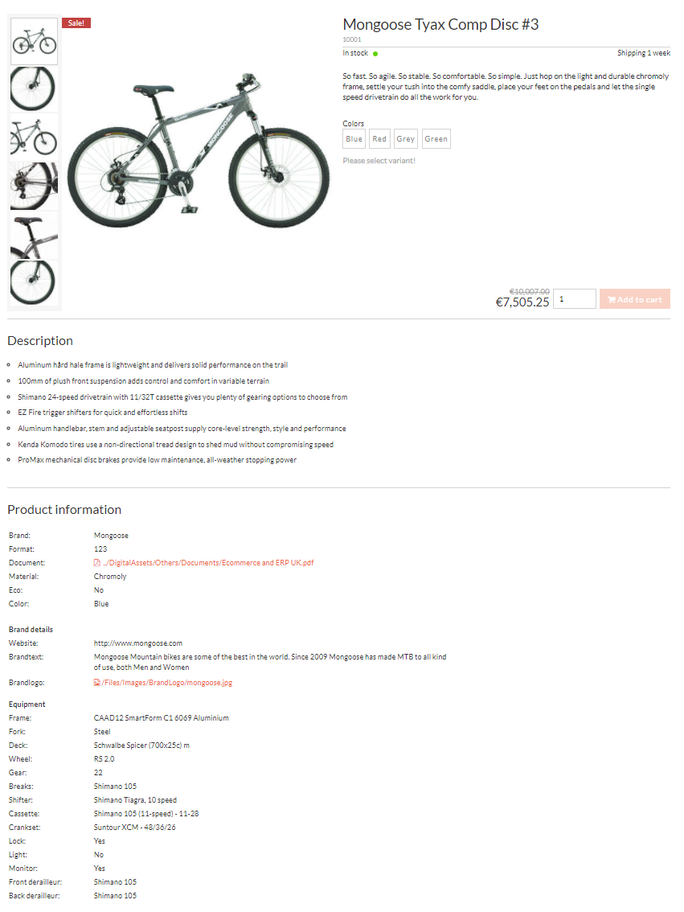
Content
Enrichment
content are maintained on …
Group/category level
Product Main level
Product Variant level

Slide 22
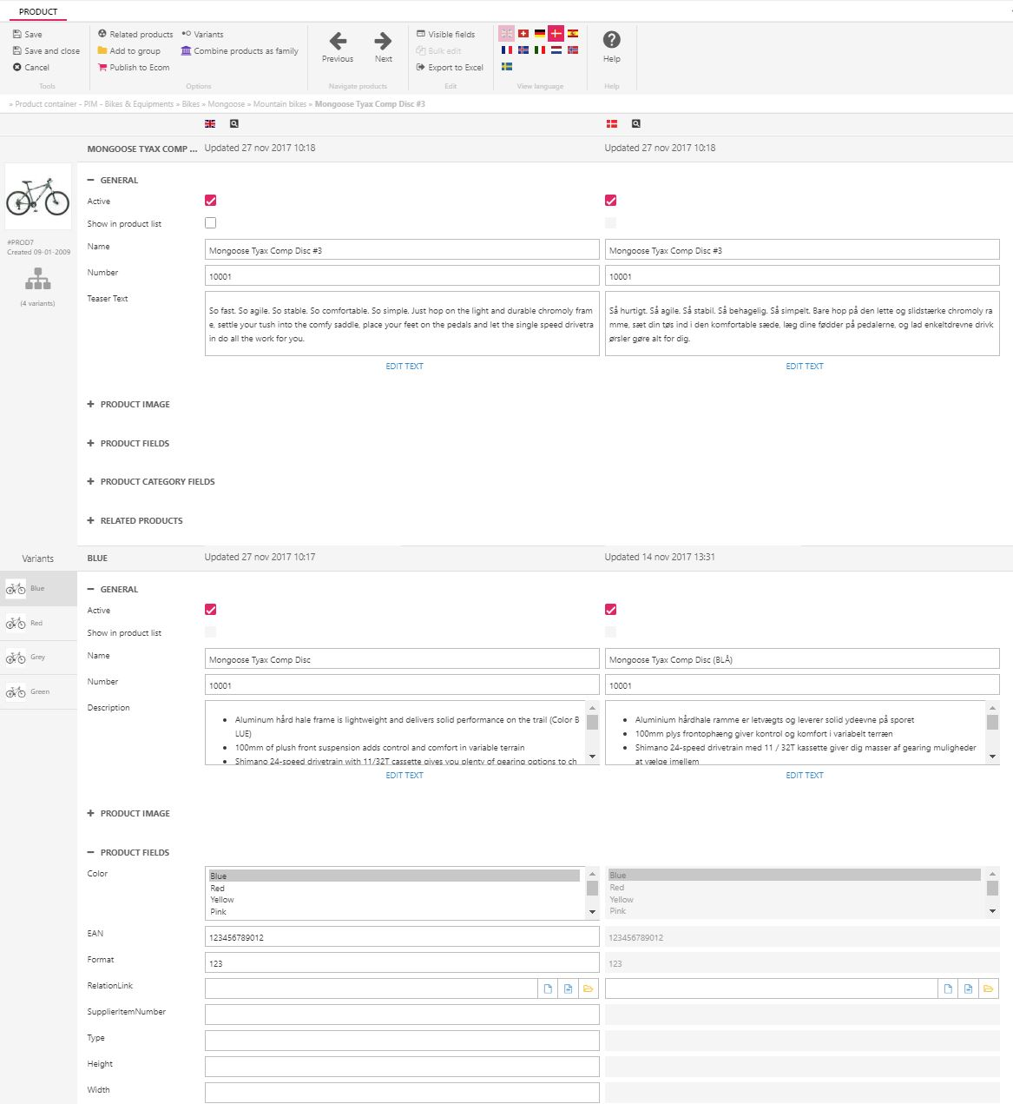
Product container
specification levels
content are maintained on …
Product Main level
Product Variant level
Values across language

Slide 23
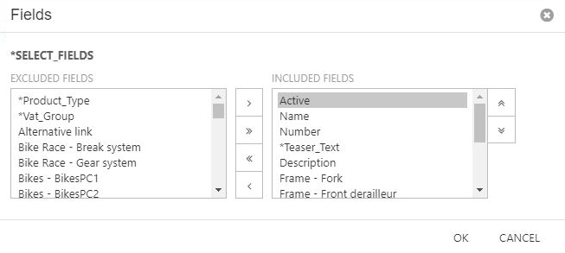
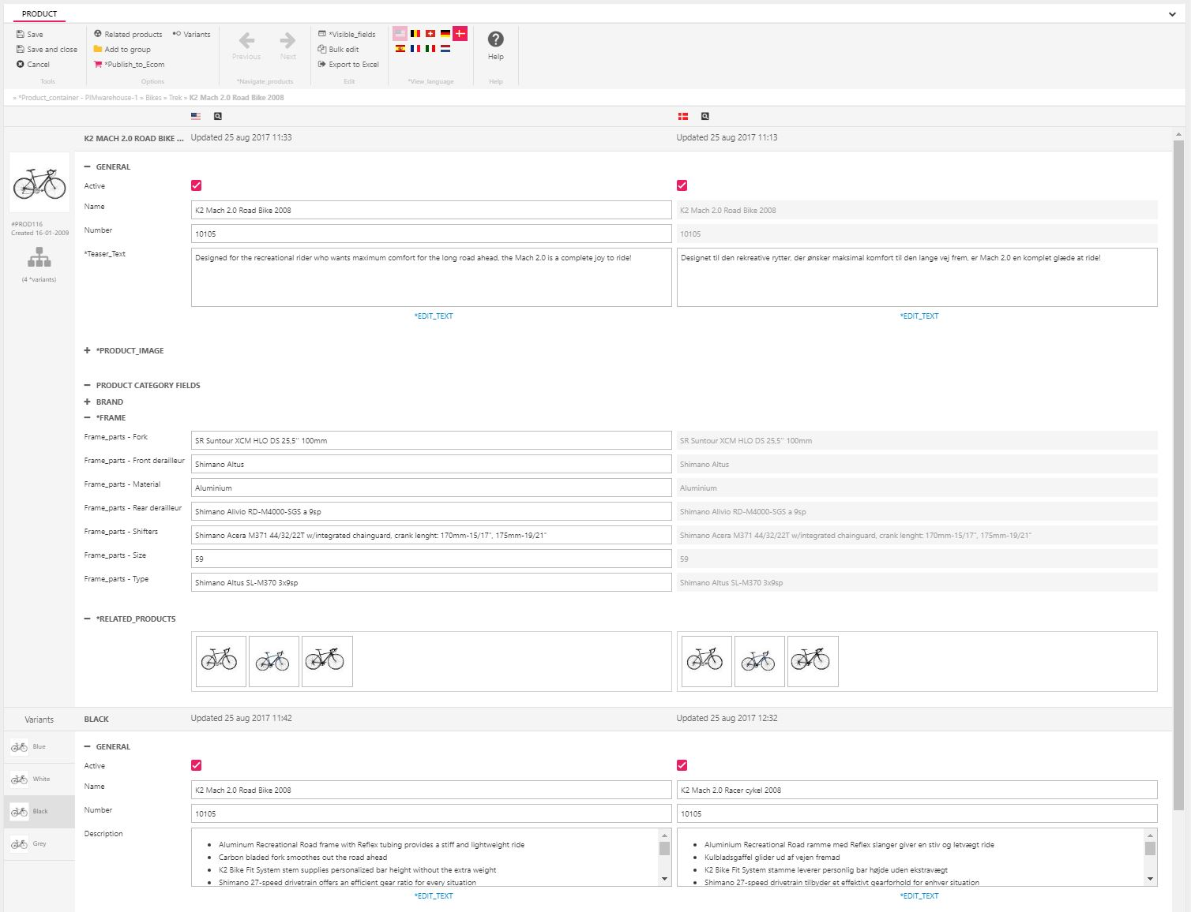
1
Multi product edit view
2
3
4
Choose the visible product fields you want in your view
Navigate back and forth between products
Export / import product information in Excel
Work with your products in multiple languages
Handle all your product text, images, languages, categories, related products and variants – in the same view
5

Slide 24
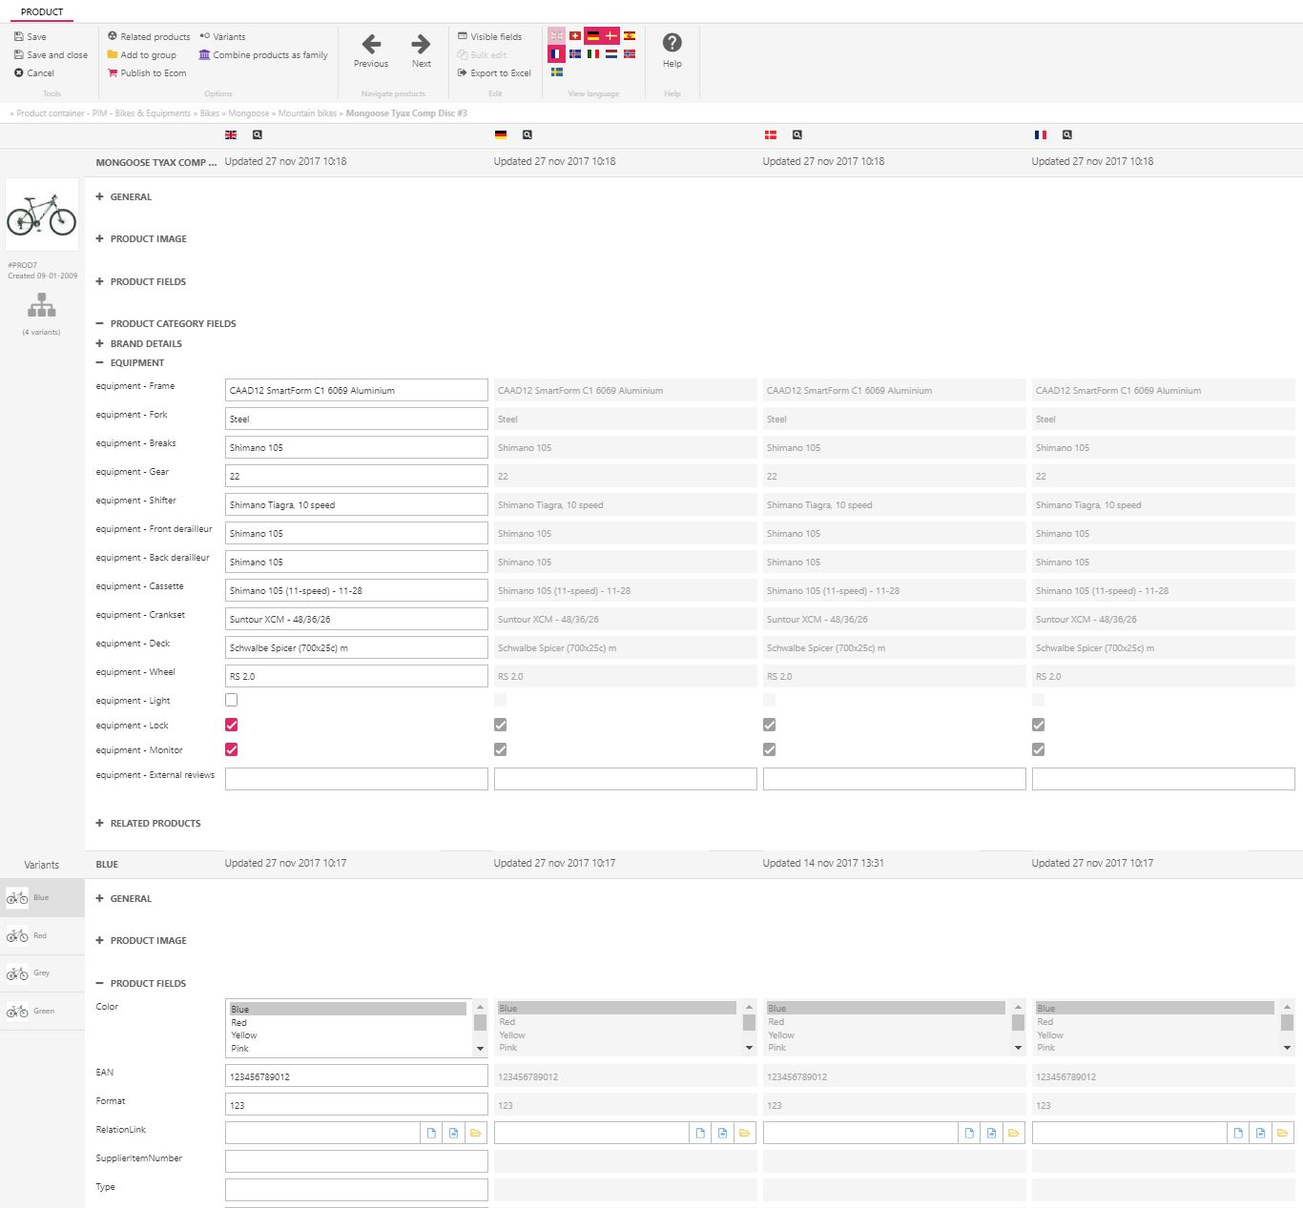
Values
across language
Enrich on “Default language”, inherit to all other language
Optimize maintenance time

Slide 25
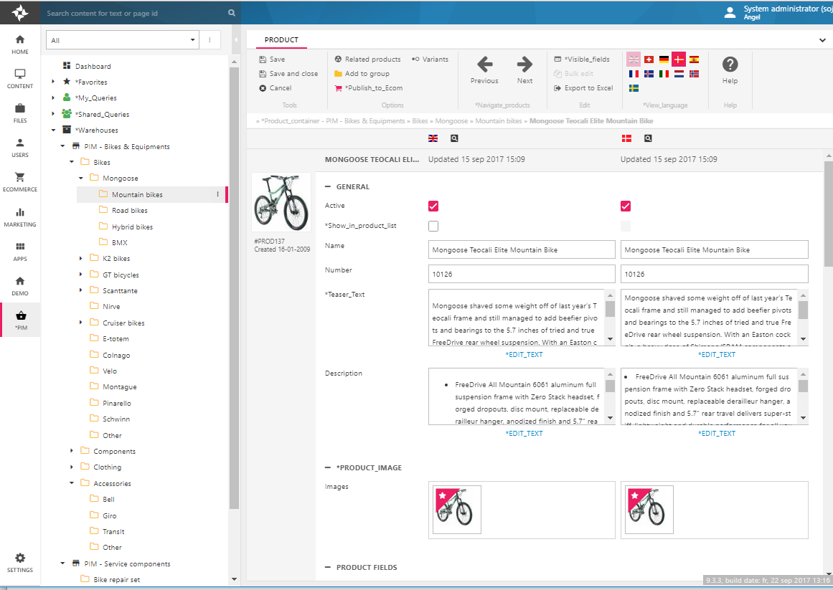
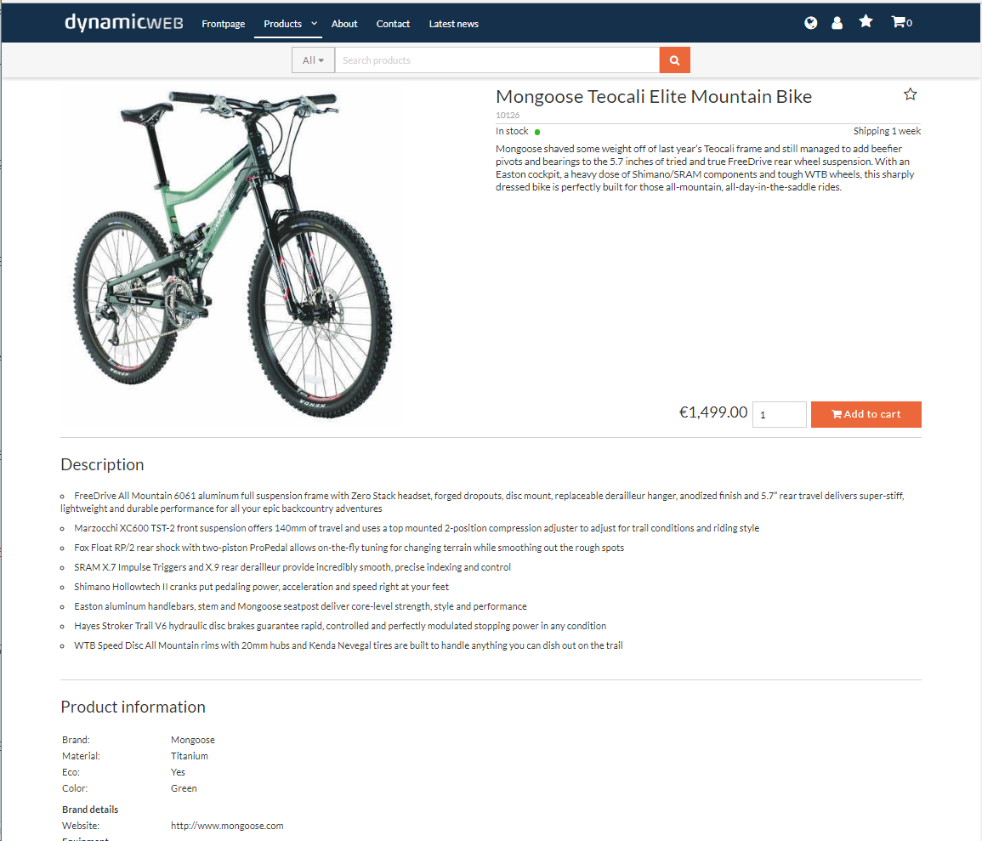
Live preview
in ecommerce
Direct front-end preview of products when editing
Distribute link to partners and colleges for approval

Slide 26
Digital warehouse
PIM frontend

Slide 27
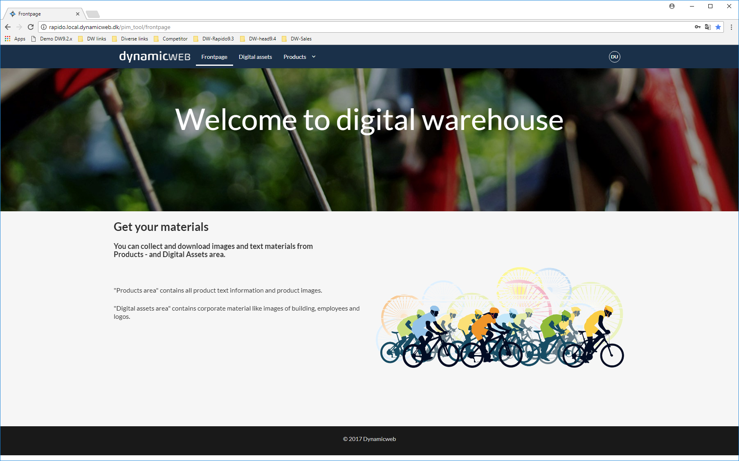
Welcome to
Digital warehouse
Dedicated Website, there give users access to download Product texts and Digital assets
Download feature, with build-in image-convert/down-sampling, with embedded ICC-profile
Extract Product text-content in various format (XML,JSON,CSV)
API/URL call, can be used from 3. party systems

Slide 28
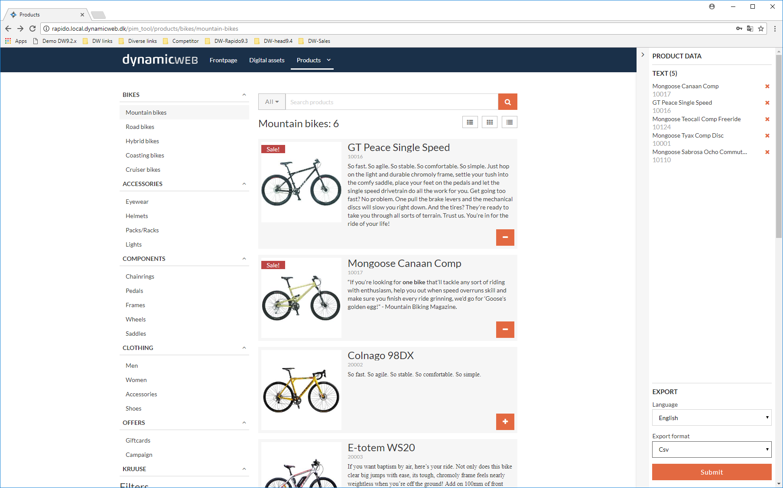
Collect & download
Multiple products
Collect multiple products to the Download panel
Navigate in Structures, filtering with Facets or Search with “type-a-head” facility
Select language and the “Export format”, you want the content to be downloaded in

Slide 29
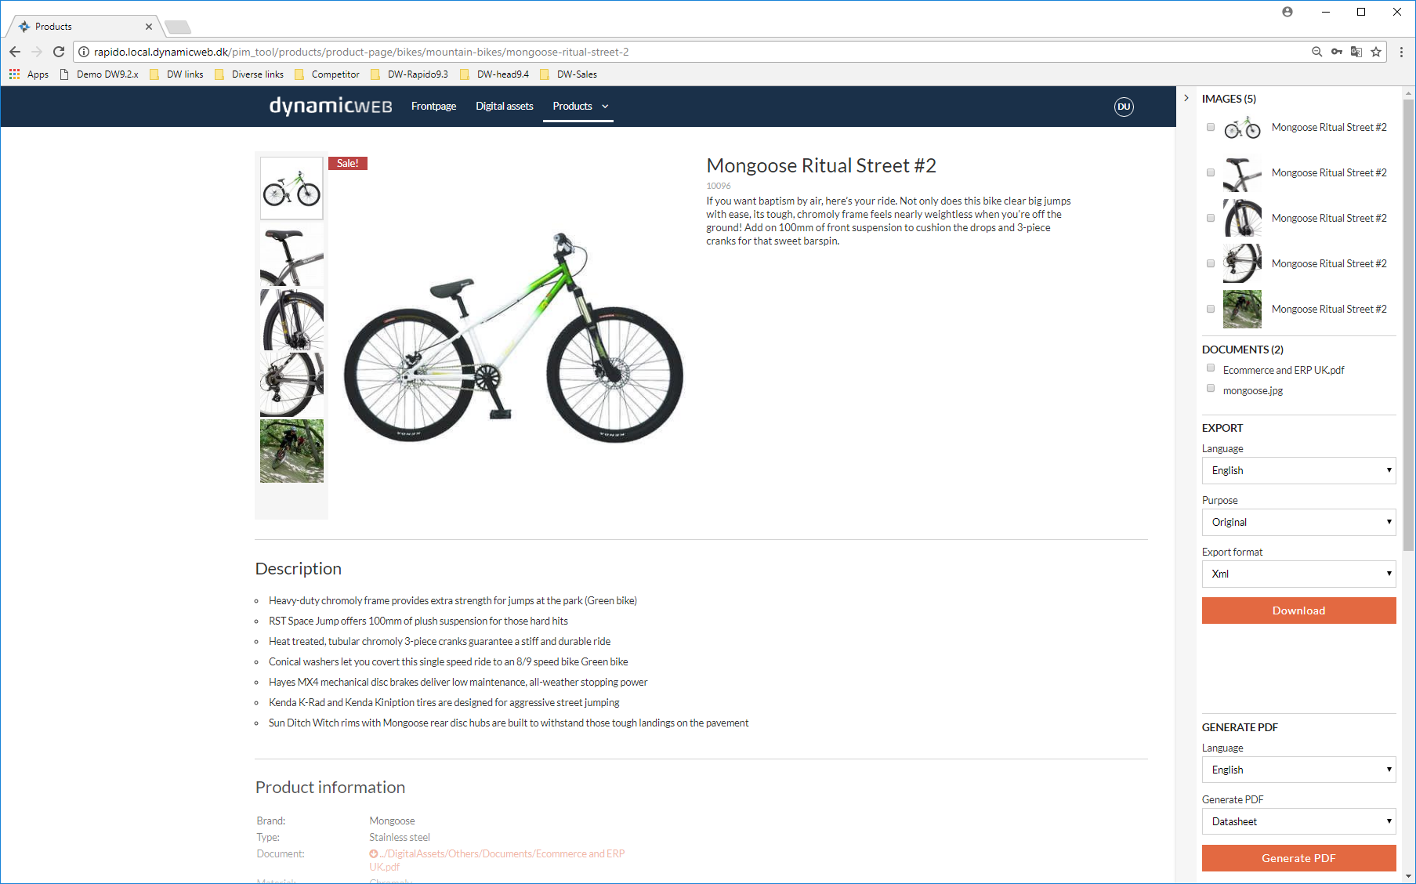
Product related
content & assets
Collect multiple assets on product, to be Downloaded
Choose the wanted Image conversion for purpose
Select language and the “Export format”, you want text content to be downloaded in

Slide 30
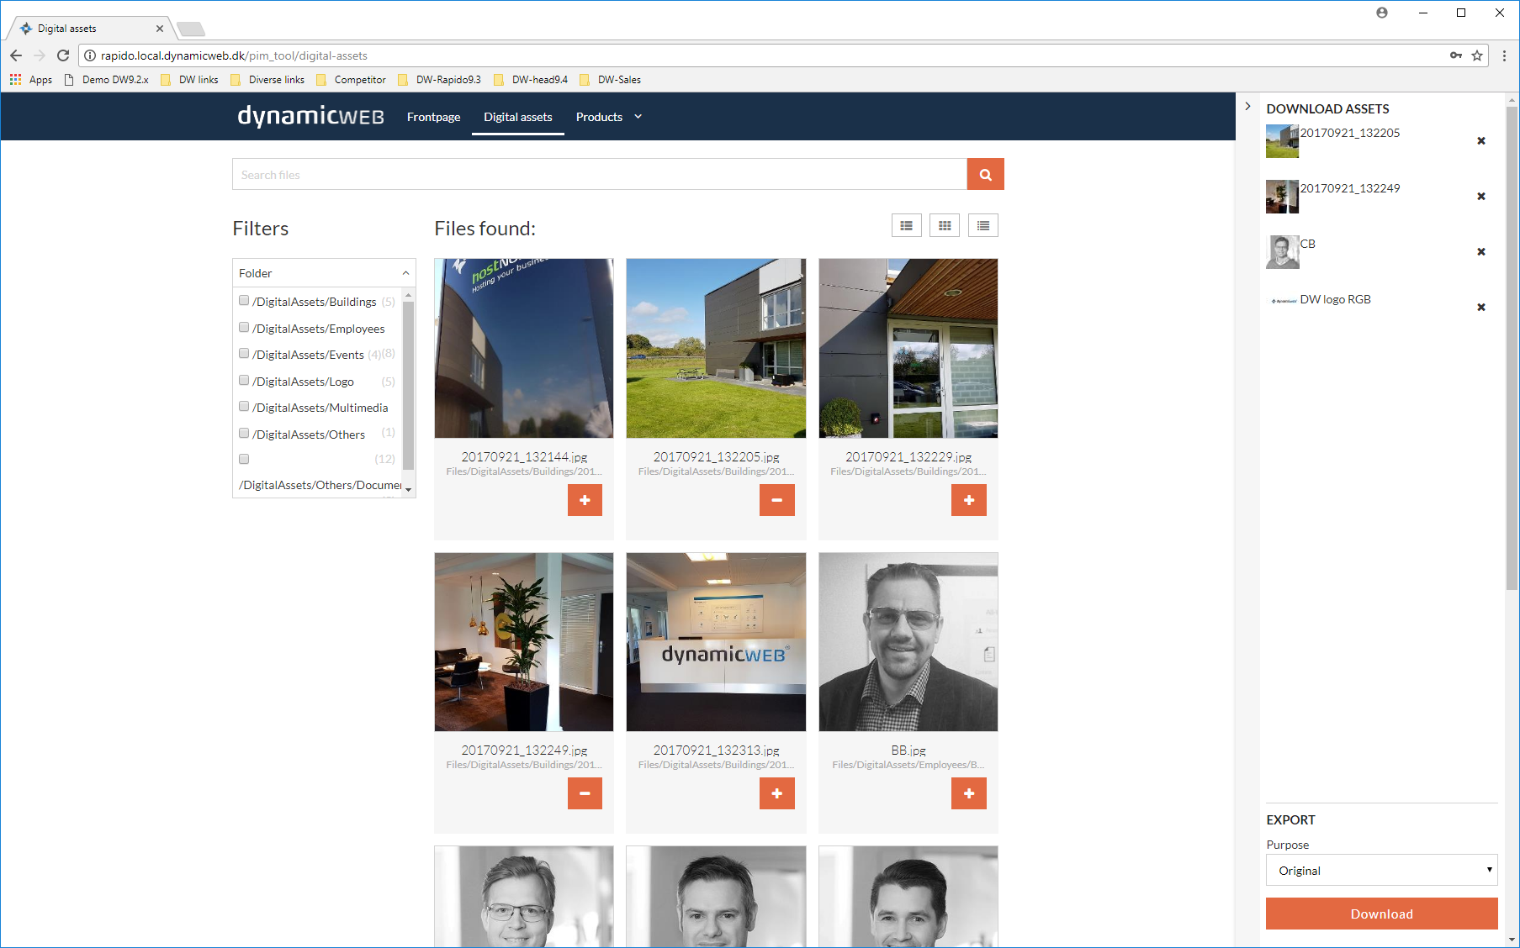
Download from
digital assets
Area for Digital assets, there is not a part of Product content
Navigate in folder structure, or search on embedded Metadata
Collect assets to the download panel, and choose image conversion to needed purpose
Build “Facets” windows, based on embedded Matadata

Slide 31
Who needs
a PIM?
Total number of total SKU’s?
Number of languages and markets?
Complex product dependencies?
Collecting data from multiple sources?
Multi-channel distribution of product content?

Slide 32
Any Questions?

Slide 33
what’s next
Dynamicweb 9.4
Versions control on Products
New enhanced workflow mechanism
Product enrichment, improved & extended
Enhanced maintenance & control tool
Improved user rights managements

