Slide 1
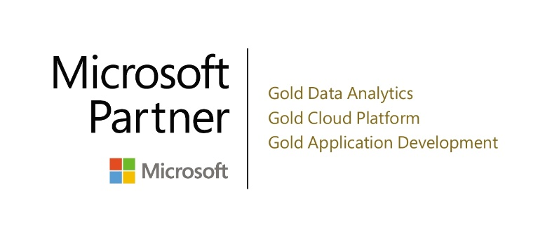
PREDICT · SHAPE · ACHIEVE
Richard Pedigo
VP, Alliances, North America

Slide 2
Session Overview
Take-aways from today
Making Business Intelligence Easy and Practical:
These are the four functions within a Business Intelligence solution:
Data Warehouse and OLAP Cubes: Automatically collect and consolidate data for immediate availability 24 / 7.
Automated Reporting/Budgeting/Forecasting: Allows you to spend less time on repetitive tasks and more time on your business with more accurate information.
Analytics: Guided Analytics gives a business user valuable insights and access to detailed information.
Data Visualization: Custom visualizations based on user specific roles of Key Performance Indicators (KPI’s) and Operational Metrics.

Slide 3
Climbing The BUSINESS INTELLIGENCE Value Curve
Analytic Tasks
Corporate Performance Management
What Next?
What if?
Complexity
So What?
What Happened ?
Value

Slide 4
USER ROLES AND NEEDS
COMPLEXITY
Business User
Business User
Majority of users
User specific roles when it comes to data
Advanced Business User
Deeper analysis of the dashboards and reports
Analyst User
Responsible for business user's specific information requirements
Advanced Analyst User
Combination of technical skill and deep domain knowledge
Data Specialist
Works closely with Advanced Analysts to prepare data models, calculations and connectivity
Advanced
Business User
Analyst User
Advanced Analyst User
Data Specialist
Notes:
The ability for non-specialists to create content. Email, Spreadsheets, Social media, Facebook, Salesforce

Slide 5
Session OBJECTIVES
Take-aways from today
Demonstrate CPM Reporting, Budgeting and Forecasting showing how:
Flexible and Easy To Use templates will save time and improve processes and accuracy.
Digital Transformation of Reporting, Forecasting, and Budgeting will allow you to spend less time on repetitive tasks and more time on your business
A centralized Data Warehouse will automatically collect and consolidate your data for immediate availability 24 / 7
An All-In-One System Suite, for Financial, Administrative, Operational Reporting, Forecasting and Budgeting as well as a Data Visualization and Analytics solution.
Understanding the Business Advantages of CPM

Slide 6
Business Challenges, Solutions, and Outcomes
CPM Customer Outcomes
Challenges
Desired Solution
Many data sources to combine
Many “versions of the truth”
Legacy reporting products not built for current needs
Managing (reporting and budgeting) business using Excel spreadsheets
Centralize data with built in business logic
Fast and easy analysis
Quick report template creation by non-IT people
Excel and Web based for both PC and Mobile delivery
Reduced reporting and budgeting burden on Finance
Removed errors
Stopped manually maintaining reports and budget sheets
Significantly decreased budgeting and reporting timeframes

Slide 7
Microsoft Dynamics Without CPM
Devices and platforms
?
Reporting and Budgeting Tools
FRx
Management Reporter
Excel
Forecaster
SSRS
GL
AR
AP
Sales
HR.
Budget
Data to report
Company 1
Company 2
Company 3
Company 4
Company 5
Company 6
Microsoft Dynamics

Slide 8
Microsoft Dynamics With CPM
Devices and platforms
ONE Reporting and Budgeting Tool
CPM SOLUTION
GL
AR
AP
Sales
HR
Budget
Data to report
Company 1
Company 2
Company 3
Company 4
Company 5
Company 6
Microsoft Dynamics

Slide 9
CALUMO Demo
CALUMO DEMO
All-In-One platform for:
Reporting, Business Intelligence, Budgeting and Forecasting.

Slide 10
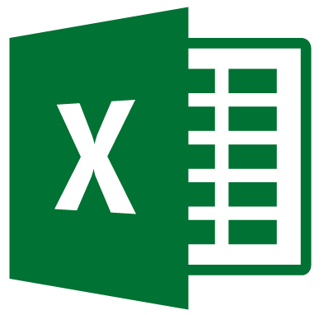
Simplify Reporting & Planning
On-Premises or in the Cloud
Outcomes
Operational Reporting
Budgeting/ Planning
Continuous Forecasting
Ad-Hoc Analytics
Scorecards
Dashboards
Work Flow/ Alerting
Statutory Reporting
Modes
CALUMO Client (Ribbon)
CALUMO Client (Zero Footprint)
Interface
On-Premises
Cloud
BI Platform
Application Server
GL AR AP
CRM
HR
Ops
* η
Source
Spreadsheets
Manual data

Slide 11
ranked #1 in the world’s largest survey of business intelligence SOLUTIONS
2015 – 2018 BARC Ranked Top in 11 and Leader in 10 categories:
Business Benefit & Price to Value
Customers & Product Satisfaction & Recommendation
Sales Experience & Competitive Win Rate
Implementer Support & Ease of Use
Vendor Support & Innovation
Cloud & Mobile BI & Competitiveness
Go to the CALUMO website for a complete copy of the survey:
www.calumo.com

Slide 12
SECURE, configurable, scalable cloud security
Microsoft Azure
CALUMO-as-a-Service

Slide 13
The Calumo solution
FULL BENEFIT FROM BUSINESS DATA
Easily putting facts in Context, allowing best Next actions to be taken, everyday
The Right Information | Overcomes organizational data siloes by bringing together and capturing (forecasting) the full intelligence / insight of the organization CALUMO brings that together – and exposes it
In the Hands of the Right People | Anyone who is responsible for acting, knows what to do next or can act. The tools must get this information into their hands naturally and effortlessly
At the Right Time | The right time is when they can do something valuable with it. The "right time" adheres to its own schedule, not just the work day or the agreed upon meeting. Its use must fit the day to day flow of the right people.

Slide 14
CALUMO RESULTS
ALL-IN-ONE Easy-To-Learn, Departmental and Enterprise-Ready solution.
Optimize your operations On-Premise or in the Cloud with a single code set.
Key Feature 1:
Make data-driven decisions
Key Feature 2:
Easy for anyone to use
Key Feature 3:
Work at lightning speed
Drive productivity across the organization, by ensuring teams make business decisions based on consistent and accurate data in real time.
The intuitive web interface is as easy as browsing online, so if you can use the internet, you can use CALUMO
Use Excel for template authoring and Excel, Web and Mobile for distribution
We use agile data cubes that are up to 100 times faster than traditional relational databases. This means seriously good results, seriously fast.

Slide 16
CALUMO Customer Success
Win Results
Lowered finance costs by 22%
Saving hundreds hours per year!
“CALUMO can do everything Oracle’s Hyperion can at a fraction of the cost - and better”
CFO , dynata
Business Goal: 100% visibility on up to date operational and financial data.
Solution: CALUMO reporting data from MS Dynamics and other systems
CALUMO for budgeting
Financial Consolidations and Budgets in moments not weeks!
Easily Handle Multi-Currency
Combining Up-To-Date Operational and Financial data in Reports and Dashboards

Slide 17
CALUMO CUSTOMER rEVIEW
What Customers say about CALUMO:
Dynata - “Time saving is huge. We cut our budgeting process down by over 60%, saving about 400 hours per year.”
Wow Logistics - “CALUMO puts budgeting on individual department heads, so it is specific, instead of figuring out how to manually spread it out each month.”
Liberty Tax Service - “We have significantly improved our financial reporting and consolidation processes by using CALUMO….with CALUMO it is Super fast, all very smooth, and easy to use.”
Sizzling Platter - “CALUMO is incredibly powerful providing Improved Accuracy, Greater Visibility, and Faster Answers…. With CALUMO, the sky’s the limit.”

Slide 18
questions, next steps
Questions:
What would you like to know?
Next Steps:
What is needed to move forward?
Visit the CALUMO website to learn more:
www.calumo.com
Thank you for investing your time with me today

Slide 19
Introductions
Warwick Leitch - COO and VP Americas
13 years at CALUMO
20+ years working with companies to develop reporting and planning applications, including Ernst and Young, Johnson & Johnson, Canon and others.
Holds a Bachelor of Commerce degree from Bond University in Accounting and Business Intelligence.
Richard Pedigo – VP Alliances, North America
20+ Years experience in the Microsoft Dynamics channel ecosystem
Working for both Microsoft and Partners
15+ Years experience in Selection and Deployment of ERP systems
5+ Years experience in the Corporate Performance Management market

Slide 20
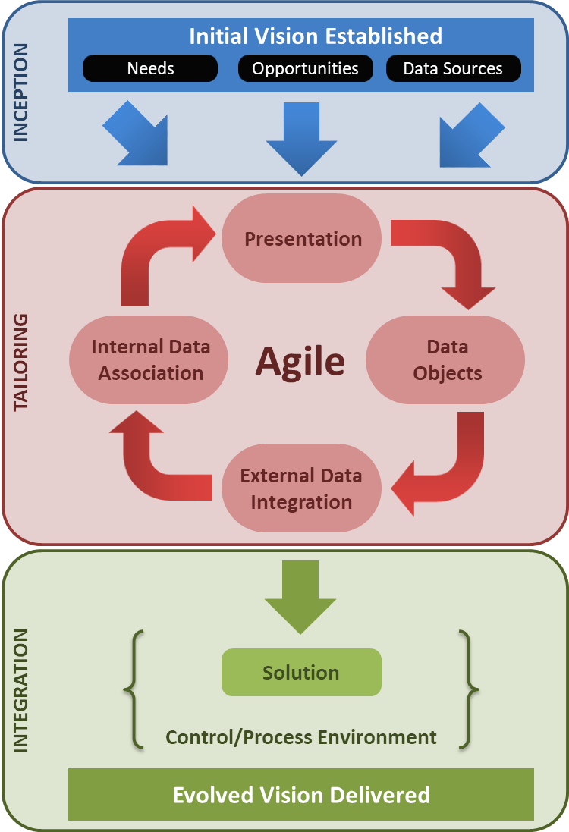
Delivery and DEVELOPMENT
Agile
Outcomes Focussed
Deep Domain/Deep Technical
Rapid Deployment
Exceptional ROI

