Slide 1
Reserved for Intro Picture
What If Process is Your Problem?
Please contact Tim for Assistance
Bob Beaird
Business Analyst bbeaird@Innovia.com
Alan Wyne
Director of Operations
awyne@Innovia.com
Picture
Picture

Slide 2
Session Objectives
Discuss how Value Stream Mapping can be used in your business
Show the process for a successful Value Stream Mapping session
Attendees leave with an understanding of Value Stream Mapping

Slide 3
Session Agenda
Discuss different types of maps
What questions to ask
Review of Process
Questions

Slide 4
Mapping Styles

Slide 5
Mapping Styles
Baseline: Flow Chart Style Map
Starting point
Ending point
Process boxes
Decision diamonds
Alternative branches
Great for mapping out logic flow

Slide 6
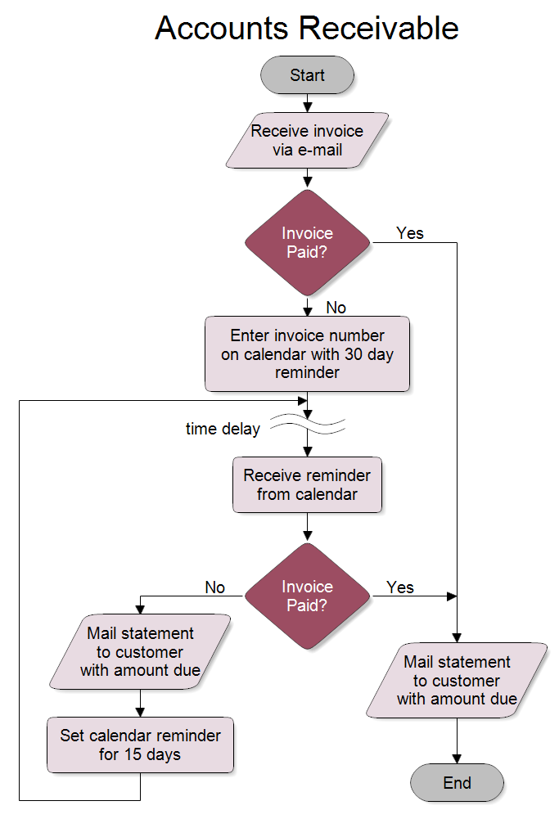
Mapping Styles: Your Familiar Flow Chart

Slide 7
Mapping Styles
Swim Lane Map 1
Activity What happens in this step
Who What departments or personnel are involved in this activity
Tasks What is being completed during this activity
Task Completed What happens when the activity is completed
System What computer or manual systems are used
Time How long does it take on average to complete the activity
One benefit is that it is more amenable to detailing logic behind activities

Slide 8
Mapping Styles – Swim Lane 1

Slide 9
Mapping Styles
Swim Lane Map 2
Uses Flow Chart Symbols – represents the “logic” of the process
Maps Tasks as actions that are completed in process
Adds “Functional Bands” (swim lanes) to show who / where task is performed
Includes external functional bands (customer, supplier) for tasks
Can include time for each task / time frames for groups of tasks
Coding for system involved / comments for task detail
One benefit is that it captures overall process logic flow and functional handoffs

Slide 10
Mapping Styles – Swim Lane 2

Slide 11
Mapping Styles – Swim Lane 2

Slide 12
Mapping Styles
The way Value Stream maps are developed varies by organization, but their purpose remains consistent:
Diagram how value is currently delivered – Current State (identifying where waste occurs)
The diagram how value should be delivered – Future State (finding ways to improve processes)

Slide 13
Questions to Ask

Slide 14
Questions to Ask
The emphasis is not only on doing things more efficiently: the first question is why an operation or step must be done at all
Highlight Value/Non-value activities, classify
Start to Identify / Prioritize Issues and possible action items (Do-its, Events, Projects)

Slide 15
Questions to Ask
Does the task enable a competitive advantage (reduce the price, provide faster delivery, create fewer defects)?
If the customer knew we were doing this would they ask us to stop it in order to lower the price / deliver faster?
Can I eliminate or reduce this activity?
Does the task “touch” the customer? Would the customer be willing to pay extra or prefer us over the competition if we were doing this task?

Slide 16
Questions to Ask
When in doubt about what constitutes waste and what doesn’t always look at the situation from the end users’ perspective
Team can prioritize where and when to apply changes between the current and future state maps, using the findings

Slide 17
The Process

Slide 18
Process - Overview
Initial Map and Discovery
Current State Map
Identify issues and metrics
Findings
Do-its
Events
Projects
Future State Map

Slide 19
Process – Current State Map
Many functions are not well documented
Many functions support several services without clear boundaries
Hard to identify customer, product and customer values
Waste in administrative processes is much harder to see – more entrenched and hidden

Slide 20
Process – Current State Map
Completed in a day – so scoped to that objective
Performed by a cross functional team of knowledgeable doers (often middle managers) responsible for implementing change
Resulting in a picture (and team observations) of what we “see” when following the product/service

Slide 21
Process - Findings
Observations gathered along the way are summarized into a Findings document, developed by and reviewed with the team
Findings include action items:
Do Its – Actions that can be taken immediately to improve the process
Events – Actions that will require some analysis and cost to implement but are not resource intensive and are typically more localized in effect
Projects – Actions that require teamwork across functions, more in-depth analysis and costs that usually require a cost benefit analysis
Data gathered showing potential ROI should be documented
Open issues that address broader policy and cultural issues often included

Slide 22
Process - Findings
One methodology we use documents points in the process that are not value adds – collecting them as “disconnect” bullet points
Disconnects are part of the process of going from present to future state, providing a starting point for defining do-it’s, events, and projects and as requirements for the future state
Two examples:
Disconnect is “receipt in WMS does not consistently flow into receipt in NAV”
Event: Have warehouse, planning, purchasing, IT investigate the root cause(s) and create a plan to fix
Disconnect: No visibility into future demand – particularly for stock products, but also including demand for new product launches and marketing campaigns – creating difficulties for purchasing and planning
Project (and part of future state map): Scope and implement demand management/forecasting

Slide 23
Process – Future State Map
Complete in a day with the same team
Create a flexible, reactive system that quickly adapts to changing customer needs
Eliminate waste, minimize handoffs and silos, trigger resources only when needed
Note: The Future State will evolve, particularly as Events and Projects are worked through, which will flesh out initial map

Slide 24
Process – Some Meeting Rules
Everyone is equal
Focus on the process, not the person
Be specific, give examples
Limit “war stories”
One conversation at a time
Two second rule
Five minute rule
Mobile devices off, laptops closed during workshop

Slide 25
Process – Tools of the Trade
Large room with a lot of wall space
Post-It Flip Chart
3x5 post-it notes
Markers

Slide 26
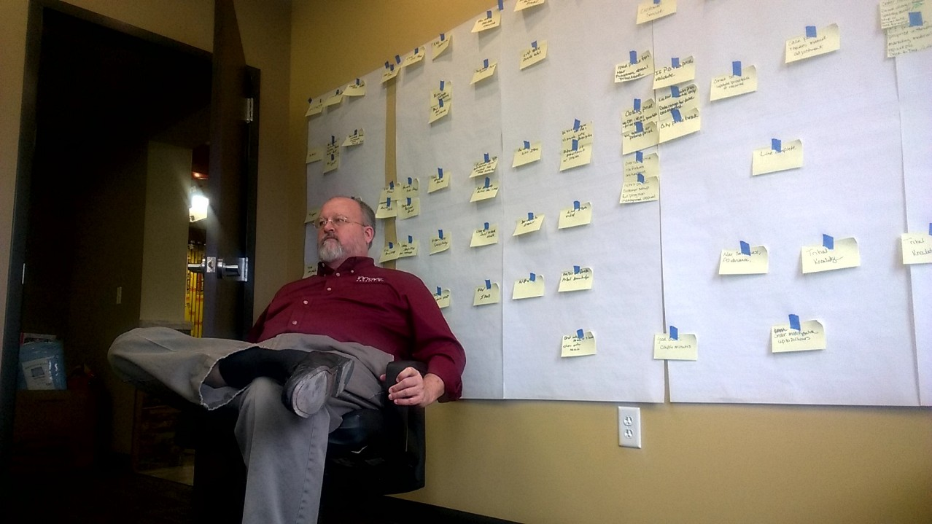
Process Selfie

Slide 27
Any Questions?

Slide 28
Thank You for Attending!

