Slide 1

Sales Tax Complexities and What South Dakota v. Wayfair means to you!
Stacy Dose
Strategic Alliance Manager, National Accounts, Avalara
Notes:
**NOTE** Edit the highlighted areas to reflect the presenter and date of presentation.
Thank you for joining me/us today for “Sales and Use Tax Compliance for Dummies”

Slide 2
Challenges of Compliance
South Dakota vs. Wayfair
What Does Compliance Mean?
How Automation Helps
Ebook: Sales & Use Tax Compliance for Dummies
Notes:
Let’s talk about what we’re covering today:
Challenges of Compliance
How Automation Helps
Ebook: Sales & Use Tax Compliance for Dummies
and some time at the end to answer questions.

Slide 3
Challenges of Compliance
Notes:
Why is tax so complicated though? Let’s take a look at the challenges of tax compliance today.

Slide 4

Complexity is growing
Nexus: economic
and physical
Rules change constantly
Compliance costs increasing
Notes:
The sales tax landscape is complex and changing all the time.
Different states have different rules with regard to economic nexus and notice/reporting provisions -- and those rules are always in flux.
In September, South Dakota’s effort to collect sales taxes from online retailers was rejected by the state’s highest court. South Dakota is now taking the case to SCOTUS.
Meanwhile, in Florida, janitorial services to clean the insides of windows is taxable, while commercial services to clean the outsides of windows is non-taxable. In NY, a sliced bagel is taxable while a whole bagel is not.
Increasing pressure plus increasing complexity exposes businesses to increased risk, and states will capitalize on that risk.
Proof of compliance is a burden that rests on you [and this applies to exemptions as well].
Once an auditor gets a whiff that you’re out of compliance – or that you can’t prove otherwise -- you can expect regular visits.
Back taxes are just a portion of the overall cost… penalties, interest, team time preparing and supporting all add up.
Even companies who want to comply can find it difficult and – to varying and sometimes alarming degrees – costly:
Mattress World, based in Oregon, got caught up in a wacky tax nuance when the use of a third-party delivery service created nexus for them in Washington. Because they discovered this nuance too late, Mattress World ended up owing Washington $1.7 million in 2012. It was too much debt to bear -- they closed seven stores and put 80 people on the unemployment line.

Slide 5
Compliance is
not optional
The burden of proof
is on you
Easy targets audited repeatedly
Back taxes + penalties
+ interest
Notes:
The sales tax landscape is complex and changing all the time.
Different states have different rules with regard to economic nexus and notice/reporting provisions -- and those rules are always in flux.
In September, South Dakota’s effort to collect sales taxes from online retailers was rejected by the state’s highest court. South Dakota is now taking the case to SCOTUS.
Meanwhile, in Florida, janitorial services to clean the insides of windows is taxable, while commercial services to clean the outsides of windows is non-taxable. In NY, a sliced bagel is taxable while a whole bagel is not.
Increasing pressure plus increasing complexity exposes businesses to increased risk, and states will capitalize on that risk.
Proof of compliance is a burden that rests on you [and this applies to exemptions as well].
Once an auditor gets a whiff that you’re out of compliance – or that you can’t prove otherwise -- you can expect regular visits.
Back taxes are just a portion of the overall cost… penalties, interest, team time preparing and supporting all add up.
Even companies who want to comply can find it difficult and – to varying and sometimes alarming degrees – costly:
Mattress World, based in Oregon, got caught up in a wacky tax nuance when the use of a third-party delivery service created nexus for them in Washington. Because they discovered this nuance too late, Mattress World ended up owing Washington $1.7 million in 2012. It was too much debt to bear -- they closed seven stores and put 80 people on the unemployment line.

Slide 6
$393K+
The average annualized cost
to manage sales and use tax
$63K+
$67K+
Small businesses
Medium businesses
Large
businesses
Source: Aberdeen Group 2015
Notes:
That management of sales and use tax can end up being quite costly. A recent Aberdeen Group survey found that the average costs for businesses were hefty to even nearly $400K for large companies. Let’s talk about the challenges of why that might be.

Slide 7
Why do companies outsource tax compliance?
Auditor is NOT LIKELY to find mistakes
25%
Auditor is LIKELY
to find mistakes **
75%
*Aberdeen Research, The Costs of Compliance **Wakefield Research, Sales and Use Tax Compliance, 2017
Notes:
Manual sales tax management is time consuming and expensive.
Even after you spend that time and money, most believe that auditors will still find errors. So many are spending big money on compliance, but not reducing their risk.
Doing tax compliance in-house makes as much sense as doing payroll in-house.

Slide 8
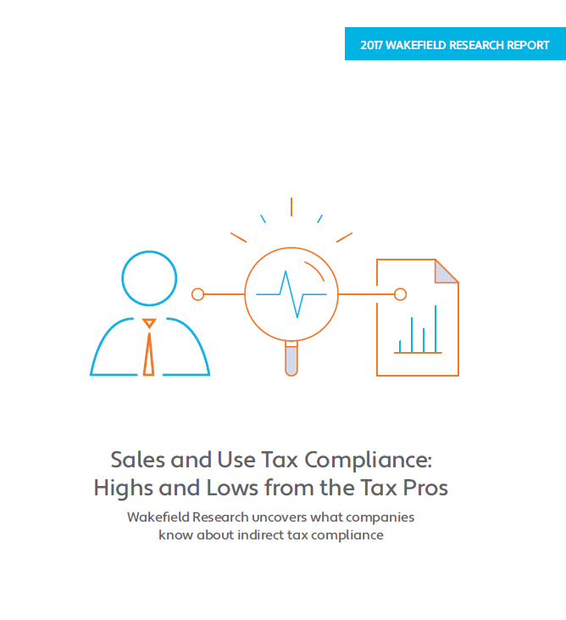

Sales tax audits are not fun
56%
of companies have found the cost of an average sales tax audit to be over $50,000
Costs
  Time spent preparing
  and supporting
  Back tax payments
  Penalties and interest
2017
Notes:
Most companies spend over $50,000 on a typical tax audit.
If you operate in multiple states and get a reputation as a “productive audit” (states talk), you’ll be audited every year.
$50K per year per state can add up fast…
Additional talking points:
The audit lookback period can be from 3 to 10 years
Seemingly minor problems can compound over this period
A single missing exemption certificate can have a big impact
“It was really grueling,” says Lois Browne, Dylan’s Candy Bar’s vice-president of finance. “Every time an auditor came in, we’d have two people completely dedicated to that for at least three weeks. Our exposure was so high, we couldn’t afford not to prioritize it.”
We thought we had a good handle on sales taxes until we were examined in detail by one of the states where we do business. Proceq USA
We got audited and owed probably three years of California sales tax. Barbara Barry, Senior Project Coordinator at ANC Sports
Wakefield Survey
- 97% have one or more misconceptions about audit risk.
- Over half of respondents had missing or inaccurate documents and/or could not produce
correct documentation requested by a state auditor.

Slide 9
States rely on sales tax revenue
Total state government tax collections
Selective sales taxes 16.6%
Sales and gross receipts taxes make up 47% of total state revenue
States are losing $13B from uncollected tax on ecommerce sales*
General sales and gross receipts taxes 30.5%
Source: US Census Bureau: Finance – Survey of State Government Tax Collections at 2016 State Government Tax Tables
* Government Accountability Office report, November 2017 – SALES TAXES: States Could Gain Revenue from Expanded Authority, but Businesses Are Likely to Experience Compliance Costs
Notes:
Sales tax is a major source of revenues for all states – almost 50% of total revenues.
About 31 states in the US are at a total budget deficit of almost $55 billion dollars.
States are losing $13B from uncollected tax on ecommerce sales.
The states are looking for ways to increase revenues and collections
Changing laws to tighten nexus obligations.
Putting pressure on businesses in the form of increased audits
Examples
California is currently hiring a total of 100 auditors over three years to focus their efforts on collecting online sales tax.
Idaho hired 48 temporary auditors who are now full time employees of the state.
Even if you have not been audited in the past, if you are not proactive about compliance, you will likely have audit exposure in the future…

Slide 10

Let’s talk about South Dakota…..
This Photo by Unknown Author is licensed under CC BY-SA

Slide 11
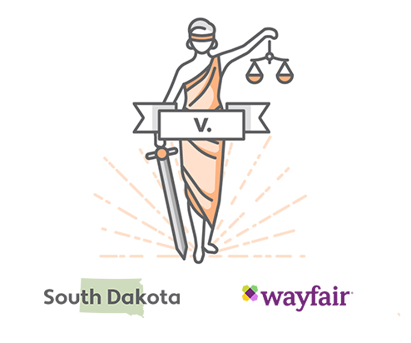
What was South Dakota vs. Wayfair, Inc. about?
South Dakota asked the U.S. Supreme Court to overturn its long-standing physical presence rule (Quill Corp. v. North Dakota) for determining when a state can make remote sellers collect sales tax.
The Supreme Court ruled in favor of South Dakota on June 21, 2018.
South Dakota is granted authority to impose sales tax obligations on out-of-state transactions.
Notes:
So what was the buzz about this court case about? On March 6, 2017, the South Dakota Sixth Judicial Court ruled that the state’s economic nexus legislation was unconstitutional but on September 13 that same year, their Supreme Court struck down the legislation. The U.S. Supreme Court agreed to take up the case in January 2018. The ruling on June 21st was in favor of South Dakota and overturned the long-standing physical presence nexus rule from 1992, Quill Corp. v. North Dakota.
What does it mean? South Dakota now has the authority to impose sales tax obligations on out-of-state transactions.

Slide 12
South Dakota vs. Wayfair, Inc. ruling details
Affected: Remote sellers not currently registered with the state who meet threshold requirements
Impact: States can now implement economic nexus laws – businesses don’t need a physical presence to be required to collect & remit sales tax. 15+ states have already declared new laws since the ruling.
Most impactful is that the “physical presence” rule has been overturned.
Notes:
Who’s affected? All remote sellers both online and offline not registered with South Dakota who meet their threshold requirements.
The effective date is to be determined though as South Dakota has not published or explicitly stated when their law will go into effect.
The most important takeaway here, however, is that Quill was overturned.

Slide 13
South Dakota vs. Wayfair, Inc. ruling details
The ruling adds economic nexus to the existing list of nexus-creating activities.
South Dakota’s law applies to taxable sales made to consumers. It:
  Does not change what is tax exempt
  Will apply to service providers (not just tangible personal property) as South Dakota taxes many services
  Will apply to manufacturers and wholesalers who sell direct to consumers
Notes:
The ruling merely added economic nexus to the existing list of nexus-creating activities. Nexus is still enforced when companies have substantial physical presence in another state.
South Dakota has one of the broadest tax bases of any state. This law applies to taxable sales made to consumers overall and will apply to service providers as the state taxes many services as well as manufacturers & wholesalers who sell direct.

Slide 14
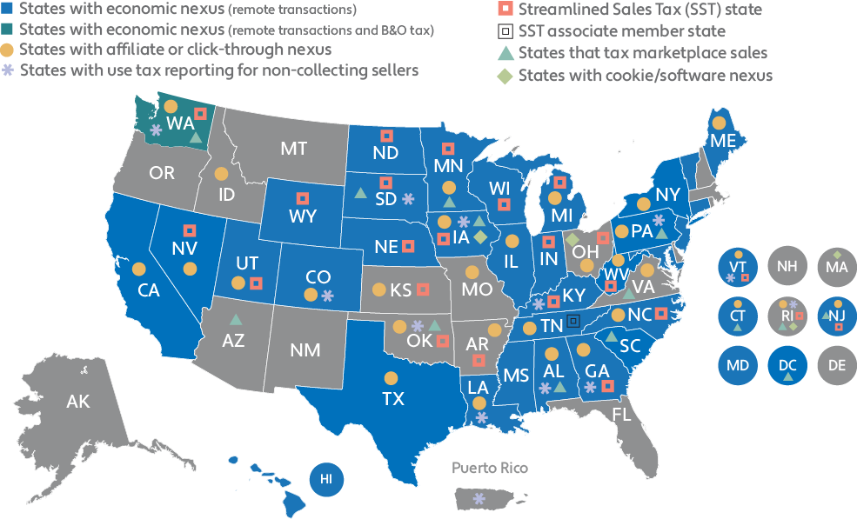
ECONOMIC NEXUS
Effective date ECONOMIC nexus (34):
29 already in effect
Note 18 states in orange report more than just taxable sales (some include exempt or nontaxable sales – wholesalers take note!
  July 1, 2017 – Tennessee (injunction until further notice)
  June 21, 2018 – New York**
  July 1, 2018 – Hawaii, Maine, Vermont
  September 1, 2018 – Mississippi
  September 30, 2018 - Michigan
  October 1, 2018 – Alabama, Illinois, Indiana, Kentucky, Maryland, Minnesota, Nevada, North Dakota, Washington, Wisconsin
  November 1, 2018 – North Carolina, South Dakota, New Jersey, South Carolina
  December 1, 2018 – Colorado, Connecticut
  January 1, 2019 – Georgia, Iowa, Louisiana** (date TBD), Nebraska, Utah, West Virginia, Washington, D.C. (adoption of emergency rule)
  February 1, 2019 – Wyoming
  April 1, 2019 – California
  July 1, 2019 – Pennsylvania
  October 1, 2019 – Texas
All of these states have different statutory start dates and thresholds. See our online grid for updates.
(map update as of 01/17/19)
Economic nexus is sweeping the nation in the wake of South Dakota v. Wayfair, Inc., but it’s important to remember that states also have other ways of taxing remote sales: affiliate nexus (ties to in-state affiliates), click-through nexus (links on in-state websites), cookie nexus(placing software or apps on in-state devices), tax on marketplace sales (facilitator held liable), and non-collecting seller use tax reporting (non-collecting sellers must share consumer use tax information). See the chart below for more details.
Notes:
Wholesalers take note. Even if you only sell wholesale and officially have only exempt sales, there are some states with economic nexus which require you to register and report all sales, including:
exempt (EITHER buyer/entity doesn’t have to pay tax for who it is – ex charitable orgs, governments OR because of USE (resell, production of finished )
or nontaxable sales (non taxable item for the nature of what it is – ex types of food, certain services)
IMPORTANT:
Even file “0 returns” even if you didn’t collect tax during a taxable period. States still require you to file by the deadline, and some of them will even levy a fine (w/ interest & penalties) if you don’t file. If you fail to file for multiple periods in a row, they may even automatically cancel your sales tax permit (worst case scenario).

Slide 15
What Does Compliance Mean?
Notes:
Why is tax so complicated though? Let’s take a look at the challenges of tax compliance today.

Slide 16
Rates
Notes:
When most people thing about sales tax compliance, they focus on calculating the tax and specifically about using the correct rate.
But rates are just the tip of the iceberg.
Let’s take a minute to explore some of the key sales tax challenges for your business.

Slide 17
Tax calculations
Nexus
1
6
Audit readiness
Product taxability
2
5
State and local tax prep and filing
Jurisdiction assignment
3
4
Exemption certificates
Notes:
When most people thing about sales tax compliance, they focus on calculating the tax and specifically about using the correct rate.
But rates are just the tip of the iceberg.
Let’s take a minute to explore some of the key sales tax challenges for your business.

Slide 18

The Nexus Challenge
Understanding nexus
“Nexus” describes the connection
between a state and a business
Having nexus allows a state to compel an
out-of-state company to register and
collect sales or use tax
The out-of-state company must have
“physical presence” – but that definition is
changing
Notes:
One of the culprits we spotted on that iceberg was “Nexus.” What is nexus? It’s the connection between a state and a business that makes the business responsible to the state for collecting sales or use tax. While the general term refers to a physical presence in a state, the definition is changing so while you may have a warehouse physically outside of your HQ state today that gives you nexus there, you may have another trigger for nexus in a separate state without a warehouse.

Slide 19
The nexus challenge
Multistate locations
Maintenance / service / repairs
Licenses / royalties / fees
Direct /
online sales
Owned / leased
real property
Trade shows
Marketing / web advertising
Manufacturer’s reps
Field sales / service staff
Investors / board meetings
Hosted data centers
Inventory location
Affiliates
Economic nexus
Notes:
Each state has different rules for establishing nexus, requiring sales tax collection and filing. The rules go well beyond physical presence.
Tightening rules for nexus obligations is a major state trend and weapon to address their loss of tax revenues to out-of-state ecommerce sales.
Key nexus items to call out for general
Own / lease real property
Field sales / service staff
Inventory location
Affiliates
Economic nexus

Slide 20






Tree trimming in California
Snow removal in Midwest
Taxable
With lights
Exempt
Labor only
Taxable
Ohio
Exempt
Illinois
The product taxability challenge
Takeout in Colorado
Bagels in New York
Taxable
Straws,
cup lids
Exempt
Cups
Taxable
Sliced
Exempt
Whole
Product definitions vary
by jurisdiction
Donuts in Texas
Candy bars in Indiana
Taxable
< 5
Exempt
> 6
Taxable
Butterfinger
Exempt
KitKat, Twix
Complex product-based tax exemptions and special rates
Taxability may vary based on how the product is used
1,800
DIFFERENT
RULES
Notes:
1,800 different rules! Impossible to keep track of them…
Examples
Indiana– can you imagine WHY Butterfingers are taxable, when KitKats and Twix are exempt? KitKats / Twix have flour so not considered candy!
Cotton balls exempt (medical device) but cotton rounds are a cosmetic

Slide 21
150M+
mailing addresses
The jurisdiction assignment challenge
11,000+
jurisdictional rules
35,000+
16,000+ U.S. jurisdictions
sales / use / rental tax rates
~30M
product / service exemptions
750,000
buyer / seller exemptions
Notes:
Understanding which tax jurisdictions a specific address belongs in can be a significant challenge.

Slide 22
The jurisdiction assignment challenge
16,000+ U.S. jurisdictions
Boundaries may overlap
ZIP code-based jurisdiction assignment is inaccurate
80111 taxes
2.9%
Colorado
State
.25% Arapahoe County
1.0%
Douglas County
3.5% Englewood
City
3.0% Greenwood Village City
2.5% Centennial City
1.0% Regional Transport District
.10% Football District
.10%
Science
and Cultural District
7.85%
4.35%
4.35%
6.85%
7.72%
7.35%
5.10%
Notes:
Zip codes cannot uniquely define a tax jurisdiction, so zip-code based jurisdiction assignment will lead to tax errors.
The full mailing address must be used to pinpoint the correct jurisdiction.

Slide 23

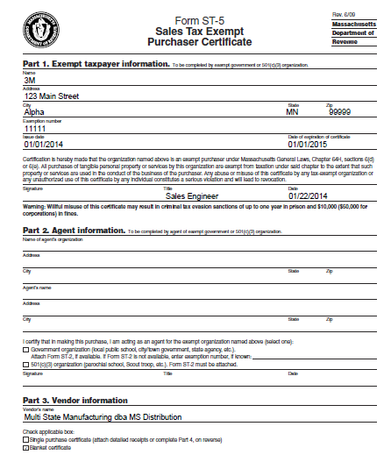
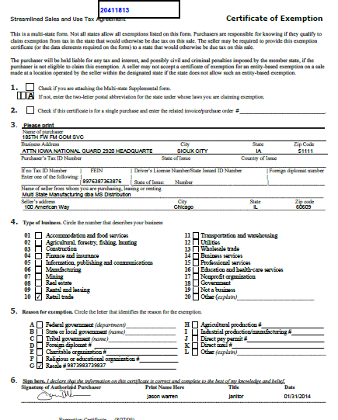
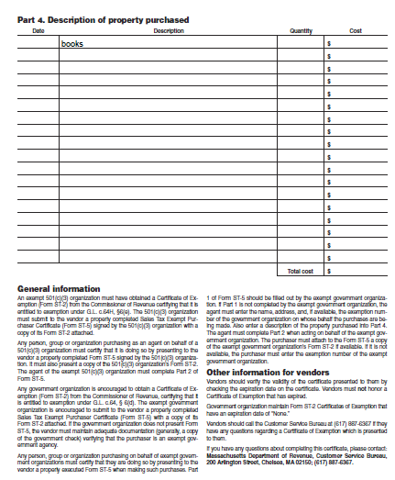
The exemption certificate challenge
Certificate retrieval is time consuming and hard
Employees are not trained to validate them properly
Missing certificates expose you to risk
Notes:
Employees find it difficult to collect them
Can add friction to the sales process
Collection is important, but not urgent, so not a priority
Business process controls to ensure collection often don’t exist
Employees are not trained to validate them properly
An invalid certificate is just as good as no certificate
Processes for detecting and updating expired certificates can be overlooked
Certificate retrieval is time consuming and hard
Multiple storage methods is common- hardcopy file, computer file, email attachment, etc.
An audit may go back 3+ years- where did your predecessor store the certificates?
A single missing certificate could cost much more than the taxes you failed to collect
A proven source of audit revenues
A single missing certificate could cost you back taxes on 3+ years of sales

Slide 24

The state and
local tax prep and filing challenge
Managing the filing calendar
Aggregating information across multiple billing systems
Responding to state
tax notices
Spending too much time on prep and filing vs. higher valued projects
Notes:
Managing the filing calendar
Efile and payment processes
Filing deadlines
County, city, and outlet reporting
Local filing in home-rule states
Aggregating information across multiple billing systems to enable consolidated filing
ERP, billing, ecommerce systems
Retail POS
On-line ecommerce marketplaces
Responding to state tax notices
Must reply on-time to avoid penalties
Must spend the time to avoid future audits
Spending too much time on prep and filing vs. higher valued projects
- Prep and filing is not a revenue generating activity
- Prep and filing doesn’t improve sales competitiveness
- Takes time away from strategic projects

Slide 25
The audit readiness challenge
Access transaction and tax detail data when needed
Provide proof of valid exemption certificates for all tax-exempt sales
Comply with each jurisdiction’s records retention rules
Notes:
Access transaction and tax detail data when needed
Need flexible reporting tools or will spend lots of time with spreadsheets
Invoice line items for taxable and non-taxable sales by filing period
Invoice line items by county / city
Invoice line items by outlet
Provide proof of valid exemption certificates for all tax-exempt sales
- This is a high for manufacturers, distributors, or any business that sells tax exempt
Compliance with each jurisdiction’s records retention rules

Slide 26
Mental Break - True or False?
In Massachusetts, a clothing item costing up to $175 is exempt from sales tax.
However, any item costing $175.01 and above is subject to the state sales tax.
True!
Notes:
Quick! Let’s take a mental break.

Slide 27


How can sales tax automation help your business?
Mitigate risk by increasing accuracy
Improve efficiency with time saved and
increased profitability
Photo from Paul Skorupskas on Unsplash
Notes:
For one, you can really mitigate risk by increasing accuracy. Not only that but efficiency improves with the time you save and the attention you can devote to increasing profitability rather than paying attention to a non-revenue generating necessity.

Slide 28
“Any efforts spent on sales and use tax compliance and related activities are non-revenue generating.”
Jennifer Mesiano
IT DIRECTOR, WALTON SIGNAGE
Notes:
“Any efforts spent on sales and use tax compliance and related activities are nonrevenue generating. “ Jennifer Mesiano, IT Director at Walton Signage

Slide 29



Avalara Sales Tax Suite
End-to-end sales tax automation
CertCapture
exemption management
AvaTax
tax calculation
Returns
managed filing
Request
Certificates
Transaction
info
Taxes
Research tax rates,
boundaries,
and rules
Research filing rules, forms
Returns, remittances
Customer info
Your customers
Your systems
Government
ERP, ecommerce, POS, billing
Notes:
The Avalara Sales Tax Suite provides a cloud-based end-to-end tax compliance solution.
<<Discuss each component, how they integrate, and how they support the tax compliance process as the diagram builds:>>
AvaTax determines and calculates taxes
Your systems are integrated to Avalara’s service in the cloud.
At the point in your business process when taxes are needed, say invoicing or on-line checkout, a request is made
AvaTax evaluates the transaction information, determines the taxes, and returns that to your system
In order to make this work, Avalara is constantly monitoring and updating tax rates, rules, and boundaries
CertCapture manages your exemption certificates
When a certificate is about to expire, a request is sent to your customer
Your customer clicks a link in an email directing them to the CertCapture site where they can provide the certificate information on-line
When AvaTax is calculating tax, it checks CertCapture to see if the transaction should be exempt, and if so, exempts the tax
In order to stay in-synch with your customer master data, CertCapture is designed to pull customer info from your ERP or accounting system
Returns manages preparation and filing of your returns
When it’s time to file, you’ll review a liability report based on the tax data from AvaTax, and approve filing
Returns will then prepare and file your returns and submit your payment to the appropriate jurisdiction
In order to make this work, Avalara is constantly monitoring and updating filing rules and forms

Slide 30
Addressing the challenges
Avalara Sales Tax Suite
Nexus
1
Product taxability
6
Jurisdiction assignment
2
Exemption certificates
5
Find jurisdictions using full address, not ZIP codes
State and local tax prep and filing
Add jurisdictions with one click
Automate certificate management
Easily access tax data and documents
Outsource filing and remittance
Uses built-in rules, ongoing updates
3
Audit readiness
4
Notes:
The good news is that the Avalara Sales Tax Suite, can help you address each of the sales tax compliance challenges we’ve discussed.

Slide 31



98%
of companies are actively involved in one or more
nexus-creating activities
94%
of companies have misconceptions about
how nexus is created
39 hrs/mo
Devoted, on average, to compliance-related tasks
Source: Wakefield Research 2017
Notes:
Understanding nexus already isn’t easy but throw in frequent changes and it gets more complex.

Slide 32

69%
of accounting and finance professionals agree understanding sales and use tax is one of the
most confusing parts of the job
Source: Wakefield Research Report: The Executive’s Guide to Sales Tax Risk, 2015
32
Notes:
What you do is damn hard. 69% of your peers said understanding sales and use tax was one of hardest things you do.
Nearly half of tax pros said that they would not be right in an audit.
This is not you, you use Avalara
[Magic moment]

Slide 33

Avalara’s reason for being
42%
would rather get a root
canal than go through a
sales tax audit
42%
think acing the SATs is easier to accomplish than mastering sales and use tax regulations
48%
think a Rubik’s Cube would be easier to master than sales and use tax laws
69%
say that understanding sales tax compliance is one of the most confusing aspects of
the accounting team’s job
Source: Wakefield Research 2015
Notes:
Because what you do is hard, what you might prefer to do instead seems almost comedic but these are real answers from real people!
<<Go over some of these traits>>
While this is the “fun” anecdotal slide, it really does shine a little light on how much people struggle with sales tax compliance day in and day out.

Slide 34

Founded in 2004
Over 20,000 active customers
More than 700 pre-built integrations
6.7 billion transactions processed in 2017
Over 18 million exemption certificates managed
$28.9 billion in taxes prepared for remittance in 2017
34
Notes:
So who is Avalara?
We were founded in 2004 to tackle the problem of sales tax and now serve more than 20,000 active customers through more than 700 pre-built integrations.
Our cloud solutions processed 6.7 billion transactions in 2017 alone, managed more than 18 million exemption certificates, and prepared $28.9 billion in taxes for remittance.
If there’s one thing we know, it’s tax.

Slide 35
Questions? https://avlr.co/innovia
Contact us for more information
Stacy Dose
(612) 741-2427 Stacy.Dose@Avalara.com
Notes:
**NOTE** Use your contact information to replace the highlighted areas.
Any questions?

Slide 36
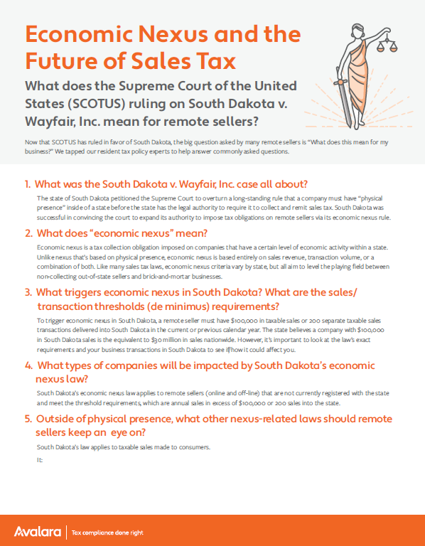
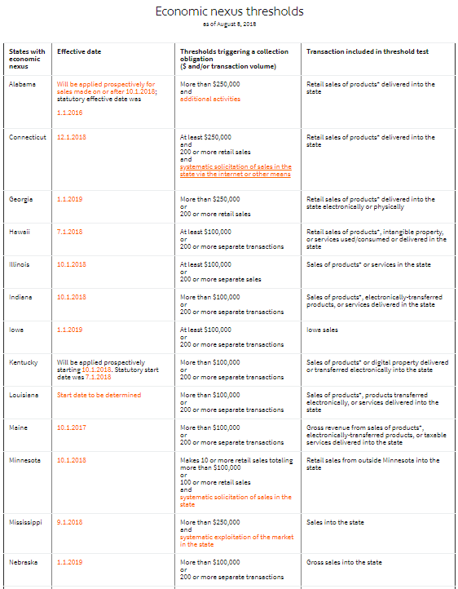


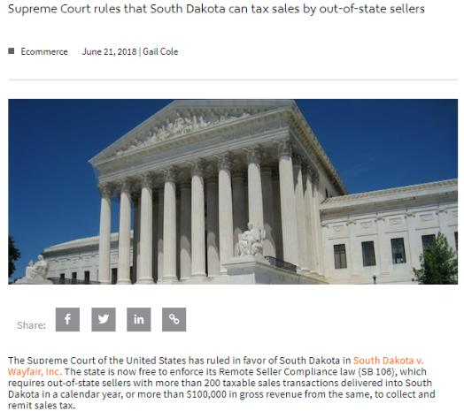
Resources to reference
Hub: https://www.avalara.com/us/en/learn/sales-tax/South-Dakota-Wayfair.html
FAQ guide
Economic Nexus guide
Expert videos and blog
(All images on this page have live links)
Notes:
We’ve also got several resources you can reference at our South Dakota vs. Wayfair online hub including an FAQ, economic nexus threshold guide, expert videos, and expert blog articles.

