Slide 1
Reserved for Intro Picture
12 Ways to Help Your Users Be More Productive
Please contact Tim for Assistance
Alan Wyne
Director of Operations
awyne@Innovia.com
Picture

Slide 2
Session Objectives
Take away 3 suggestions that you can implement immediately
Think about how you will gauge the effectiveness and usage
What defines success?

Slide 3
The Excuses for not improving
But That’s So Simple. Everyone Knows That!
60% of companies we work with don’t personalize screens
How many of your uses still have default menus?
How many of your users have all the fields on an item card?
Are you using Job Queues for non-priority tasks?
Is everyone a super user?

Slide 4
The Excuses for not improving
I’m IT so why would I need to look at the whole business?
Small improvements save big labor dollars
(10 minutes a day saves $866 in labor cost per person per year)
Better reporting can drive material costs down
How do you identify processes that need to change?
More With The Same!

Slide 5
Today’s Agenda
Business Applications
Manufacturing
Warehousing
Finance
Purchasing
Inventory
Jobs
Setup and Usage
Role Center Setup
Filtering
Search
User Types
Data Tools
Staff

Slide 6
Business
Applications

Slide 7
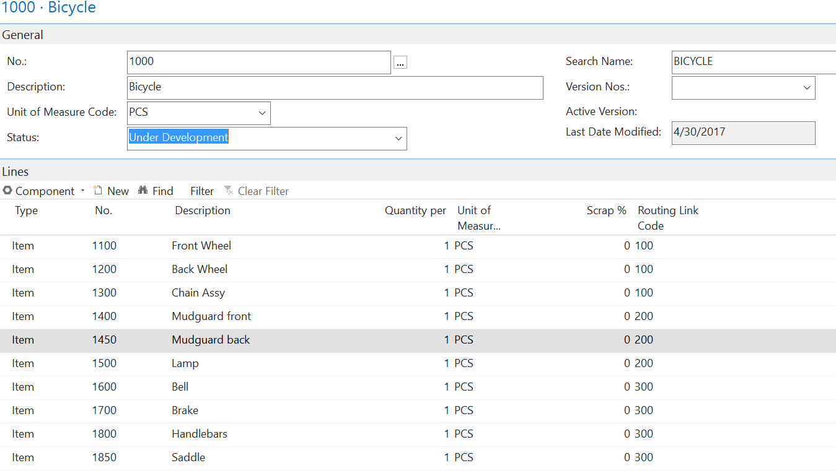
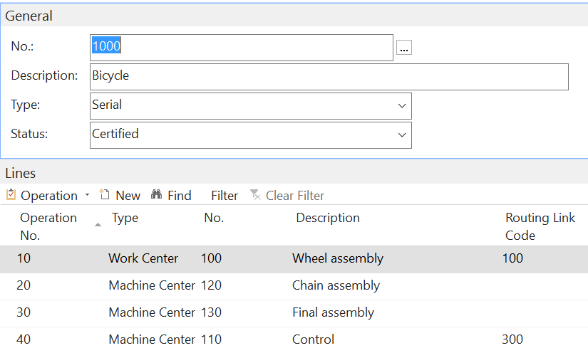
Manufacturing
Route
BOM
Consume Material at specific step
Better calculation of WIP
More accurate real-time inventory
Does not work with Manual Flushing
Routing Link Code

Slide 8
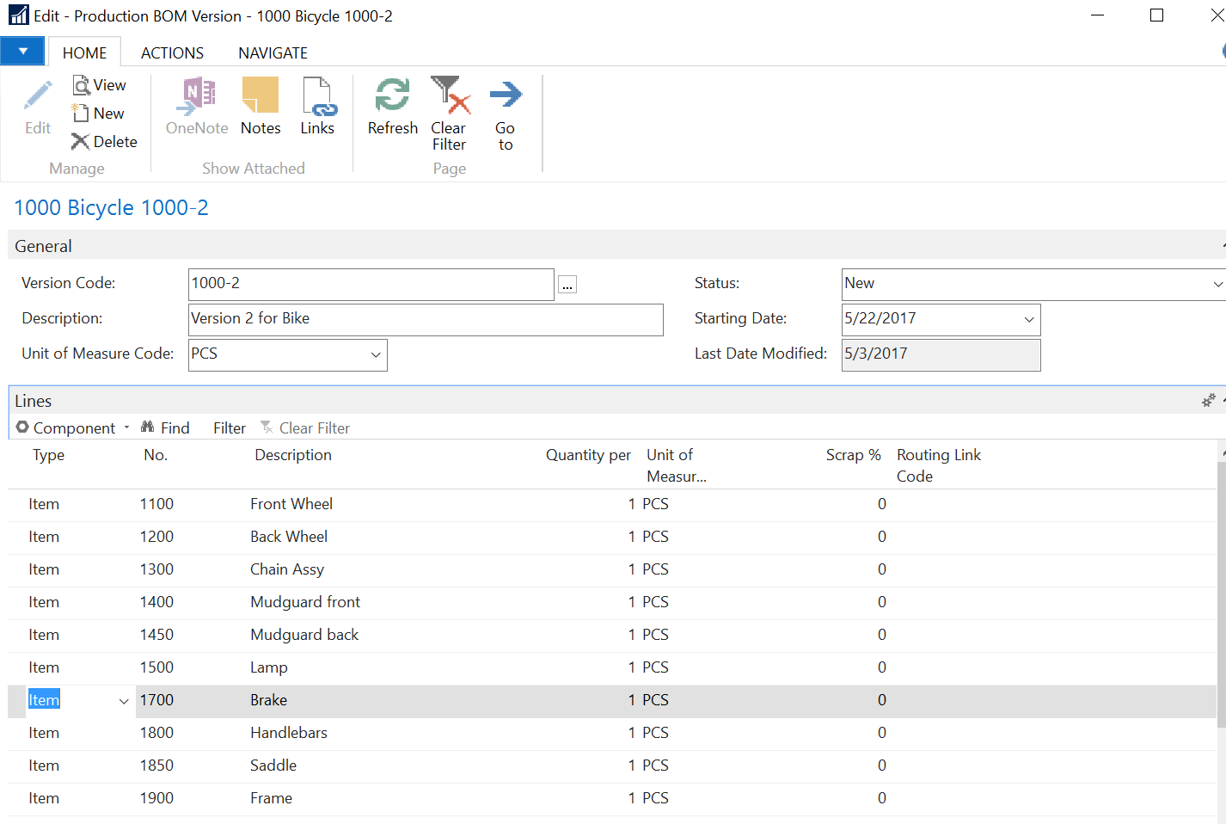
Manufacturing- BOM Versions Window
Version Code
Start Date
Helps facilitate engineering changes
BOM is attached to work order
Helps with proper inventory consumption and costing

Slide 9
Manufacturing- BOM Versions Window
Version Currently in use

Slide 10
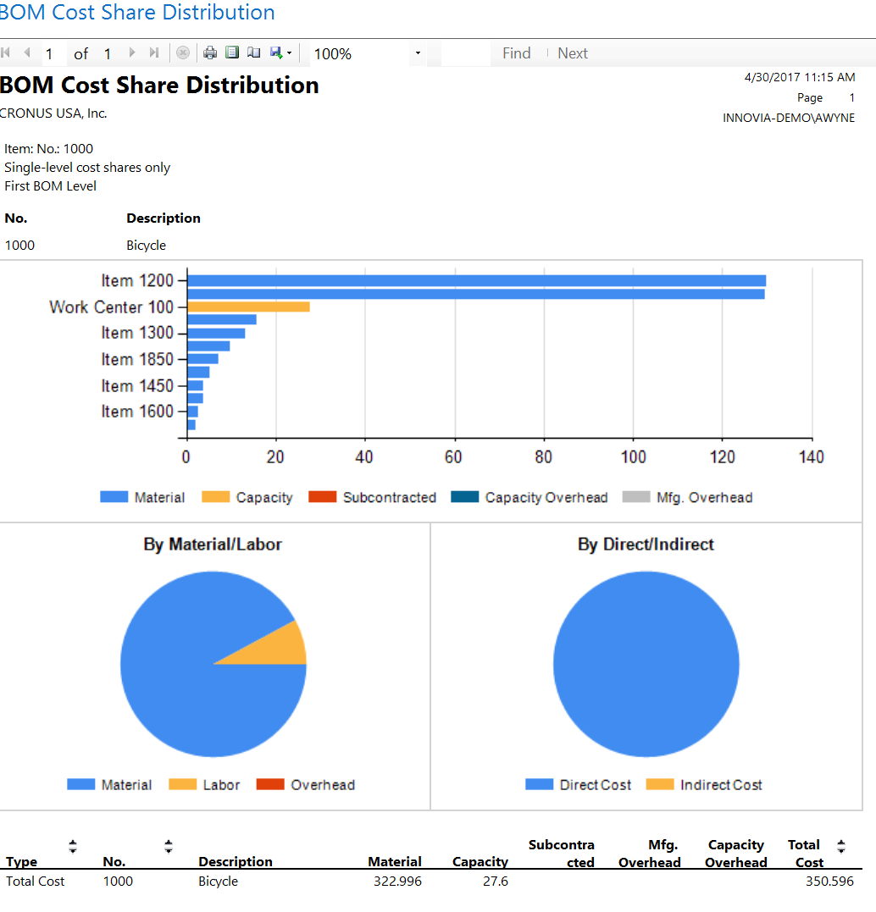
Manufacturing- BOM Cost Share Distribution
Expected Costs
Material
Labor
Work Center

Slide 11
Warehousing
Locations
You should always have at least one in NAV
Other locations
Returns
Quality
Receiving
Benefits
Inventory traceability
Inventory control without bins

Slide 12
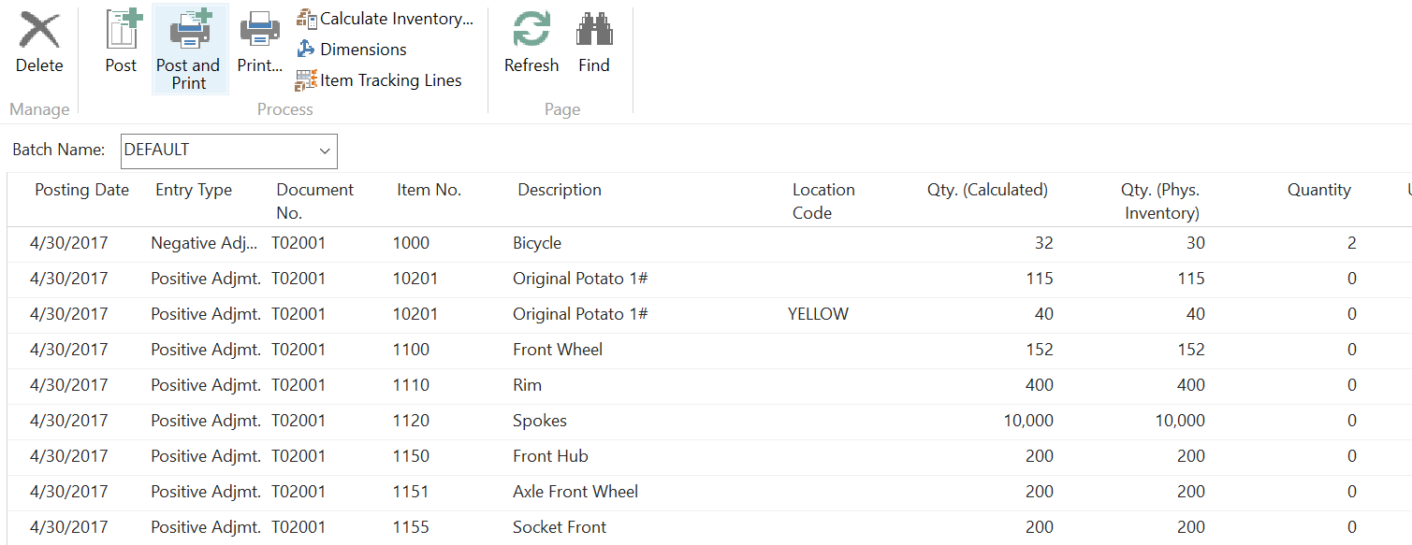
Warehousing
Cycle Counting
Inventory Accuracy
Reduce stock outs
Reduce over stocks
Turns
Counting periods
Item category

Slide 13
Finance
Cost Accounting
Define cost types, centers and object to analyze
What costs are
Where they come from
Which dept. should bear the costs
Non-GAP compliant P&L report
Comes from GL entries and outside data

Slide 14
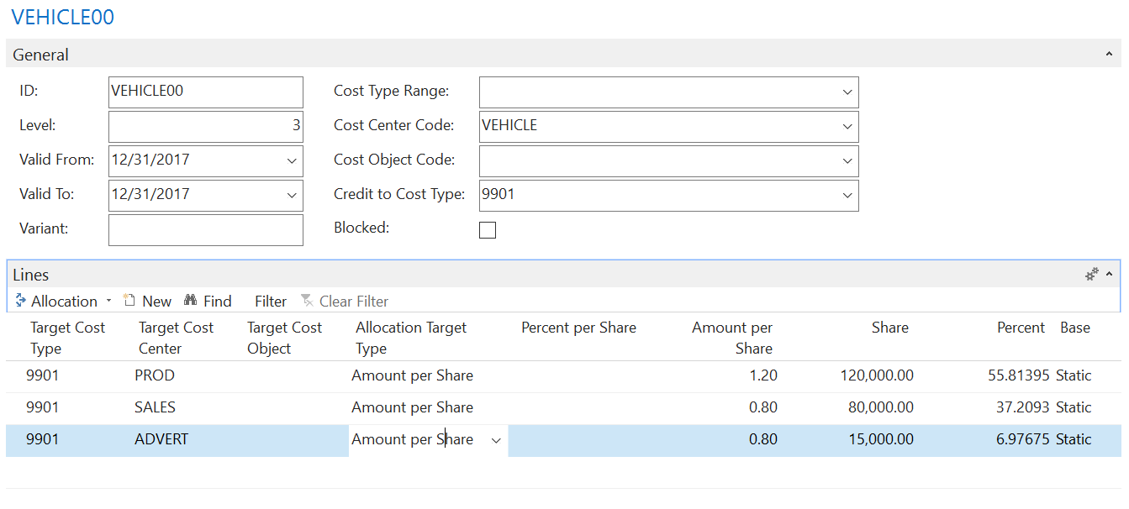
Finance
Cost Allocation
Set up amount of GL cost to allocate
Set up cost centers
Pulls from GL
Amount to allocate
Full cost
$ / share
% / Share

Slide 15
Purchasing- Planning Parameters
Look forward period take
out white noise
Reorder
Types
Reorder Qty
parameters
When to reorder
Reorder Qty
Conditions

Slide 16
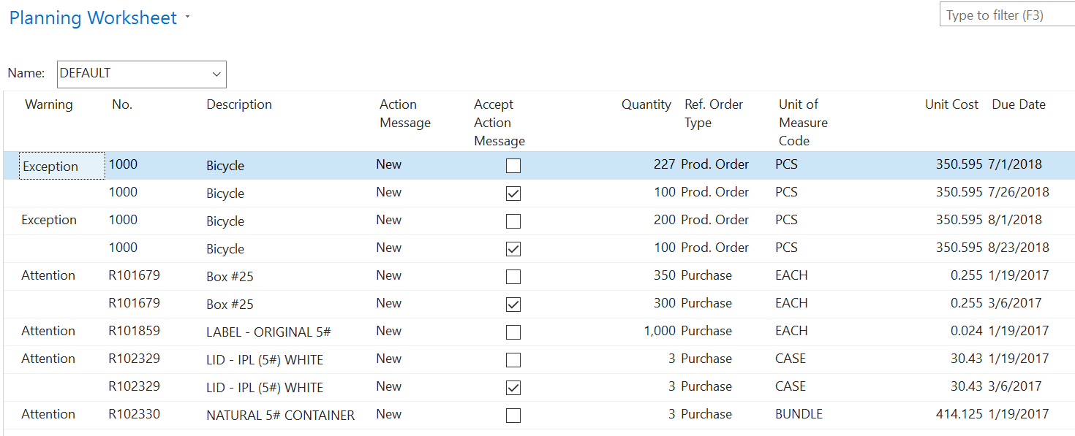
Purchasing- Planning Worksheet
Benefits
Shows Demand
Creates suggested
Purchase Orders
Prod. Orders
Combines orders
Auto create PO’s and Prod.
Recalc. to pull in changes
Shows “Why” for orders

Slide 17
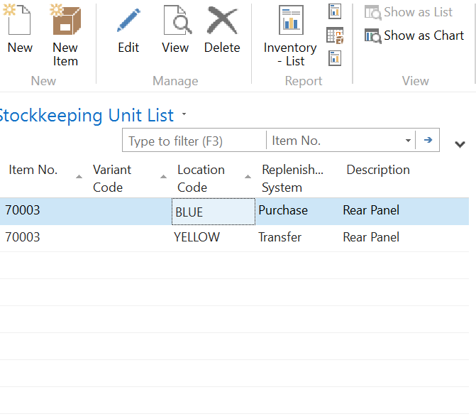
Inventory- SKU’s
Stock Keeping Units
Planning parameters unique to location
Replenishment settings can vary
Most items settings can be unique to location
Vendor and consignment inventory capable

Slide 18
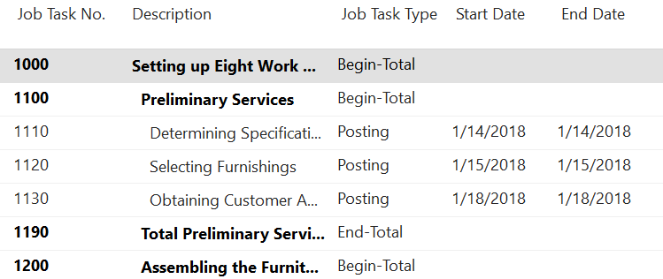
Jobs
Why use Jobs?
We’re not a job shop
Track installations
Project management
Cost allocations (actual to budget)
Machine and personnel resource allocation
Job setup
screen
Job detail line
screen

Slide 19
Setup and Usage

Slide 20
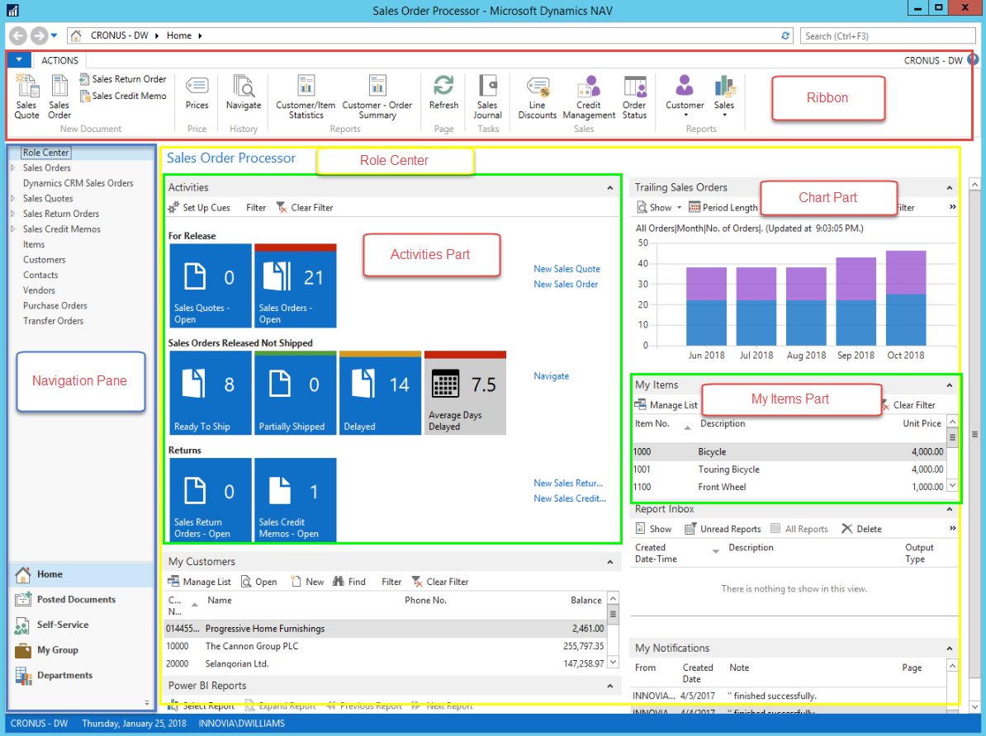
Role Center
Menu Ribbon
Frequently used items on first tab
Remove any buttons not used
Navigation Pane
Activity tiles
Charts
Lists

Slide 21
Role Center
Menu Ribbon
Navigation Pane
Remove any menu options not used
Most popular at the top
Create special filtered list views and place here
Activity tiles
Charts
Lists

Slide 22
Role Center
Menu Ribbon
Navigation Pane
Activity tiles
Set good/bad colors
Order top to bottom based on relevance
Remove what is not used
Charts
Lists

Slide 23
Role Center
Menu Ribbon
Navigation Pane
Activity tiles
Charts
Most people don’t need charts
Focus on management and KPIs
Lists

Slide 24
Role Center
Menu Ribbon
Navigation Pane
Activity tiles
Charts
Lists
Remove most lists
Keep Notifications and Reports

Slide 25
Filtering & Sorting
Standard Filter box
Multi-Column Sorting
Click on columns holding the shift key down.
Data sorts in order of columns clicked
2015 and later

Slide 26
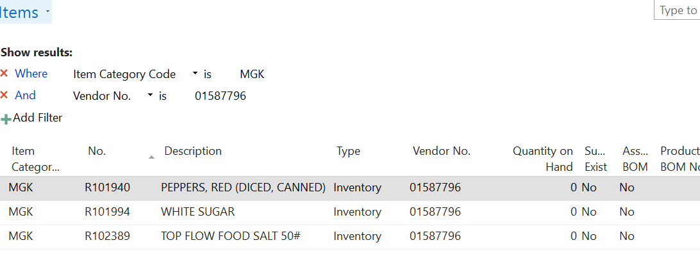
Filtering & Sorting
Advanced Filtering

Slide 27
Filtering & Sorting
Click on “Items” and select “Save as a view”
Right click on a value in a column and select “filter to this value”

Slide 28
Searching
Easily find the seldom used menu options
Helps keep menu ribbon and navigation pane cleaner

Slide 29
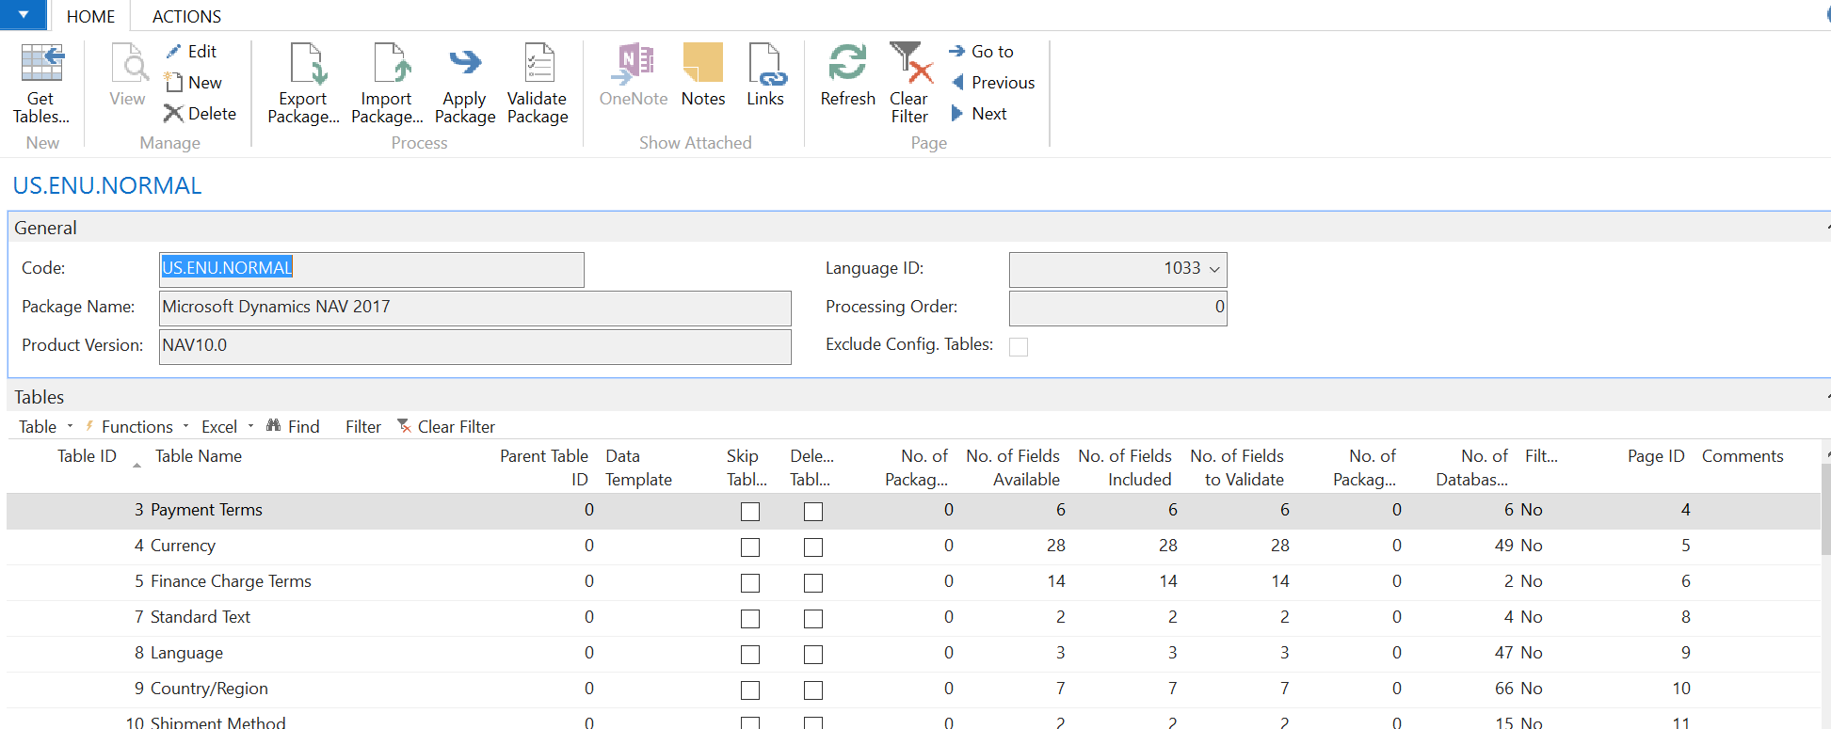
Data Tools- Rapid Start

Slide 30
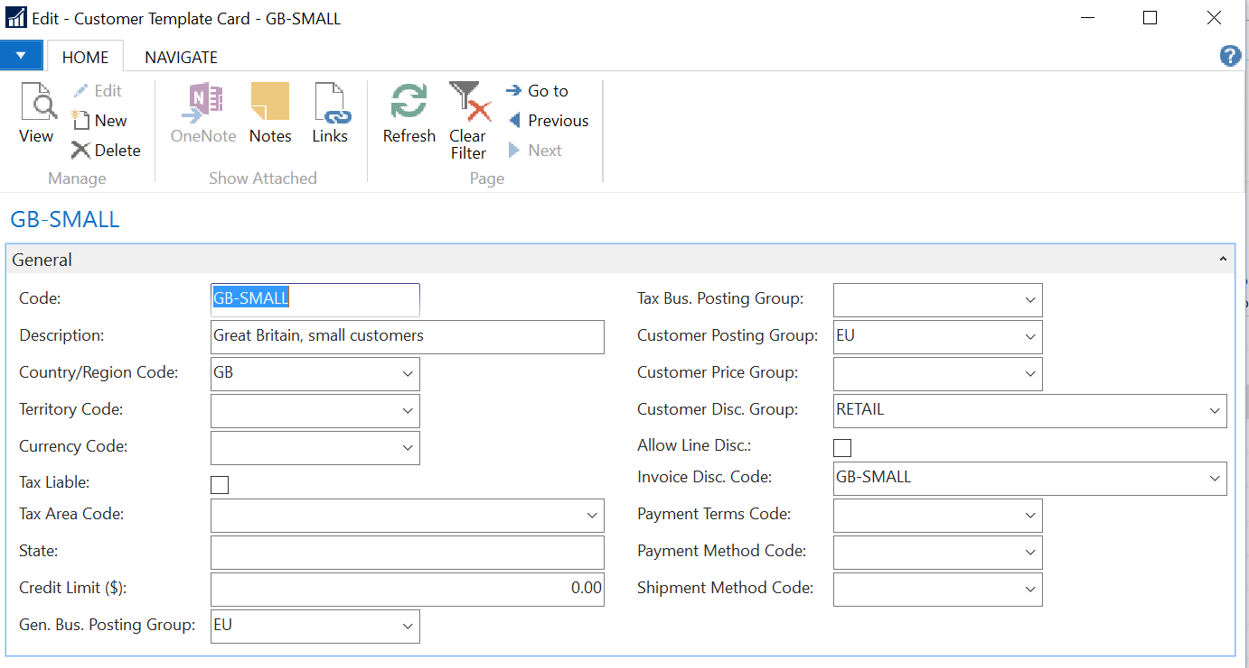
Data Tools
Data Templates
Pre-populates fields
Quicker entry. Fields can be skipped
Reduction in keying errors
Set tab stops on Card
2017 allows for creating template from customer/item etc.

Slide 31
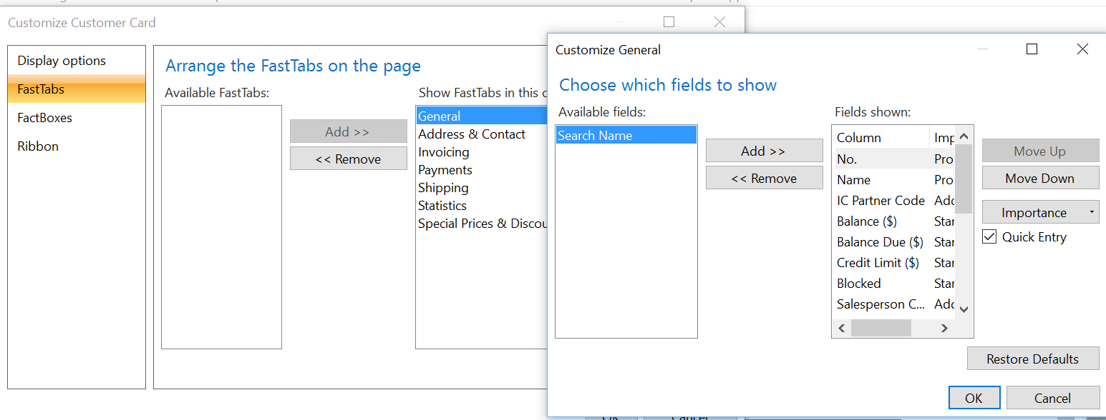
Data Tools
Screen fields
Set fields in proper order
Show only required fields. Set all others off the card or reduce importance
Set tab stops on Card (quick entry)

Slide 32
Staff
Super Users
Focused in one or two areas
Expert in the operations of those areas
Able to train and support other users in NAV
Internal User Group
Provide NAV support
Lunch and Learns
Help with training new staff
Look for improvements and other ISV options
How to leverage your partner

Slide 33
Any Questions?

Slide 34
Thank You for Attending!

